Slide 1
Land Surface Radiation/Albedo Focus Area
Zhuosen Wang^{1,2}, Dominique Carrer³, Fernando Camacho⁴, Jorge Sánchez-Zapero⁴, Crystal Schaaf⁵, Angela Erb⁵
¹ University of Maryland College Park, College Park MD, United States
² NASA Goddard Space Flight Center, Greenbelt MD, United States
³ National Centre for Meteorological Research, Toulouse, France
⁴ Earth Observation Laboratory (EOLAB) at University of Valencia , Valencia , Spain
⁵ University of Massachusetts Boston, Boston MA, United States

Slide 2
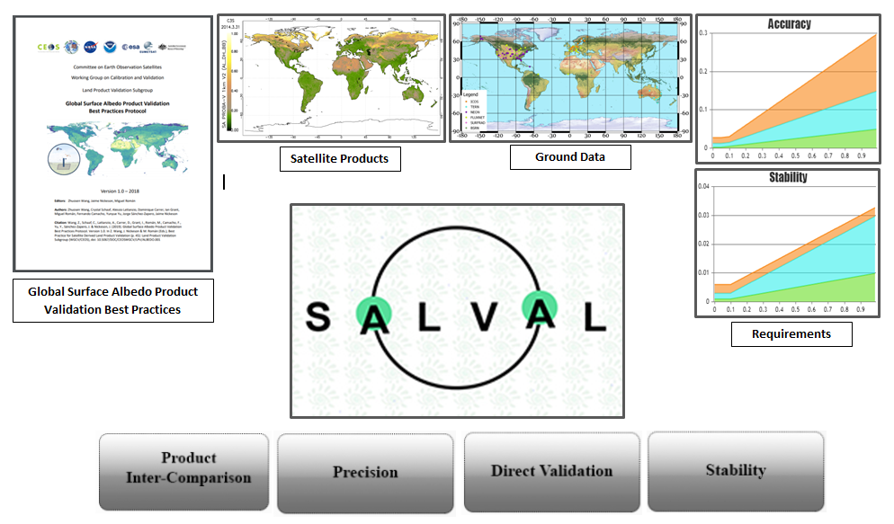
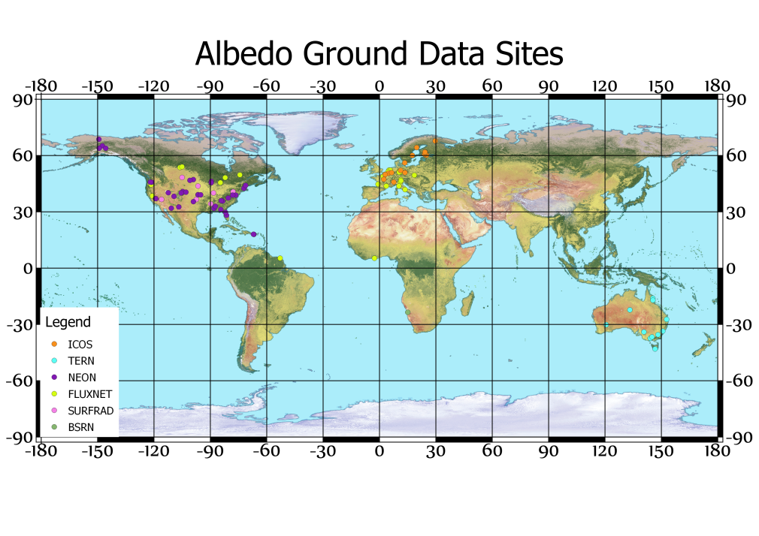
SALVAL: Surface ALbedo VALidation tool
SALVAL online beta version available
Working on improving the user inteface and updating the databases
Satellite Database:
5 Datasets availables:
C3S PBV V1 (2013-2020)
C3S VGT V1 (2000-2014)
CGLS VGT V1 (2000-2014)
GlobAlbedo (2000-2011)
MCD43A3 C6 (2000-present)
Working on include new datasets:
C3S VGT-PBV Multi-sensor V2 (2000-2020)
VNP43C3 (2012-present)
C3S S3 V3 (2018-present)
Ground Reference Database:
80 homogeneous (1km) sites from ICOS, TERN, NEON, FLUXNET, SURFRAD and BSRN available

Slide 3
Validation Metrics
Quantity | Current practice | Good practice, add:
Accuracy | Bias; absolute bias | Median error Median and percentiles of residuals Box-plots of residuals vs. Albedo
Precision | Standard deviation | Median absolute deviation Median 3 point difference
Uncertainty | Root mean square error | Scatter plot of match-ups Median and percentiles of absolute residuals, RMSE Box-plots of absolute residuals vs. Albedo
Completeness |  | Gap size distribution Gap length
Stability |  | Time series average, standard deviation, and regression slope Mean error per decade

Slide 4
In-situ Reference Sites
Networks | Reference/Remark
BSRN | https://bsrn.awi.de/
BSRN-SURFRAD | https://www.esrl.noaa.gov/gmd/grad/surfrad/
FLUXNET | http://fluxnet.fluxdata.org/
NEON | http://www.neonscience.org/
GC-Net | http://cires1.colorado.edu/steffen/gcnet/
PROMICE | https://www.promice.dk/home.html

Slide 5
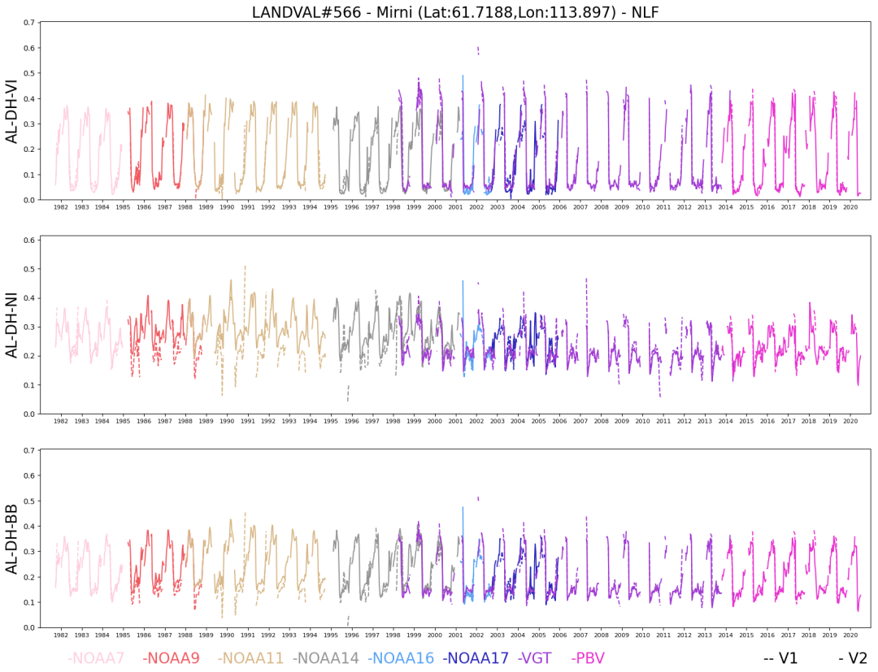
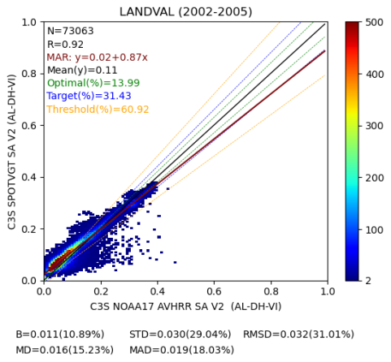
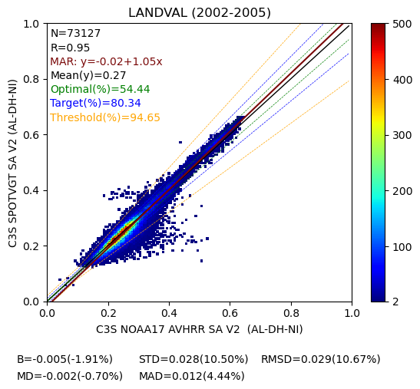
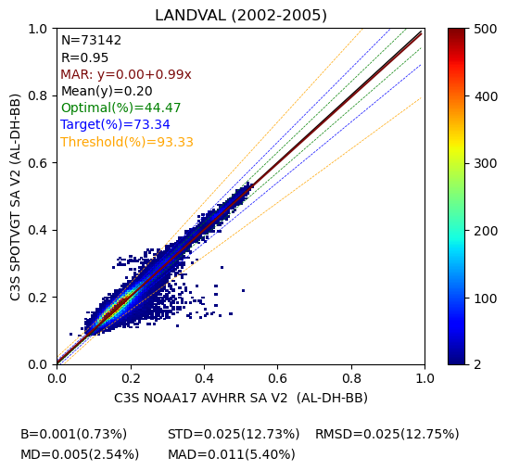
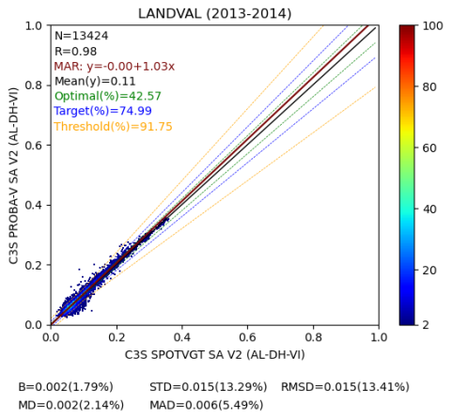
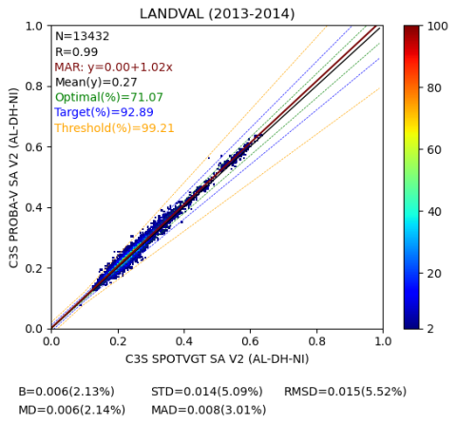
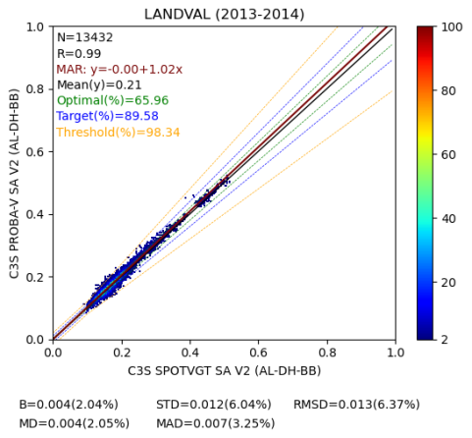
Preliminary Quality Assessment (EOLAB)
C3S Multi-sensor albedo (v2.0) → 1981 – 2020 Climate data record
AVHRR vs VGT
VGT vs PBV

Slide 6
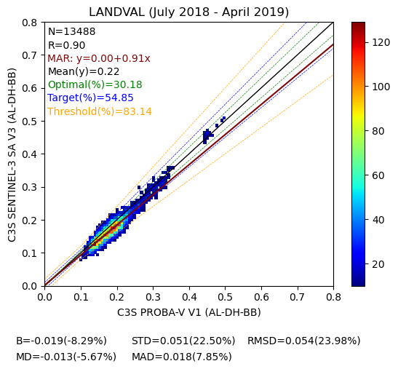
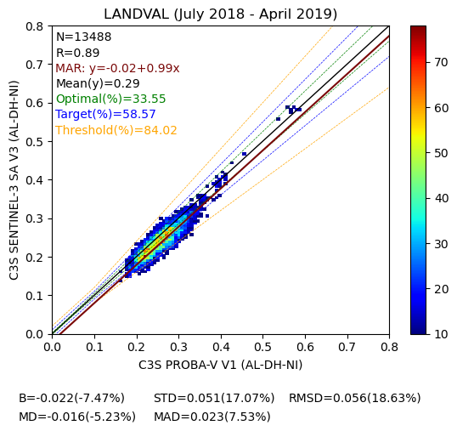
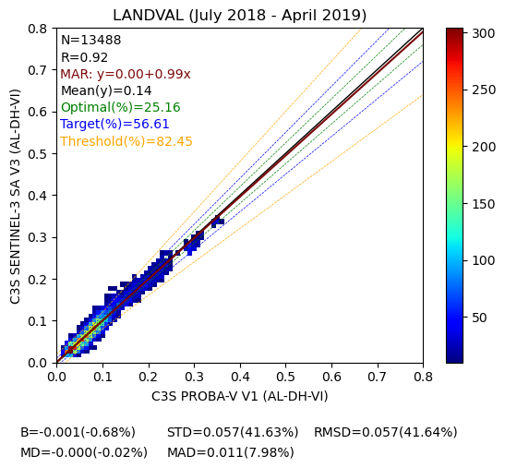
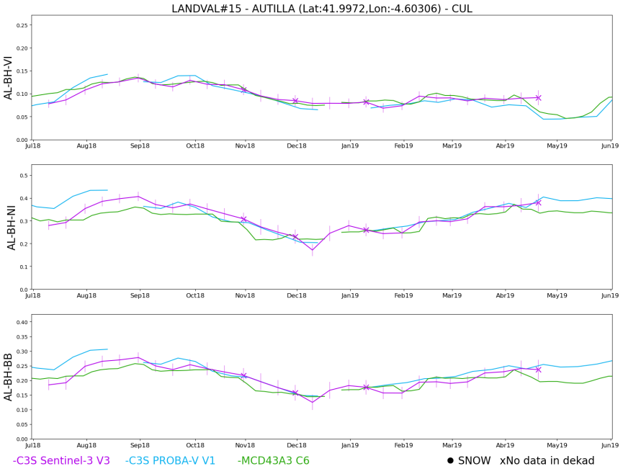
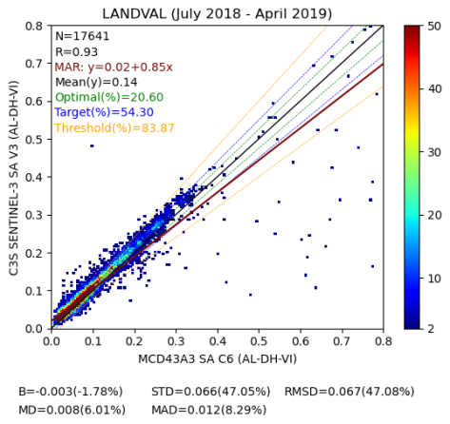
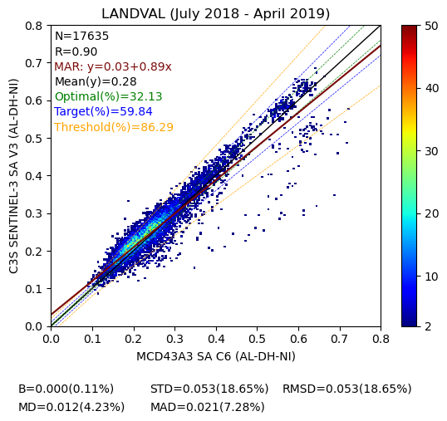
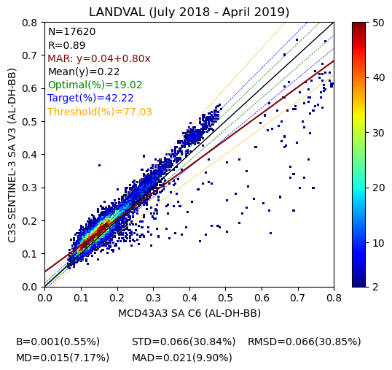
C3S Sentinel-3 vs C3S PROBA-V v1.0 Albedo -- Good Continuity with PV
C3S Sentinel-3 vs MCD43A3 C6
Preliminary Quality Assessment (EOLAB)

Slide 7
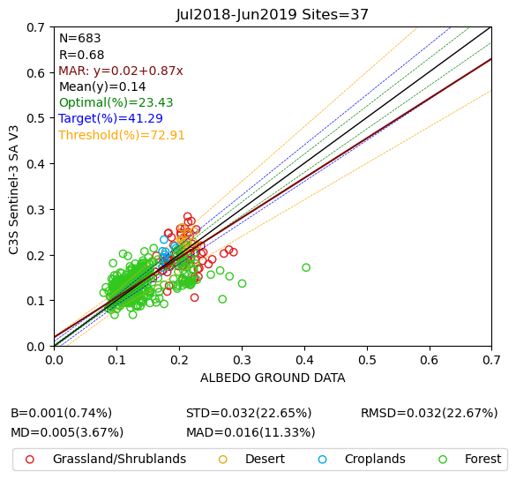
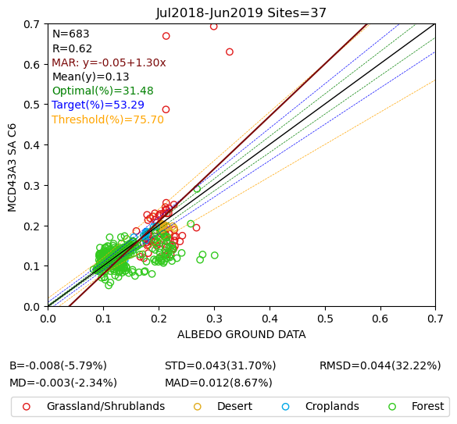
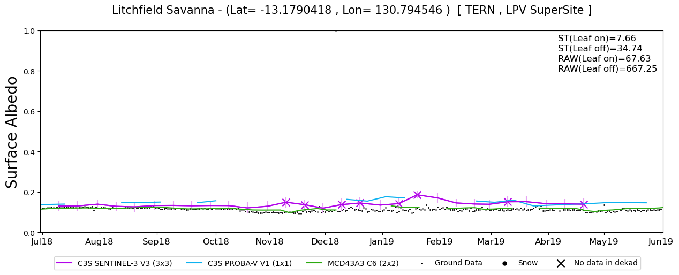
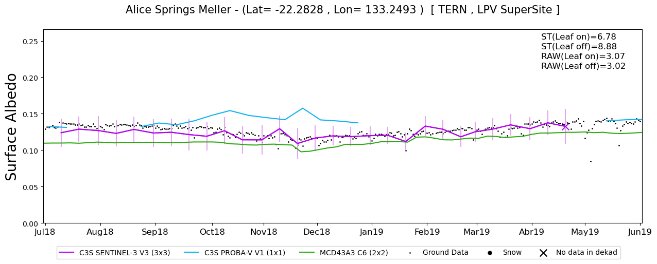
Direct Validation
C3S Sentinel-3 SA (300m)
NASA MCD43A3 C6 (500m)
Accuracy Precision Uncertainty
Accuracy Precision Uncertainty
Preliminary Quality Assessment (EOLAB)

Slide 8
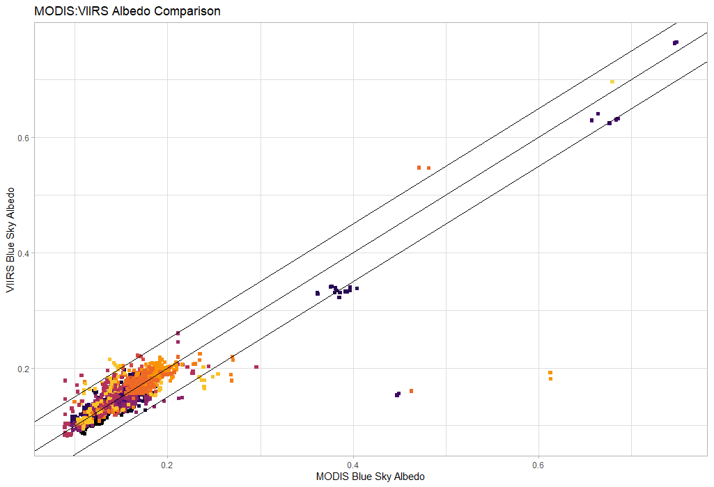
NASA MCD43 vs. VNP43 albedo
# obsv: 1829
rmse: 0.0259
bias: 0.0013
University of Massachusetts Boston

Slide 9
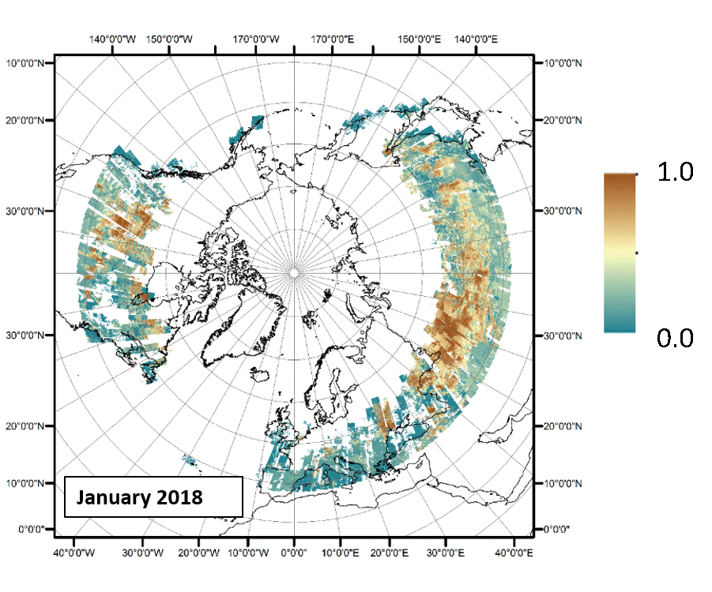
Evaluation Sites
Landsat Albedo
Networks: NEON, BSRN, SURFRAD
University of Massachusetts Boston

Slide 10
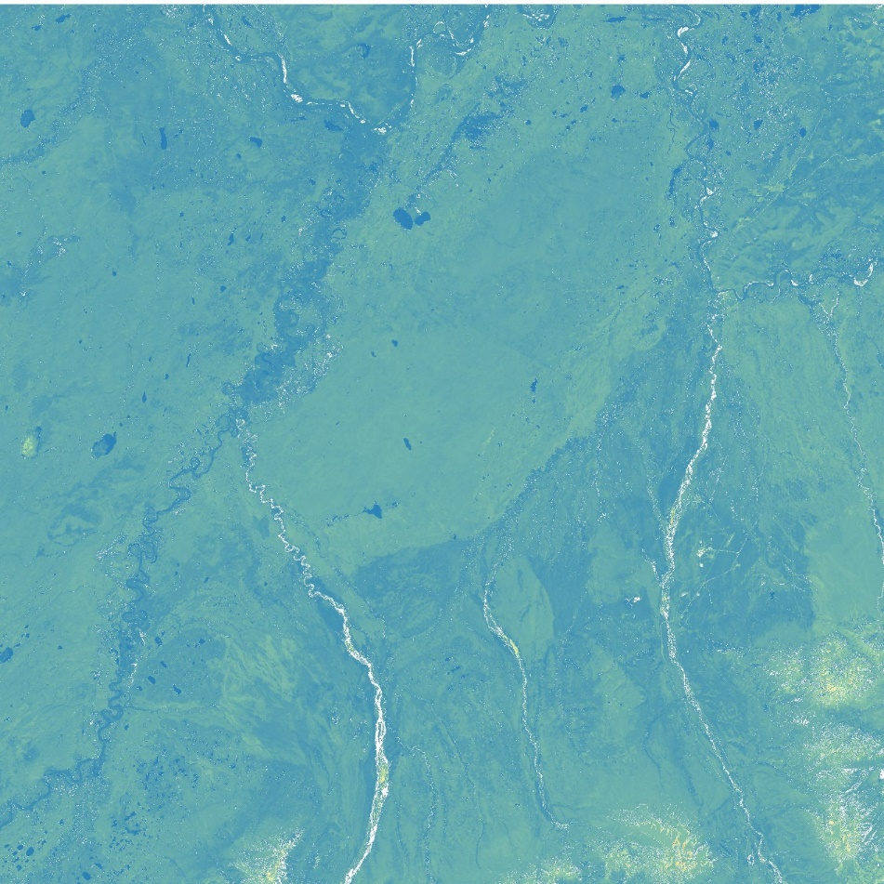
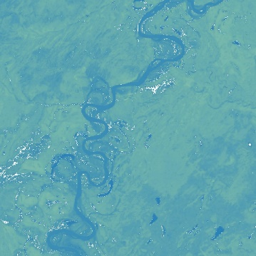
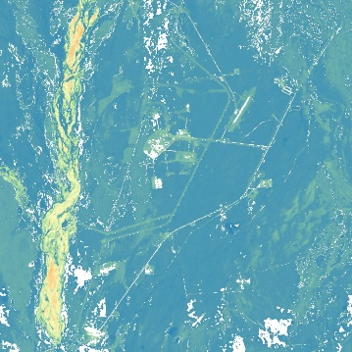
Harmonized Landsat Sentinel-2 (HLS) S30 Shortwave Albedo
MCD43A3 Shortwave Albedo
HLS MCD43A3
HLS MCD43A3

Slide 11
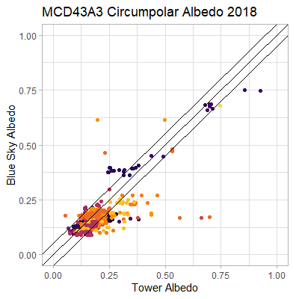
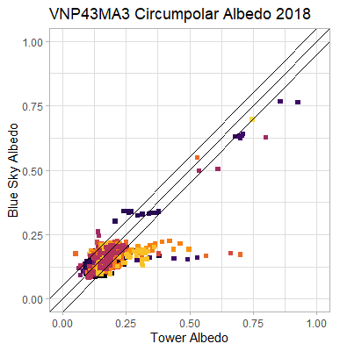
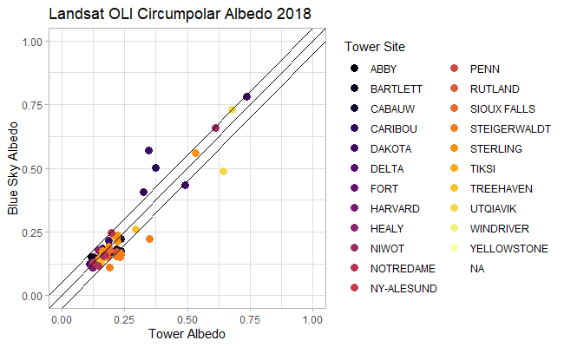
Spatial Resolution: 500m
Temporal Resolution: daily
# obsv: 1829
rmse: 0.0457
bias: 0.0214
Spatial Resolution: 1000m
Temporal Resolution: daily
# obsv: 1874
rmse: 0.0482
bias: 0.0228
Spatial Resolution: 30m
Temporal Resolution: 16days
# obsv: 95
rmse: 0.0445
bias: 0.0082
University of Massachusetts Boston

Slide 12
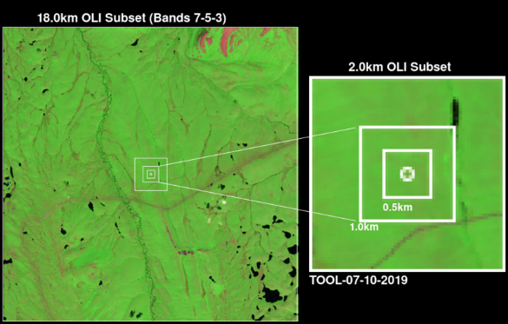
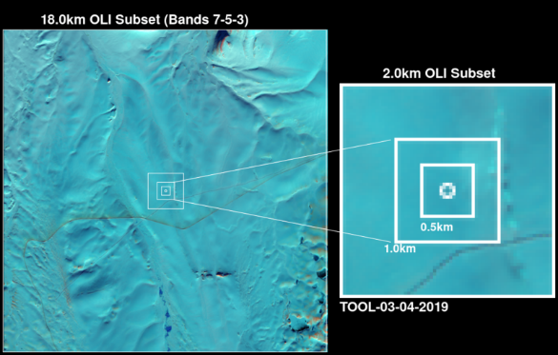
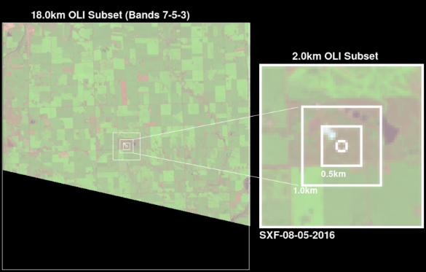
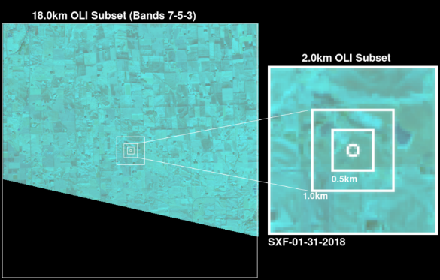
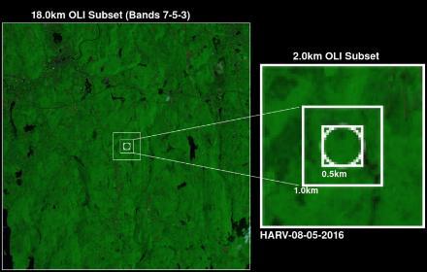
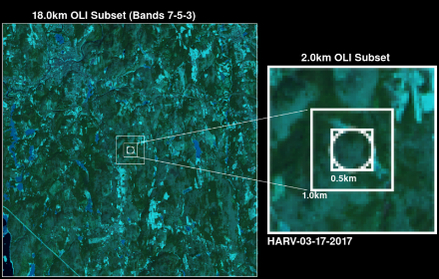
Evaluation Sites
Summer
Winter
University of Massachusetts Boston
Notes:
Winter/Summer headers

Slide 13
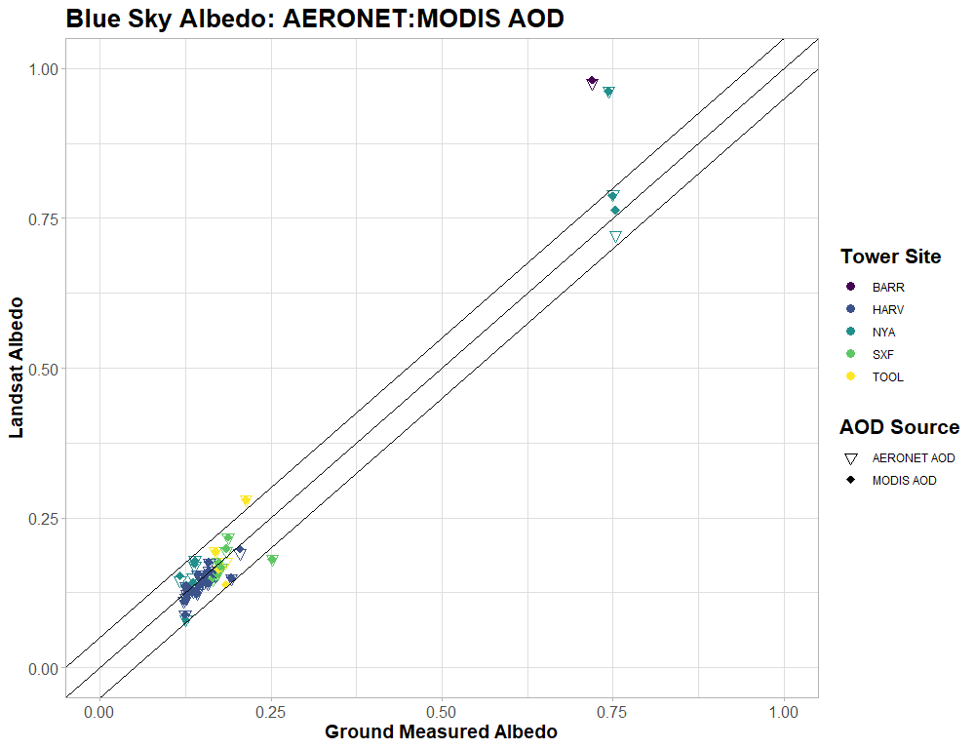
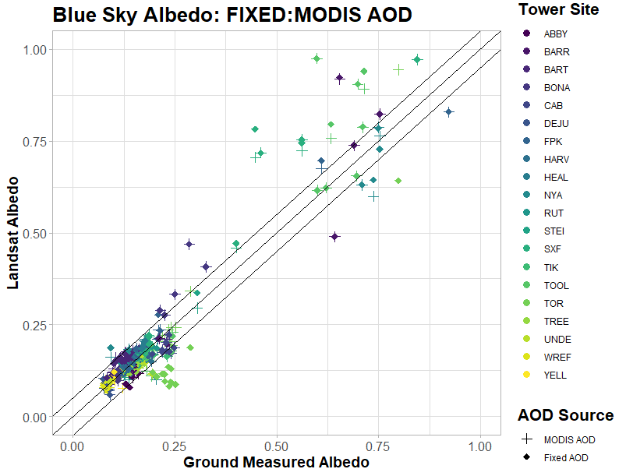
Impact of AOD sources on Blue Sky Albedo Evaluation
AERONET:
RSME = 0.0539
BIAS = -0.007
MODIS AOD
RMSE = 0.055
BIAS = -0.008
Fixed AOD (0.2):
RSME = 0.060
BIAS = -0.003
MODIS AOD
RMSE = 0.052
BIAS = -0.006
University of Massachusetts Boston
Notes:
Aeronet vs MODIS AOD
Fixed AOD (0.2) vs MODIS AOD
BIGGER!

Slide 14
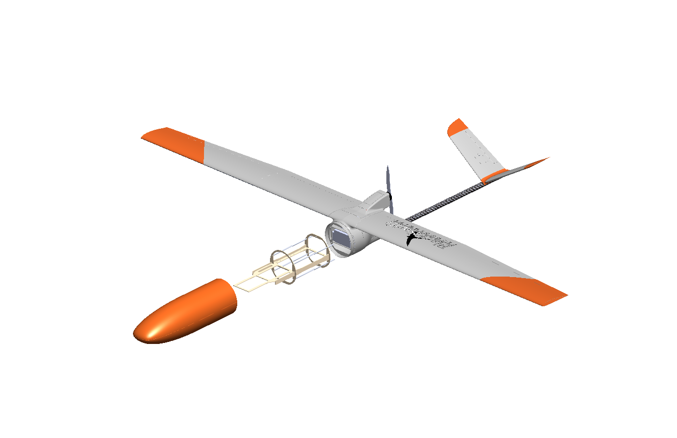
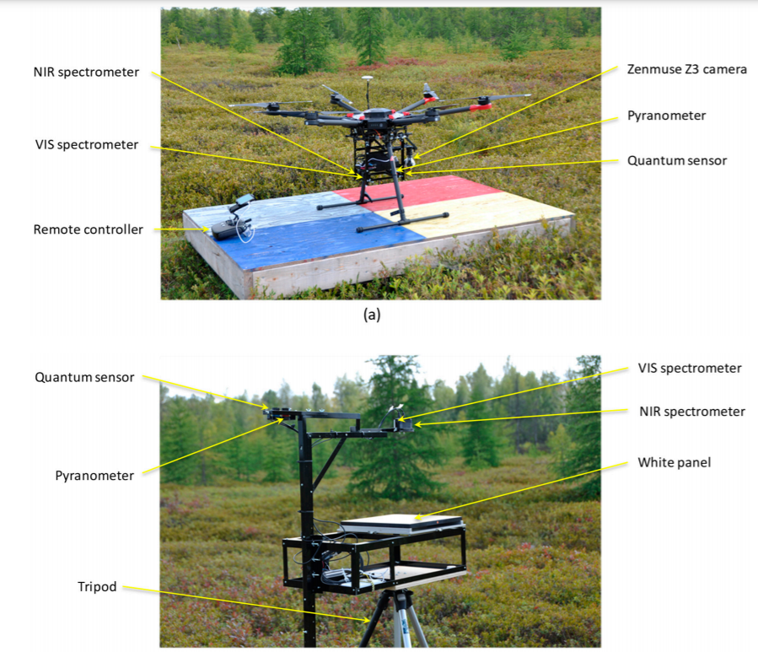
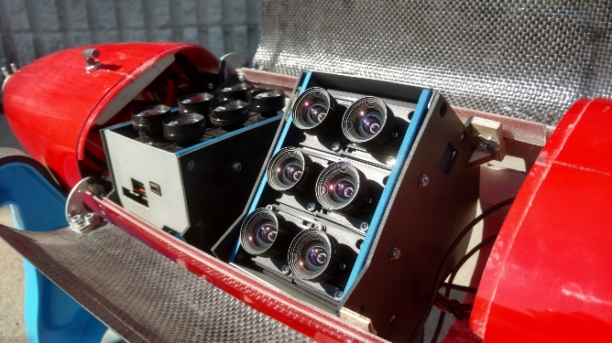
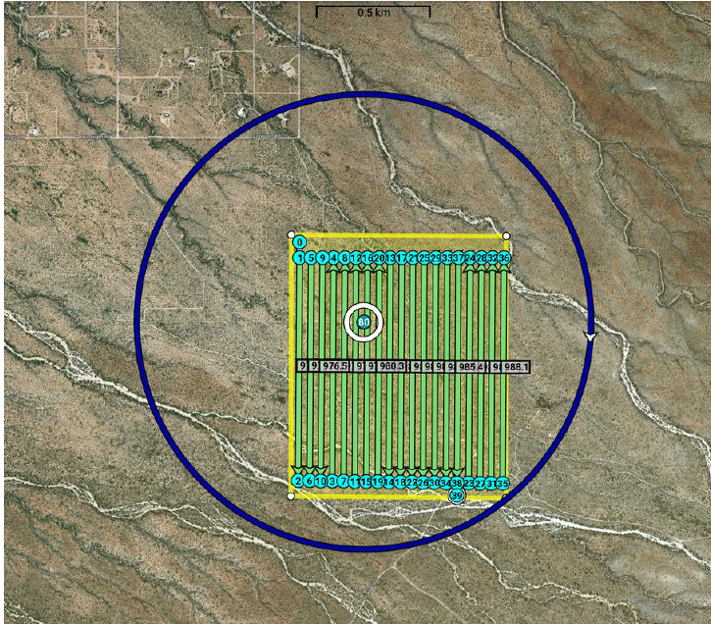
High spatial resolution albedo measurements from UAV
MALIBU https://viirsland.gsfc.nasa.gov/Campaigns.html
Hexacopter Canisius et al., 2019 Drones

Slide 15
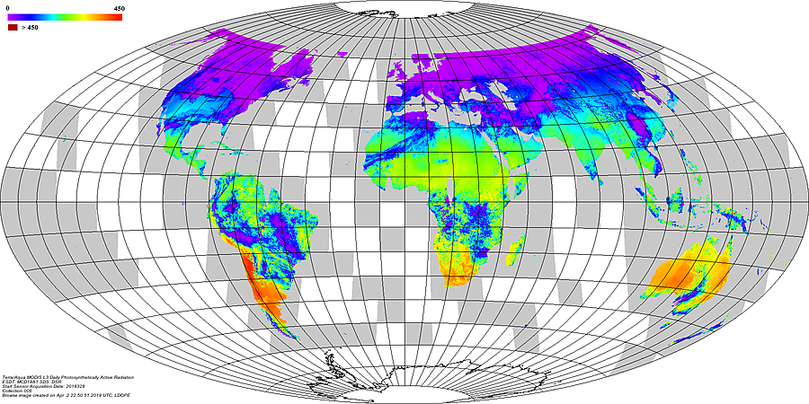
Downwelling surface solar radiation validation protocol
Downwelling surface solar radiation (DSSR) is a key environmental variable. It drives weather, climate, evapotranspiration, plant growth, solar energy
DSSR is a GCOS ECV
Under: Atmosphere – Surface – Radiation budget
GCOS has proposed the GCOS Surface Reference Network (GSRN) with DSSR a core variable as one of the four components of surface radiation budget.
DSSR is produced by CEOS agencies
WGClimate inventory of satellite ECV datasets:
EUMETSAT (CM SAF): CLARA (AVHRR), CLAAS (SEVIRI), SARAH (SEVIRI by Heliosat)
NASA (CERES, MODIS)
Others include
NOAA: NSRDB (US coverage)
NASA: POWER (global coverage, from GEWEX/SRB)
EC: CAMS radiation service (Meteosat coverage)
ABoM (Australia coverage)
JAXA (Himawari coverage)
DSSR is the fuel for solar energy generation
UN Sustainable Development Goal (SDG) 7 "Affordable and Clean Energy"

Slide 16
List of new products:
Copernicus Climate Change Service (C3S) Albedo products:
AVHRR: 1981-2005; SPOT/VGT 1998-2014; PROBA-V 2013-2020
https://cds.climate.copernicus.eu/cdsapp#!/dataset/satellite-albedo?tab=overview
Continuation of the development of the COPERNICUS/C3S Albedo Collection 2 (1981-today)
EUMETSAT/LSA-SAF incoming solar radiation products (based on MSG/SEVIRI):
MSG Total and Diffuse Downward Surface Shortwave Flux (MDSSFTD) – Total+Diffuse (every 15min).
https://landsaf.ipma.pt/en/products/longwave-shortwave-radiation/mdssftd/
EUMETSAT released a new collection of the Geostationary Surface Albedo covering both first and second generation of Meteosat from 1981-2017.

Slide 17
Release of open-source albedo code:
The access to the source code (called PYALUS) is provided through an open access platform: https://github.com/dominiquecarrer/pyalus. The code is used to retrieve surface albedo through the ECMWF/EU and LSA-SAF/EUMETSAT programmes. This work leads to a consistent archive of almost 40 years of satellite-derived albedo data.

Slide 18
Recent published papers:
Lellouch, Carrer et al., Evaluation of Two Global Land Surface Albedo Datasets Distributed by the Copernicus Climate Change Service and the EUMETSAT LSA-SAF, Remote Sensing, 12(11), 2020
Sánchez-Zapero, J., Camacho F., Martínez-Sánchez E., Lacaze R., Carrer D., Pinault F. Benhadj I, Munos-Sabater J., Quality Assessment of PROBA-V Surface Albedo V1 for the Continuity of the Copernicus Climate Change Service, Remote Sensing, 2020, 12(16), 2596; https://doi.org/10.3390/rs12162596
Carre et al. Surface albedo retrieval from 40-years of Earth observations through the EUMETSAT/LSA SAF and EU/C3S programmes: the versatile algorithm of Pyalus, Remote Sensing, 2021, 13(3), 372
Carrer, D.; Ceamanos, X.; Moparthy, S.; Vincent, C.; Freitas, S.; Trigo, I. Satellite Retrieval of Downwelling Shortwave Surface Flux and Diffuse Fraction under all Sky Conditions in the Framework of the LSA SAF Program (Part 1: Methodology). Remote Sensing, 2019, 11(21), 2532; https://doi.org/10.3390/rs11212532)

Slide 19
Next Steps:
Downwelling surface radiation validation protocol
Ground albedo/radiation measurements – (BSRN albedo Working Group)
Albedo validation – spectral, high spatial resolution
Newsletters
Website update – products/papers etc.
Workshop/conference
LPV Surface Radiation/albedo Work Plan 2019 - 2022
group | Lead / PoC | ID | Action | Start | Status
Albedo | Dominique Carrer / FA leads | 19-LPV-09 | Developing protocols for surface downwelling radiation product validation | 2019 | In progress
Albedo | F.Camacho / FA leads | 19-LPV-10 | Paper on albedo validation and intercomparison (SALVAL tool) | 2019 | In progress

