Slide 1
Land Product Validation
Land Cover
Sophie Bontemps (UCLouvain, Belgium)
Alexandra Tyukavina (U. Maryland, USA)
LPV Plenary – 26-27 May 2021

Slide 2
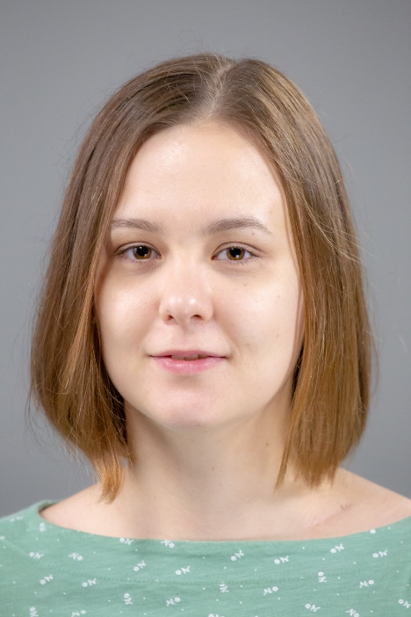
New co-lead
Dr. Alexandra (Sasha) Tyukavina
Assistant Research Professor, Department of Geographical Sciences,
University of Maryland, College Park, USA
Ph.D. in Geographical Sciences, 2015, University of Maryland, USA
M.Sc. in Cartography, 2011, Moscow State University, Russia
Current research projects:
2021-2023, Multi-resolution quantification and driver assessment of hot spots of global forest disturbance (NASA LCLUC), Principal Investigator
Publications:
Tyukavina et al. (2018) Congo Basin forest loss dominated by increasing smallholder clearing.
Science Advances 4(11), eaat2993
Tyukavina et al. (2017) Types and rates of forest disturbance in Brazilian Legal Amazon, 2000-2013. Science Advances, e1601047
Tyukavina et al. (2016) Pan‐tropical hinterland forests: mapping minimally disturbed forests. Global Ecology and Biogeography, 25(2), 151-163.
Tyukavina et al. (2015) Aboveground carbon loss in natural and human-modified tropical forests from 2000 to 2012. Environmental Research Letters, vol. 10, № 7, pp 1-14.

Slide 3
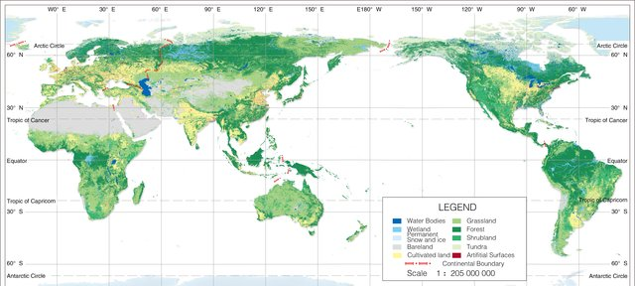
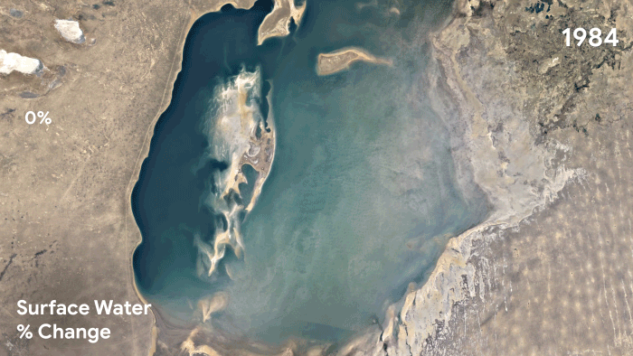
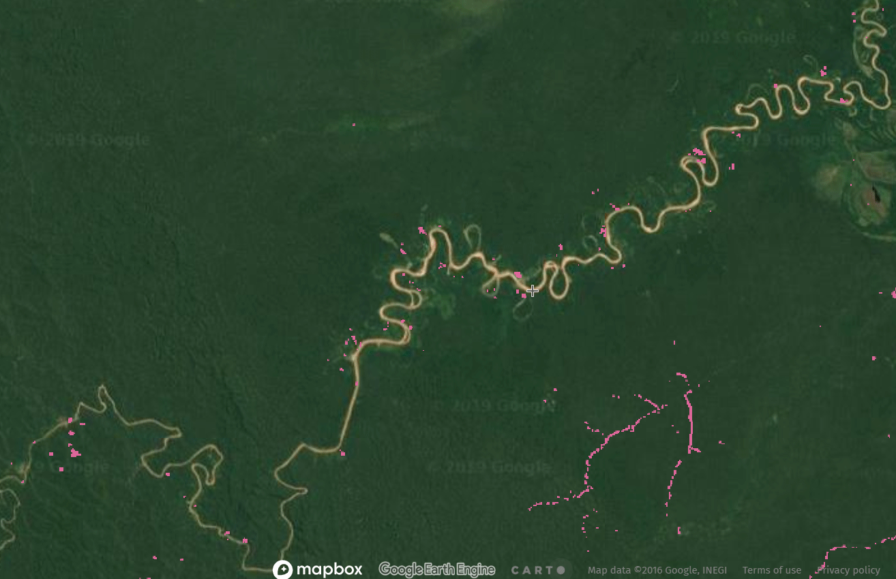
Good practices LC validation protocol
Key activity for Land Cover Focus Area
More and more LC products (LC, LU, LCC, single-class, etc.)
Wider access to VHR imagery to be used as reference dataset
Moving from Stage 3 to Stage 4
http://www.globallandcover.com/home_en.html
https://global-surface-water.appspot.com/
https://maps.elie.ucl.ac.be/CCI/viewer/
https://maps.elie.ucl.ac.be/CCI/viewer/
https://land.copernicus.eu/global/products/lc
https://glad.umd.edu/projects/global-forest-watch

Slide 4
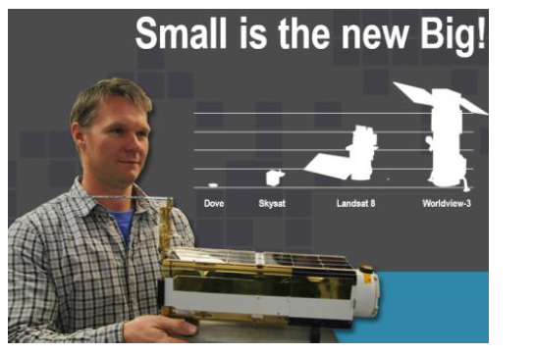
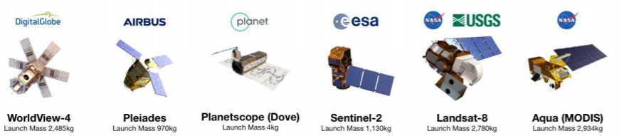


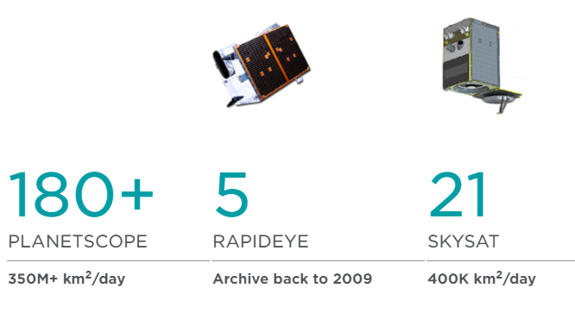
Increased access to VHR imagery
Global daily coverage of very high-resolution imagery over successive years – commercial satellite constellations (RapidEye, SkySat, PlanetScope) with privileged access for scientific community
Norwegian International Climate and Forest Initiative (NICFI) providing free access to Planet mosaics of full tropical land mass
Bi-Annual archive (Dec. 2015- Aug. 2020)
Monthly monitoring (Sep. 2020 onwards)
https://www.planet.com/nicfi/
Daily imagery available to university-affiliated researchers and other non-profit user groups:
https://www.planet.com/markets/education-and-research/

Slide 5
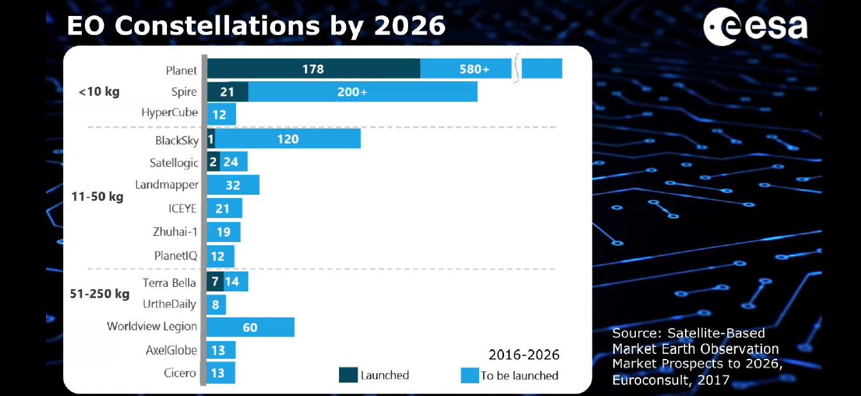
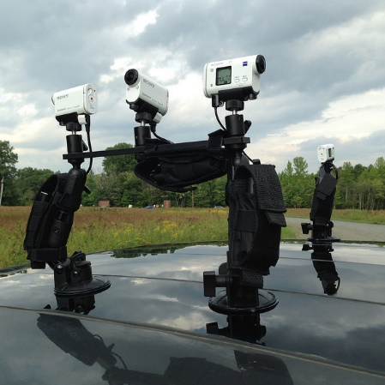
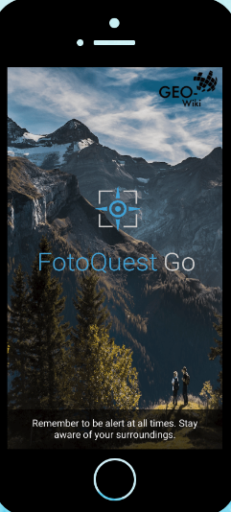
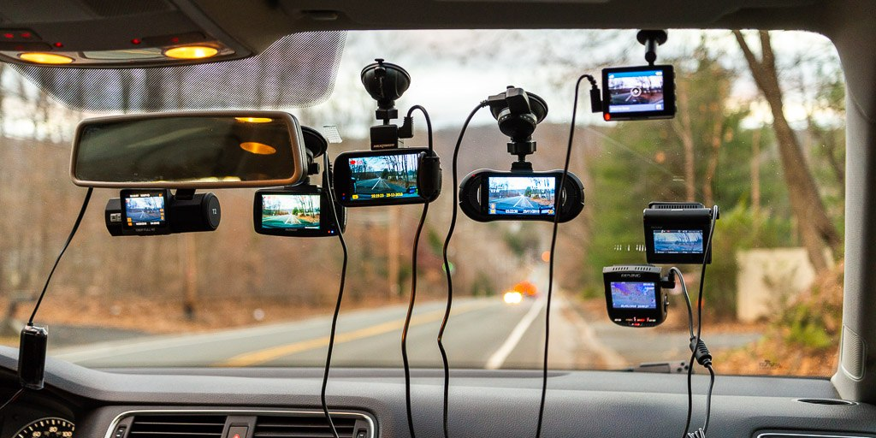
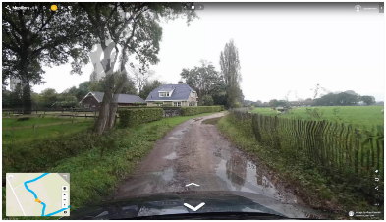
Booming of EO smallsat constellations
+ other technologies
© d’Andrimont R

Slide 6
Moving from Stage 3 to Stage 4
Most products validated until Stage 3 …
… recent initiatives demonstrating Stage 4 is feasible
Comparison with reference in situ or other suitable reference data
Uncertainties quantified over > 30 locations and time periods representing global conditions
Spatial and temporal consistency of the product, and its consistency with similar products, evaluated over globally representative locations and time periods
Stage 3 are systematically updated when new product versions are released or as the interannual time series expands

Slide 7
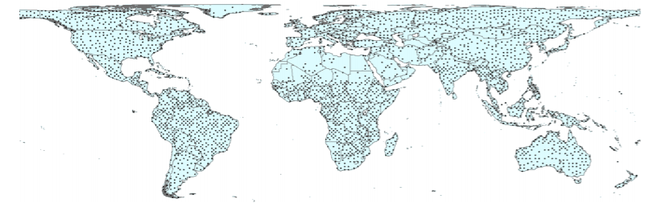
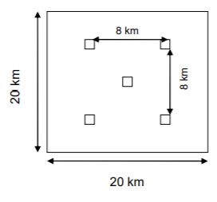
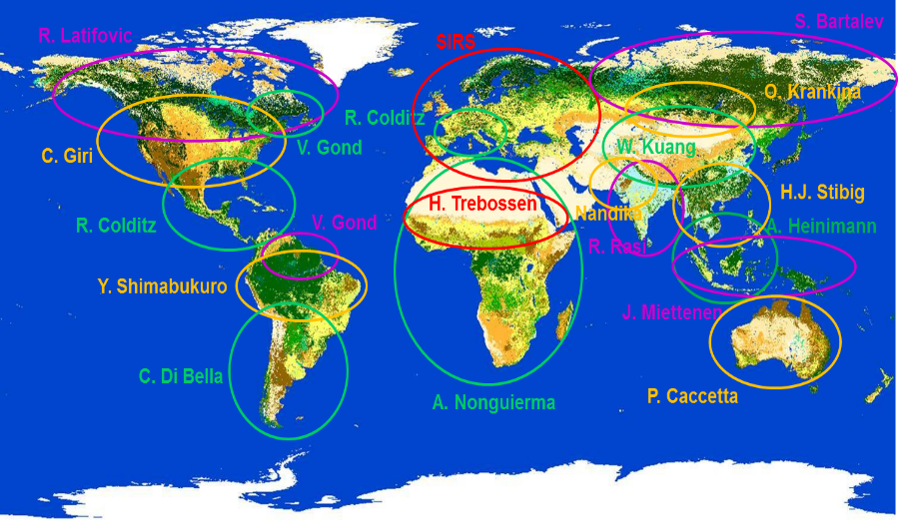
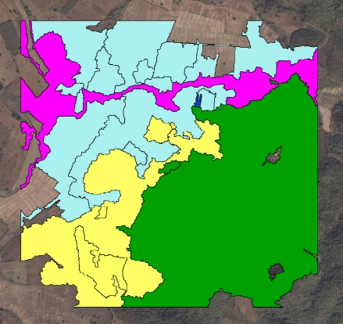
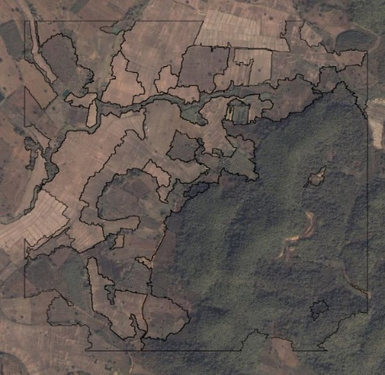
ESA CCI (1992-2015) & C3S (2016-2019) Land Cover
Global LC maps @300m, 22 LC classes – 6 IPCC land categories
2600 Primary
Sampling Units
(PSU)
5 Secondary Sampling Units per PSU
900m * 900 m → 13.000 potential units
SSU = validation units to be interpreted
2-stage stratified random sampling
J.P.
Kibambe
LC validation database originally generated thanks to a collaborative effort of LC experts
http://www.esa-landcover-cci.org/ https://cds.climate.copernicus.eu/cdsapp#!/dataset/satellite-land-cover?tab=overview

Slide 8
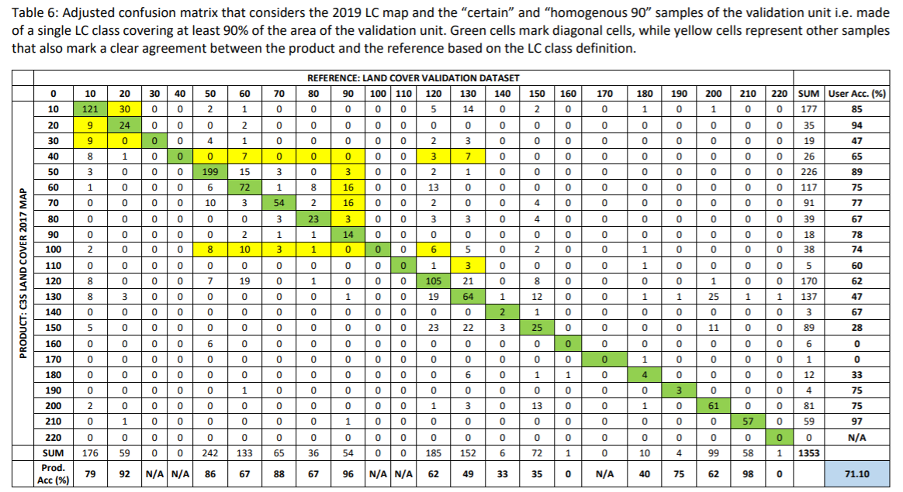
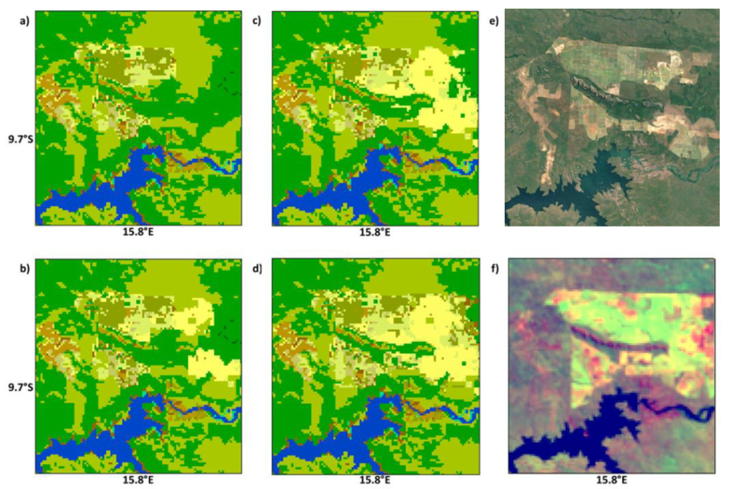
Statistical validation
Red points = LC change samples 2018-2019
DB updated to reflect annual changes
-> Two many LC classes for LC change
-> Complemented through systematic
confidence-building procedure and IC
2016-2017 (0,3% of the SSU)
2017-2018 (1,1% of the SSU)
2018-2019 (1,2% of the SSU)
22 LC Classes
2016 – OA = 71.1%
2017 – OA = 71.1%
2018 – OA = 70.8%
2019 – OA = 70.6%

Slide 9
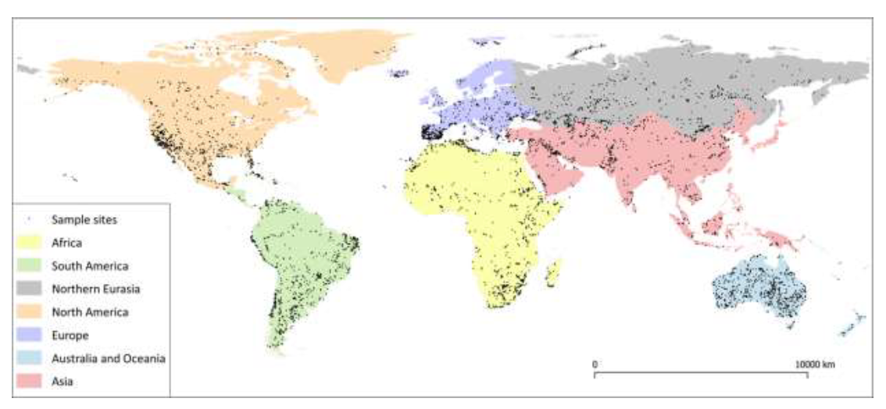
Copernicus Global Land Cover map
Global LC maps @100m, 23 LC classes + 10 continuous fields layers
2015 epoch validation using 21.752 sampling locations across the globe
Revising 43,5% of sample sites + new samples in possible change areas
10mx10m sub-pixels included into
a PROBA-V pixel (100mx100m)
Continental distribution of the new CGLS_LC100m land cover change validation dataset for reference years 2015 - 2019
https://land.copernicus.eu/global/products/lc

Slide 10
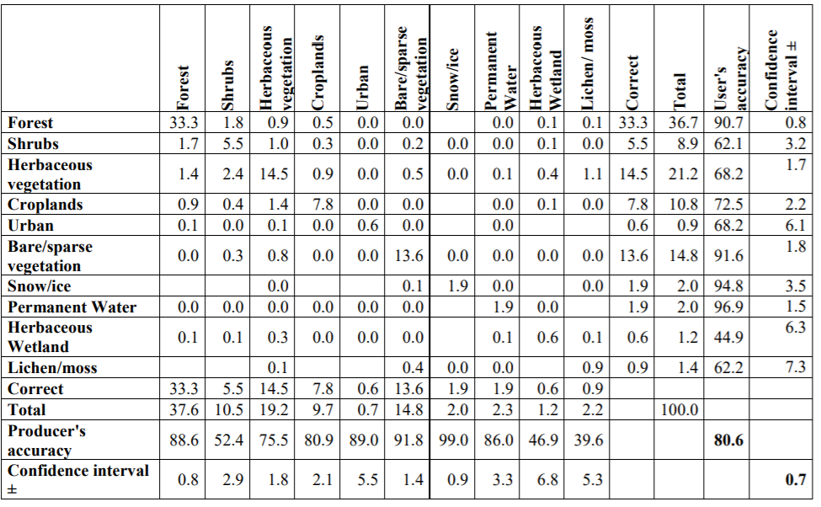
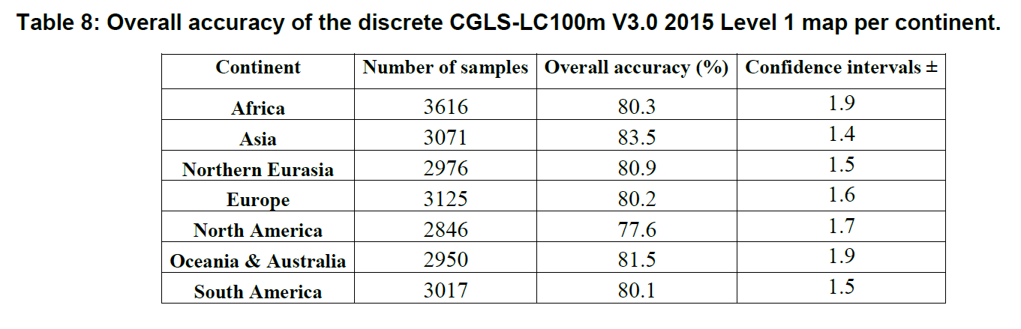
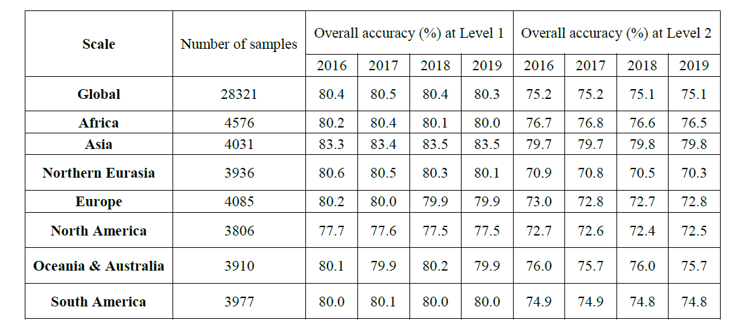
Statistical validation
Over years, going down to continent, 10-12 LC classes
OA 2015 (10 classes) = 80.6% +/-0.7%
(confidence intervals at 95% confidence level)
OA (10 and 12 classes) for 2016-2019, global and continental levels
-> Demonstration of an efficient validation protocol for 10-12 LC classes
https://land.copernicus.eu/global/products/lc

Slide 11
Stage 4 validation of UMD GLAD global forest loss
Initial validation (Hansen et al. 2013):
Sample: 1,500 120m blocks globally, stratified random sample;
Reference data: Landsat, MODIS and high resolution data from Google Earth;
Time interval: 2000-2012.
Current global validation (funded through NASA LCLUC Muesli project and USGS/NASA Landsat Science Team):
Sample: 600 5x5km blocks globally, stratified random sample;
Reference data: PlanetScope and Sentinel-2;
Time interval: 2018 (annual forest loss) + land cover 5 years after initial disturbance (end of 2022);
Value-added thematic analysis: drivers of forest loss.

Slide 12
Stage 4 validation of UMD GLAD global forest loss
Locations of 5x5km
validation blocks,
Colored by sampling strata
Red – global forest loss map, left (A) – over the best cloud-free post-disturbance Landsat
observation, right (B) – over the PlanetScope image concurrent with disturbance

Slide 13
Stage 4 validation of UMD GLAD global forest loss
Prototype PlanetScope (left) and Sentinel-2 (right) reference block maps
Chiquitano dry forest loss, Santa Cruz province, Bolivia
Secondary forest reclearing in Sankuru province, Democratic Republic of the Congo

Slide 14
Good practices LC validation protocol
Building on existing protocols
  R&D projects
  GFOI’s Methods and Guidance Documentation
Include Land Cover & Land Cover Change (land use ?)
Sampling design + response design protocols
  Single-class vs multi-class products
  Expert-based vs crowd-sourcing
  Products validation vs methodologies comparison (benchmarking)
Accuracy assessment methodology (including uncertainty)
Areas estimation of specific classes of LC and LCC
Guidance and tools for using collecting reference dataset from VHR images

Slide 15
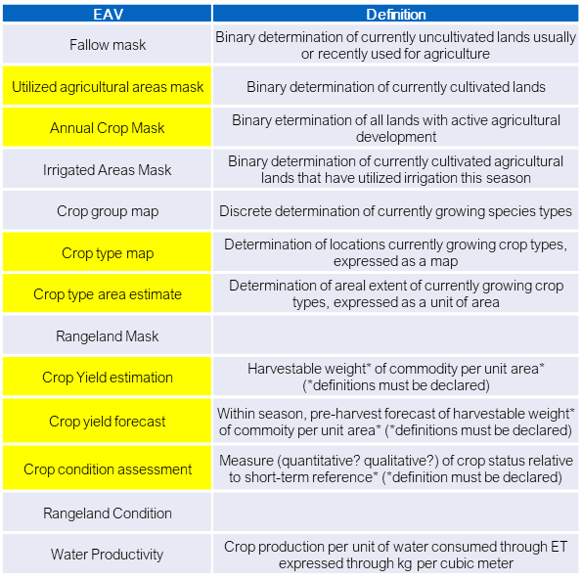
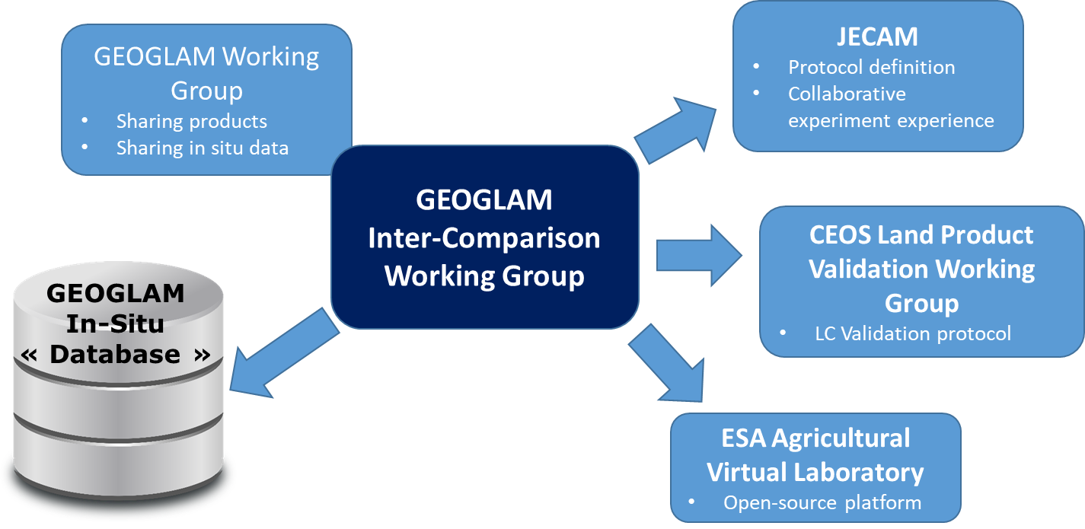
Outreach, synergies and collaboration
GFOI – with previous co-lead Pontus Olofsson
  3rd version of GFOI’s Methods and Guidance Documentation (MGD)
GEOGLAM with Essential Agricultural Variables
  New variables to consider
  Ongoing protocol for products IC and
  validation (cropland and crop maps)
  Special session @IGARSS 2021 (Brussels, July 2021)
  « CEOS Land Product Validation: Sampling-based estimation of area and accuracy for Land Cover products »

