Slide 1
LST & Emissivity
COVID-19 and conferences
IGARSS Conference 2021: Jul 11 - 16, Brussels, Belgium → decision by May 28
EUMETSAT Conference 2021: Sep 20-24, Bucharest, Romania → changed to virtual event
6th Recent Advances on Quantitative Remote Sensing (RAQRS) Conference: Valencia (Torrent), Spain → postponed to 19-23 September 2022

Slide 2
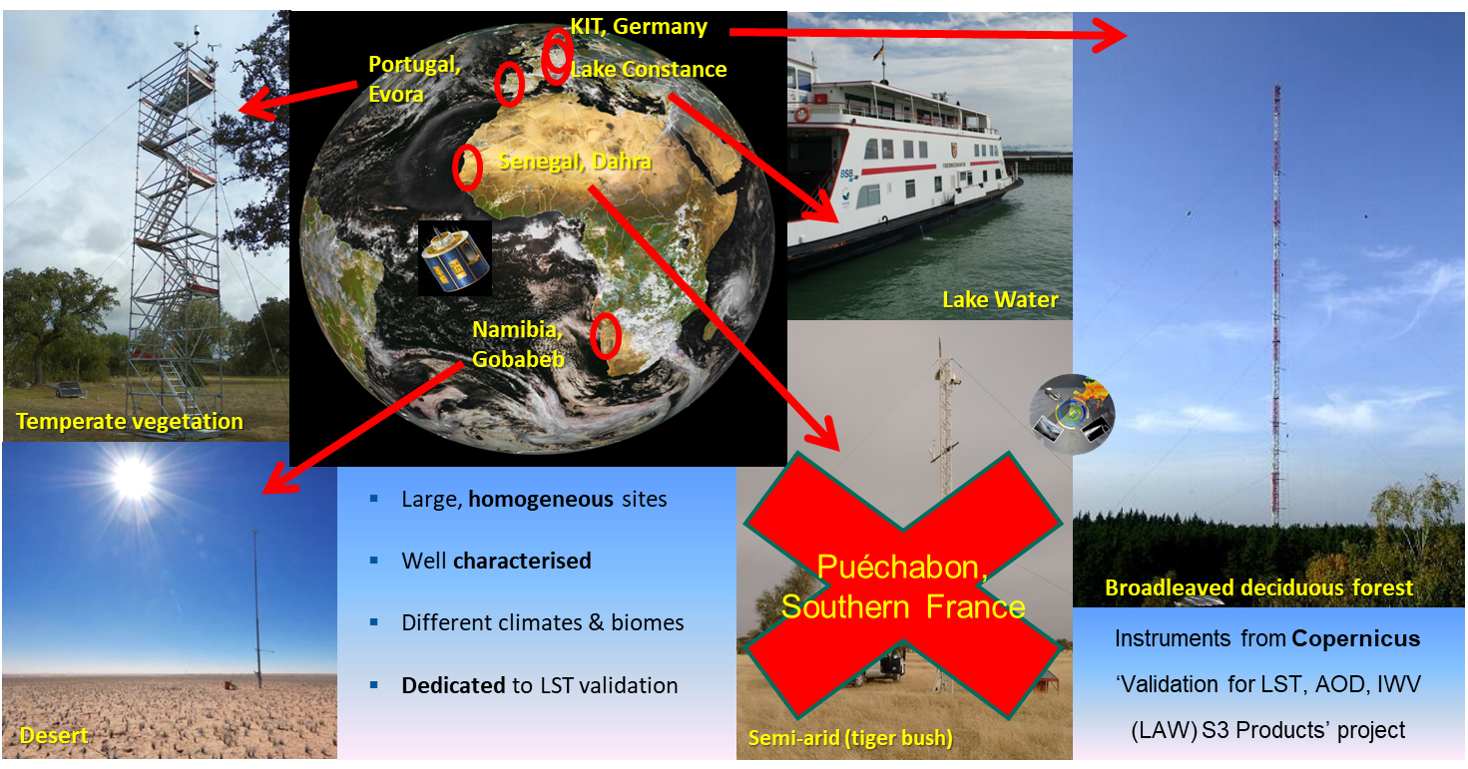
LST validation stations (KIT instrumented)

Slide 3
In-situ Lake Water Surface Temperature (LWST)
Standard instrument package on car ferry ‘Friedrichshafen’, Lake Constance.

Slide 4
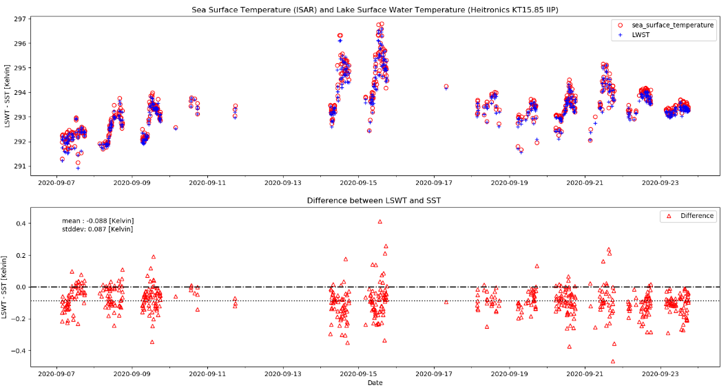
Lake Constance inter-comparison
Heitronics KT15.85 and ISAR onboard BSB ferry Friedrichshafen during field experiment (01.-24. September 2020)
Difference in-situ ST KT15.85 – ISAR:
Bias = -0.09 K
Stddev = 0.09 K
www.isar.org.uk

Slide 5
Validation of LST, AOD, WV (LAW)
law.acri-st.fr/home

Slide 6
Sites with ‘KIT instrumentation’

Slide 7
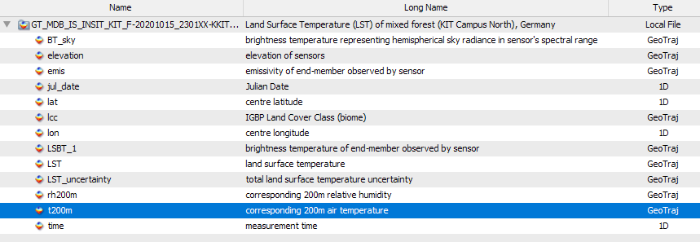
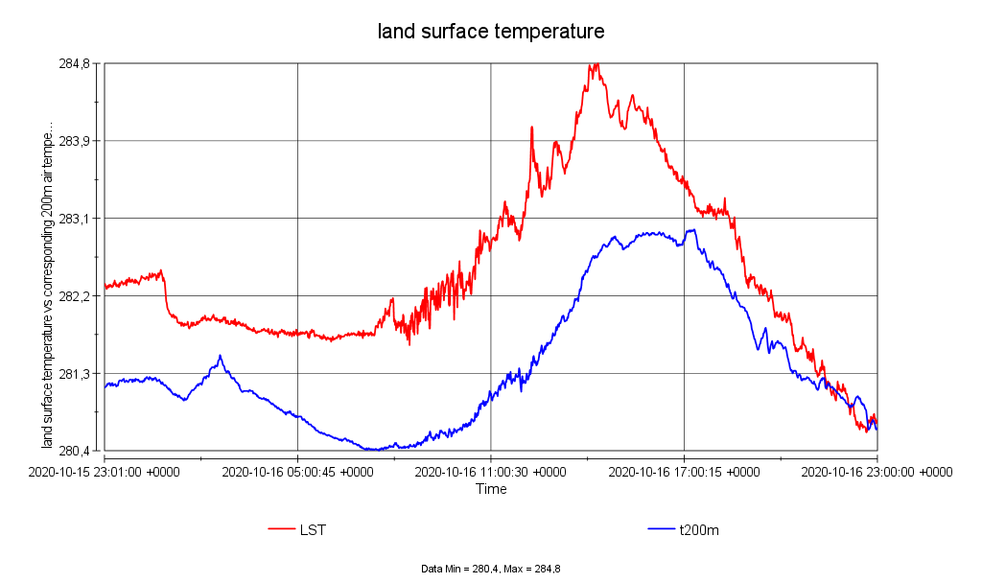
LAW project: netCDF in-situ data (KIT-Forest)
Raw data logger files (csv) converted to netCDF (ESA GlobTemperature)

Slide 8
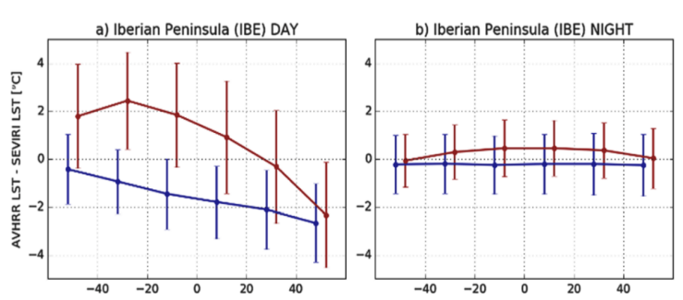
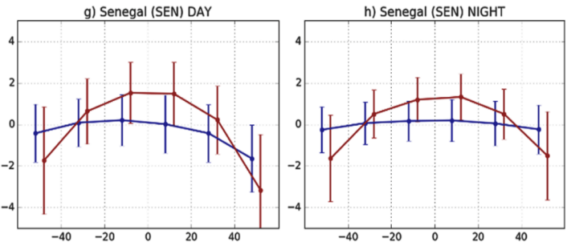
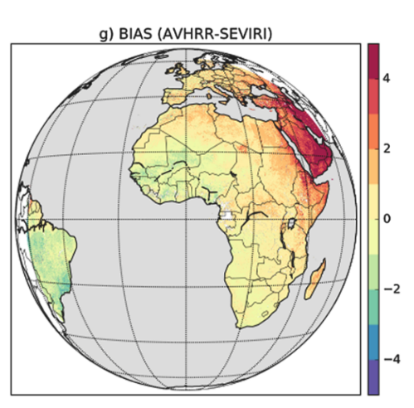
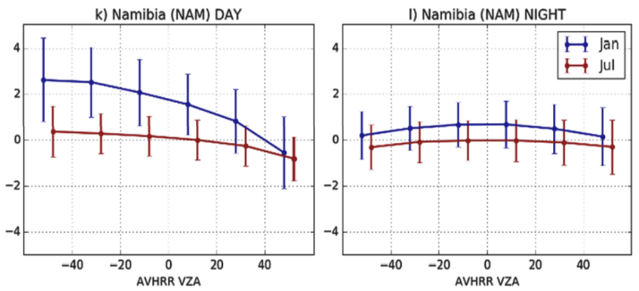
Trigo et al. (2021): in-situ validation & SEVIRI vs AVHRR/Metop
DJF
daytime
LST product inter-comparison:
Same retrieval algorithm (GSW)
Same training data base
Results for 2015 - 2018
→ Differences (mainly) due to different viewing geometries
Largest differences at very high SEVIRI angles (edge of disk) over specific land cover (sand desert)
Similar dependence of AVHRR LST on VZA is observed over KIT sites
mostly within ±2◦C
JJA
daytime
Arabian Peninsula: AVHRR LST 3◦C to 4◦C warmer. Desert at large VZA: SEVIRI emis too low?

Slide 9
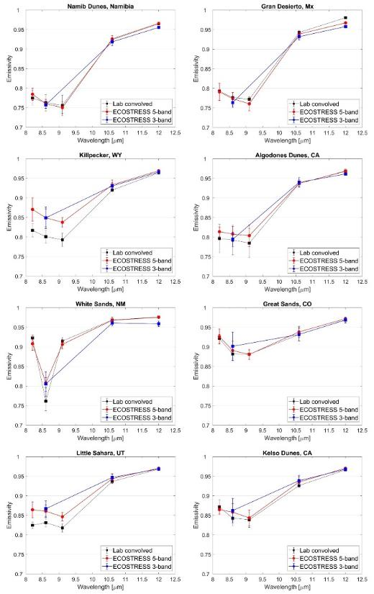
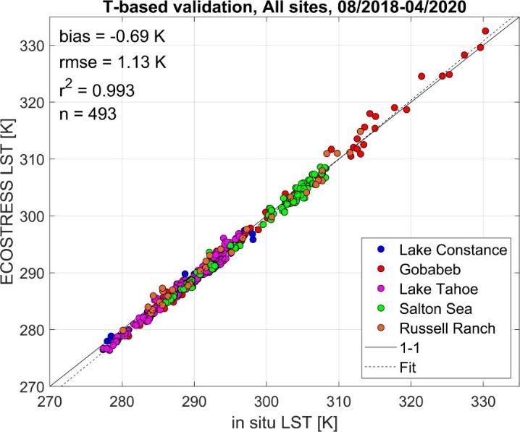
ECOSTRESS LST&E validation
Stage-1 validation of Level-2 LST&E products completed.
Paper in press: IEEE TGRS
LST accuracy: 1.07 K
Emissivity accuracy: 2.14%

Slide 10
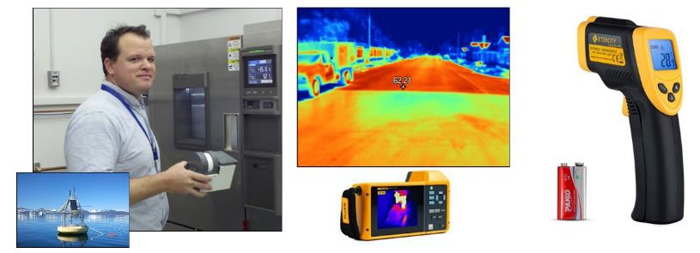
Urban validation activities: Citizen science
Summer 2021: Utilize graduate students and other citizen scientists to validate fine-scale temperatures of urban surfaces to validate downscaled LST products at 30m resolution, e.g. ECOSTRESS, MuSLI urban LST
JPL apogee radiometers
Crowdsourcing thermometer guns
Fluke thermal camera

Slide 11
Landsat 9 validation activities
Summer 2021: conduct a validation ‘round-robin’ at JPL:
Thermal radiometers from JPL, ASU, RIT
JPL blackbodies, chambers, and water baths
Conduct additional measurements during Landsat 8/9 under-flights at field sites:
June-July 2021
Railroad valley, Algodones dunes
Lake Tahoe, Salton sea, Tonzi ranch, Russell Ranch
Establish protocols for Landsat 9 checkout and validation

Slide 12
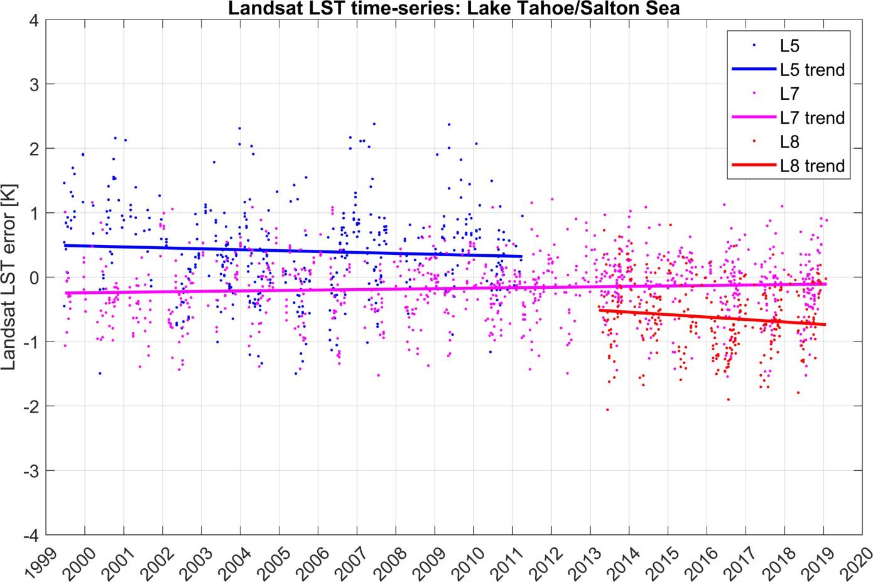
Long-term Landsat LST validation at Tahoe/Salton Sea

Slide 13
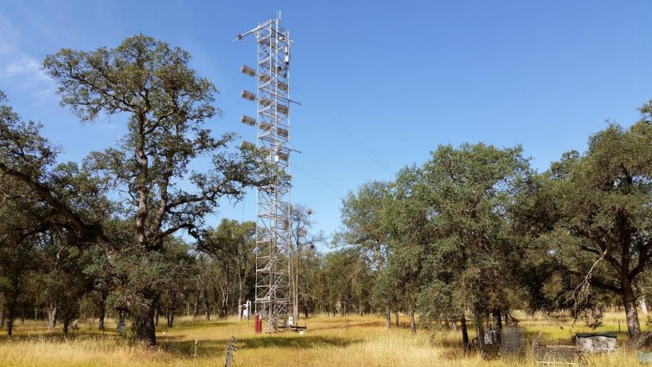
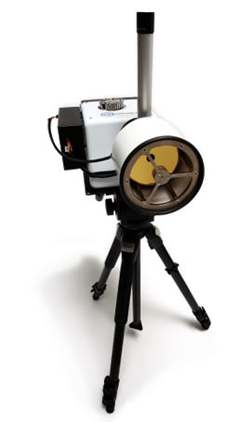
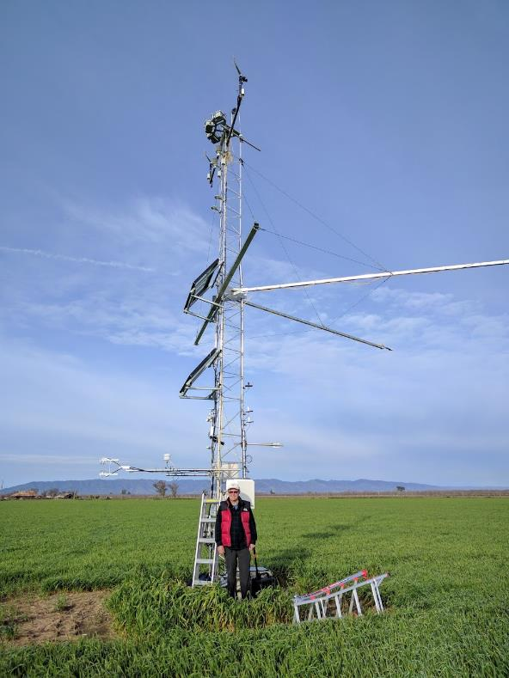
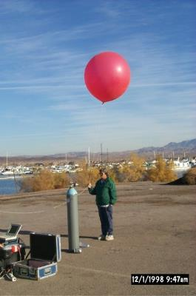
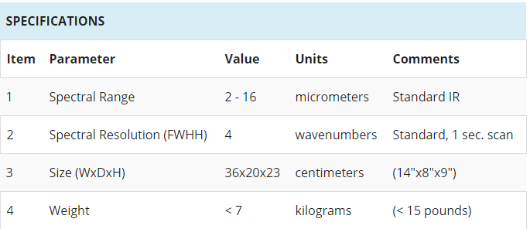
Landsat 9 validation planned activities
Tonzi Ranch, CA
Russell Ranch, CA
Notes:
JPL apogee radiometers installed on towers at Tonzi and Russell ranch, in addition to field spectrometer to measure surface emissivity.

Slide 14
Recent LST&E publications
I.F. Trigo, S.L. Ermida, J.P.A. Martins, C.M. Gouveia, F.-M. Göttsche, and S.C. Freitas (2021), Validation and consistency assessment of land surface temperature from geostationary and polar orbit platforms: SEVIRI/MSG and AVHRR/Metop. ISPRS Journal of Photogrammetry and Remote Sensing, Vol. 175, pp. 282-297, doi: 10.1016/j.isprsjprs.2021.03.013.
G.C. Hulley, F. Goettsche, G. Rivera, S.J. Hook, R. Freepartner, R. Radocinski, M. Martin, K. Cawse-Nicholson, and W.R. Johnson (2021), Validation and quality assessment of the ECOSTRESS level-2 land surface temperature and emissivity product. IEEE Transactions on Geoscience and Remote Sensing, in press.

