Slide 1
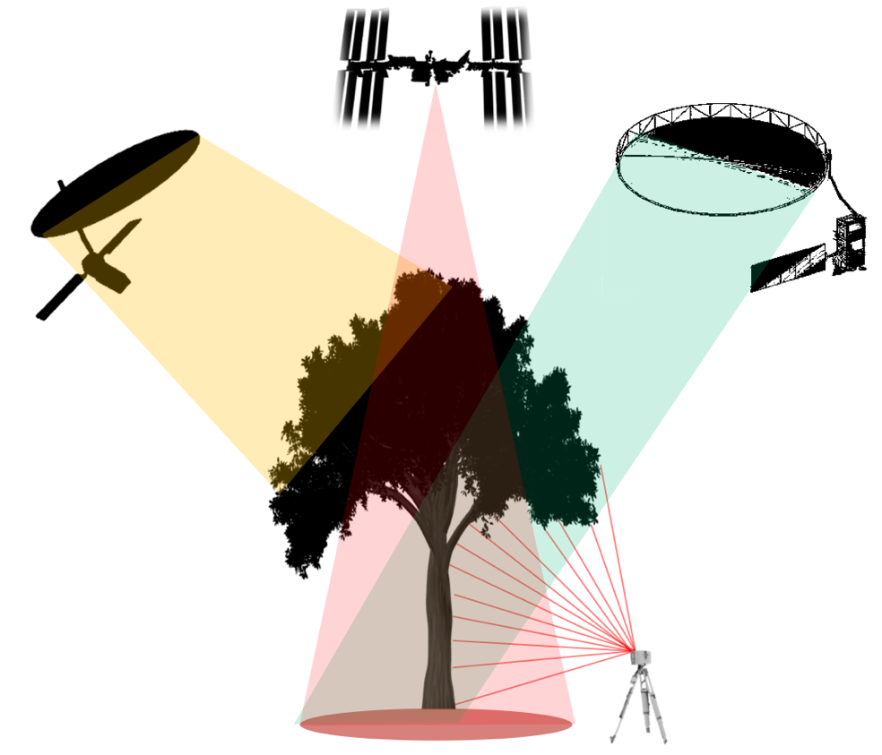
CEOS WGCV LPV
Biomass Focus Area
LPV Biomass Protocol Authors:
Laura Duncanson, John Armston, Mat Disney
Avitabile, V., Barbier, N., Calders, K., Carter, S., Chave, J., Herold, M., MacBean, N., McRoberts, R., Minor, D., Paul, K., Réjou-Méchain, M., Roxburgh, S., Williams, M., Albinet, C., Baker, T., Bartholomeus, H., Bastin, J.F., Coomes, D., Crowther, T., Davies, S., de Bruin, S., De Kauwe, M., Domke, G., Dubayah, R., Falkowski, M., Fatoyinbo, L., Goetz, S., Jantz, P., Jonckheere, I., Jucker, T., Kay, H., Kellner, J., Labriere, N., Lucas, R., Mitchard, E., Morsdorf, F., Næsset, E., Park, T., Phillips, O.L., Ploton, P., Pultini, S., Quegan, S., Saatchi, S., Schaaf, C., Schepaschenko, D., Scipal, K., Stovall, A., Thiel, C., Wulder, M.A., Camacho, F., Nickeson, J., Román, M., Margolis, H.
We gratefully acknowledge several expert reviewers:
S. Bauwens, M. Hayashi, A. Held, A. Hudak, N. Knapp, S. Maier, C. Patnaik, P. Patterson, A. Rosenqvist, S. Saarela, P. Montesano

Slide 2
Many Upcoming Missions will Provide Data Used to Map Biomass
Mission | Funding Agency | Launch Date (Expected) | Data Type | Measurement resolution | Biomass map Resolution | Geographic Domain | Accuracy Requirement
ICESat-2 | NASA | 09/2018 | 532 nm photon counting lidar | 13m footprint aggregated to 100-m transect | NA | Global | NA
SAOCOM 1A | CONAE | 10/2018 | L band SAR | 10-100m depending on mode | NA | Global | NA
GEDI | NASA | 12/2018 | 1064 nm waveform lidar | 25 m circular footprint | 1 km | ISS (+/- ~51.6°) | <20% standard error for 80% of forested 1 km cells
SAOCOM 1B | CONAE | 08/2020 | L band SAR | 10-100m depending on mode | NA | Global | NA
ALOS-4 | JAXA | (2022) | L-band SAR | 1-25 m depending on mode | NA | Global | NA
NISAR | NASA/ISRO | (2023) | L-band SAR | 3 - 10 m (depends on mode) | 1 ha | Global | <20% RMSE for <100 Mg/ha
BIOMASS | ESA | (2023) | P-band SAR | 60 x 50 m with >6 looks | 4 ha | Global except western Europe and North America | <20% RMSE for AGB >50 Mg/ha; 10 Mg/ha for AGB ≤50 Mg/ha
MOLI | JAXA | (2023) | 1064 nm waveform lidar | 25 m circular footprint | 250 m | ISS (+/- ~51.6°) | 20 Mg/ha for < 100 Mg/ha; 25% for >100 Mg/ha
TanDEM-L | DLR | (2023) | L-band SAR | TBD | 1 ha | Global | 20% accuracy or 20 Mg/ha
Copernicus HPCM ROSE-L | ESA/EC | (2027) | L-band SAR | TBD | 1 ha | Global | TBD

Slide 3

WGCV LPV Biomass Protocol
Completed and Endorsed by CEOS!
The protocol is a good practices guide to biomass model calibration and product validation at a global (or near global) scale
Guidance for:
Map producers on how to estimate, propagate and report errors
Map users on how to interpret errors
How to collect reference data (field and airborne lidar)
How to use reference data to conduct independent biomass product validation
Summary of:
State of knowledge of biomass mapping
Community identified research and tool development priorities
Recommendations for protocol implementation

Slide 4
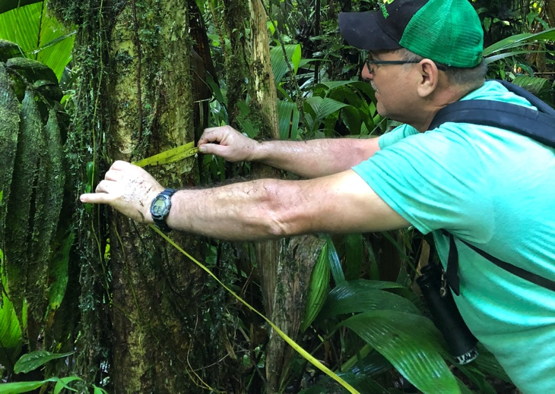
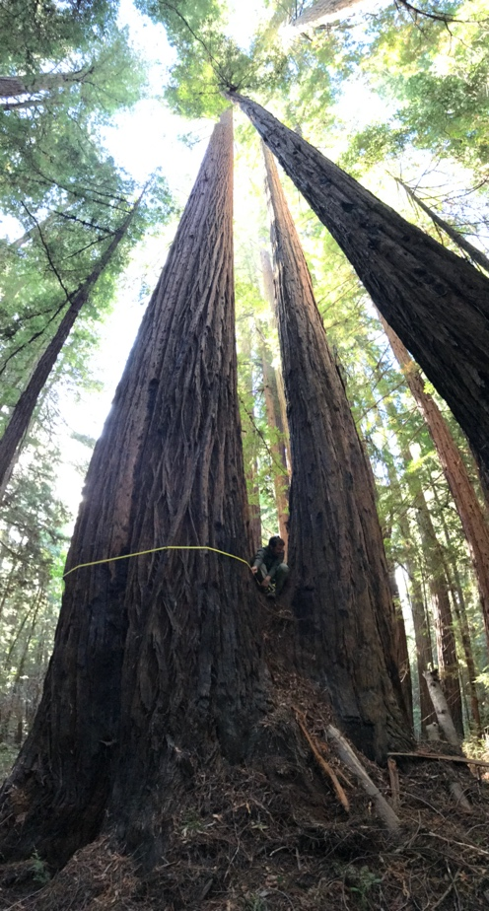
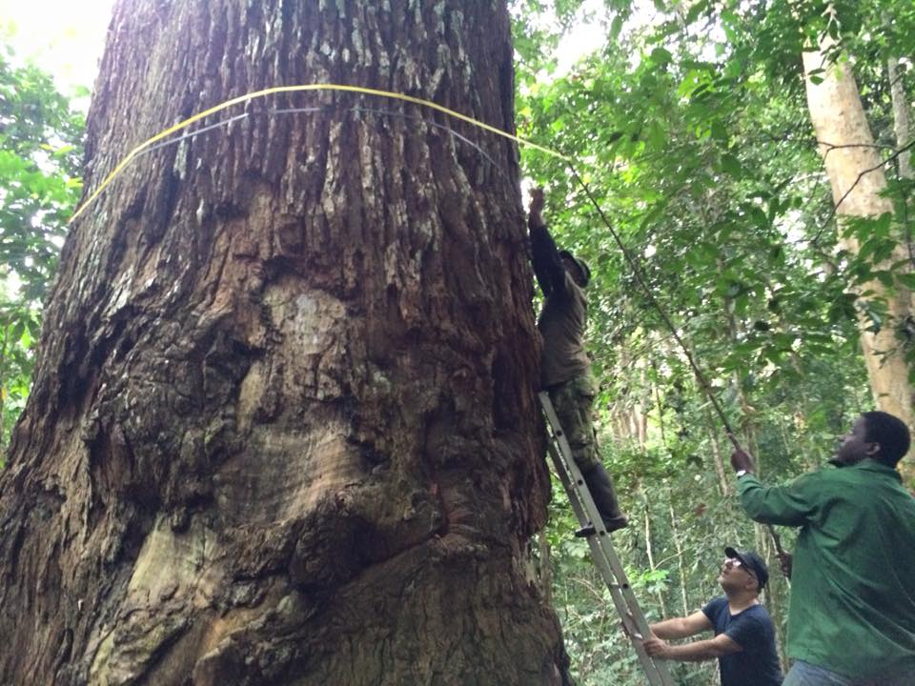

Recommendations for Field Measurements
Field Measurements and derived estimates are not truth – there can be large errors.
Need transparent handling and reporting of errors, consistent definitions
Recommendations for measurements
Summary of uncertainties in allometric models, recommendations for improving allometries
Terrestrial Laser Scanning (TLS) where possible
Jerome Chave, Kim Calders, Keryn Paul et al.

Slide 5
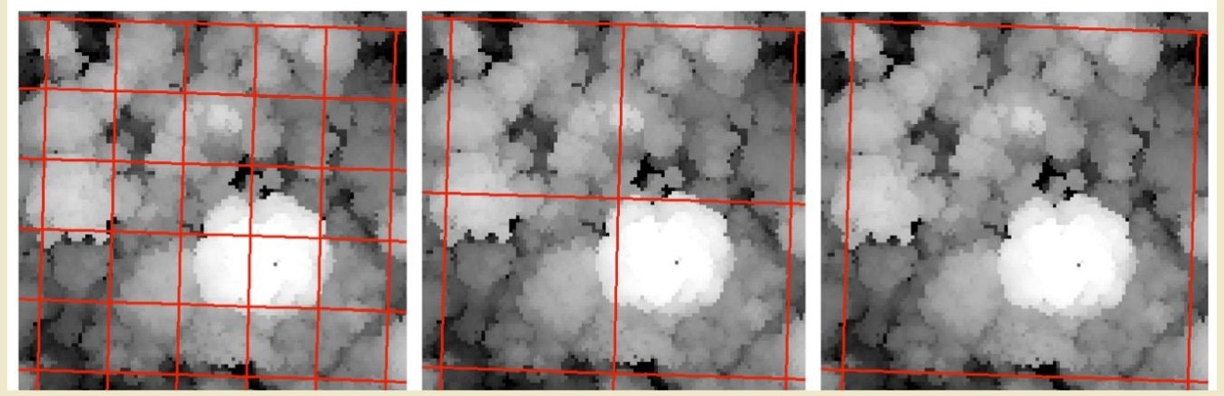
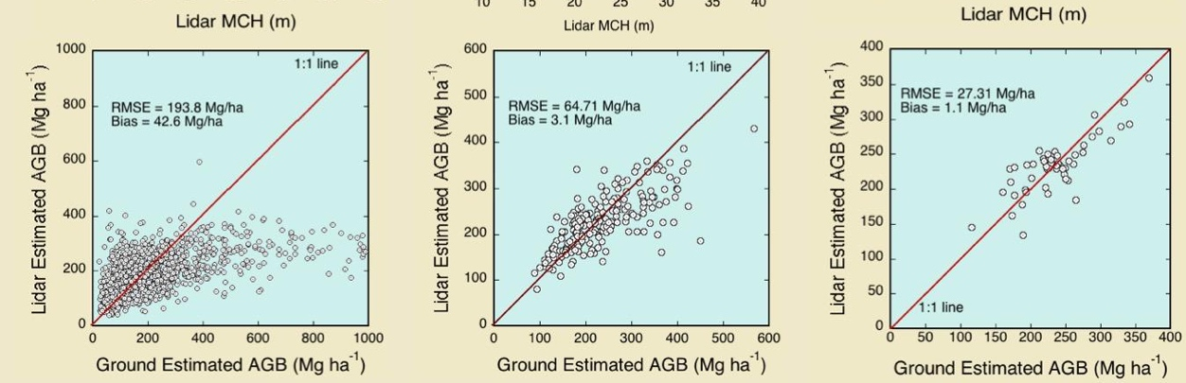
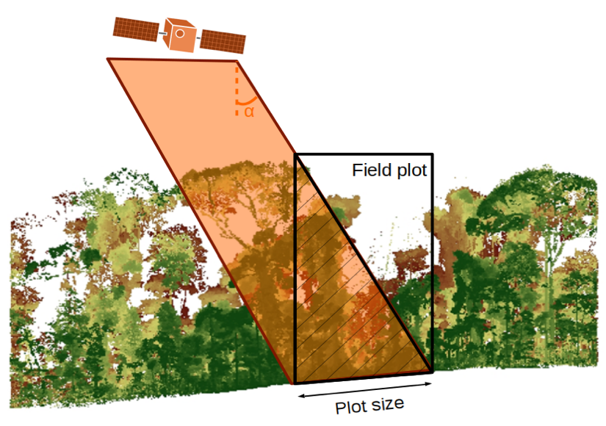
We Recommend Large Plots in Closed Canopy Forests (Especially in Tropics)
Small plots with poor geolocation are not useful for validation at the pixel-level
Large plots reduce errors, particularly from large crowns/edge effects and geolocation
20 m
50 m
1 ha
0.25 ha – 1 ha in tropics; smaller (~25 m) sufficient in temperate/boreal assuming good geolocation
Maxime Réjou Méchain, Nicholas Barbier et al.

Slide 6
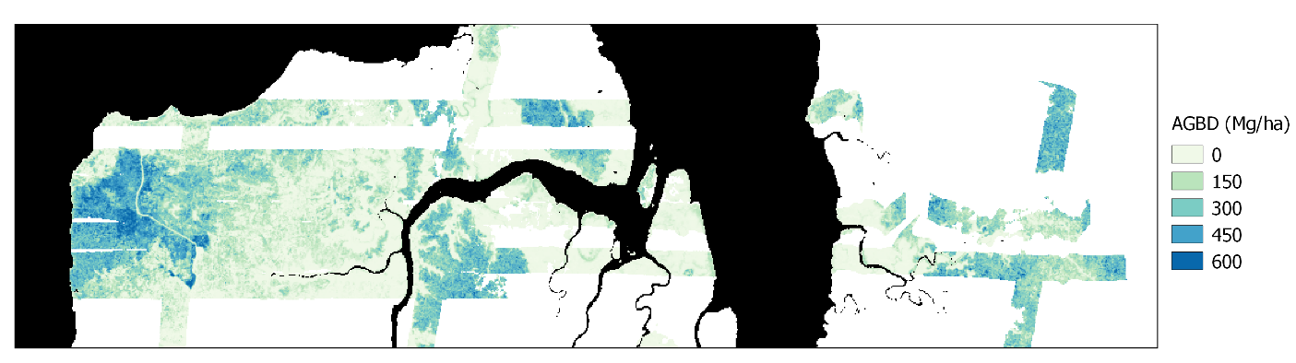
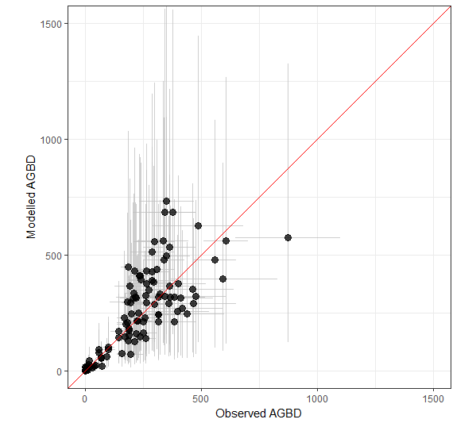
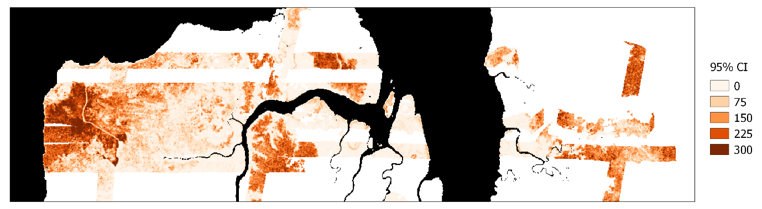
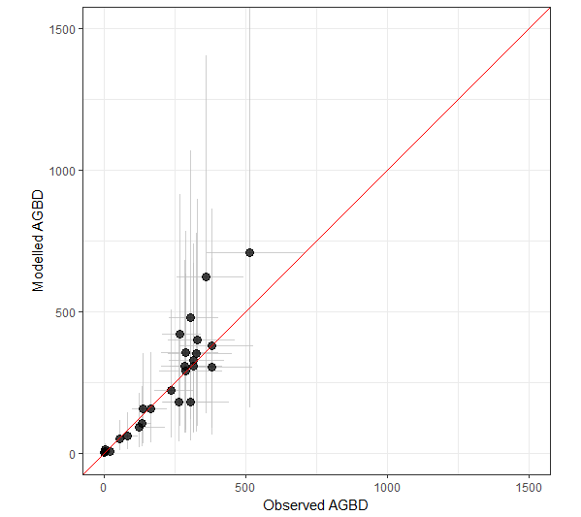
Airborne Lidar is Critical for
Multi-mission Validation and Fusion
Airborne lidar maps can provide multi-resolution validation (provided they are calibrated with local high-quality field plots over the range of environmental conditions covered by the lidar)
0.25 ha
R² = 0.72
RMSE = 114.07
1 ha
R² = 0.82
RMSE = 84.94
John Armston et al.

Slide 7
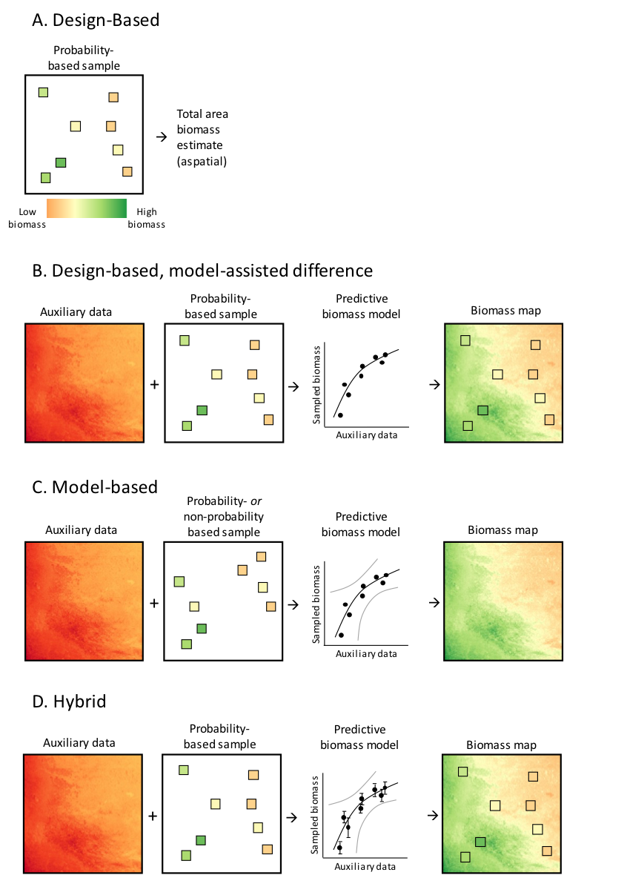
Uncertainties and Errors Should be Estimated as Consistently as Possible
Error reporting should comply with IPCC Good Practices Guidelines and GFOI Methods and Guidance Documents.
Measurement and modeling errors should be estimated following appropriate inference methods and propagated to mapped products (both reference and satellite)
Stephen Roxburgh and Ron McRoberts

Slide 8
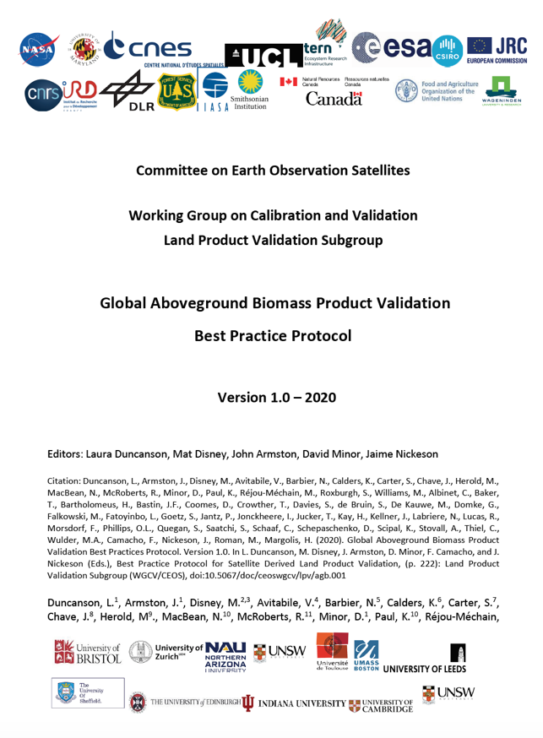
What’s New, What’s Next?
Updated Reference Datasets
CEOS Endorsed Biomass Product Validation
Validation Tools

Slide 9
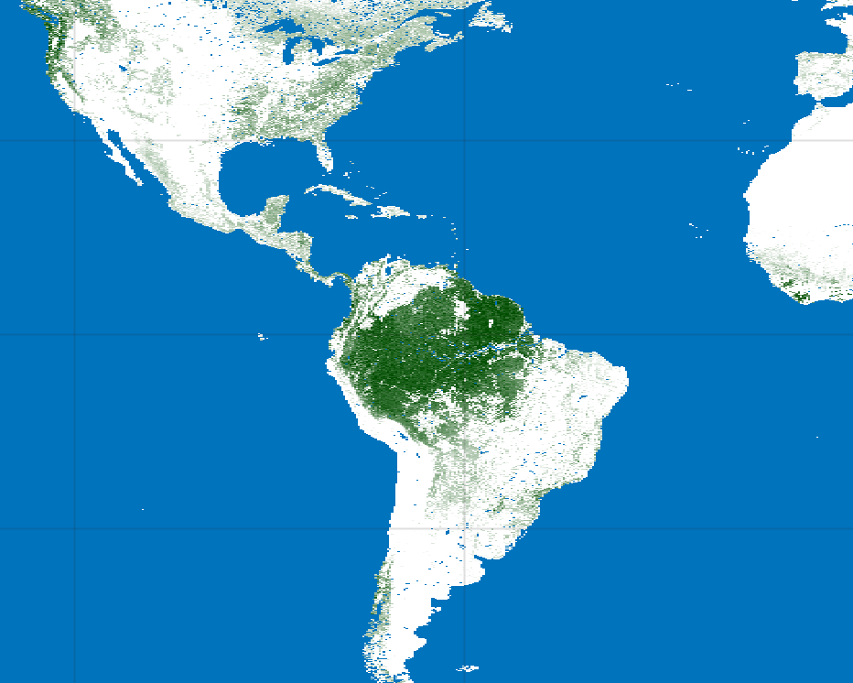
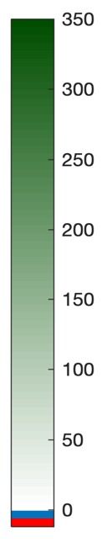
Biomass Product Harmonization Activity for the UNFCCC GST
As new biomass products come online, the protocol can serve as a guide for their uncertainty estimation, validation, and even harmonization.
Aboveground Biomass Density (Mg/ha)
CCI Biomass
2017
JPL Biomass
2015
GEDI Biomass
2020

Slide 10

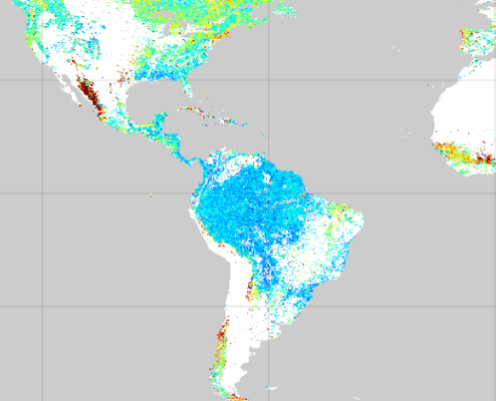
Biomass Product Harmonization Activity for the UNFCCC GST
Open Science activity proposed to use ESA-NASA Multi Mission Algorithm and Analysis Platform (MAAP) for inter-comparison and harmonization of biomass products for the GST.
Products will be assessed following the WGCV LPV biomass protocol using available reference data in pilot USGS Silvacarbon countries
The first goal is to have a pilot harmonization framework (and product) by COP-26 (Nov 2021).
Uncertainties are calculated differently between products, and are scale-dependent. Harmonizing uncertainties will be challenging.
CCI Biomass
2017
Standard
Deviation (%)
JPL 2015
Uncertainty
Mg/ha
0 20 40 60 80 100
0 20 40 60 80 100
GEDI 2020
Standard Error
Mg/ha
GEDI Biomass
2020

Slide 11
BRIX2 Activity: Launched April 2021
Launch meeting April 28-29 2021
Compares biomass algorithms over tropical forests in Gabon (AfriSAR sites)
Uses recommendations from the LPV biomass protocol
Focused on lidar and SAR data (particularly for GEDI, ICESat-2, L-band and P-band SAR)
Airborne lidar biomass maps and high quality field plots used as reference data
All algorithms will be made open

Slide 12
BRIX2 vs. Harmonization Activities
BRIX2
Inter-comparison of algorithms
Lidar SAR fusion
Focused on new mission datasets
Focused on AfriSAR sites
Heavy use of airborne campaign data
Testing new methods / algorithms, learning as a community
Organized by ESA/NASA
Biomass Harmonization
Inter-comparison of products
Continental to Global scale
Attempt to combine / harmonize outputs
Policy application (UNFCCC’s 2023 Global Stocktake)
Organized by CEOS AFOLU
Use the MAAP Platform – Open Science Activities
Follow recommendations from CEOS protocol
Result in notebooks for validation
Inform future development of missions / products

Slide 13
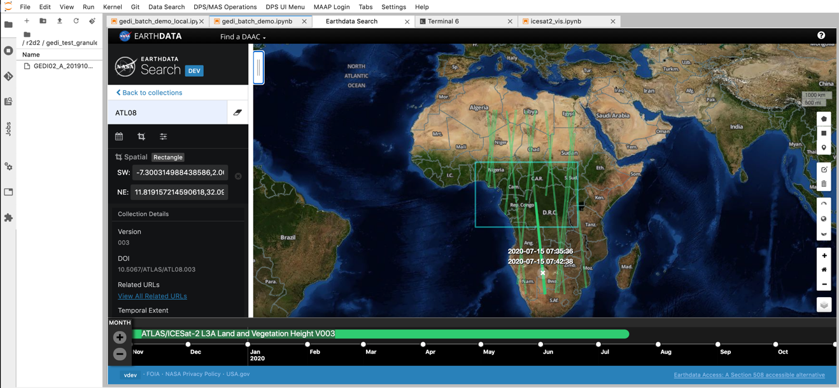


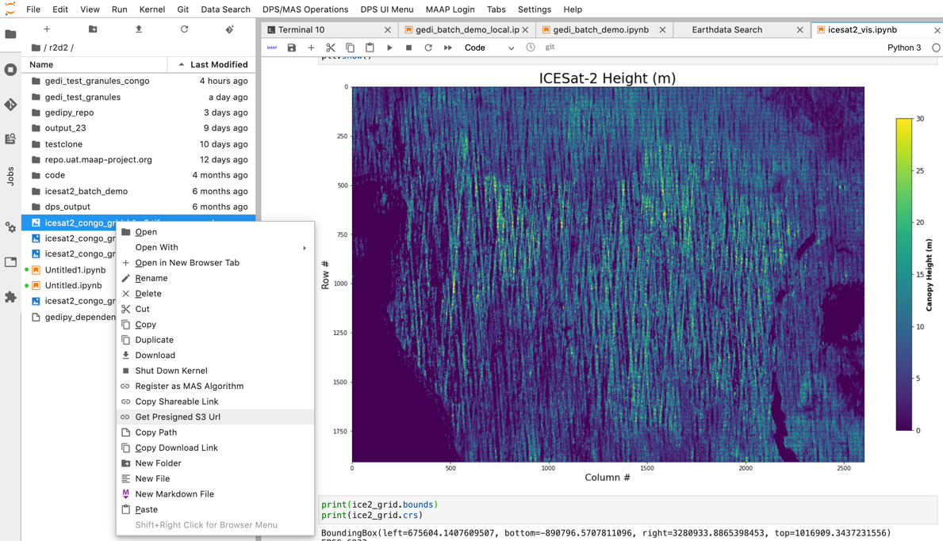
New open science platform - the Multi-Mission Algorithm and Analysis Platform (MAAP)
MAAP
Joint access to data and algorithms
Data and Computing
Data and Computing
Bilateral platform between ESA and NASA
Designed for collaborative open science, algorithm and product development
Processing in the cloud (AWS)
Linked to Earth Data Search

Slide 14

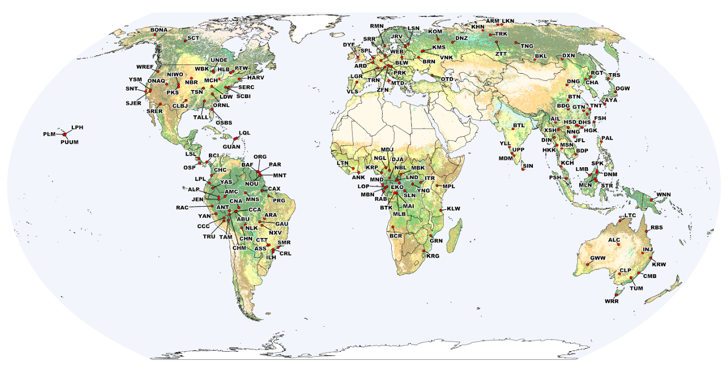

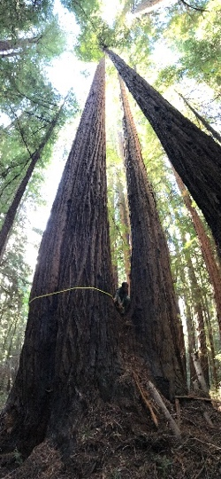
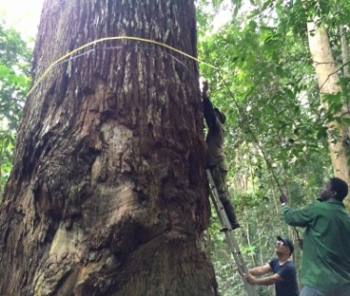
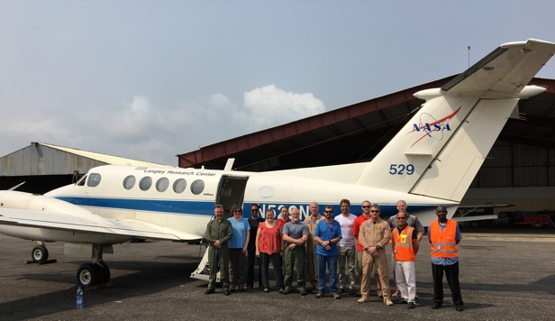
Updated Reference Data Remain Critically Important
New GEO activity: Forest Biomass Reference System for Tree-by-Tree Inventory Data (GEO-TREES). Supporting coordinated collection of new high-quality reference measurements for validation of biomass products.
Potential
Reference Sites
We encourage CEOS agencies to coordinate on data collection for biomass validation following recommendations from the biomass protocol (open high-quality field, TLS, and airborne lidar).
14

Slide 15

























Thank you to the many protocol co-authors
and supporting CEOS Agencies.
This is a community-driven activity!
Thank you!

