Slide 1
Snow Cover Focus Area report
CEOS WGCV Land Product Validation Plenary 2021
Simon Gascoin (CESBIO), Christopher Crawford (USGS), Thomas Nagler (ENVEO)

Slide 2
Snow focus area status
Co-leads: Christopher Crawford (USGS) & Simon Gascoin (CNRS/CESBIO) (since Nov 2020, previous lead was Thomas Nagler)

Slide 3
Snow focus area status
The snow cover is not a variable like soil moisture, LAI, etc.
Snow cover
Extent
Binary
Fraction
Mass
Albedo
Tempe-rature
Depth
...

Slide 4
Snow focus area status
The snow cover is not a variable like soil moisture, LAI, etc.
Snow cover
Extent
Binary
Fraction
Mass
Albedo
Tempe-rature
Depth
...
Validation stage 2
Validation stage 1 or less..

Slide 5
Snow focus area status
Co-leads: Christopher Crawford (USGS) & Simon Gascoin (CESBIO) (since Nov 2020, previous lead was Thomas Nagler)
First action: refreshed products list on the LPV website
Product page
Helpdesk
spatial and temporal coverage
link to validation information

Slide 6
Snow cover extent

Slide 7
Snow cover extent
19 snow cover extent products!
Typically 500m-1km resolution (e.g. MODIS)
Recent release of high resolution products
USGS (Landsat, USA)
EEA/Copernicus (Sentinel-2, Europe)

Slide 8
Snow cover extent
19 snow cover extent products!
Typically 500m-1km resolution (e.g. MODIS)
Recent release of high resolution products
USGS (Landsat, USA)
EEA/Copernicus (Sentinel-2, Europe)
Many independent evaluations
Few inter-comparison studies

Slide 9
Snow water equivalent
New products: validation needed
Coarse resolution: not suitable for mountain regions

Slide 10
ESA SnowPEx+ The Satellite Snow Products Intercomparison and Evaluation exercise 2021-2023
https://snowpex.enveo.at
PI: Thomas Nagler
Activities:
Validate and intercompare satellite-based snow extent (SE) and snow water equivalent (SWE) products with continental to global coverage for the years 2015 to 2020 (new sensors, new algorithms, uncertainty): 15 SE products and 2+5 SWE products and modeled data sets will be validated.
Virtual ISPPI Workshop held on 3 February 2021 with more than 50 participants
ISSPI WS planned in Q1 2022, bringing snow community together to discuss validation and intercomparison results and next steps.
Consolidation of validation and intercomparison protocols and documentation of results as well as updated trends, including outreach activities to the global climate research community.

Slide 11
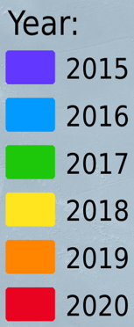
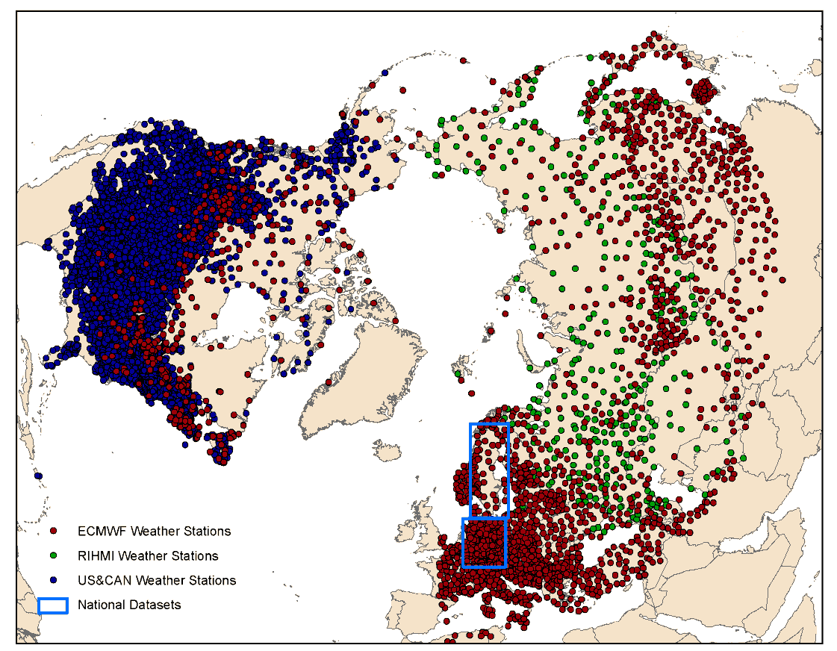
ESA SnowPEx+ Validation datasets
In situ stations
Reference data
Landsat and Sentinel-2
In situ snow depth measurements

Slide 12
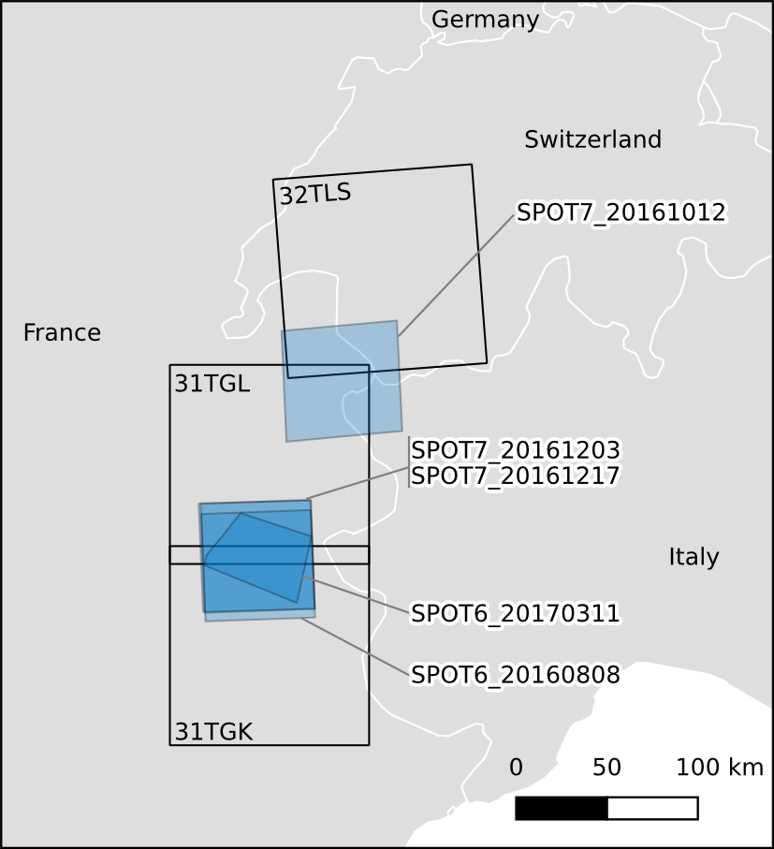
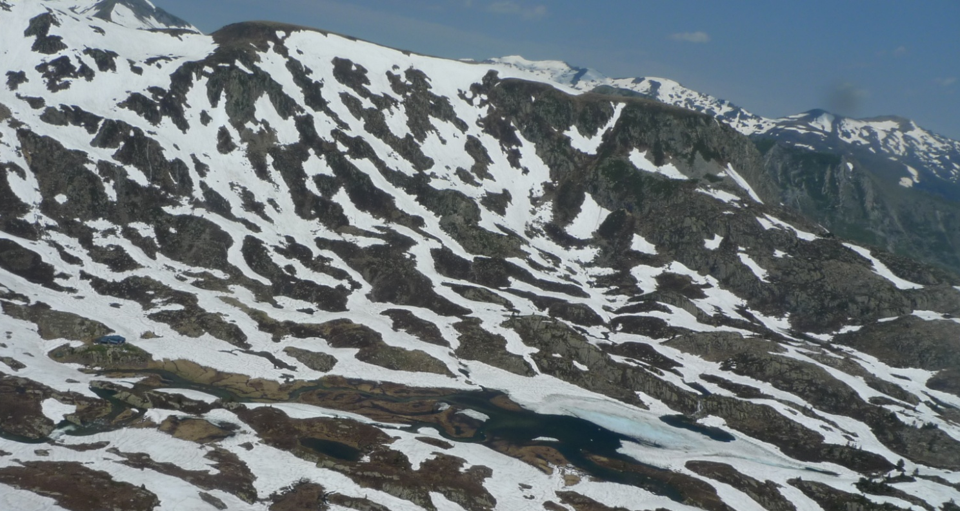
High Resolution Snow & Ice monitoring
Ongoing effort to characterize accuracy of Sentinel-2 snow cover fraction products
In situ snow depth measurements
Crowd-sourced data
Terrestrial cameras & lidar
VHR snow maps from Pléiades & SPOT 6-7
Validation data in forest are rare!

Slide 13
High Resolution Snow & Ice monitoring
Ongoing effort to characterize accuracy of Sentinel-2 snow products

Slide 14
NASA SnowEx
Groundwork for mapping global SWE from space
Preparing for future snow satellite mission opportunities
Several intensive field campaigns starting in 2017 (in situ, drone, airborne)
Many datasets publicly available at nsidc.org
https://snow.nasa.gov/campaigns/snowex

Slide 15
USGS snow activities
USGS is establishing a pilot Next Generation Water Observing System for several hydrological basins in the continental United States with emphasis on snow to flow
Current operational Landsat Collection 1 fractional snow covered area product from 1982-present for western United and Alaska
Forthcoming operational Landsat Collection 2 fractional snow covered area product from 1982-present for CONUS and Alaska

Slide 16
Conclusion
MODIS snow cover area only product at stage 2 validation (MOD10)
Further validation is ongoing (ESA SnowPex+)
Exciting developments in snow remote sensing
New HR products driven by user needs (USA: Landsat, EU: Sentinel-2)
New mission concepts and measurements (Nasa SnowEx)
Lack of distributed validation data across climate and land cover classes

