Slide 1
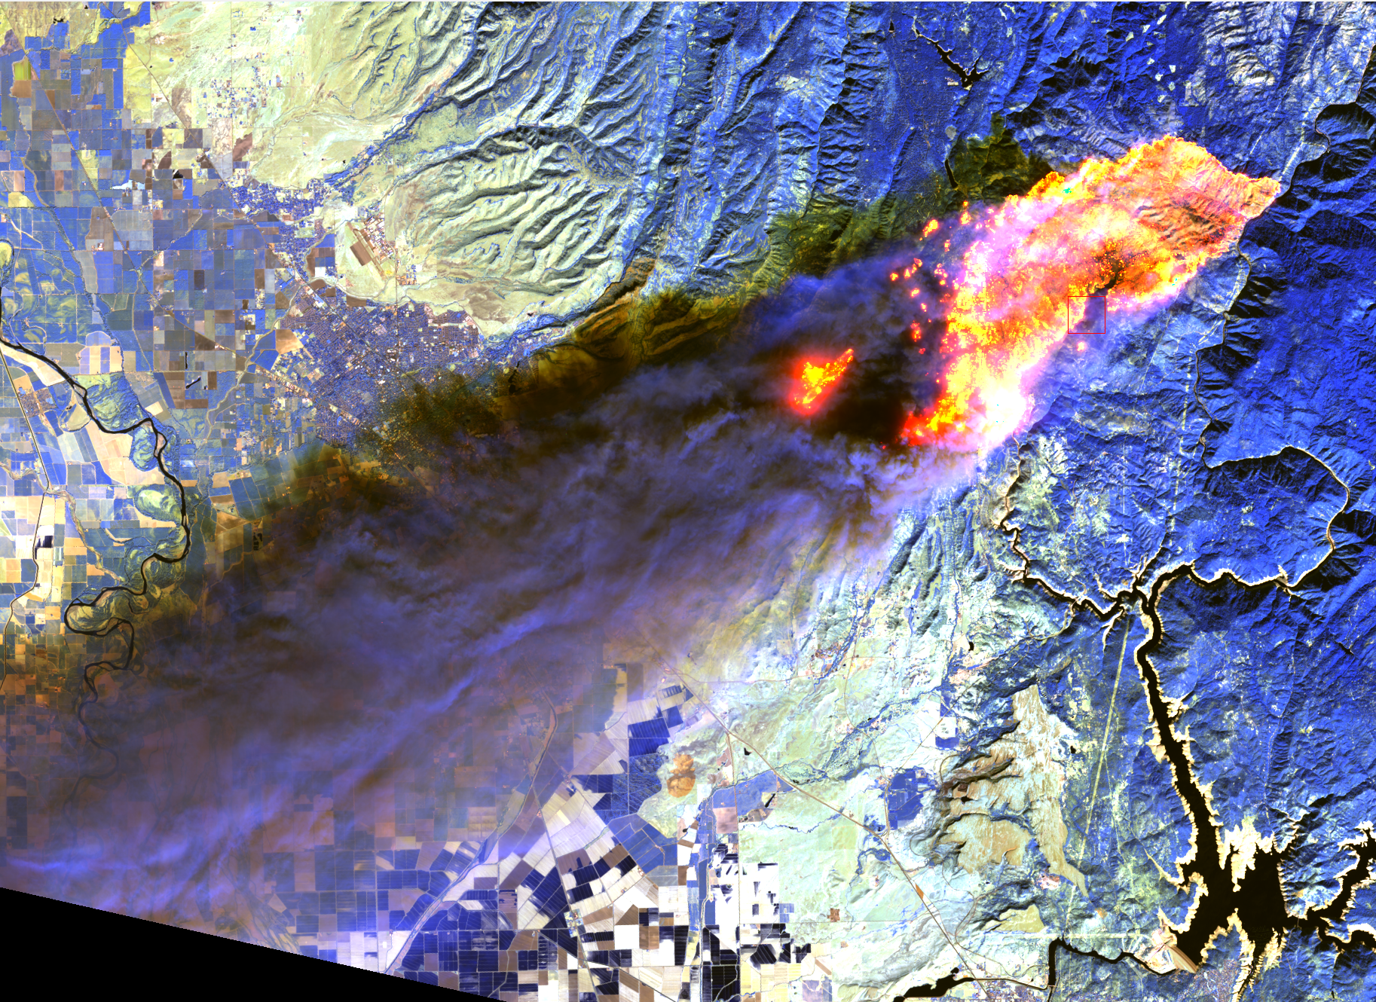
CEOS LPV : Fire Disturbance
Gareth Roberts (UoS)
Louis Giglio (UMD)
26th – 27th May (2021)

Slide 2
CEOS LPV Plenary (May 2021) : Fire Disturbance
Outline
Fire validation background
Recent
Active Fire activities
FRP activities
Burned area activities
Focus Area Updates

Slide 3
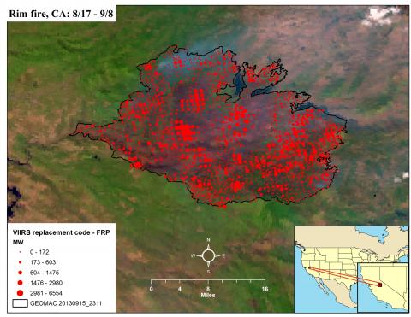
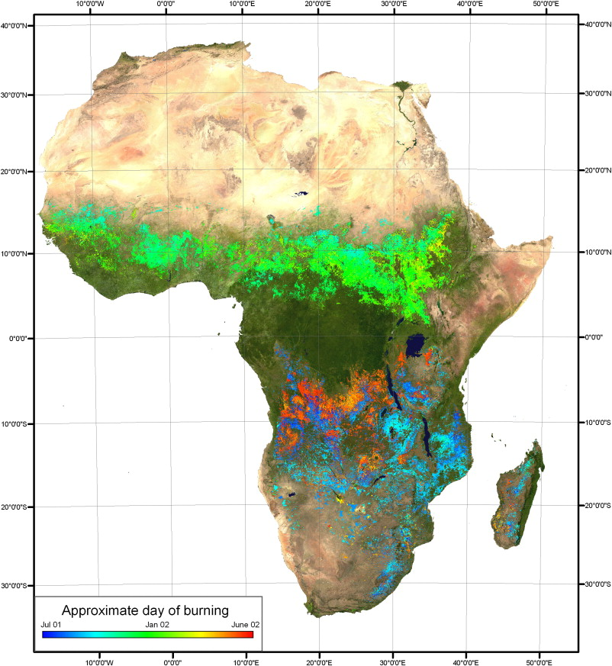
CEOS LPV Plenary (May 2021) : Fire Disturbance
Active Fire
Capture fire presence/characteristics at time of satellite overpass
Detection
Fire radiative power (FRP)
Burned Area
Retrospective mapping of cumulative fire extent
Typically include date of burn
https://viirsfire.geog.umd.edu/viirs-af-products
Roy, D.P., Boschetti, L., Justice, C.O. and Ju, J., 2008. The collection 5 MODIS burned area product—Global evaluation by comparison with the MODIS active fire product. Remote sensing of Environment, 112(9), pp.3690-3707.

Slide 4
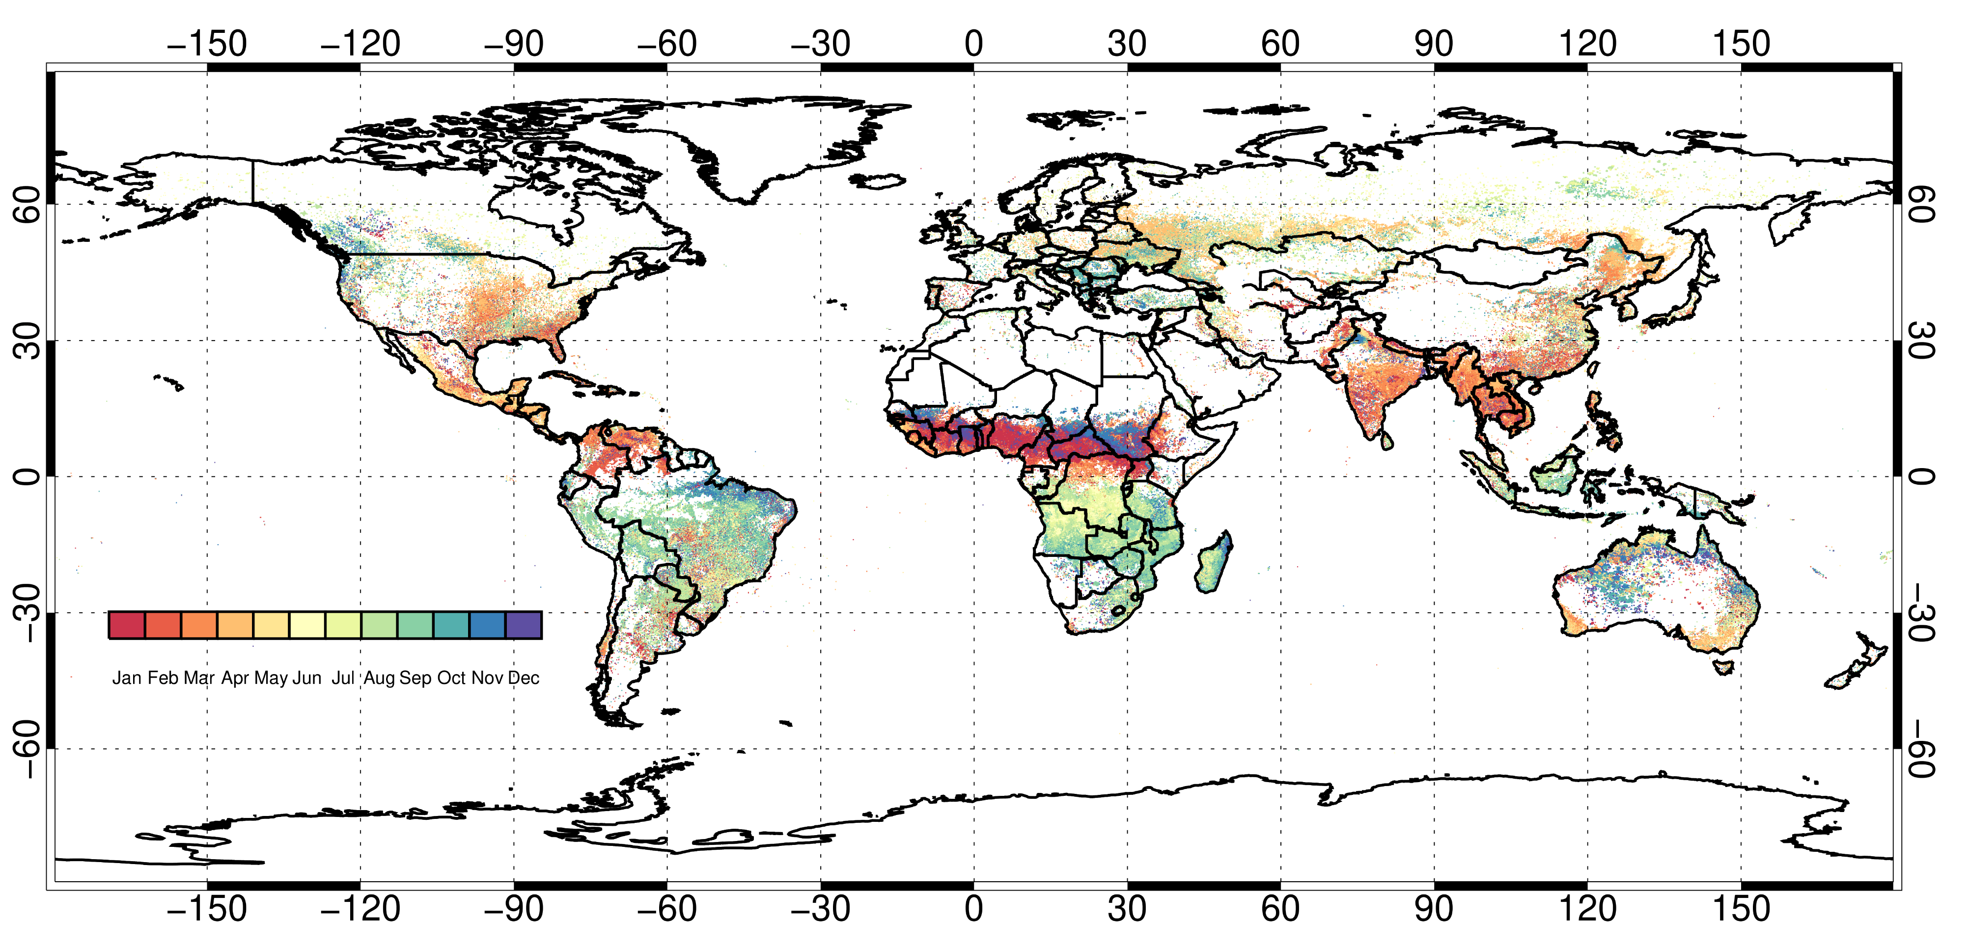
Fire Disturbance : Validation Background
Validation of burned area and active fire\FRP is challenging
fire activity has strong diurnal & seasonal variability
Validation typically involves intercomparison between satellite products
Higher/lower spatial resolution assessment
omission/commission errors
FRP difficult fire parameter to validate
requires temporally coincident data
limited number of validation studies using surface/airborne measurements
logistically challenging
Roberts et al., (2018;2021)

Slide 5
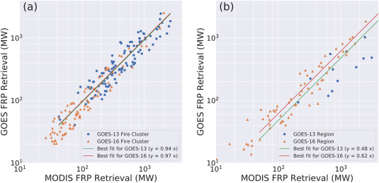
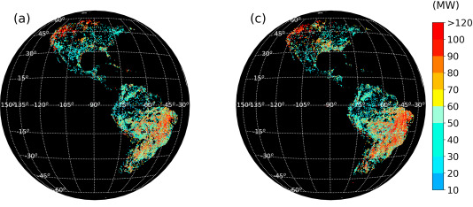
Active Fire developments
Polar-Orbit sensors
Sentinel-3 Active Fire and FRP product released (2020)
FRP retrievals from S3-A and S3-B (10:00 and 22:00 )
Night-time only detections at present (daytime alg. planned 2021)
1-km product
continues Terra MODIS heritage
Geostationary sensors
Near global geostationary active fire detections using Fire Thermal Anomaly (FTA) algorithm
GOES-16 ABI, MSG SEVIRI, GOES-13 and Himawari-8 AHI active fire products
Global ‘merged’ geostationary product under development at UMD
SLSTR active fire detections (Wooster et al., 2021)
Xu, W., Wooster, M.J., He, J. and Zhang, T., 2021. Improvements in high-temporal resolution active fire detection and FRP retrieval over the Americas using GOES-16 ABI with the geostationary Fire Thermal Anomaly (FTA) algorithm. Science of Remote Sensing, 3, p.100016.

Slide 6
Burned Area developments
Burned area product : Copernicus Climate Change Initiative (CCI)
Sentinel-3 OLCI burned area (released November 2020)
300m and 0.25° datasets
Daily temporal resolution
2017 to present

Slide 7
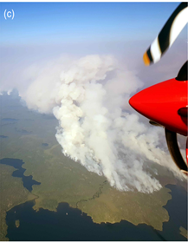
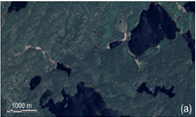
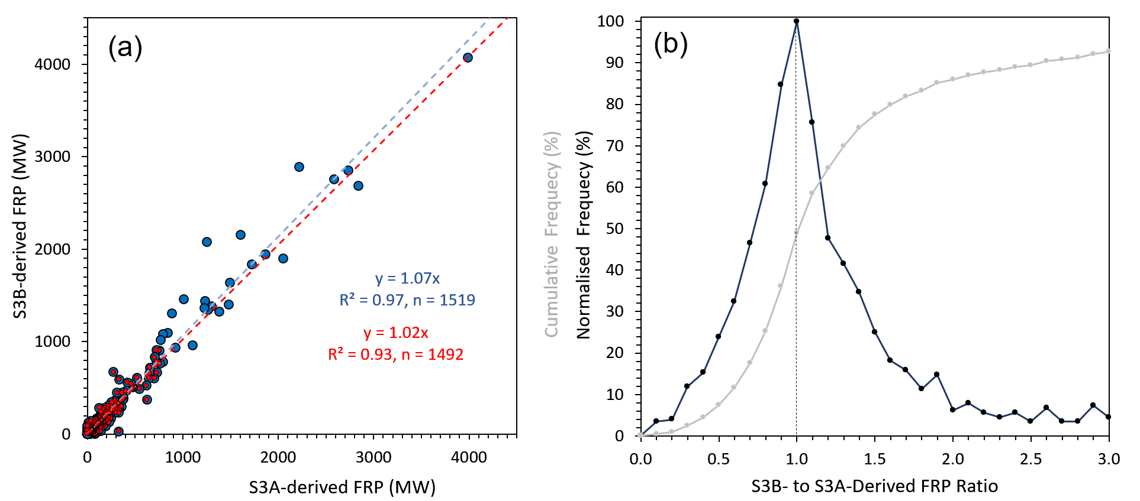
FRP validation activities : Canada
SLSTR Active fire and FRP product
currently night-time only (daytime algorithm in 2021)
Airborne validation campaign in Canada (ESA\Kings College London\CFS)
Boreal forest fires
Intercomparison of SLSTR A and B (tandem mission)
Near simultaneous observations
Good agreement between FRP retrievals from both sensors
variation due to the fires subpixel position
Airborne campaign Canada
Work from Wooster et al., (submitted)
SLSTR A and B FRP comparison

Slide 8
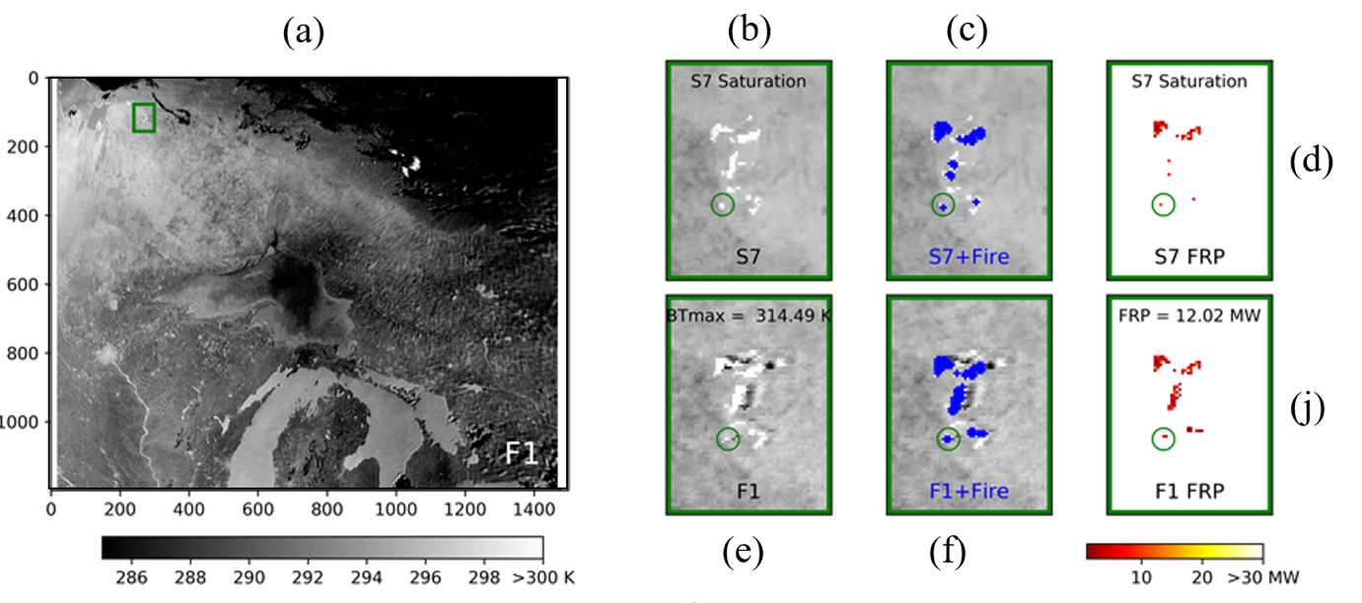
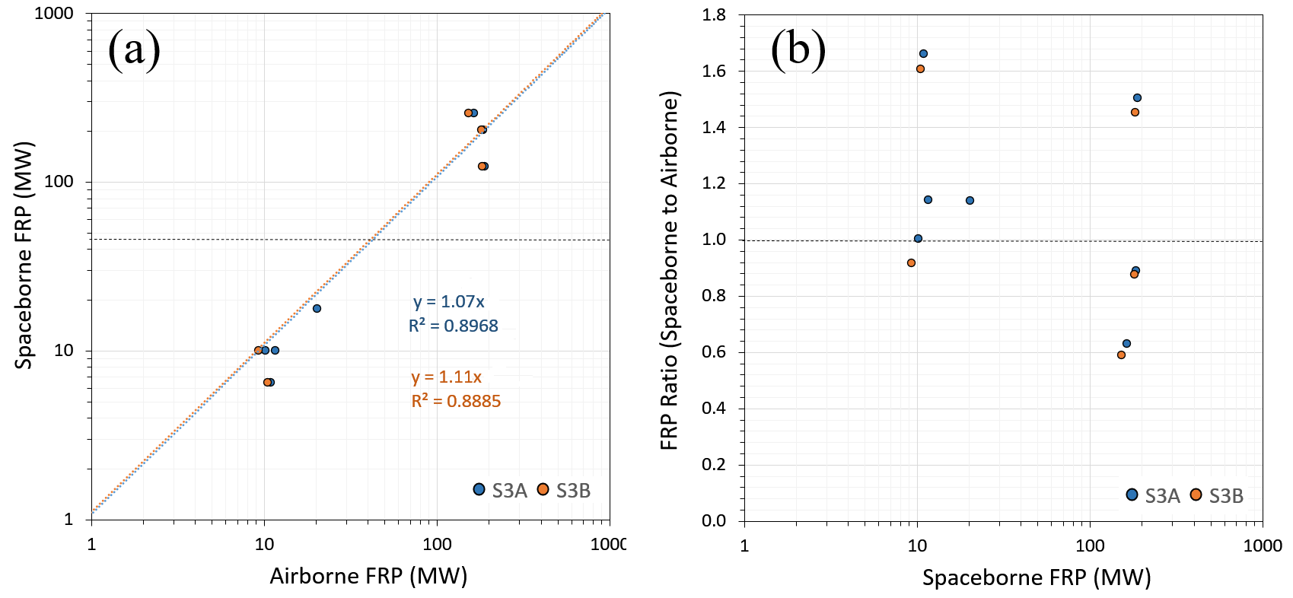
FRP validation activities : Canada
Airborne validation campaign in Canada (ESA\Kings College London\CFS)
Boreal forest fires
MWIR camera mounted on aircraft flying during S3 overpass
validate SLSTR FRP retrievals
Good agreement between airborne and spaceborne FRP retrievals
SLSTR Active fire and FRP product over North America
Work from Wooster et al., (submitted)
SLSTR and Airborne FRP comparison

Slide 9
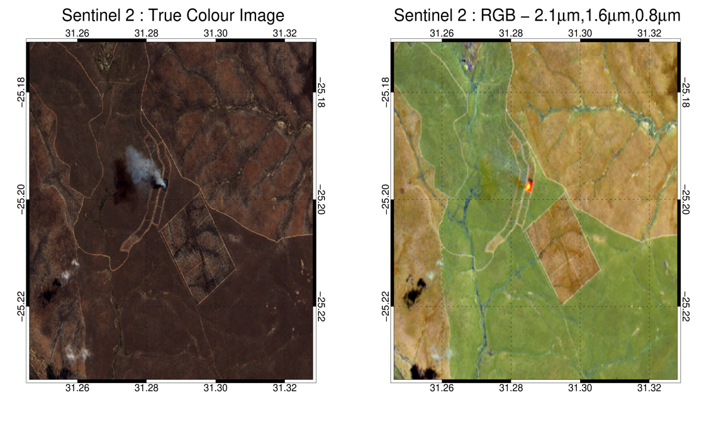
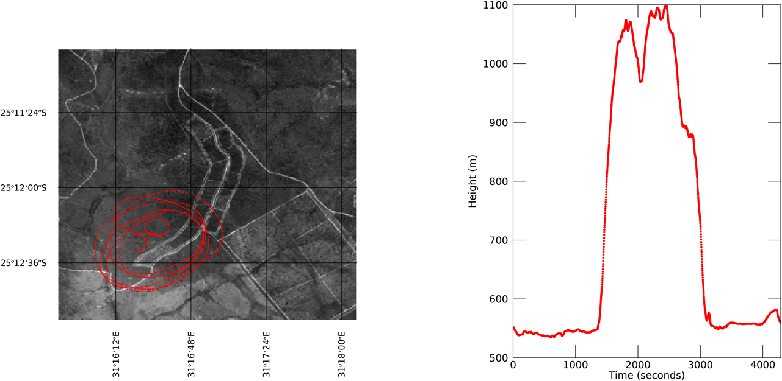
FRP validation activities : Kruger National Park
KNP long running fire experiment over small savanna plots
380 x 200 m
Prescribed fires provide opportunity to validate FRP
acquire temporally coincident data
often not representative of ‘real’ fires
Helicopter MWIR\LWIR camera observations during satellite overpass
Sentinel-3 SLSTR
SEVIRI (geostationary)
Sentinel-2 imagery during a prescribed burn (2018)
Helicopter track during a prescribed burn

Slide 10
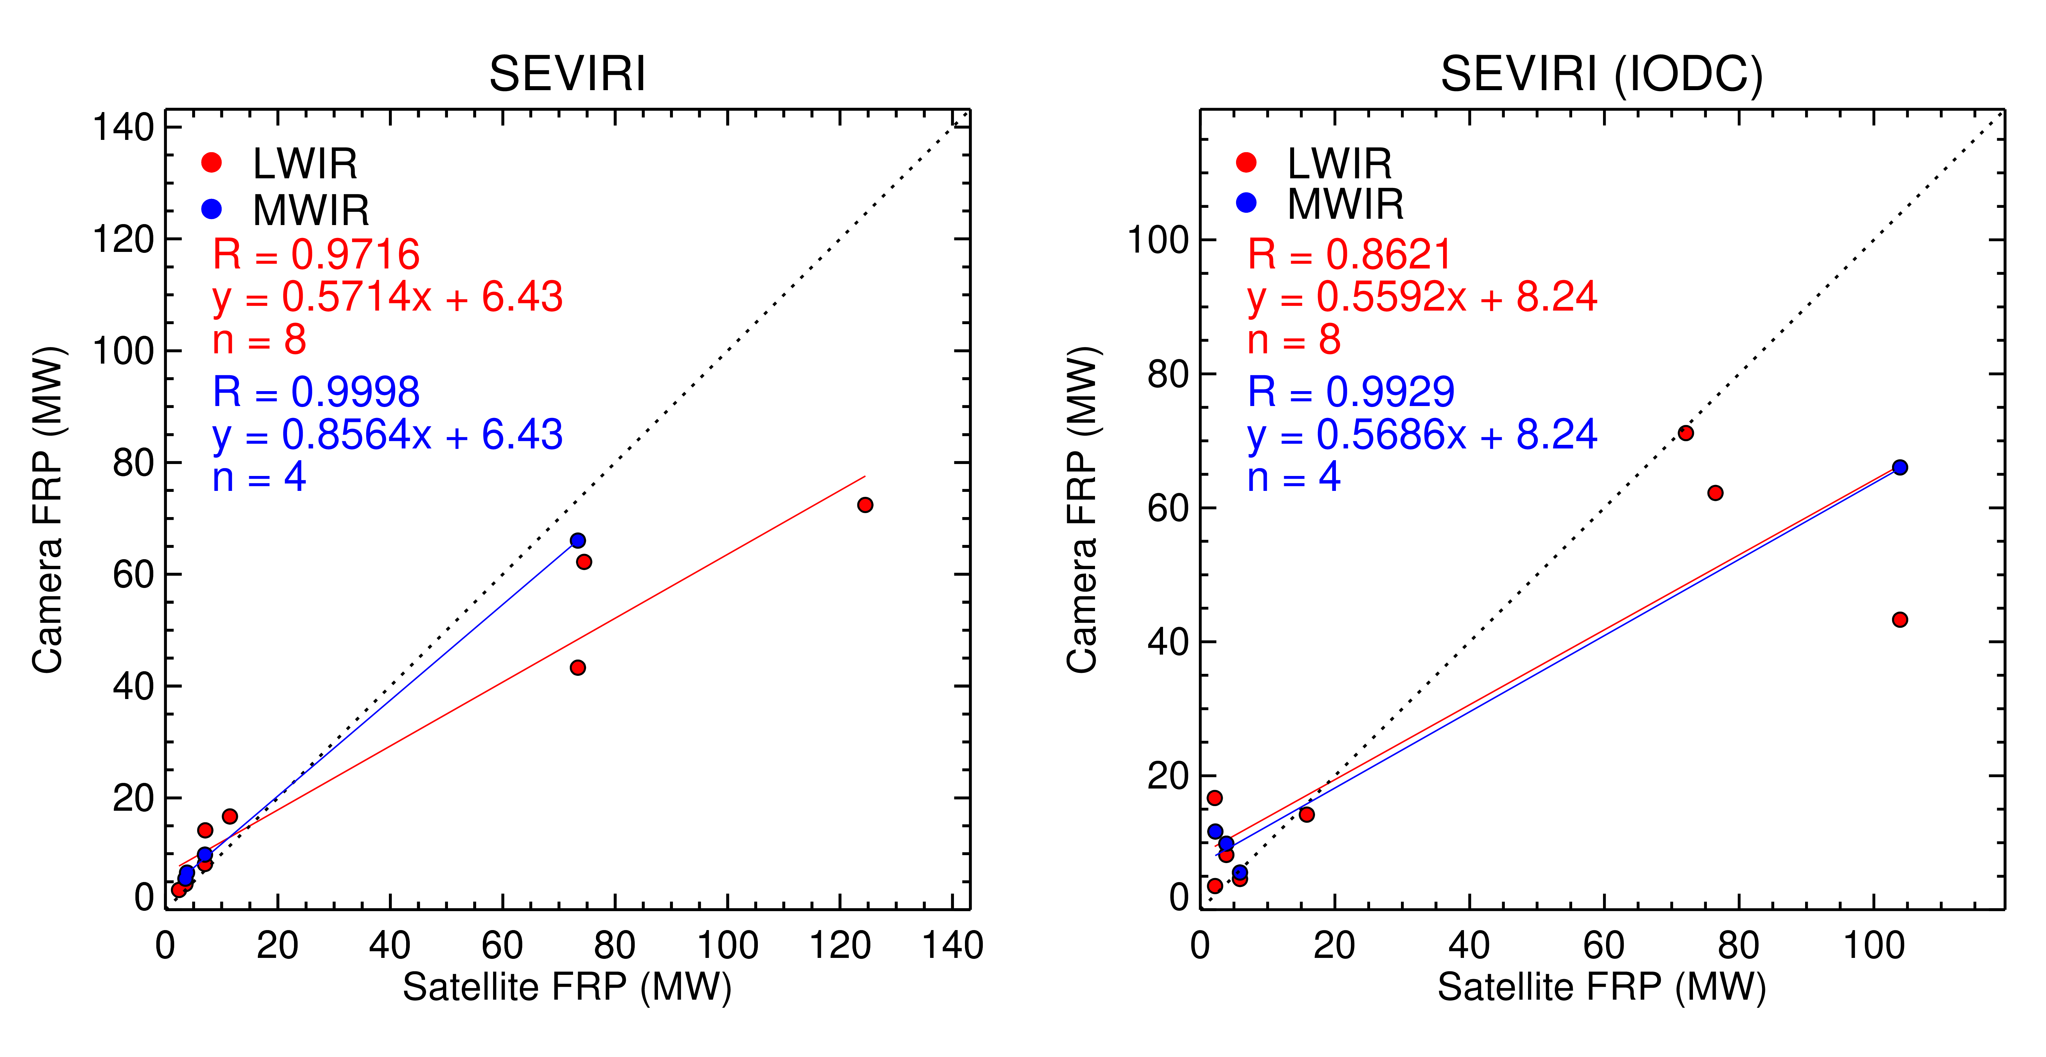
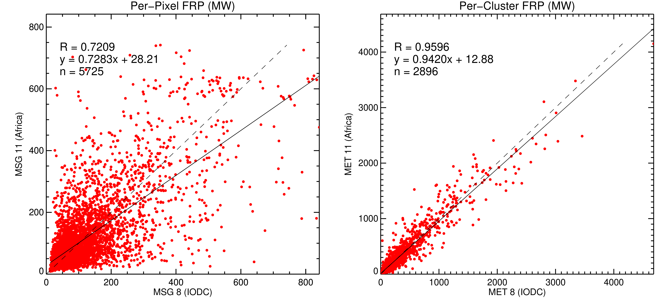
FRP validation activities : Kruger National Park
Good agreement between camera and SLSTR FRP retrievals
SEVIRI overestimates FRP at low magnitudes
also evident in intercomparison activities
Validation impacted by (e.g.) location of fire in pixel, canopy cover, viewing geometry etc
LWIR/MWIR camera and SEVIRI FRP retrievals
Sensor | View Zenith | FRP (MW) | MWIR camera FRP (MW) | LWIR Camera FRP (MW)
SLSTR | 6° | 9.7 | 9.8 | 8.1
SLSTR | 9.6° | 9.5 | 11.6
SEVIRI (MSG4) and SEVIRI (MSG1) per-pixel and fire cluster comparison

Slide 11
Burned Area Reference Datasets
Burned area reference datasets :
Database developed using Landsat and Sentinal-2 imagery
2769 reference burned area files
Globally distributed
Burned areas have been visually assessed
Franquesa, M., Vanderhoof, M.K., Libonati, R., Rodrigues, J.A., Setzer, A.W., Stavrakoudis, D., Gitas, I.Z., Roteta, E., Padilla, M. and Chuvieco, E., 2020. Development of a standard database of reference sites for validating global burned area products. Earth System Science Data Discussions, pp.1-20.
Landsat Level-3 burned area product (over CONUS only)
Analysis ready
1984 – present
Burn Probability and burn classification

Slide 12
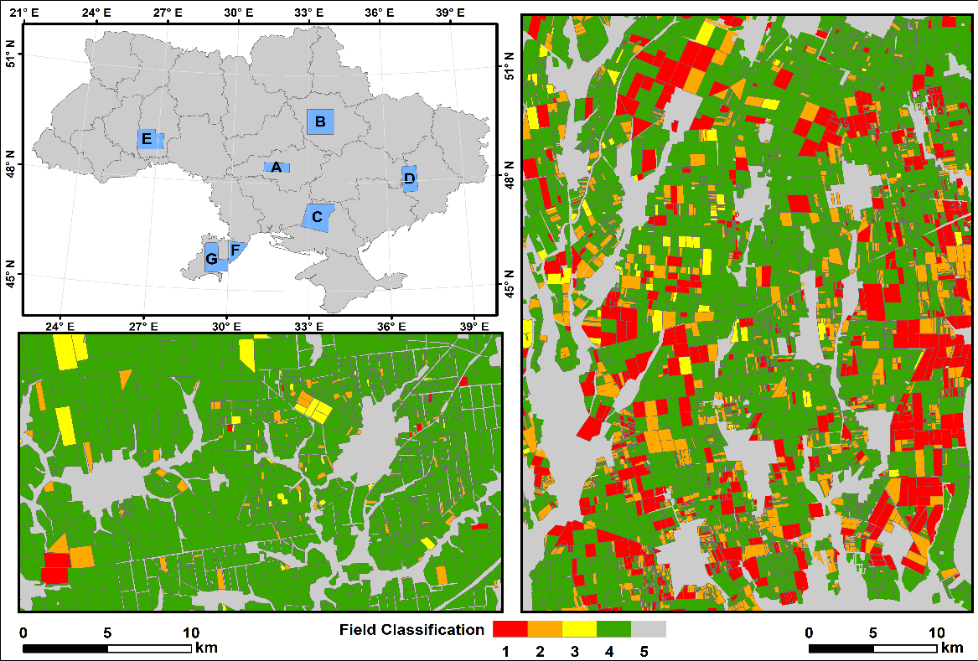
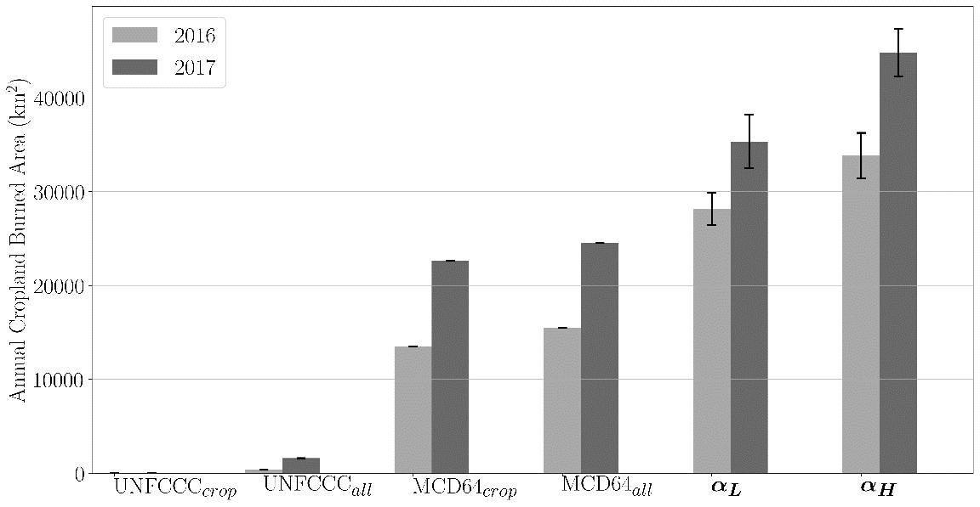
Burned area validation activities: Ukraine Cropland
Cropland residue burning banned in Ukraine yet practice is widespread
Exhaustively mapped burned cropland (wheat + maize) at 7 sites (~43,000 fields) in 2016 and 2017 using Landsat-8 + Sentinel-2 + 3-m Planet imagery and local expert
Extrapolated results using 375-m VIIRS fire data to produce country-wide estimates
Summer - G
Spring - A
Annual Cropland Burned Area (km²)
definitely burned definitely unburned
definitely burned non-cropland/field too small
possibly burned
UNFCCC
MCD64A1
THIS STUDY
Hall, J. V., et al., 2021. Environmental and political implications of underestimated cropland burning in Ukraine. Environmental Research Letters.

Slide 13
Fire Disturbance Focus Area Updates
Focus area website
validation stage updates based on validation activities
burned area and active fire @ stage 3; FRP @ stage 1
Giglio, L., Schroeder, W. and Justice, C.O., 2016. The collection 6 MODIS active fire detection algorithm and fire products. Remote Sensing of Environment, 178, pp.31-41.
Boschetti, L., Roy, D.P., Giglio, L., Huang, H., Zubkova, M. and Humber, M.L., 2019. Global validation of the collection 6 MODIS burned area product. Remote sensing of environment, 235, p.111490.
New reference datasets included and obsolete datasets removed
Burned area/active fire products up to date
List-serv user list needs updating

Slide 14
Fire Disturbance Focus Area Updates
Validation protocol documents have been delayed
Start process at next GOFC Fire IT meeting (provisionally this fall)
Fire IT community well placed to engage in protocol development
Active Fire
Need formal protocol
Detection
Existing opportunistic approaches using Landsat, etc., are extremely biased with respect to time-of-day
FRP
Burned Area
CCI “long” validation units
Cropland fire caveats + protocol
Rigorous validation in this biome is extremely costly
Course resolution burned area products

