Slide 1
MODIS/VIIRS Surface Reflectance Validation
Eric Vermote¹ et al.
¹NASA/GSFC Code 619, Greenbelt, MD 20771, USA

Slide 2

A Land Climate Data Record
Multi instrument/Multi sensor Science Quality Data Records used to quantify trends and changes
81
82
83
84
85
86
87
88
89
90
91
92
93
94
95
96
97
98
99
00
01
02
03
04
05
06
07
08
09
10
11 12 13 14 15 16 17
N16
N17
AVHRR
N07
N09
N11
N09
N14
METOP
N16
SPOT VEGETATION
Terra
MODIS
Aqua
AVHRR (GAC) 1982-1999 + 2003-2006
MODIS (MO(Y)D09 CMG) 2000-present
VIIRS 2011 – 2025
SPOT VEGETATION 1999-2000
Sentinel 3 2016
NPP
VIIRS
JPSS 1
Sentinel 3
  Emphasis on data consistency – characterization rather than degrading/smoothing the data

Slide 3
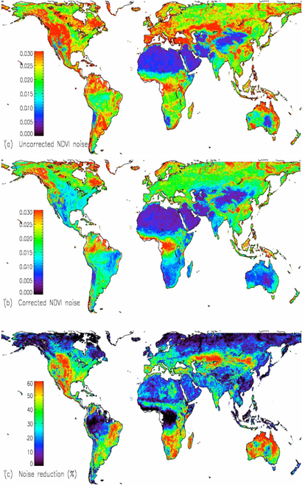
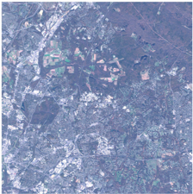
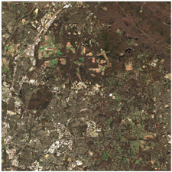
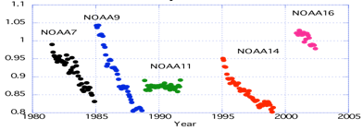
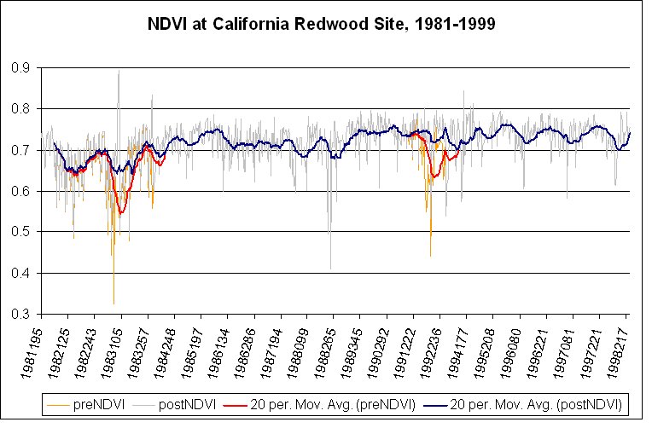
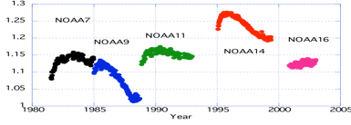
Land Climate Data Record (Approach)
Needs to address geolocation, calibration, atmospheric/BRDF correction issues
GEOLOCATION
ATMOSPHERIC CORRECTION
BRDF CORRECTION
CALIBRATION
Degradation in channel 1
(from Ocean observations)
El Chichon
Pinatubo
Channel1/Channel2 ratio
(from Clouds observations)

Slide 4
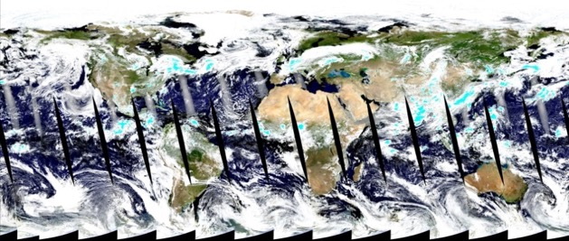
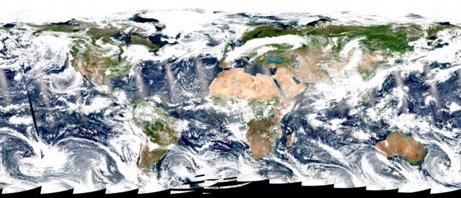
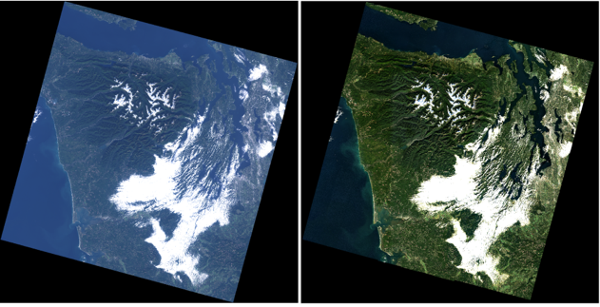
Atmospheric correction (AC)
Estimate of the surface spectral reflectance, as would have been measured at ground level if there were no atmospheric scattering or absorption
Generic approach for AC for multiple sensors
AC products for EO sensors:
  MODIS (Terra, Aqua)
    Products: MOD09, MYD09
  VIIRS (S-NPP,JPSS1)
    Products: VNP09
  OLI (Landsat-8) and MSI (Sentinel-2)
    LaSRC algorithm/product
    Harmonization Landsat / Sentinel 2 (HLS) project
    USGS’ on demand SR product for OLI
A true color composite of MODIS/Aqua (top) and VIIRS/S-NPP (bottom) images acquired on July, 1, 2017
A true color composite of Landsat-8 image without AC (left) and with AC (right). Image is acquired on October, 14, 2013

Slide 5
Landsat8/OLI and Sentinel 2/MSI Surface Reflectance is largely based on MODIS C6 (LaSRC)
Algorithm reference for L8: Vermote E., Justice C., Claverie M., Franch B., (2016) “Preliminary analysis of the performance of the Landsat 8/OLI land surface reflectance product", Remote Sensing of Environment, 185,46-56.
The MODIS Collection 6 AC algorithm relies on
the use of very accurate (better than 1%) vector radiative transfer modeling of the coupled atmosphere-surface system (6S)
the inversion of key atmospheric parameters
  Aerosols are retrieved from Landsat8/Sentinel 2 images
  Water vapor and ozone from daily MODIS product.
Home page: http://modis-sr.ltdri.org

Slide 6
Methodology for evaluating the performance of Landsat8/Sentinel2 LaSRC product
Subsets of Level 1B data processed using the standard surface reflectance algorithm
comparison
Reference data set
Atmospherically corrected TOA reflectances derived from Level 1B subsets
AERONET measurements
(τ_{aer}, H₂O, particle size distribution
refractive indices, sphericity)
Vector 6S

Slide 7
quantitative assessment of performances (APU) for MODIS
Specification:
Based on error budget for collection 4
E. Vermote and S. Y. Kotchenova, MODIS Directional surface reflectance product: Method, error estimates and validation. 2011. Land Remote Sensing and Global Environmental Change: NASA’s Earth Observing System and the Science of ASTER and MODIS. Series: Remote Sensing and Digital Image Processing, Vol. 11, Springer Verlag. 873p. ISBN: 978-1-4419-6748-0

Slide 8
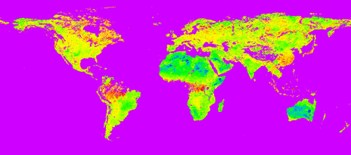

Improving the aerosol retrieval in collection 6 reflected in APU metrics
ratio band3/band1 derived using MODIS top of the atmosphere corrected with MISR aerosol optical depth

Slide 9
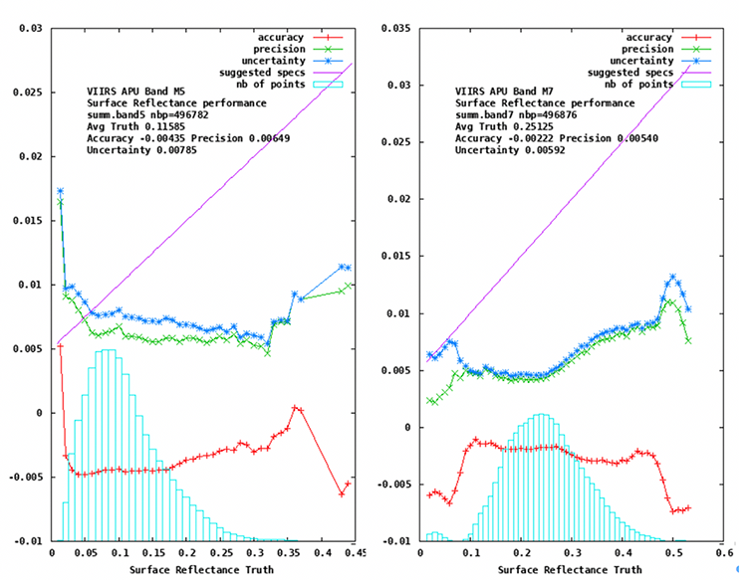
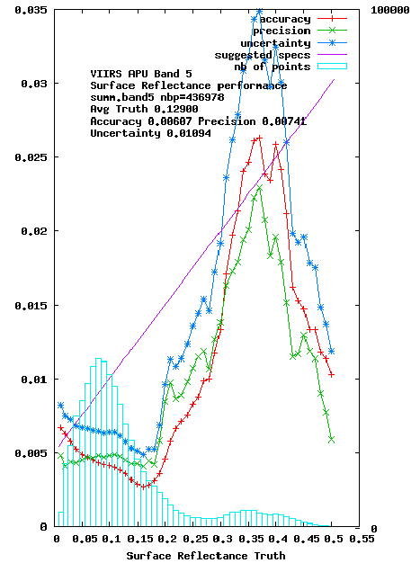
VIIRS Validation follow the same methodology
Current performances M5 (red) M7 (NIR)
Original NASA C1.1
Processing (M5)

Slide 10
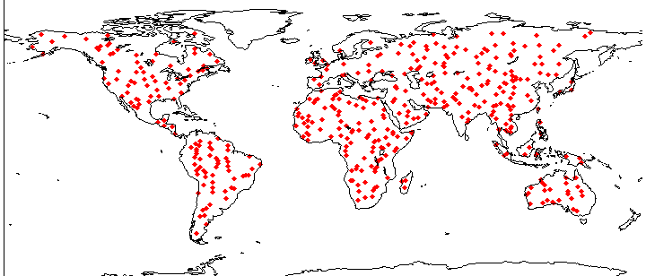
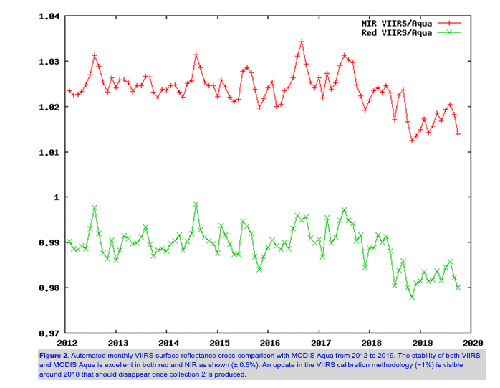
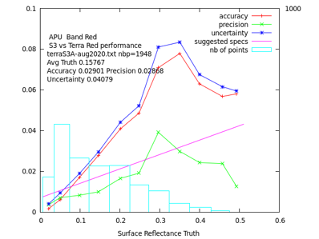
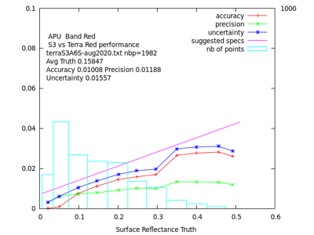
BDRF Normalization enables large scale cross comparison

Slide 11
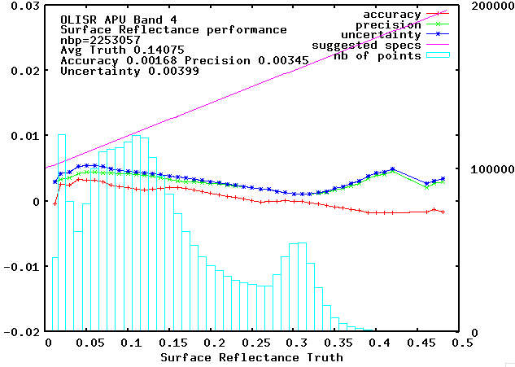
Evaluation of the performance of Landsat8
The “preliminary” analysis of OLI SR performance in the red band over AERONET is very similar to MODIS Collection 6

Slide 12
Atmospheric Correction Inter-comparison eXercise
ACIX is an international collaborative initiative to inter-compare a set of atmospheric correction (AC) processors for high-spatial resolution optical sensors. The exercise will focus on Landsat-8 and Sentinel-2 imagery over a set of test areas. The inter-comparison of the derived Bottom-of-Atmosphere (BOA) products is expected to contribute to the understanding of the different uncertainty contributors and help in improving the AC processors
ACIX-II
Georgia Doxani | Serco for ESA/ESRIN, Georgia.Doxani@esa.int
Ferran Gascon | ESA/ESRIN, Ferran.Gascon@esa.int
Jean-Claude Roger | University of Maryland/NASA jean-claude.roger@nasa.gov
Eric Vermote | NASA, eric.f.vermote@nasa.gov

Slide 13

ACIX-I
12
19
20
200
Developer Teams
from various Space Agencies, R&D Companies,
Research Institutes
and Universities
Study Sites
spread worldwide based on the AERONET stations
Image Scenes
processed acquired by Sentinel-2 and Landsat-8
Months
to complete the exercise and publish the results in a scientific journal

Slide 14
ACIX-II -Land
13
126
7
6500
Developer Teams
from various Space Agencies, R&D Companies,
Research Institutes
and Universities
Study Sites
spread globally based on the AERONET stations (location & measurements availability)
Image Scenes
to be processed acquired by Sentinel-2A, -2B and Landsat-8
Months
for participants/ coordinators to submit/analyse results

Slide 15
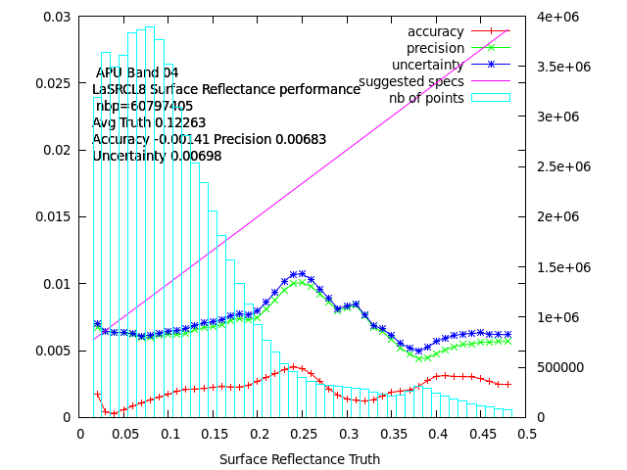
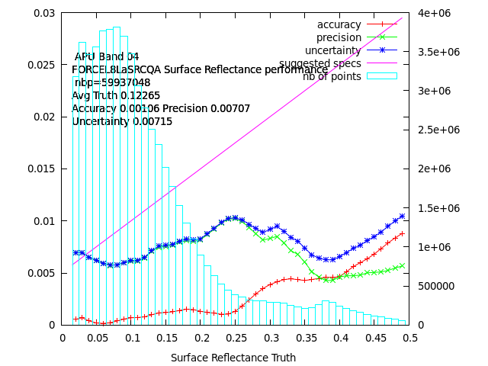
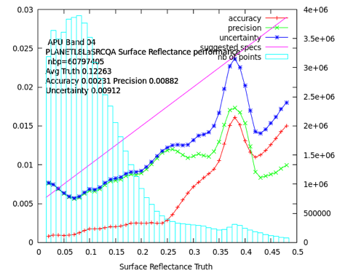
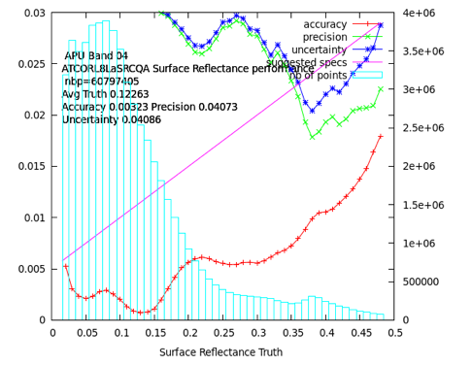
Some APU results in the Red (670nm) Filtered with LaSRC (3.5.5) QA

Slide 16
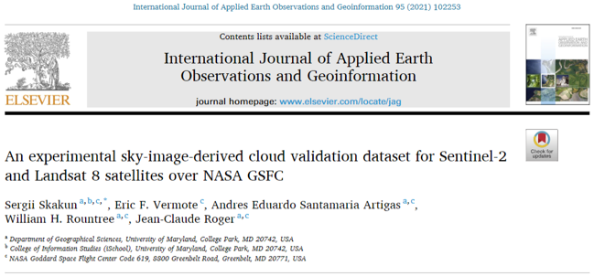
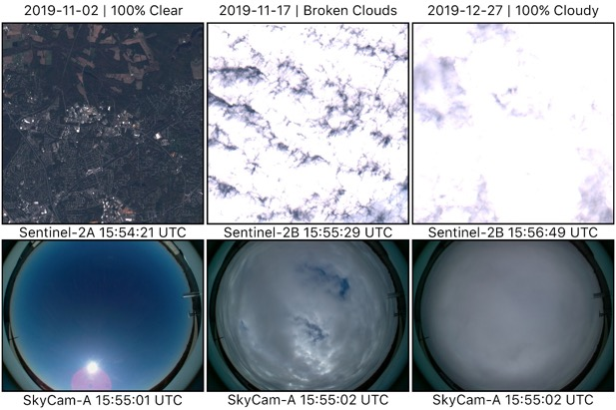
Cloud validation: SkyCam
Ground-based skycam
  For objective validation of satellite-derived cloud masks
  Proof of concept: manual iphone with fisheye lens over NASA GSFC
  Current version: automatic, enabling replication over multiple sites
  Part of validation dataset within CEOS CMIX-1 (Cloud Masking Inter-comparison Exercise)

Slide 17
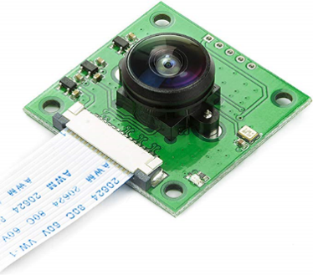
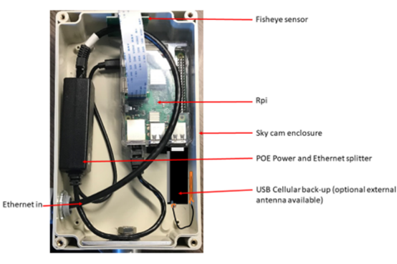
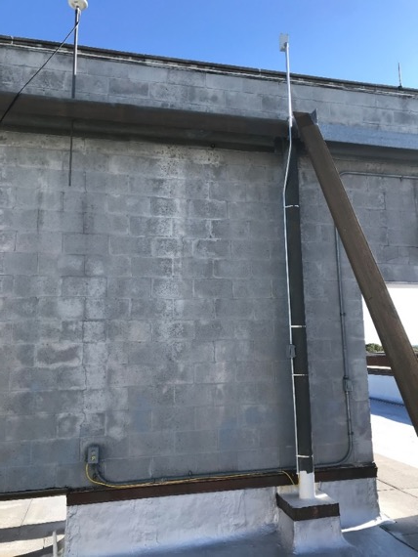
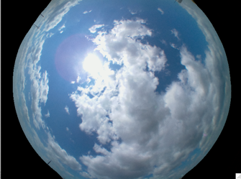
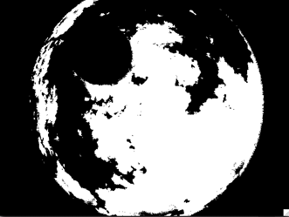
SkyCam system @ NASA/GSFC

Slide 18
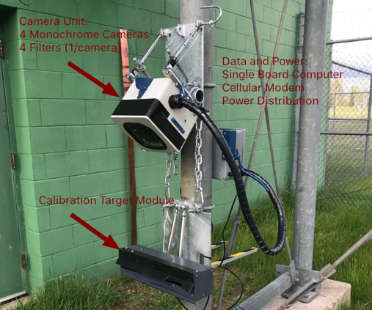
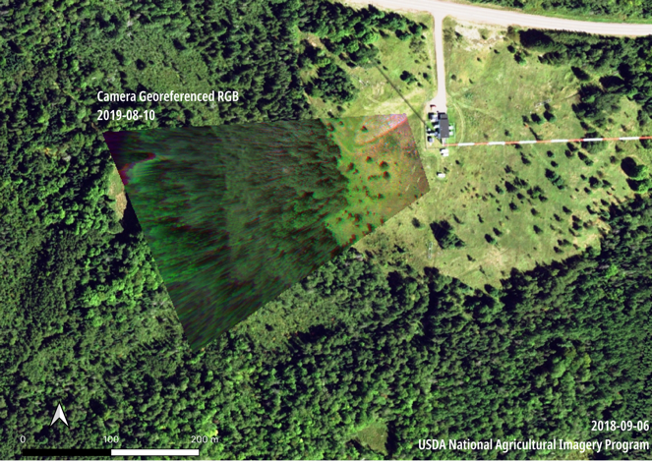
Ground Validation is on going
CAMSIS system
CAMSIS is installed at a height of 123m
on a TV tower (WLEF) near Park Falls, WI at the Chequamegon National Forest

Slide 19
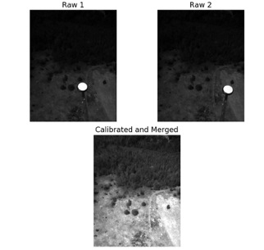
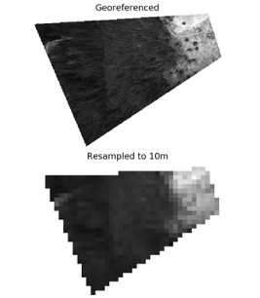
Ground Validation is on going

Slide 20
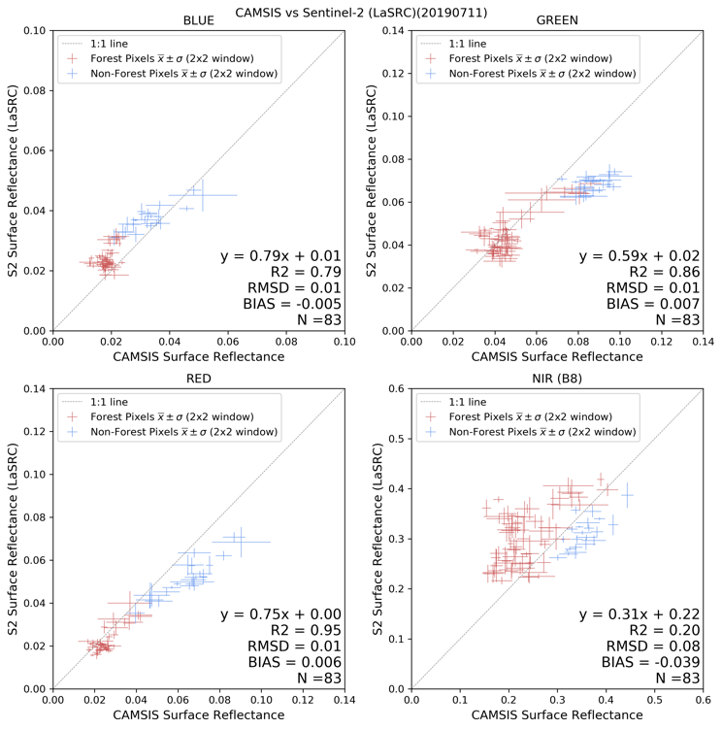
Ground Validation is on going

Slide 21
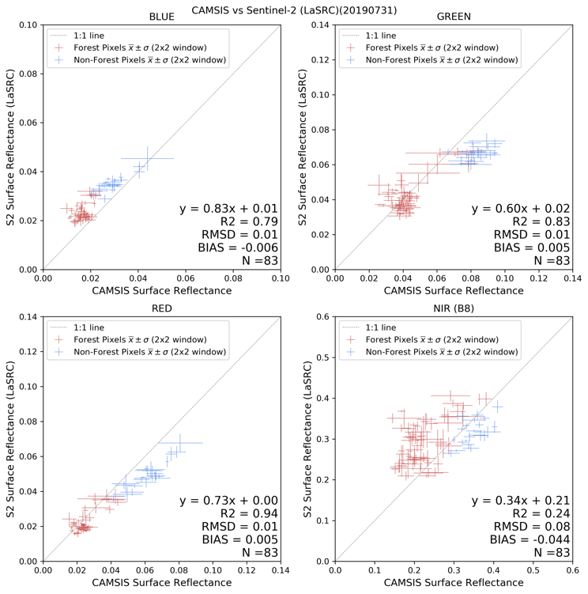
Ground Validation is on going

Slide 22
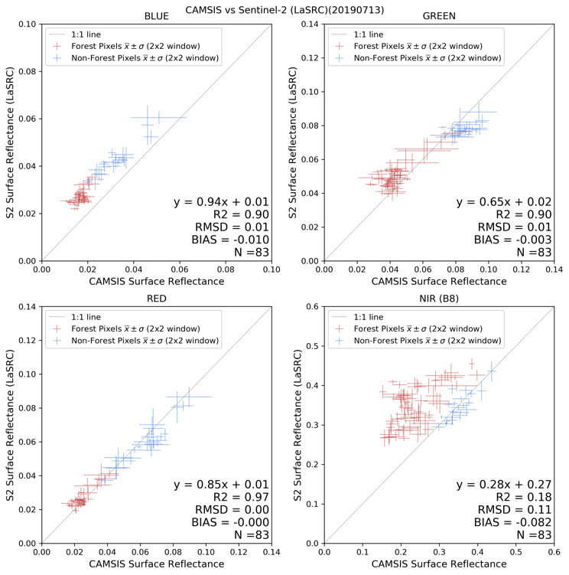
Ground Validation is on going

Slide 23
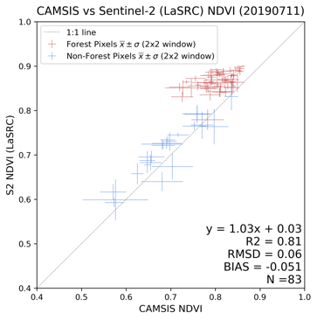
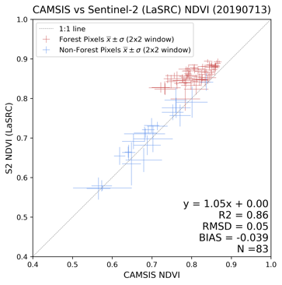
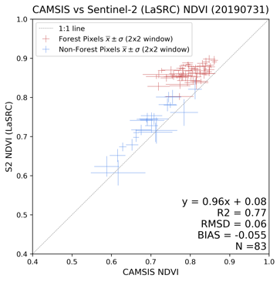
Ground Validation is on going

Slide 24
Thank You!

