Slide 1
Overview of NEON’s Airborne Observation Platform CEOS WGCV Land Product Validation Plenary
Tristan Goulden​
Science Lead​
Airborne Observation Platform (AOP)
Ian Crocker, Bridget Hass, Keith Krause, John Musinsky, Katherine Murphy, Alok Shrestha
​
National Ecological Observatory Network
A project sponsored by the National Science Foundation and proudly operated by Battelle

Slide 2
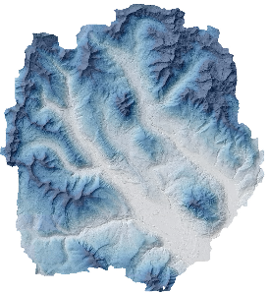
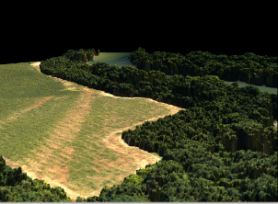
Airborne Observation Platform (AOP)
Collects airborne remote sensing data
Covers ‘regional scale’ (min of 100 km²)
Data products generated at high spatial resolution (<=1 m²)
Waveform Lidar, Imaging Spectrometer and RGB camera

Slide 3
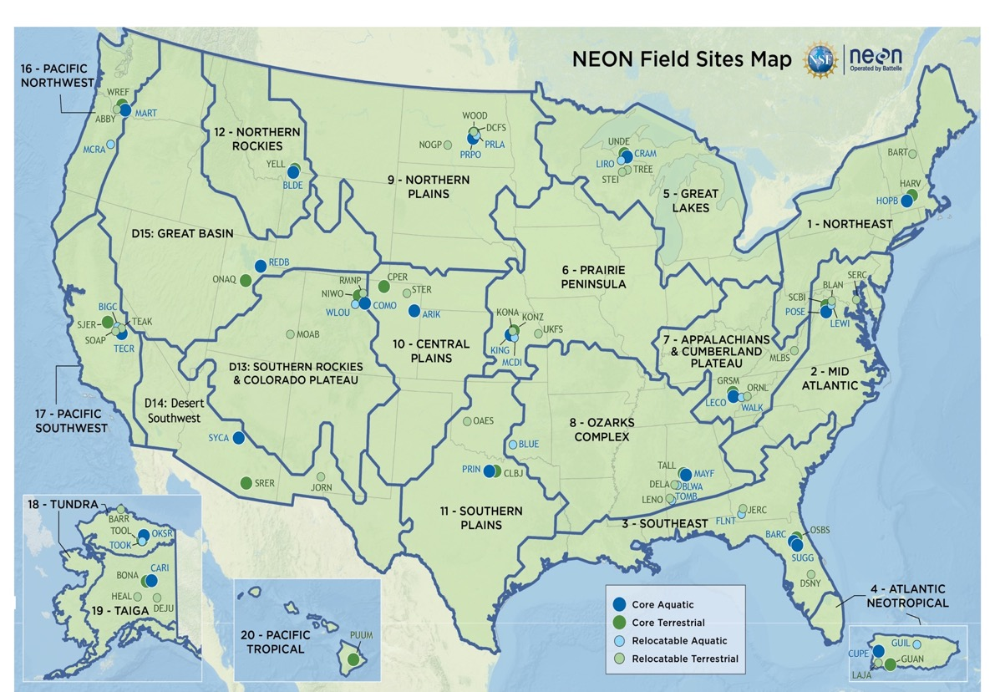

Slide 4
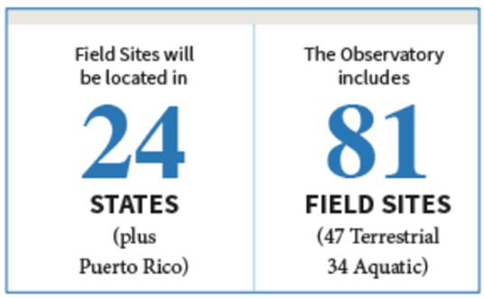
Notes:
NEON will provide data to inform these grand challenges by providing data collected by instruments located on our airborne platform, tower, in the soil and aquatic systems, and observations made both on land and in the water.

Slide 5
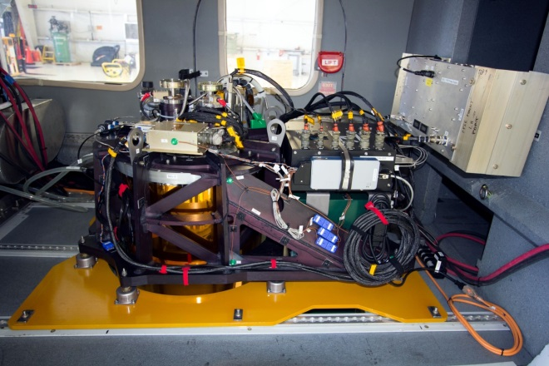
AOP Payloads – three in total
NEON Imaging Spectrometer (NIS)
Lidar / Camera

Slide 6
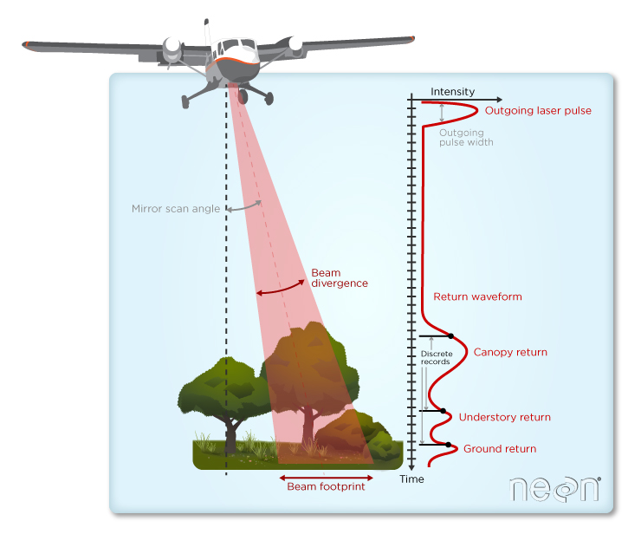
Waveform LiDAR Sensor
Active-source instrument
1064 nm
Transmits laser pulses at up to 1000 kHz
Capable of recording multiple discrete returns per pulse
Provides structural information about the landscape

Slide 7
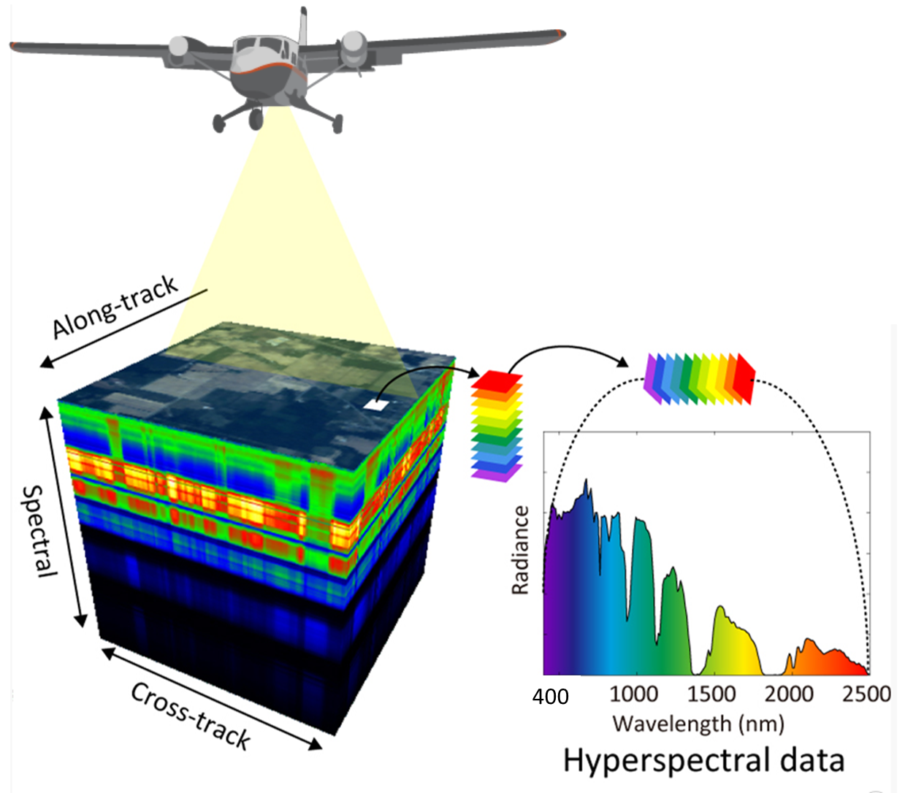
NEON Imaging Spectrometer (NIS)
Images acquired in pushbroom configuration
34 deg across-track
1 mrad along-track
1000m AGL = 1m² resolution
Each 1 mrad pixel imaged light is spread into its component wavelengths 380 - 2510 nm
5nm spectral sampling interval with <7.5nm FWHM
Notes:
We end up with hyperspectra data “cubes” of dimension x*y*# bands (usually 426). This provides rich information about the chemical properties of the vegetation we are flying over. We also make derived products from the hyperspectral data, such as indices or band ratios that indicate different properties (eg. NDVI – Normalized Difference Vegetation Index)

Slide 8
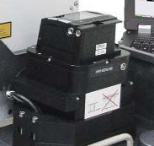
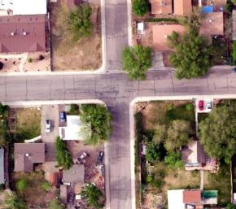
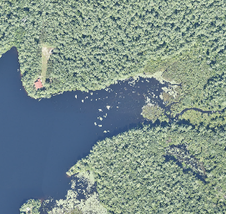
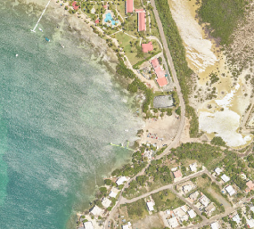
Digital Camera Sensor
Commercial instrument delivered with Optech or Riegl lidar system: DiMAC D-8900 or PhaseOne iXA
Purpose
Context for lidar and spectrometer
Provides sub-meter sampling of scene @ 1000 m AGL
High spatial accuracy

Slide 9
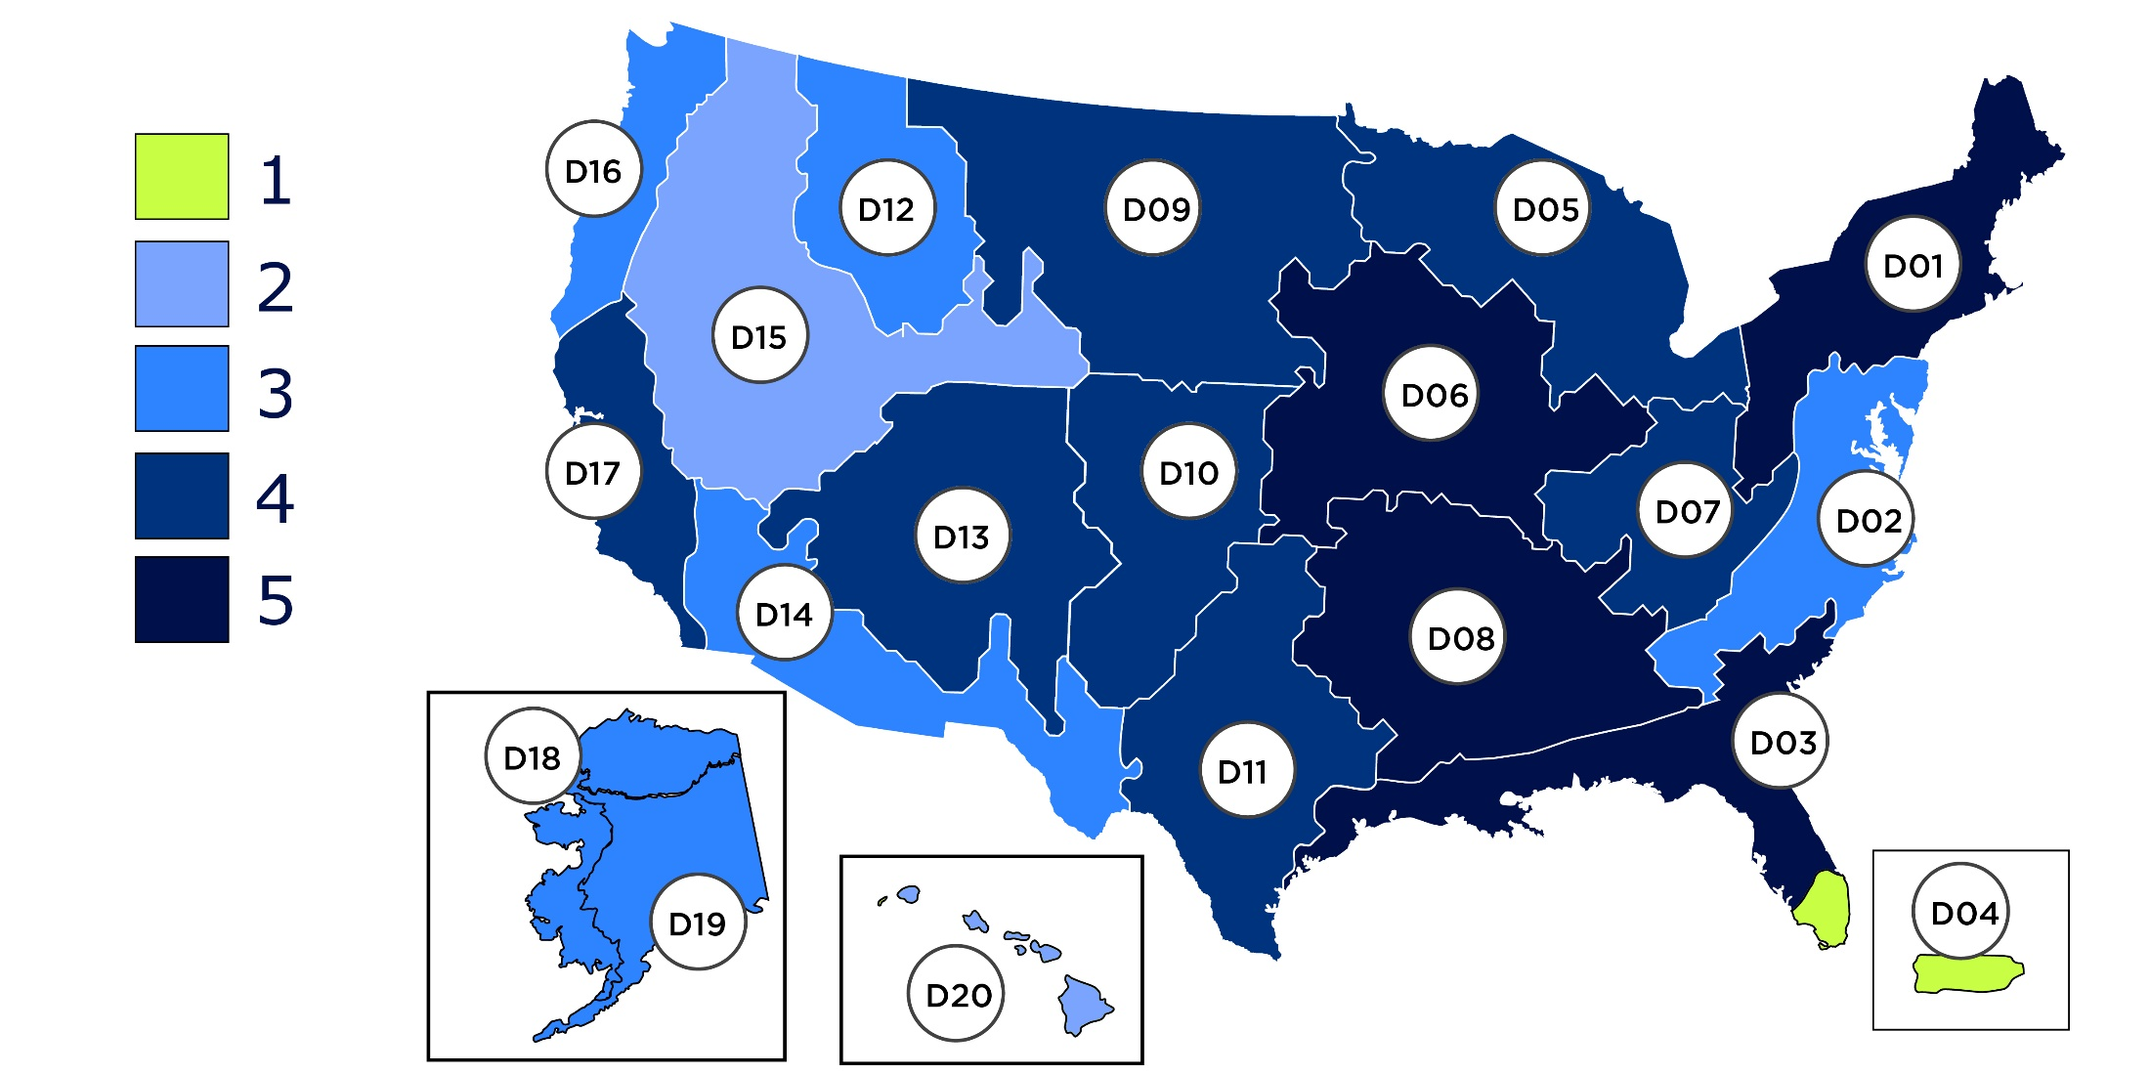
2013 – 2020 AOP collections

Slide 10
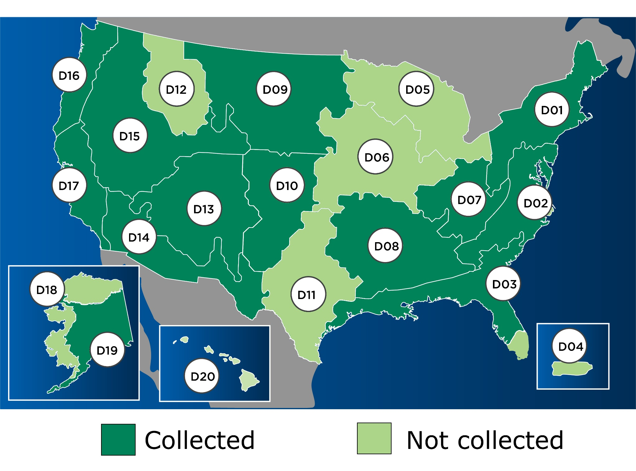
2021 AOP collections

Slide 11
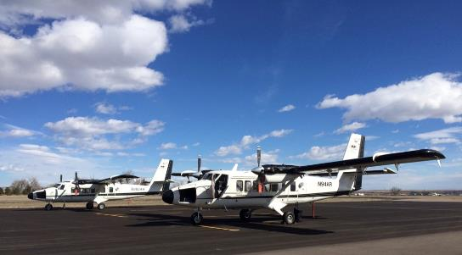
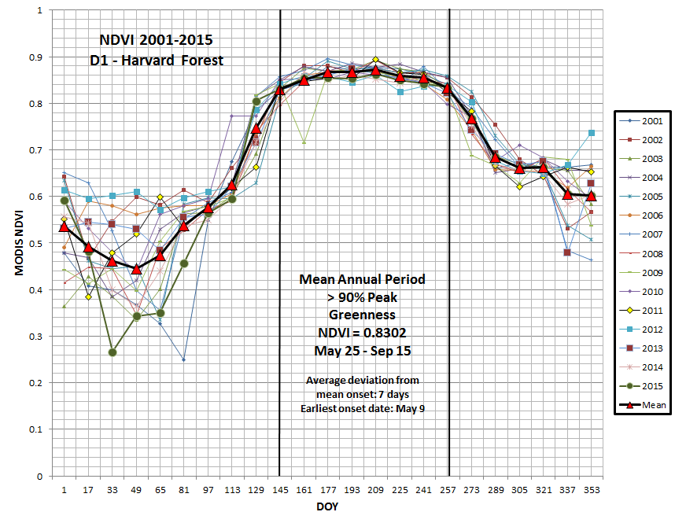
AOP Sampling Collection Requirements
Clear skies
Nominal AOP flying altitude = 1000 m AGL
Driven by requirement to collect data at the scale of individual plants
Minimum 10 km by 10 km box
Driven by requirement to collect regional scale area around NEON sites
Fly at peak ‘greenness’
Driven by requirement for consistency between annual collections
Fly N-S lines when solar angles are above 40°

Slide 12
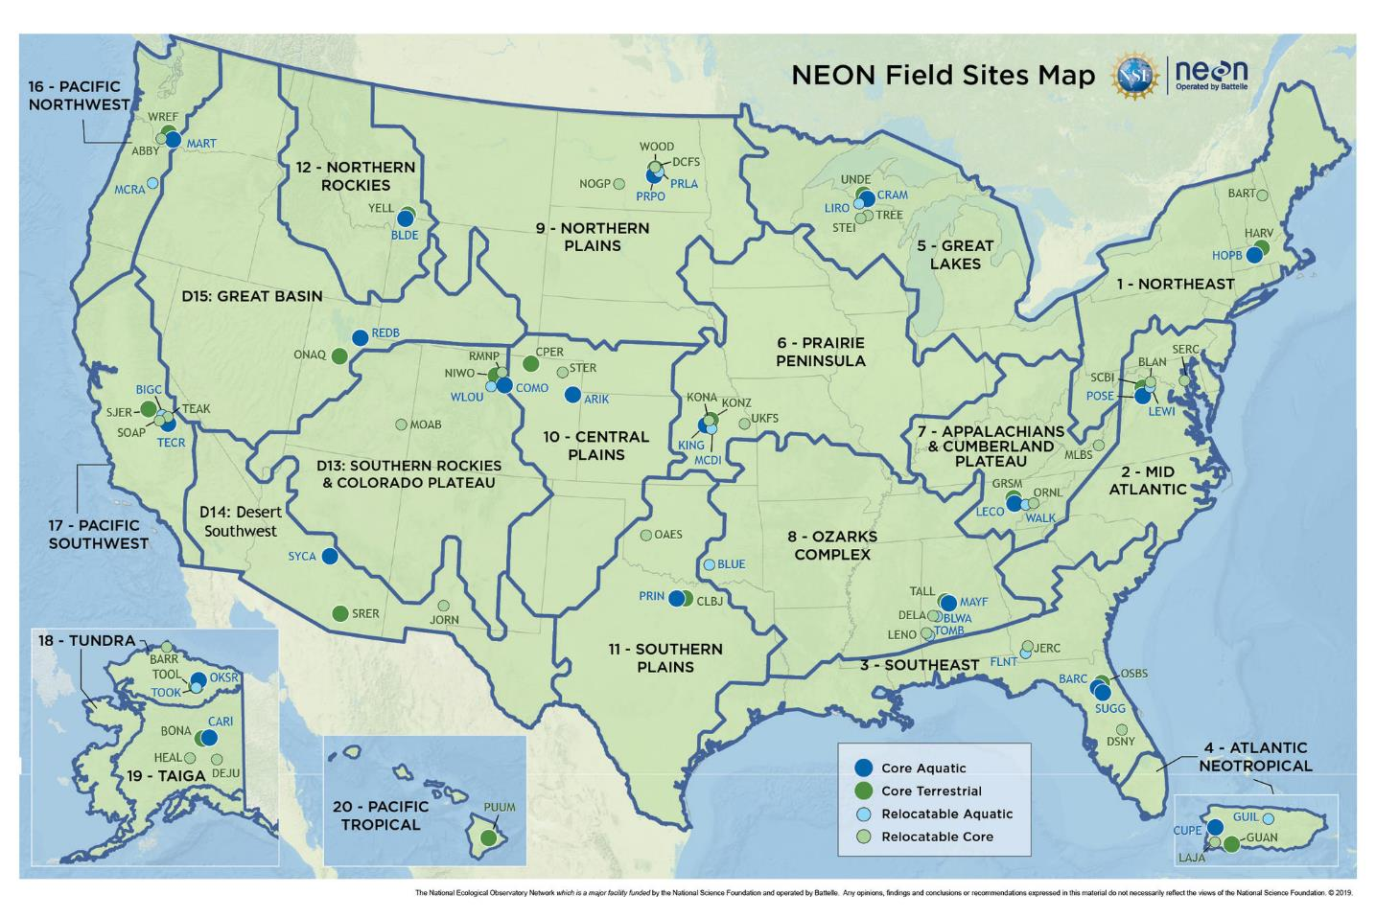
HARV
Notes:
Integrated data collection at 81 field sites distributed across 20 domains – or ecoregions – in the United States (including Puerto Rico, Alaska, and Hawaii)

Slide 13
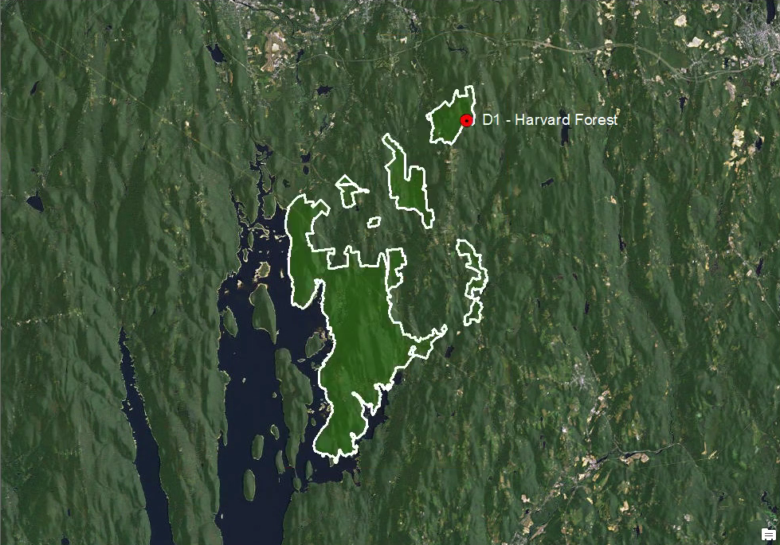
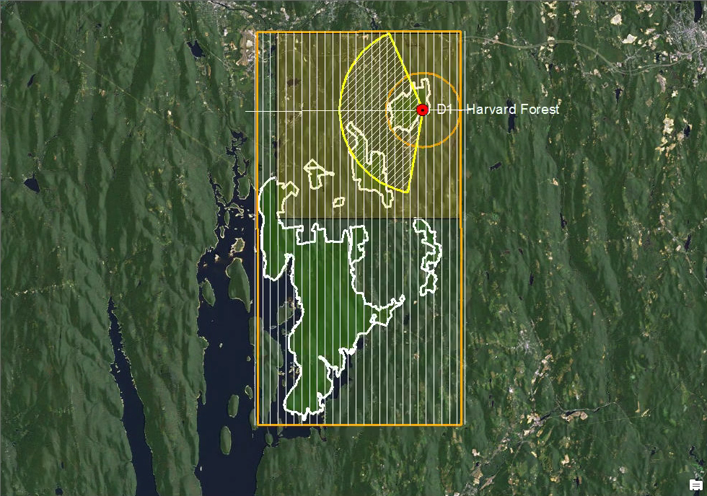
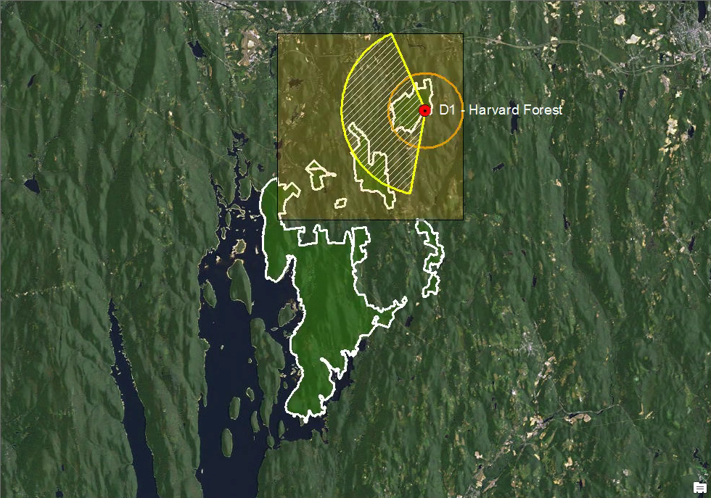
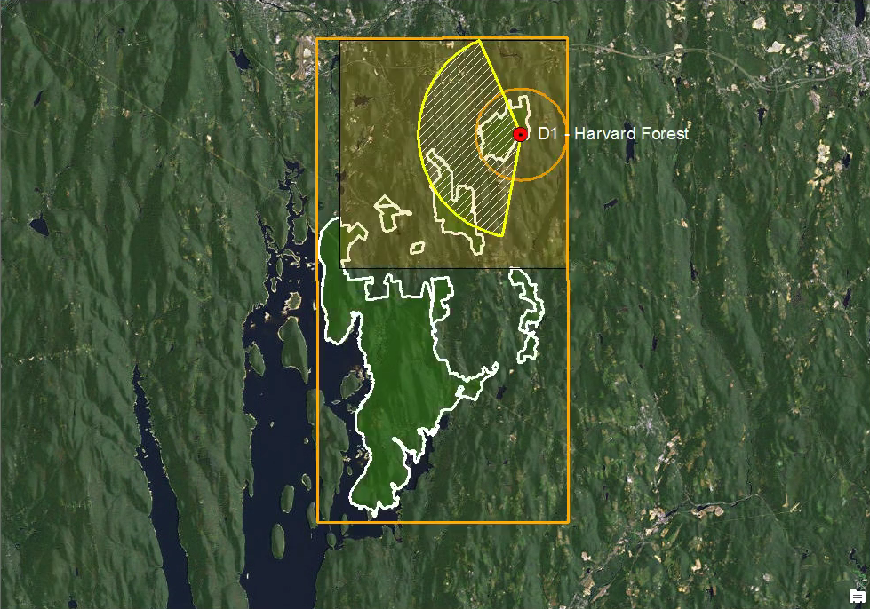

Slide 14
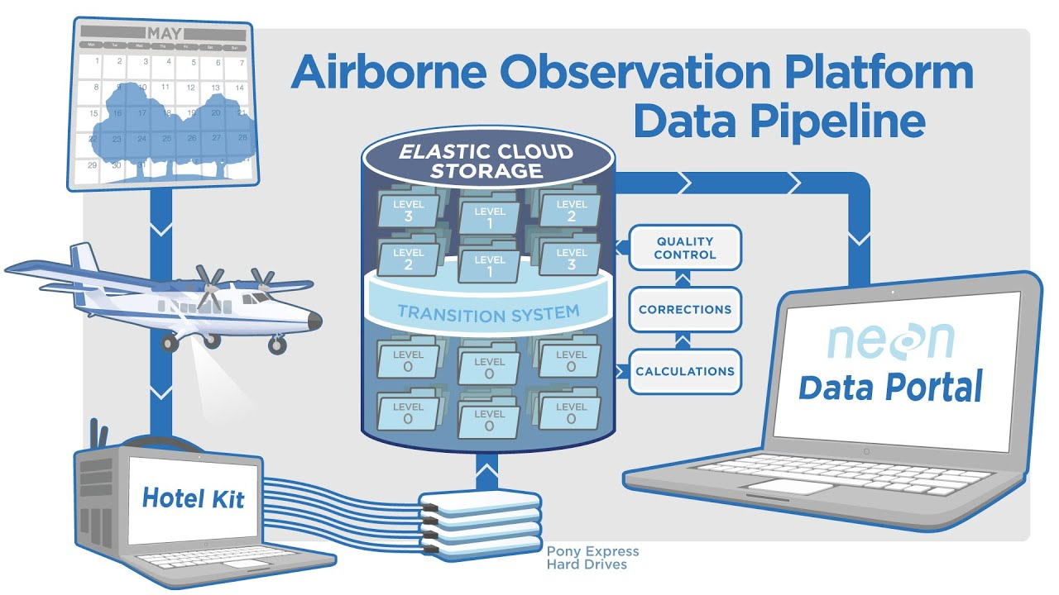

Slide 15
NEON AOP data products
Level 1
Level 2
Level 3
Canopy Water Content
Canopy Xanthophyll Cycle
Canopy Lignin
Canopy Nitrogen Vegetation Indices – Spectrometer
Albedo - Spectrometer
LAI - Spectrometer
fPAR - Spectrometer
Total Biomass Map - Spectrometer
Spectrometer Orthrorectified at-Sensor Radiance
LiDAR Slant Range Waveform
Discrete Return LiDAR Point Cloud
Spectrometer Orthorectified Surface Directional Reflectance
High-resolution Orthorectified camera imagery
Spectrometer Orthorectified Surface Directional Reflectance
High-resolution Orthorectified camera imagery mosaic
Albedo - Spectrometer
LAI - Spectrometer
fPAR - Spectrometer
Total Biomass Map - Spectrometer
Canopy Nitrogen
Canopy Water Content
Canopy Xanthophyll Cycle
Canopy Lignin
Vegetation Indices - Spectrometer
Ecosystem Structure
Elevation - LiDAR
Slope and Aspect - LiDAR
Plot 192 - Mixed Blue and Live Oak
Raw data to
physical units
Derived products
e.g. indices
Temporarily Suspended Products
ATBDs (Algorithm Theoretical Basis Documents) describing the process for data product creation
Derived product mosaics

Slide 16
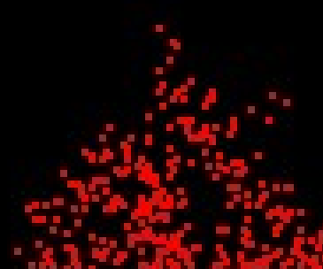
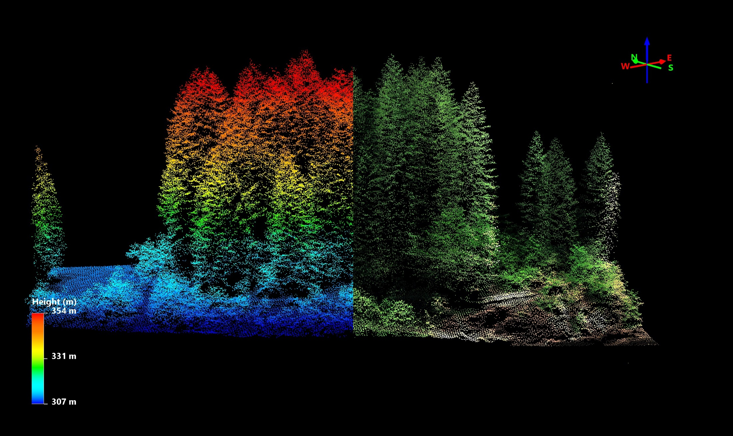
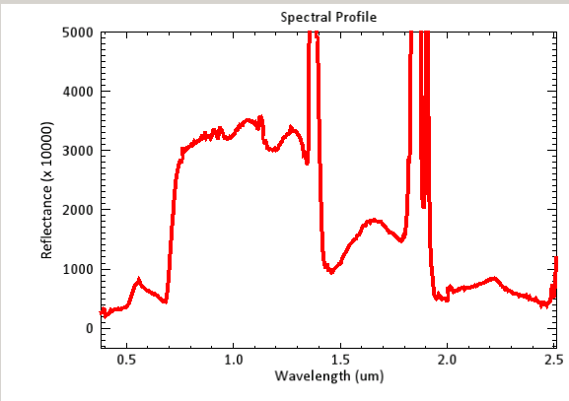
Visible

Slide 17
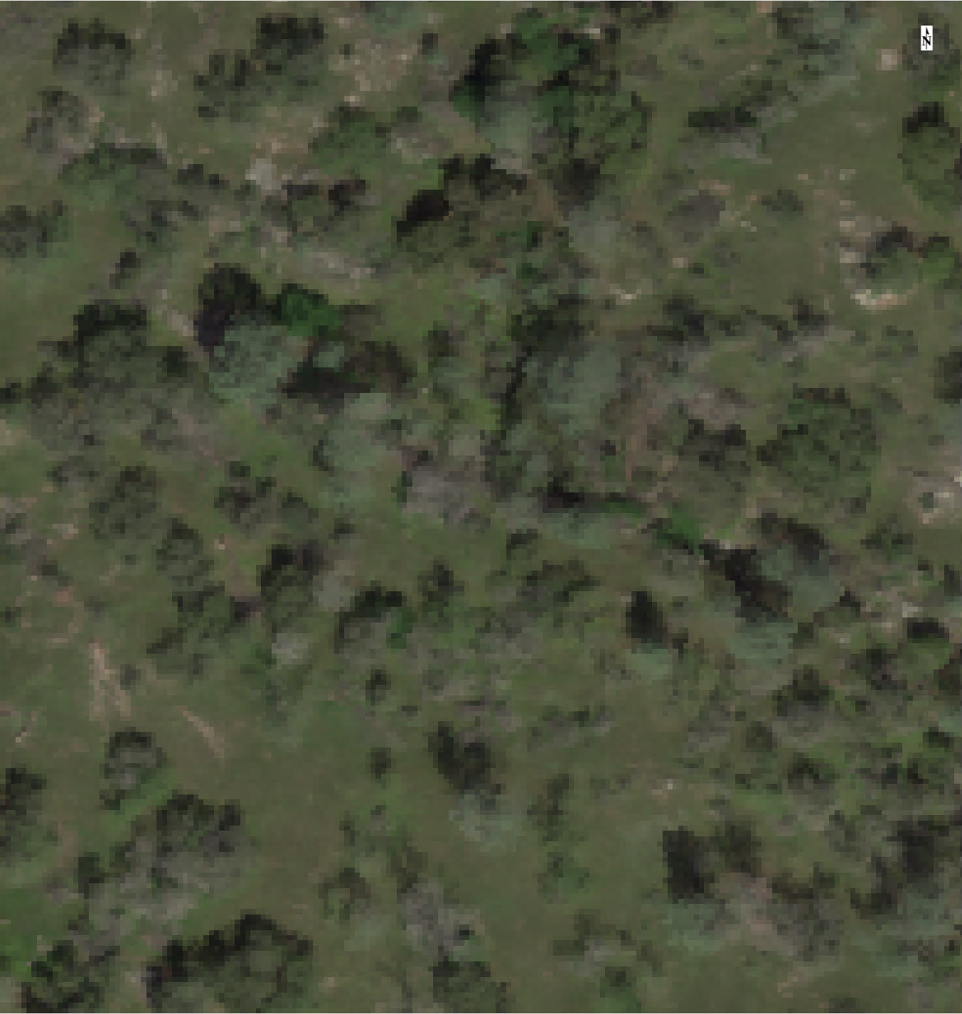
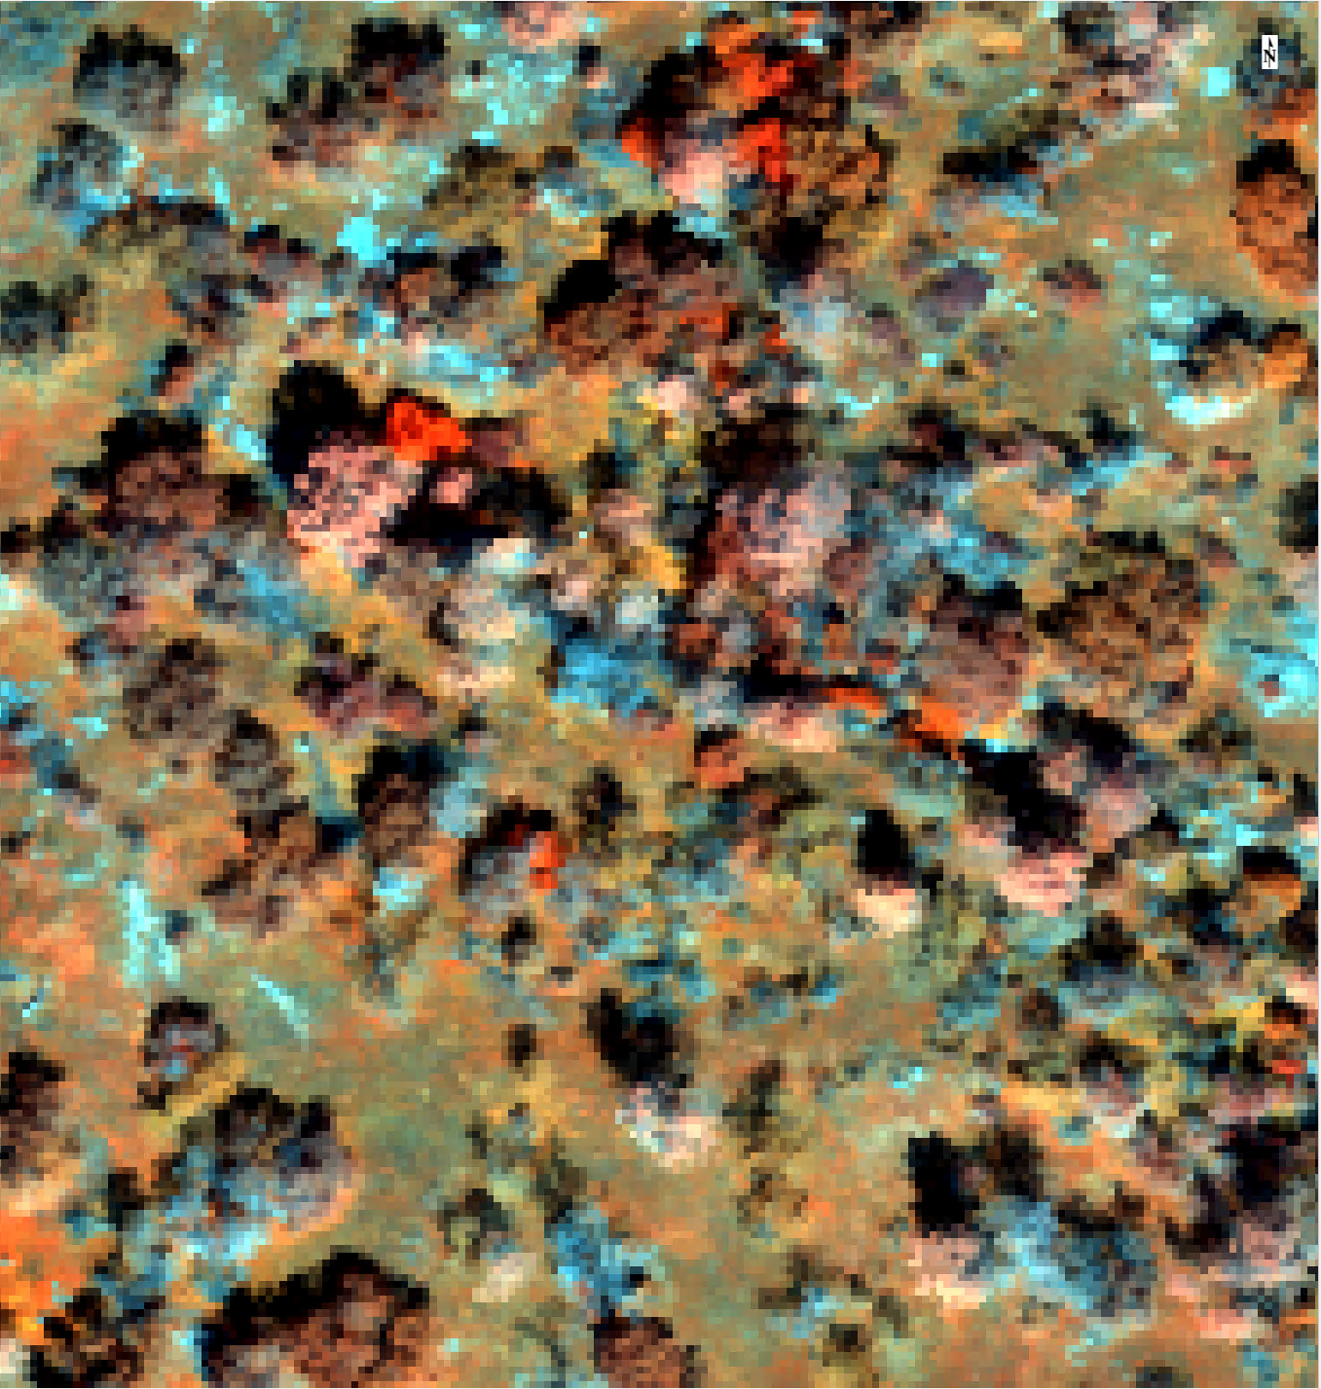
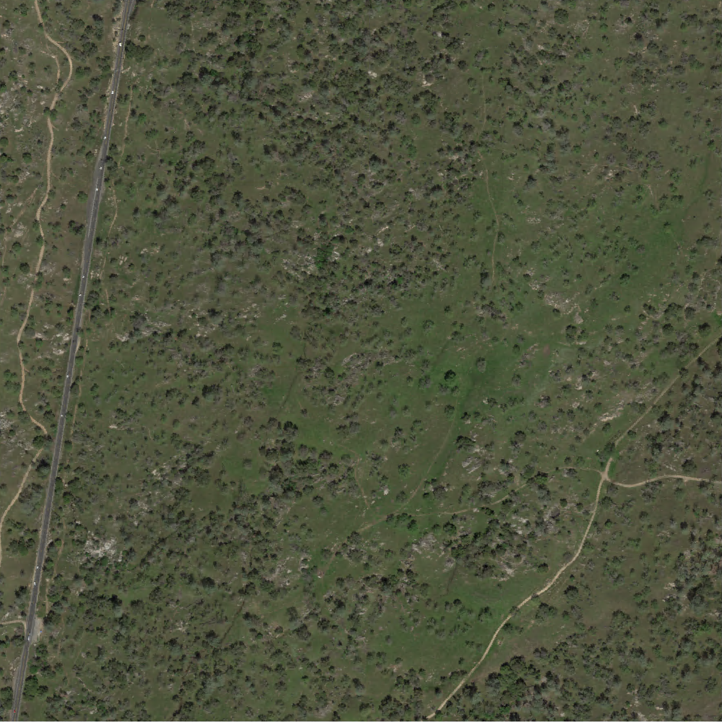
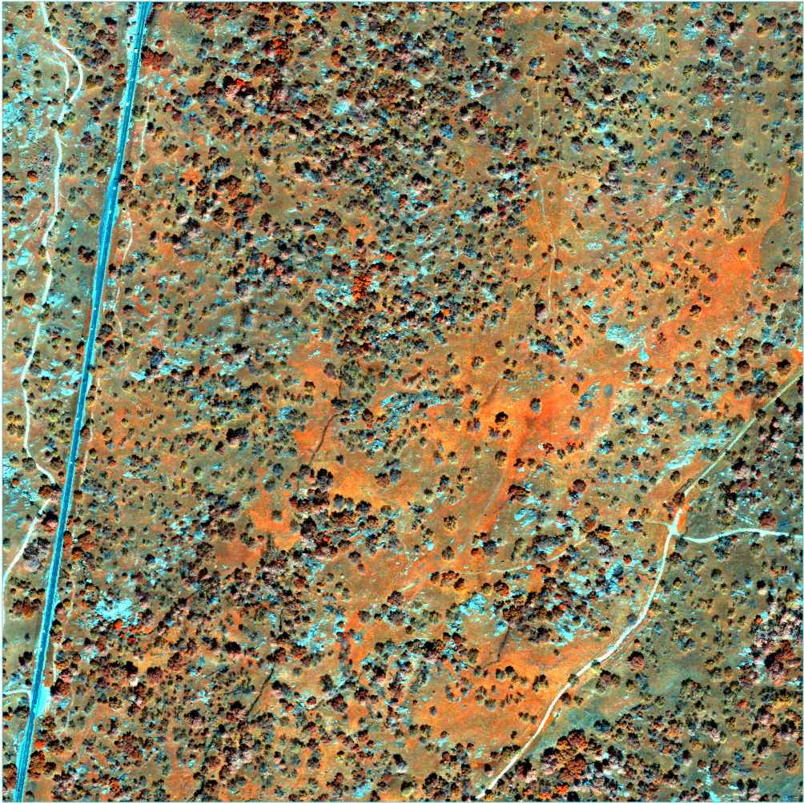
RGB Image
False Color Image (NIR GB)

Slide 18
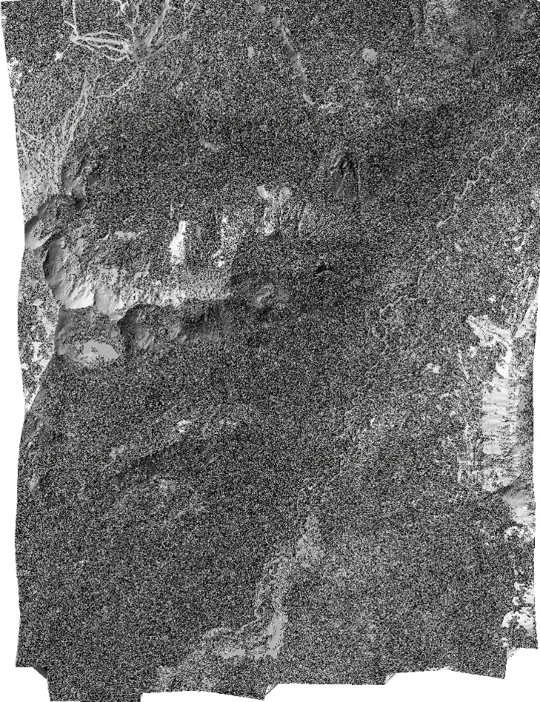
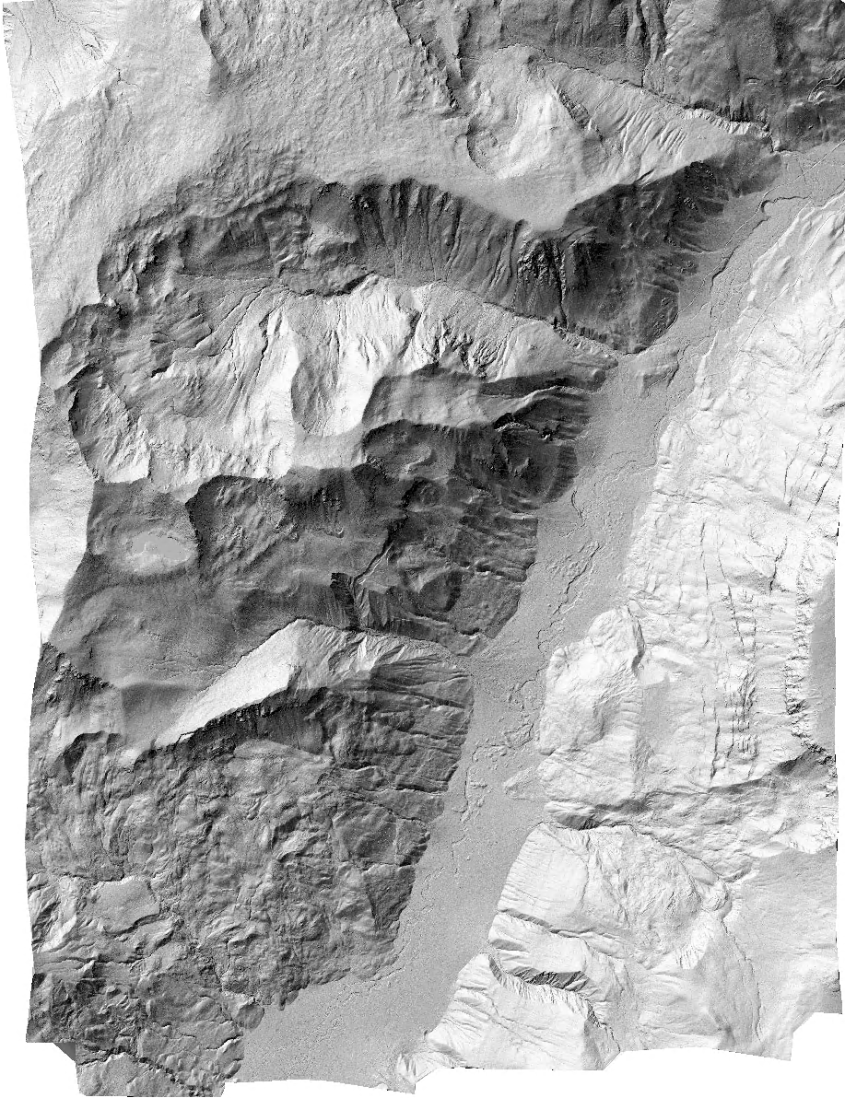
DSM
DSM

Slide 19
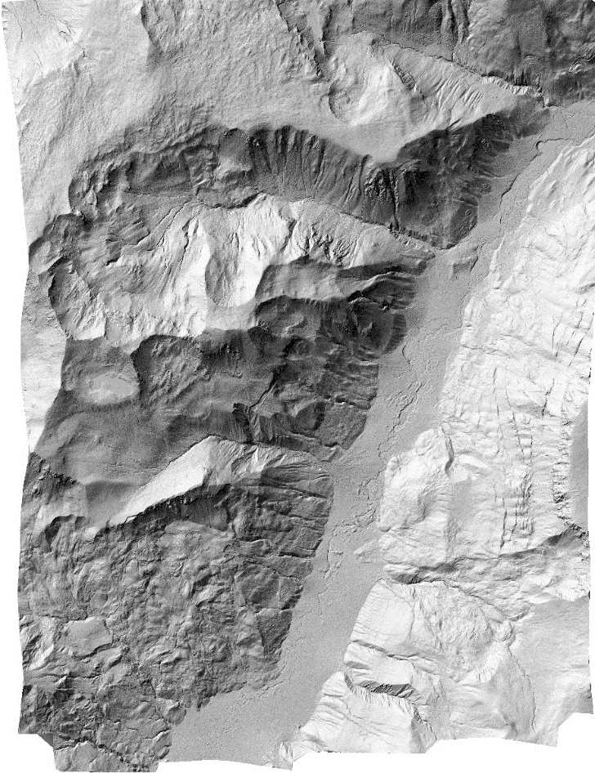
DSM
DTM

Slide 20
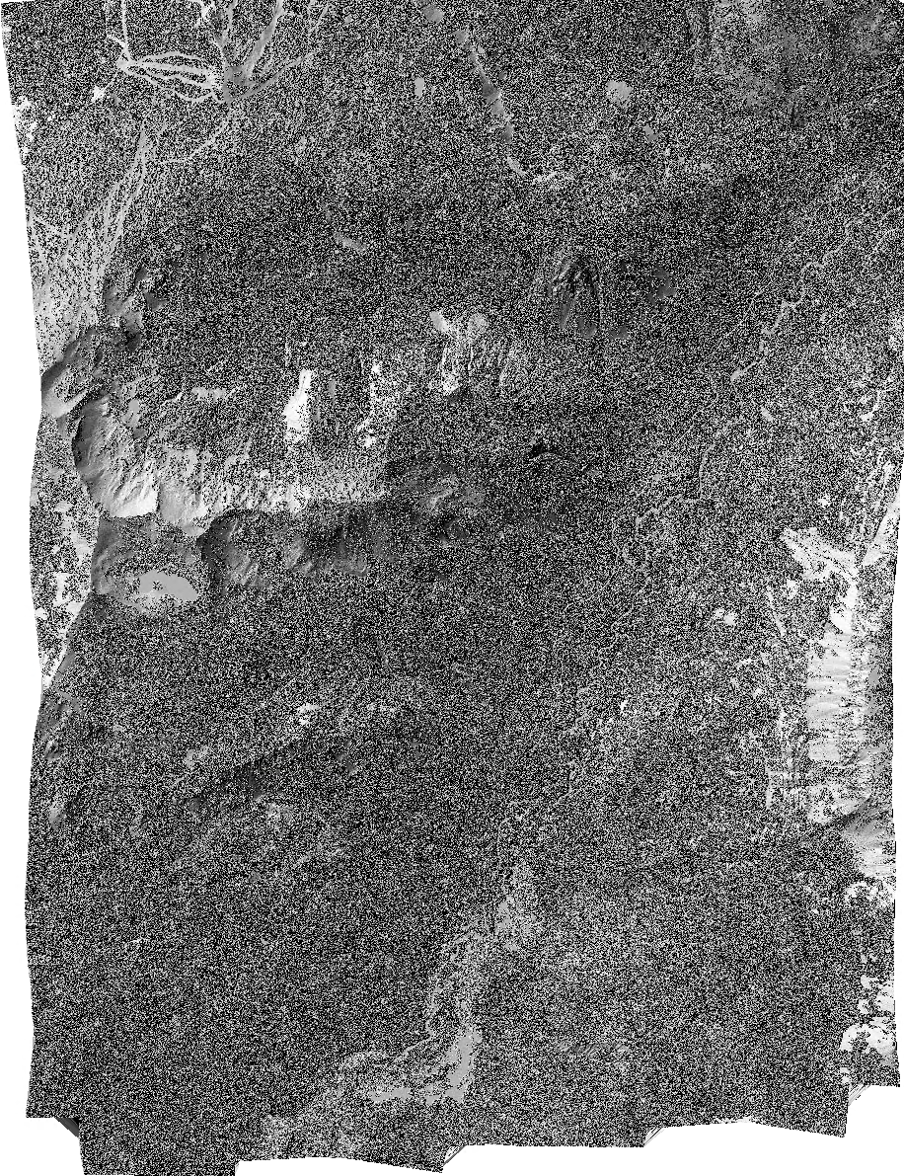
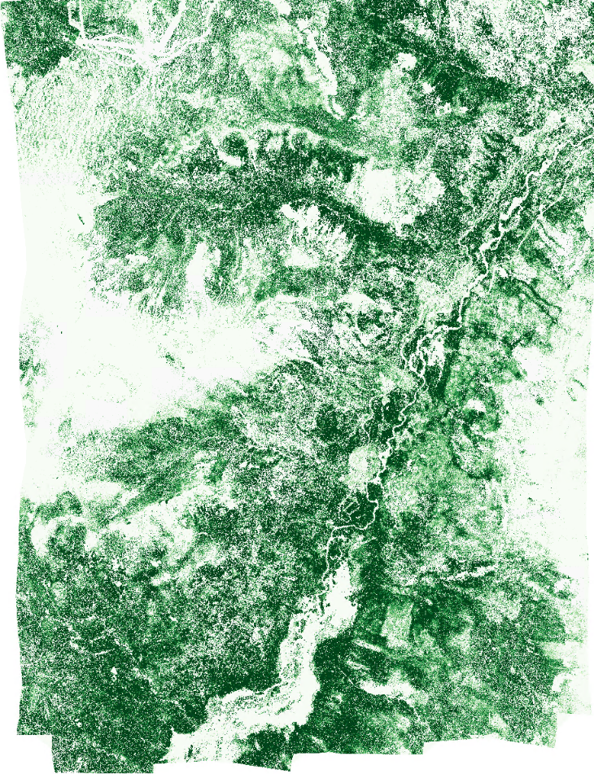
DSM
DTM
CHM
> 25 m
0 m

Slide 21
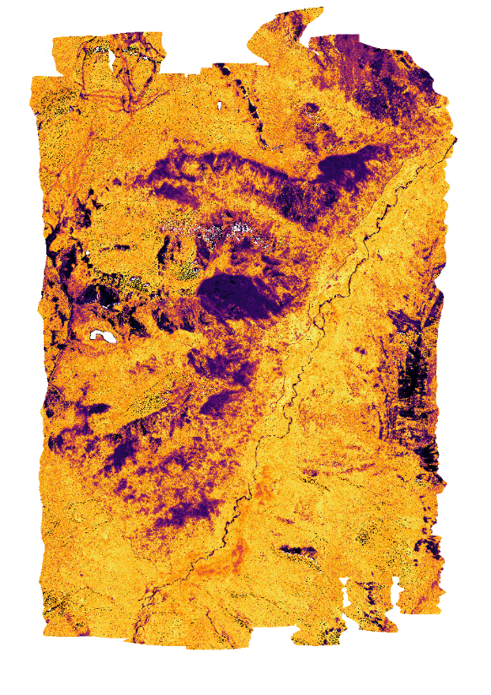
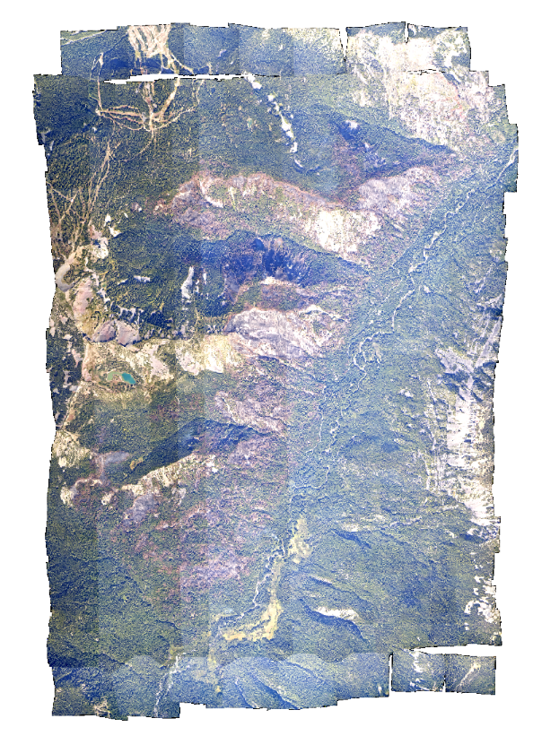
NDVI
RGB
Burned area Live vegetation

Slide 22
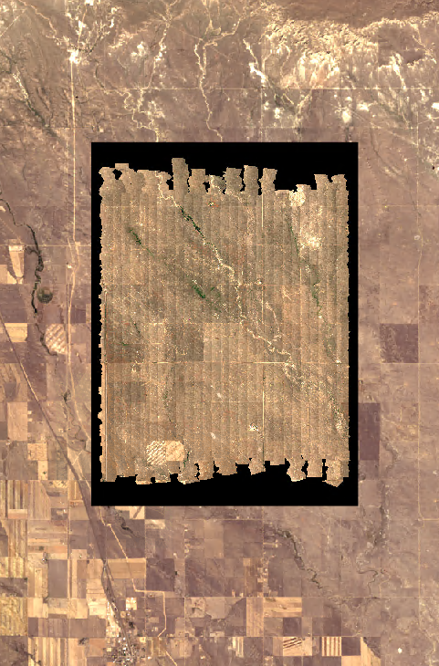
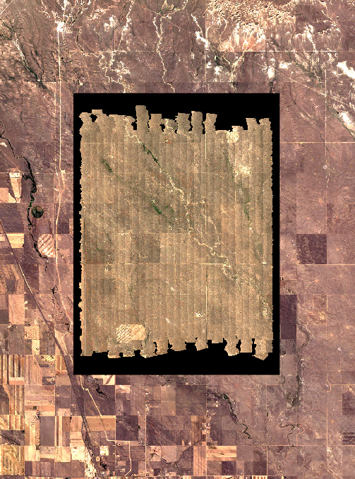
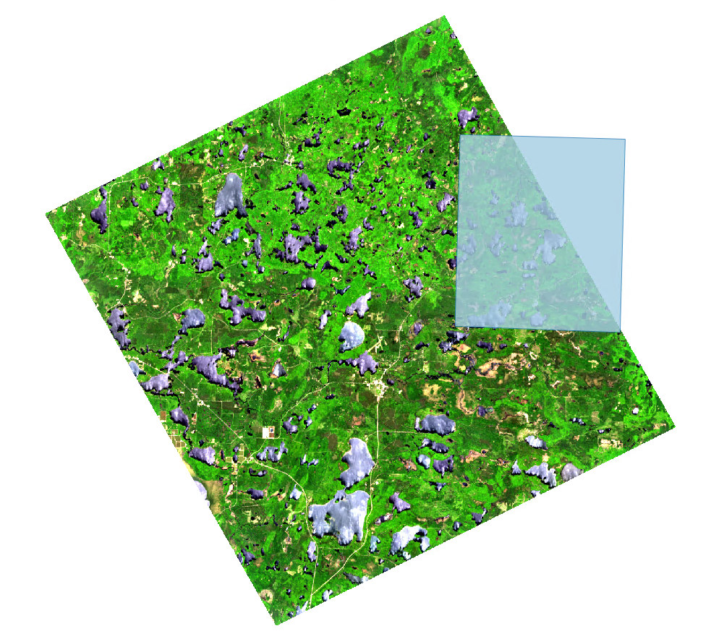
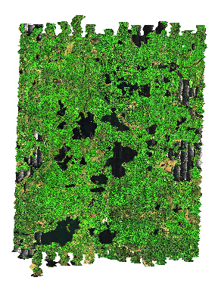
Data Interoperability with EOS
DESIS collection 20190608
Landsat 8 - 20200913
Sentinel 2A - 20200913
D05 – UNDE
flight box
Include ground field spectrometer measurements

Slide 23
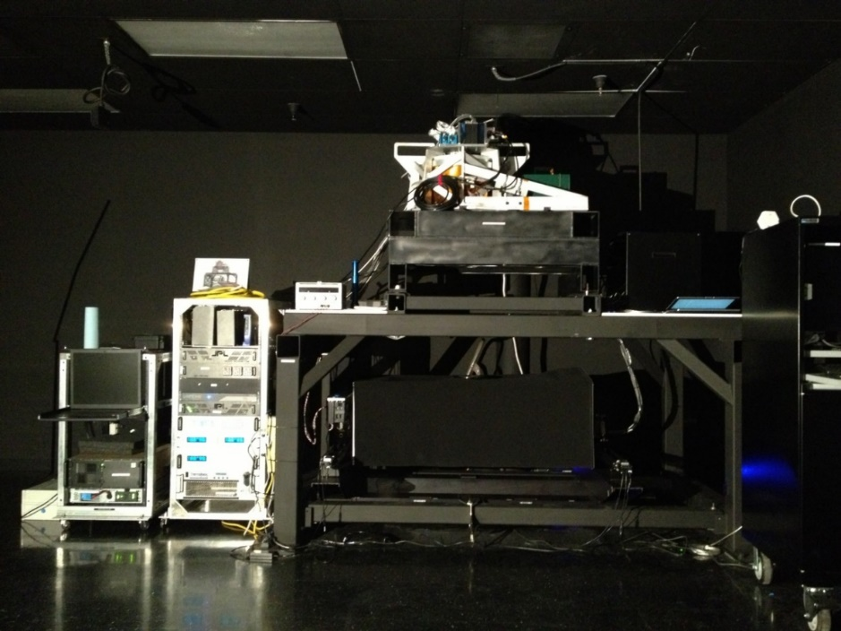
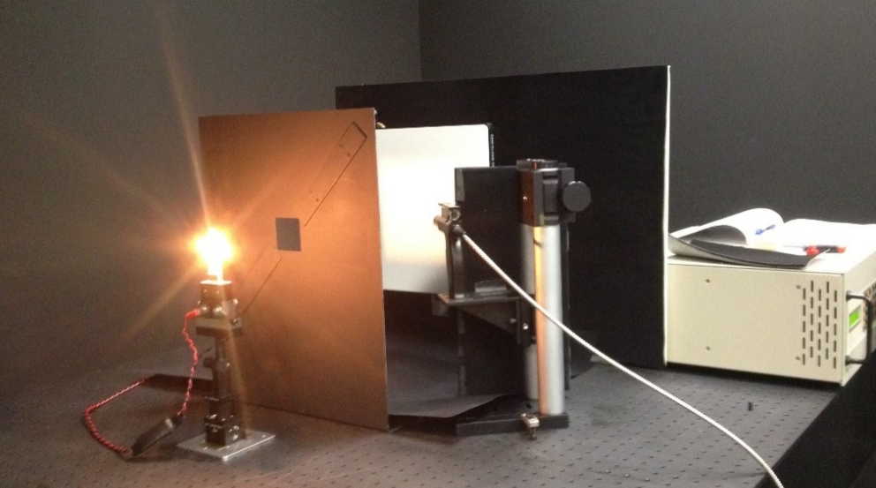
Radiometric Calibration
Radiometric Calibration
NIST bulb / spectralon panel
ASD as transfer radiometer
Integrating sphere
NIS
Integrating
Sphere
NIST bulb
Calibrated Spectralon Panel

Slide 24
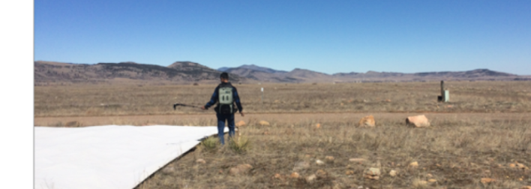
Vicarious Calibration
Performed at Table Mountain, Railroad Valley
Measure calibration tarps, gravel road and vegetation with ASD coincident with overpass
Compare at-sensor radiance observed from NIS against MODTRAN simulation

Slide 25
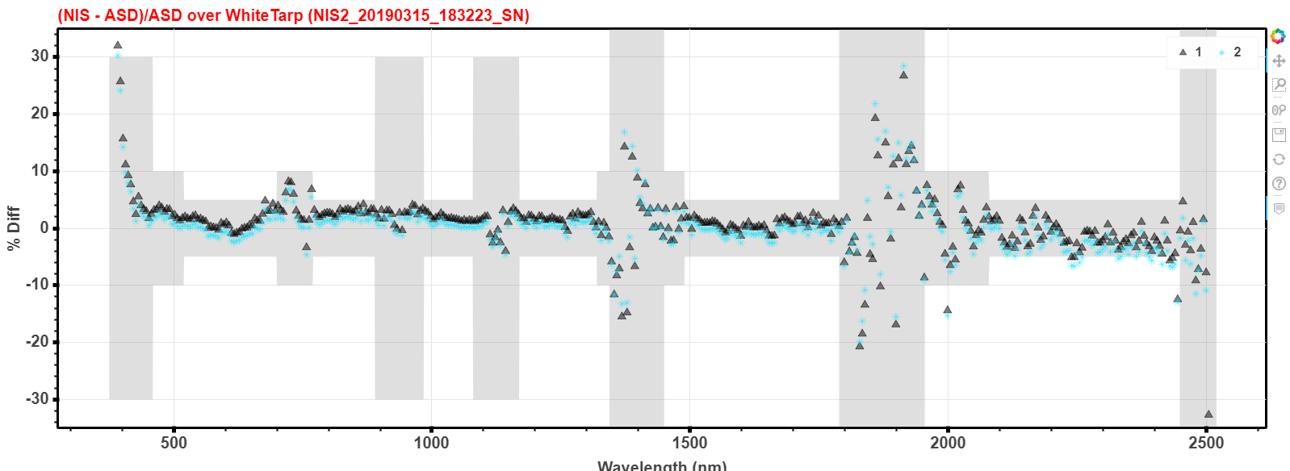
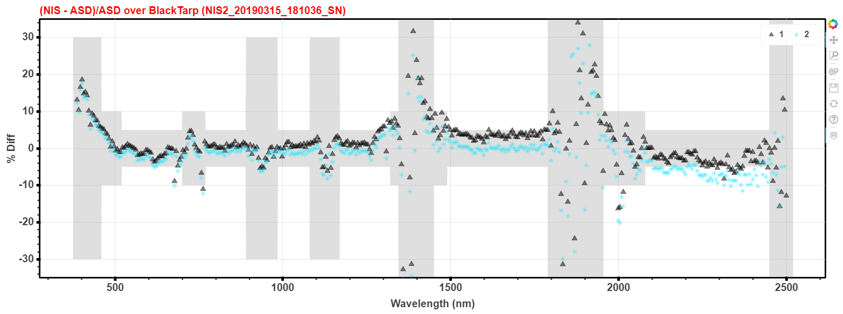
Vicarious Calibration
48%
3%

Slide 26
Data Challenges
Currently hold ~100s TB of data products, >100 TB intermediate files
Anticipate collecting ~ 100 TB per year (raw and processed)
At-sensor radiance, waveform LiDAR, reflectance (L1) require majority of the storage space (80%)
Getting data to our users
Harmonization of data
Educating users on data use and uncertainty

Slide 27
AOP as an Assignable Asset

Slide 28
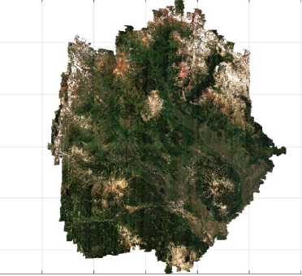
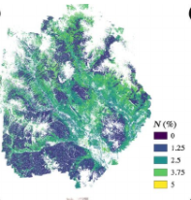
AOP Assignable Asset Research

