Slide 1
JPSS VI & GVF Products at NOAA
Yunyue YU¹, Feng Zhao², Zhangyan Jiang², Mingshi Chen², Yuxiang He², Tomoaki Miura³
¹ NOAA/NESDIS/STAR
² I.M. System Group, STAR affiliated
³ Univ. of Hawaii

Slide 2
Transition to Enterprise Algorithm
Enterprise Algorithm: An algorithm that uses the same scientific methodology and software base to create the same classification of product from differing input data (satellite, in-situ or ancillary)
Transition from IDPS to NDE: All VIIRS land products are/were being processed in NOAA's Interface Data Processing Segment (IDPS) which will be terminated very soon (January 2019)
Data Exploration (NDE) system are of obvious advantages
  Continuity of NOAA products between current and future NOAA operational satellites
  Cost effective processing for NOAA products
  Maintenance of fewer algorithms and systems within operations
  Creates product and verification consistency
  Better meets NOAA Line Office user needs
  Eliminates the need to retrain users for continuity missions
  Streamlines transition to operations for new satellite missions
  One transition of the algorithm service to the GEARS system
Notes:
NESDIS Ground Enterprise Architecture Services (GEARS)

Slide 3
JPSS Vegetation Index Requirements
Table 5.5.9 – Vegetation Indices (VIIRS)
EDR Attribute | Threshold | Proposed
Vegetation Indices Applicable Condition: 1. Clear, land (not ocean), daytime only
a. Horizontal Cell Size | 0.4 km | 4 km global, 1 km regional
b. Mapping Uncertainty, 3 Sigma | 4 km | 4 km
c. Measurement Range
1. NDVI TOA | -1 to +1 | -1 to +1
2. EVI (1) | -1 to +1 | -1 to +1
3. NDVI TOC | -1 to +1 | -1 to +1
d. Measurement Accuracy – NDVI TOA (2) | 0.05 NDVI units | 0.05 NDVI units
e. Measurement Precision – NDVI TOA (2) | 0.04 NDVI units | 0.04 NDVI units
f. Measurement Accuracy – EVI (2) | 0.05 EVI units | 0.05 EVI units
g. Measurement Precision – EVI (2) | 0.04 EVI units | 0.04 EVI units
f. Measurement Accuracy – NDVI TOC (2) | 0.05 NDVI units | 0.05 NDVI units
g. Measurement Precision – NDVI TOC (2) | 0.04 NDVI units | 0.04 NDVI units
f. Refresh | At least 90% coverage of the globe every 12 hours (monthly average) | At least 90% coverage of the globe every 12 hours (monthly average)
Notes: 1. EVI can produce faulty values over snow, ice and residual clouds (EVI>1). 2. Accuracy and precision performance will be verified and validate for an aggregated 4 km horizontal cell to provide for adequate comparability of performance across the scan
Other Attributes
 | Requirement | Proposed
Latency | 96 minutes | 6 hours after the 1-day compositing period (daily product) 1 day immediately after 7-day compositing period (weekly product) 1 day immediately after 16-day compositing period (bi-weekly product)
Timeliness | NA | daily
Formats | Granule | Gridded

Slide 4



Overview -- VI
VIIRS VIs are inherited products from MODIS VI and AVHRR VI
VIIRS VIs consists of TOA NDVI, TOC NDVI and TOC EVI
$$NDVITOA=\frac{⍴_{I2}^{TOA}−⍴_{I1}^{TOA}}{⍴_{I2}^{TOA}+⍴_{I1}^{TOA}}$$
$$NDVITOC=\frac{⍴_{I2}^{TOC}−⍴_{I1}^{TOC}}{⍴_{I2}^{TOC}+⍴_{I1}^{TOC}}$$
$$EVI=\left(1+L\right).\frac{⍴_{I2}^{TOC}−⍴_{I1}^{TOC}}{⍴_{I2}^{TOC}+C1.{ ⍴}_{I1}^{TOC}−C2{ .⍴}_{M3}^{TOC}+L}$$
Coverage: Daily, weekly and biweekly at global (4 km) and regional level (North America,1 km)
NDE VI algorithm output
Temporal Scale | Spatial Scale | Format | File Name (samples)
Daily (DLY) | Global (4km) | netCDF4 (*.nc) | VI-DLY-GLB_v1r2_npp_s20171226_e20180110_c201803161653550.nc
 | Regional (1km) |  | VI-DLYL-REG_v1r2_npp_s20171226_e20180110_c201803161740430.nc
Weekly (WKL) 7-day | Global (4km) |  | VI-WKL-GLB_v1r2_npp_s20171226_e20180110_c201803161653550.nc
 | Regional (1km) |  | VI-WKL-REG_v1r2_npp_s20171226_e20180110_c201803161740430.nc
BiWeekly (BWKL) 16-day | Global (4km) |  | VI-BWKL-GLB_v1r2_npp_s20171226_e20180110_c201803161653550.nc
 | Regional (1km) |  | VI-BWKL-REG_v1r2_npp_s20171226_e20180110_c201803161740430.nc

Slide 5

Overview -- GVF
Green Vegetation Fraction (GVF) is defined as fraction of a pixel covered by green vegetation if it were viewed vertically
GVF EDR provides continuity with NOAA 16-km weekly AVHRR GVF
GVF estimation is based on the Enhanced Vegetation Index (EVI)
G$VF=\frac{EVI − EVI0}{EVIM− EVI0}$
Where EVI₀ and EVI_{M} , the global minimum and maximum EVI, are algorithm parameters determined experimentally, and need to be calibrated.
Coverage: weekly at global (4 km) and regional level (North America,1 km)
NDE GVF algorithm output
Temporal Scale | Spatial Scale | Format | File Name (samples)
Weekly (WKL) 7-day | Global (4km) (GLB) | netCDF4 (*.nc) | GVF-WKL-GLB_v2r1_npp_ s20180103_e20180109_c201803191655370.nc
 | Regional (1km) (REG) |  | GVF-WKL-REG_v2r1_npp_ s20180103_e20180109_c201803191657490.nc

Slide 6
JPSS VI and GVF Product
S-NPP
Operational Readiness Review : Mar 2018
Operational Phase Begins: July 2018
Website*:
https://www.star.nesdis.noaa.gov/jpss/vi.php
https://www.star.nesdis.noaa.gov/jpss/gvf.php
*New website is under construction
Archive: CLASS
https://www.bou.class.noaa.gov/saa/products/search?sub_id=0&datatype_family=JPSS_NGRN
VI Products:
    Global / Regional TOA NDVI (Daily, Weekly, and Bi-Weekly) in NetCDF-4
    Global / Regional TOC NDVI (Daily, Weekly, and Bi-Weekly) in NetCDF-4
    Global / Regional TOC EVI (Daily, Weekly, and Bi-Weekly) in NetCDF-4
GVF Products:
    Weekly Global / Regional GVF in NetCDF-4
NOAA-20
Beta Maturity Review: August 2018
Provisional Maturity Review: January 2019

Slide 7
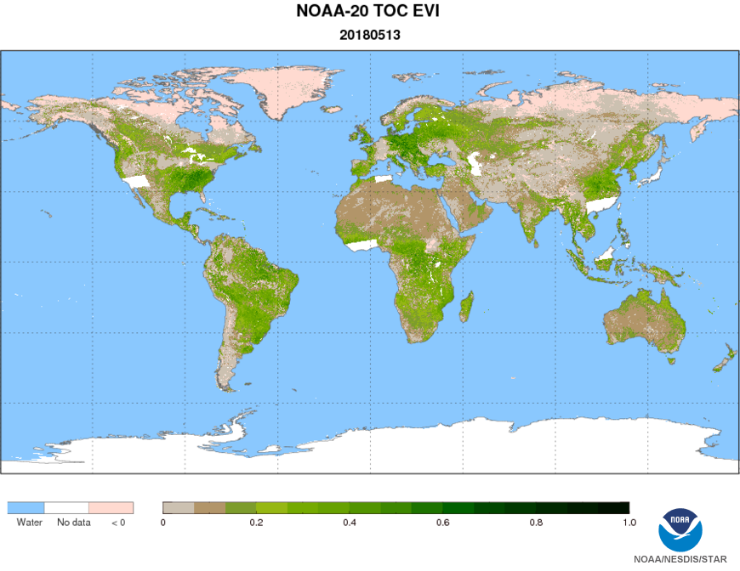
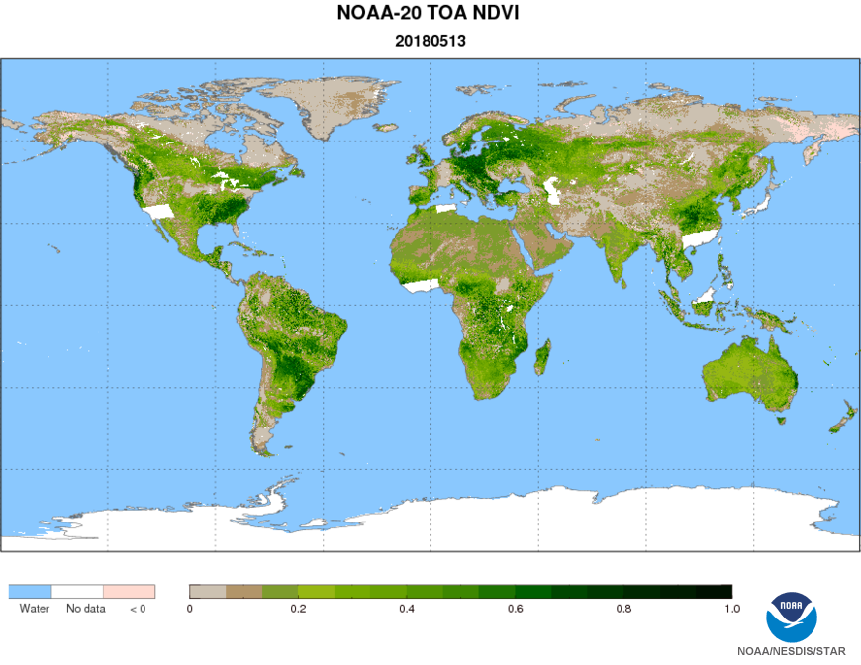
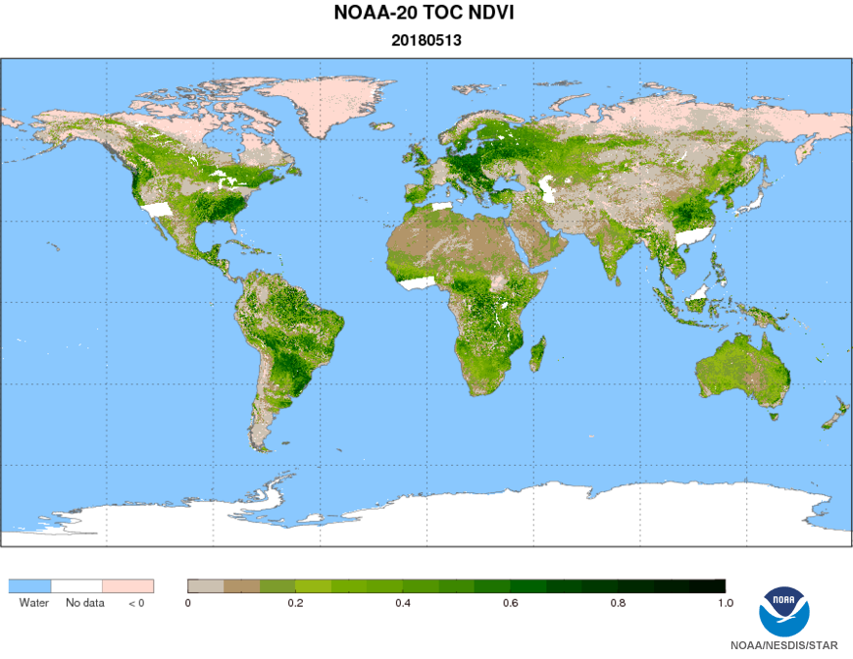
NDE Global Daily VIs on 05/13/2018
Overview ― S-NPP VI
TOC EVI
TOA NDVI
TOC NDVI

Slide 8
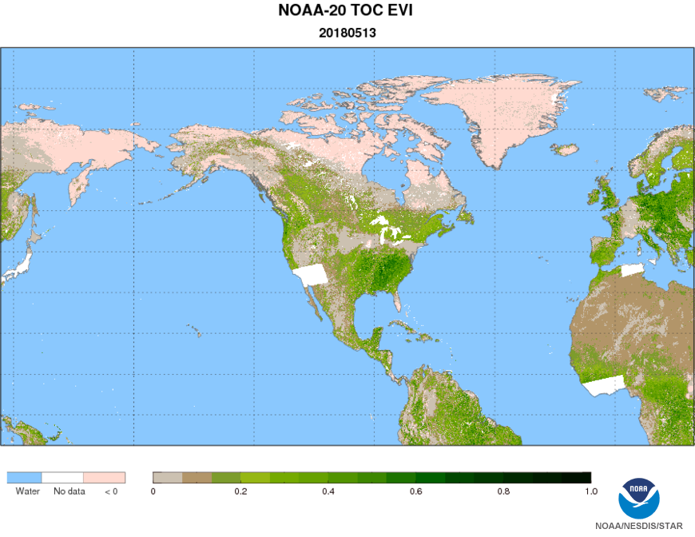
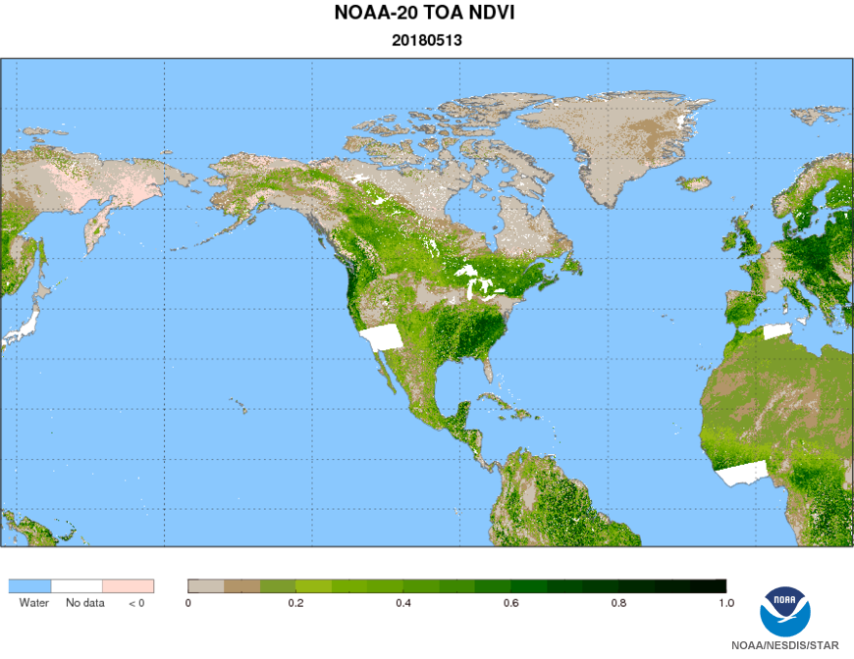
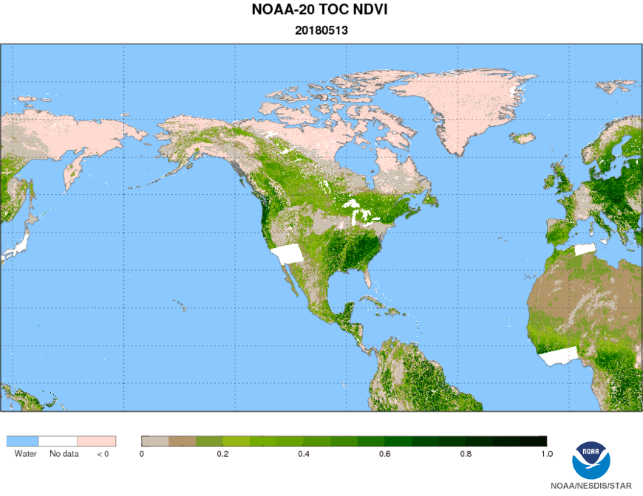
NDE Regional Daily VIs on 05/13/2018
Overview ― S-NPP VI
TOC EVI
TOA NDVI
TOC NDVI

Slide 9
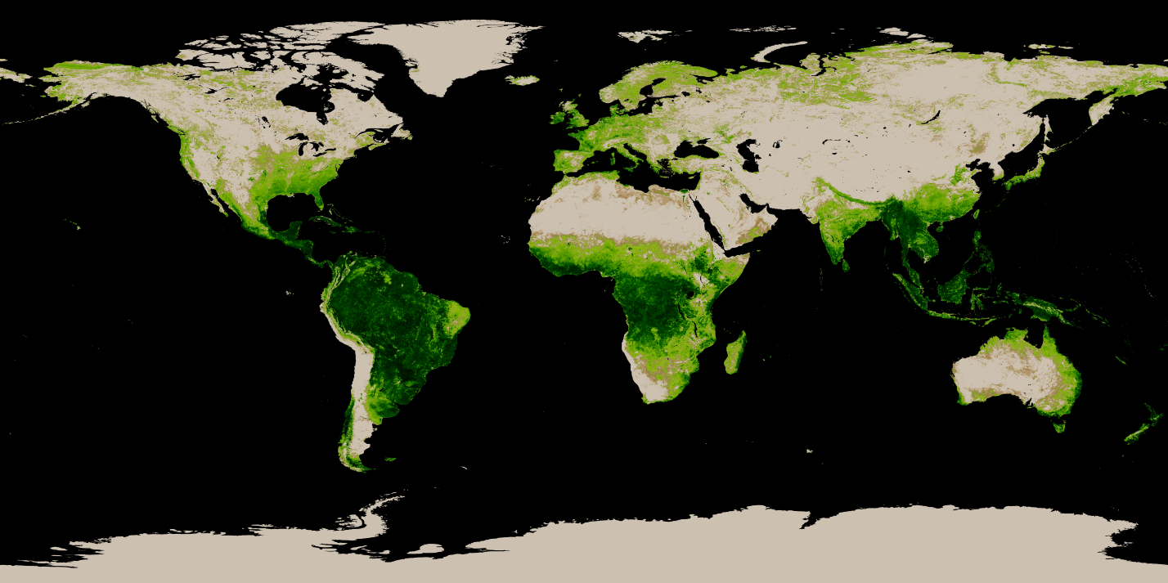
Overview ― S-NPP GVF
GVF on 11/24/2018 ~ 11/30/2018
NDE GVF Global Products
TOA NDVI

Slide 10
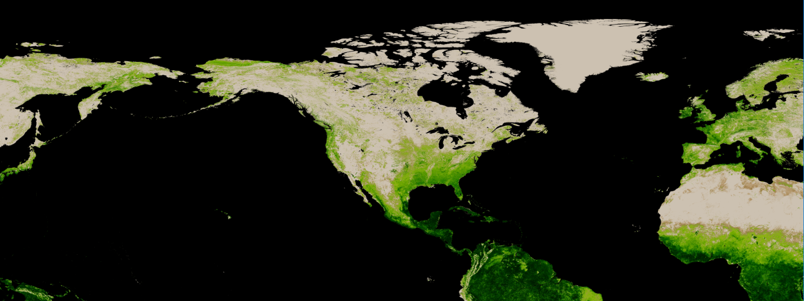
Overview ― S-NPP GVF
GVF on 11/24/2018 ~ 11/30/2018
NDE GVF Regional Products
TOA NDVI

Slide 11
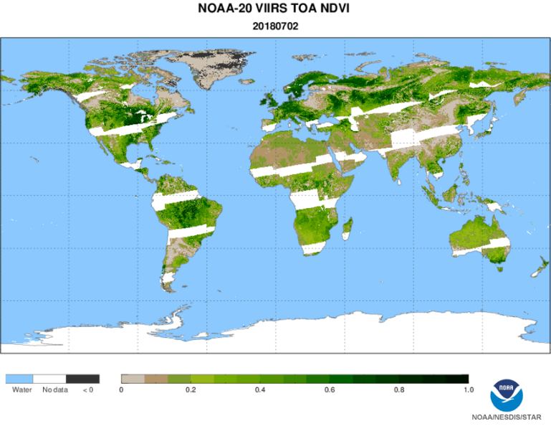
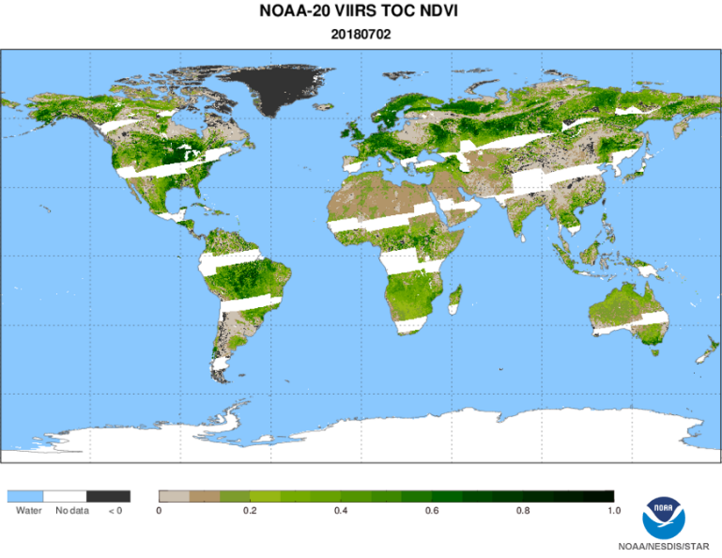
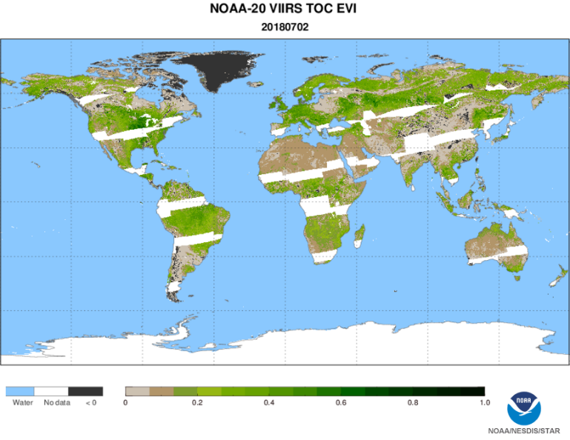
NOAA-20 Status ― VI
Beta maturity Review was done on Aug. 22., 2018
Calibration and validation is on the way for Provisional maturity (Feb 2019)
NDE NOAA-20 VI Global Products 07/02/2018
NDVI_TOA
NDVI_TOC
EVI_TOC

Slide 12
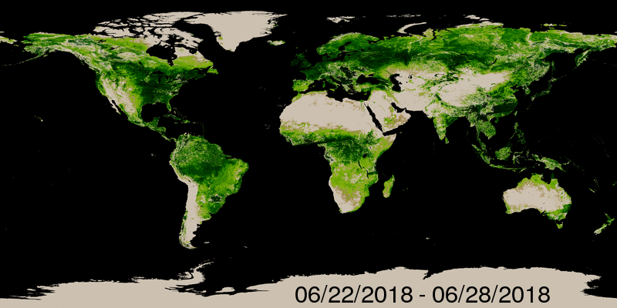
Jun 28, 2018 – July 20, 2018
NOAA-20 Status ― GVF
NDE GVF Global Products
TOA NDVI

Slide 13
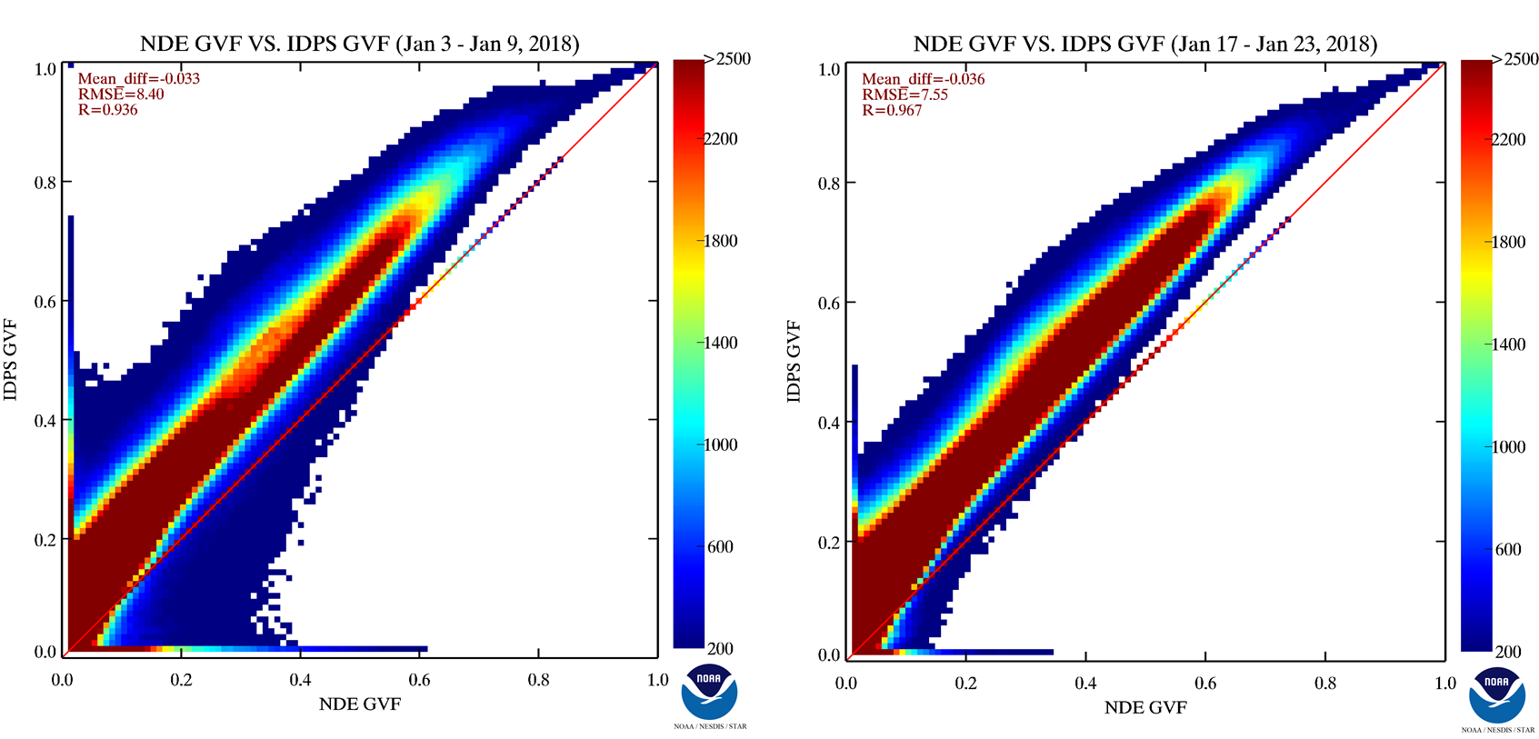
GVF Comparison: NDE vs. IDPS Input
Inconsistency issue due to the SR inputs

Slide 14
VIIRS SR LUT Correction
An error was found recently in the Surface Reflectance lookup table (Enterprise_Aerosol_Lut.hdf ):
  original order of values in lookup tables were:
    M1, M2, M3, M4, M5, M6, M7, M8, M10, M11
  The order should have been:
    M1, M2, M3, M4, M5, M7, M8, M10, M11, I1
Codes were kept identical except for swapping five LUT files:
  albedo, atau, reflec, scat_ang_val, trans
Two runs were generated on rhw3022 for November 11, 2018.
Subsetted to remove nighttime orbits – 526 orbits in total used.
VI/GVF will be reprocessed using the corrected NDE SR data (since Sep 27, 2018)
Notes:
VI input bands: I1, I2, M3

Slide 15
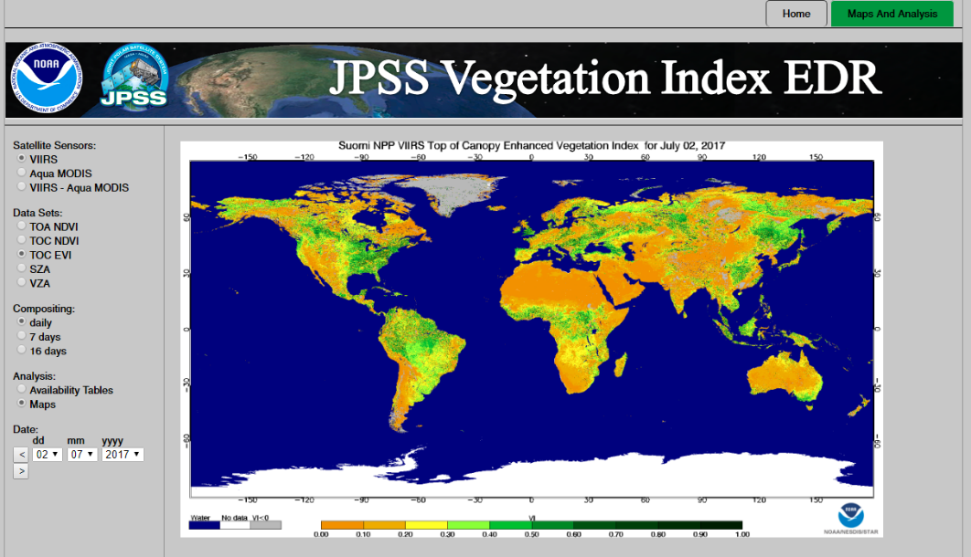
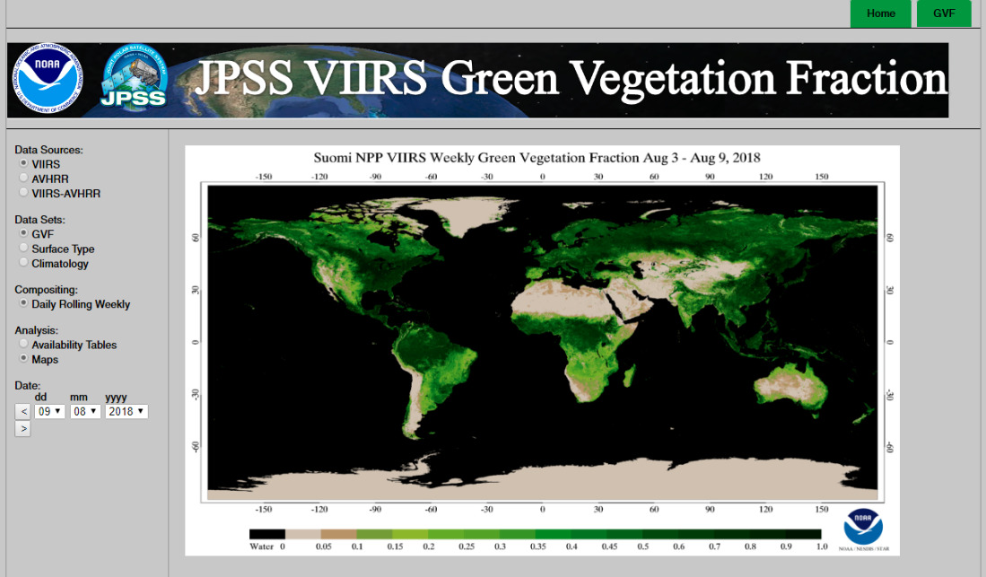
VIIRS VI Long-term Monitoring
Developing a long-term monitoring tool
    Send alerts when abnormal results occurs;
    Automatically validate against field measurements;
    Update maps through WWW
  Under construction
  https://www.star.nesdis.noaa.gov/smcd/viirs_vi_web/landwatch/index.php
A global map of land surface albedo composite with VIIRS products of May, 2016

Slide 16
Path Forward
The NDE Veg Product System (NVPS) improvements
  Code efficiency and robustness
  data layer re-arrangement, redundant removal
  QF upgrade
Comprehensive validation will be performed using in-situ data, as well as other reference data
Conduct provisional readiness for NOAA-20 VI and GVF production
Significant upgrade on validation and monitoring tool is necessary
Interactive communication with users

Slide 17
Summary of VIIRS VNIR and SWIR Spectral Band Characteristics
Band Name | Center | Width* (microns) | Resolution (m)
M1 | 0.415 | 0.020 | 750
M2 | 0.445 | 0.020 | 750
M3 | 0.490 | 0.020 | 750
M4 | 0.555 | 0.020 | 750
I1 | 0.640 | 0.075 | 375
M5 | 0.673 | 0.021 | 750
I2 | 0.865 | 0.039 | 375
M7 | 0.865 | 0.039 | 750
M8 | 1.240 | 0.020 | 750
I3 | 1.610 | 0.060 | 375
M10 | 1.610 | 0.060 | 750
M11 | 2.250 | 0.050 | 750

