Slide 1
Accuracy of Near Real-Time NDVI anomalies
Michele Meroni¹, Dominique Fasbender¹, Felix Rembold¹, Clement Atzberger², Anja Klisch²
¹ Food Security Unit – European Commission, Joint Research Centre
² University of Natural Resources and Life Sciences (BOKU), Vienna

Slide 2
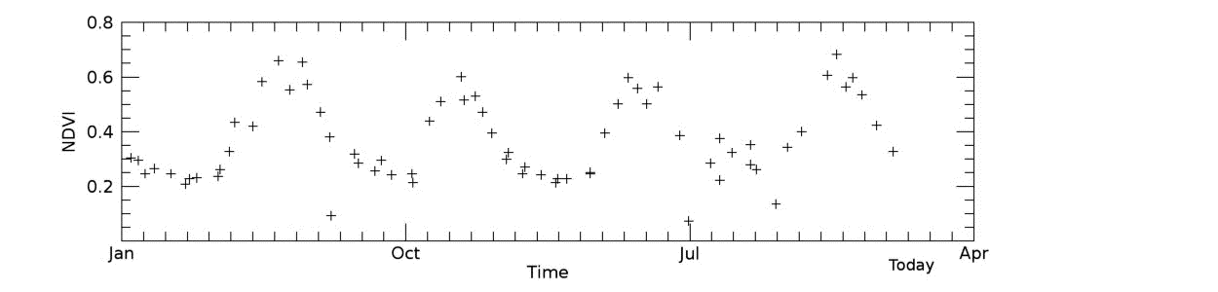
Intro
Objectives
Data
Methods
Results
Conclusions
  Coarse resolution NDVI anomalies widely used to monitor vegetation in NRT
  Noise reduction with temporal smoothing/filtering of time series
  Smoothing: symmetric availability of data points (before vs. after)
  Filtering: methods to cope with unbalanced availability

Slide 3
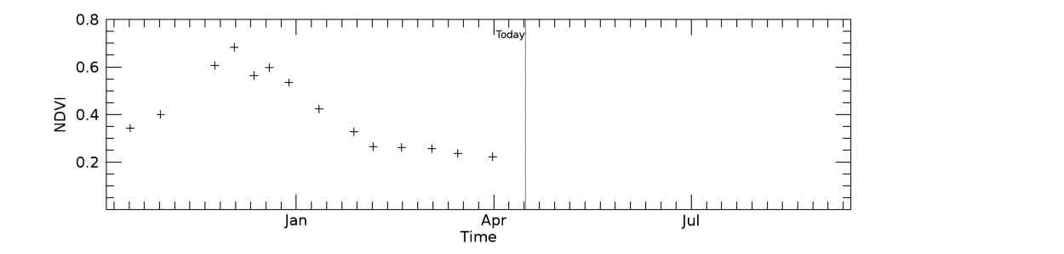
Intro
Objectives
Data
Methods
Results
Conclusions
  NRT filtering provides subsequent updates of the estimation of the same data point as more observations become available
  3 NRT consolidation stages for Copernicus biophysical products (LAI, FAPAR, etc)
  5 NRT stages for BOKU NDVI

Slide 4
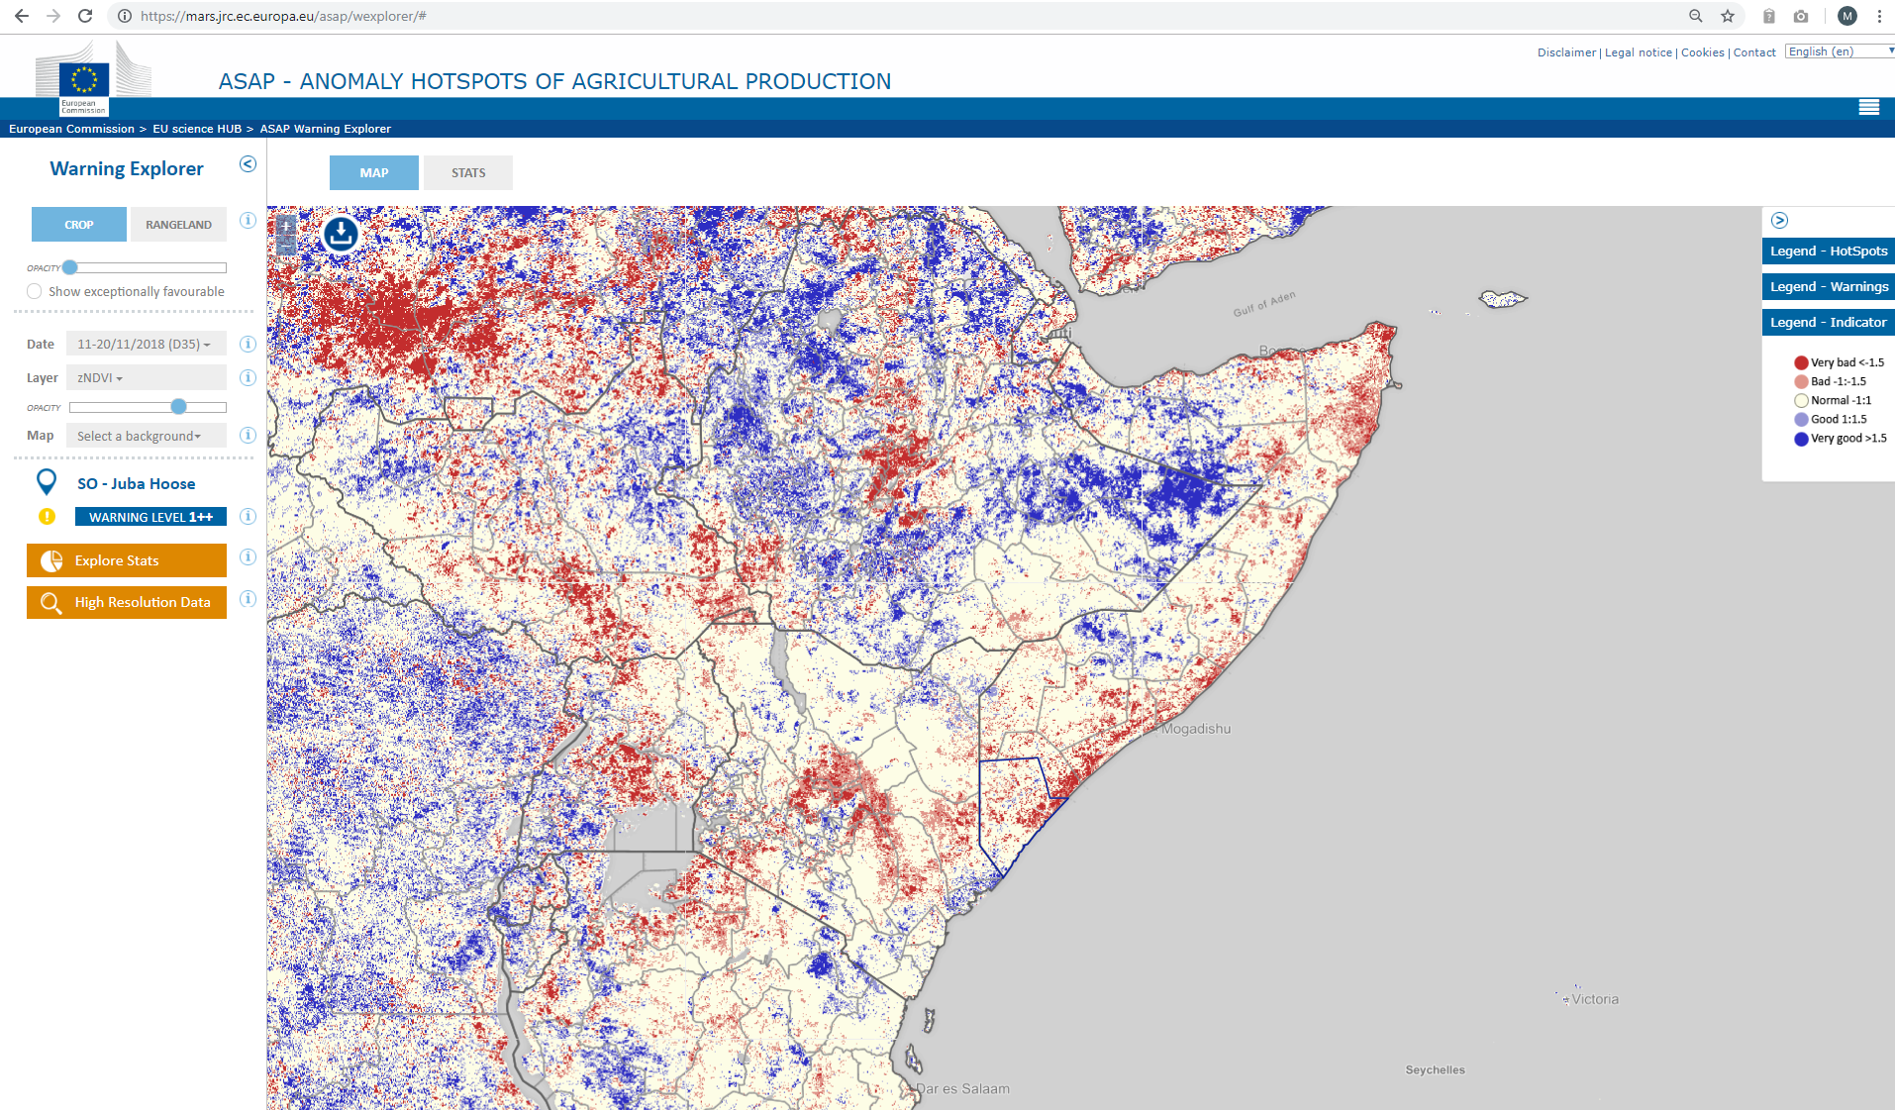
Anomalies
Intro
Objectives
Data
Methods
Results
Conclusions
  Current
  vs.
  past
NRT NDVI
NRT anomaly
HIS statistics
  Small errors in NRT NDVI may be amplified by the anomaly computation
  Negligible noise for other type of applications relying on original NDVI data may become relevant for applications using anomalies
  drought detection and early warning system ASAP
mars.jrc.ec.europa.eu/asap/

Slide 5
Intro
Objectives
Data
Methods
Results
Conclusions
  Quantify the quality of NRT NDVI products used in agricultural analysis:
  Anomalies
  Classified anomaly maps
  Detection of very large negative anomalies (e.g. drought detection)

Slide 6
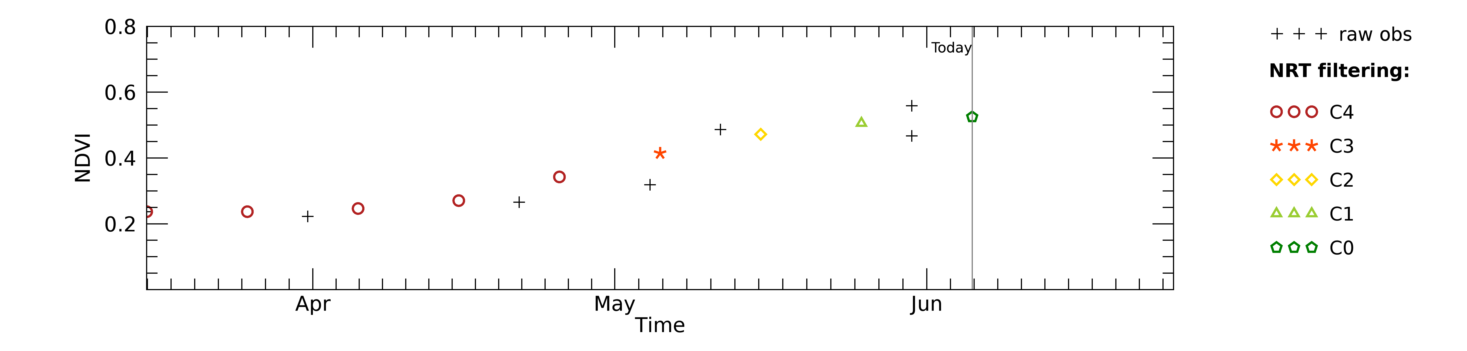
Intro
Objectives
Data
Methods
Results
Conclusions
  1 km 10-day (dekad) NDVI from BOKU University processing line (Klisch and Atzberger, 2016)
  NDVI source: MOD13A2 and MYD13A2 V006 16-day NDVI composites at 1 km
  Historical data
  Off-line smoothing using Whittaker smoother adapted to upper envelope (taking into account actual acquisition day and MODIS quality flags)
  Final reference product, f
  NRT
  Constrained Whittaker: smoothing constrained by quality and NDVI climatology
  5 consolidation stages (C0-4) produced with increasing reliability and delay

Slide 7
Intro
Objectives
Data
Methods
Results
Conclusions
  Extent of analysis
  Spatial: global
  Temporal: 2003-2016
  Targets
  Spatial: vegetated land
  Temporal: average growing season period (land surface phenology)

Slide 8



Anomalies (10-day time step)
Intro
Objectives
Data
Methods
Results
Conclusions
  Z-score
  Non-exceedance probability (also VPI, Historical probability)
  Vegetation Condition Index
$$Z_{i}=\frac{{NDVI}_{i}−{NDVI}_{AVG,i}}{{NDVI}_{SD,i}}$$
$${NEP}_{i}=100\frac{rank\left({NDVI}_{i}\right)}{n+1}$$
$${VCI}_{i}=100\frac{{NDVI}_{i}−{NDVI}_{min,i}}{{NDVI}_{max,i}−{NDVI}_{min,i}}$$

Slide 9
Intro
Objectives
Data
Methods
Results
Conclusions
NRT NDVI (C0-4)
NRT anomaly
  ?
C0-4
HIS statistics
final off-line smoothing f
NxHx option (x=0,..,4) | NxHf option (x=0,..,4)
+ No Bias & heteroscedasticity | + Use of most reliable stage for statistics
- Requires storing multiple versions of full archive and stats | + Stats computed once and used with all stages
- Stats sensitive to possible outliers in Hx
Notes:
Xx option, the one using the same consolidation stage for stats

Slide 10
Intro
Objectives
Data
Methods
Results
Conclusions
  Multi-category anomaly classes
  Yes/no event (of drought)
  NRT anomaly error estimated comparing NRT product with the reference one, f

Slide 11
Results
Intro
Objectives
Data
Methods
Results
Conclusions
  Map example: HoA drought onset in late 2010
  Evolution of reference f captured
  C0 underestimates drought severity in d27 and 30
Time delay
f

Slide 12
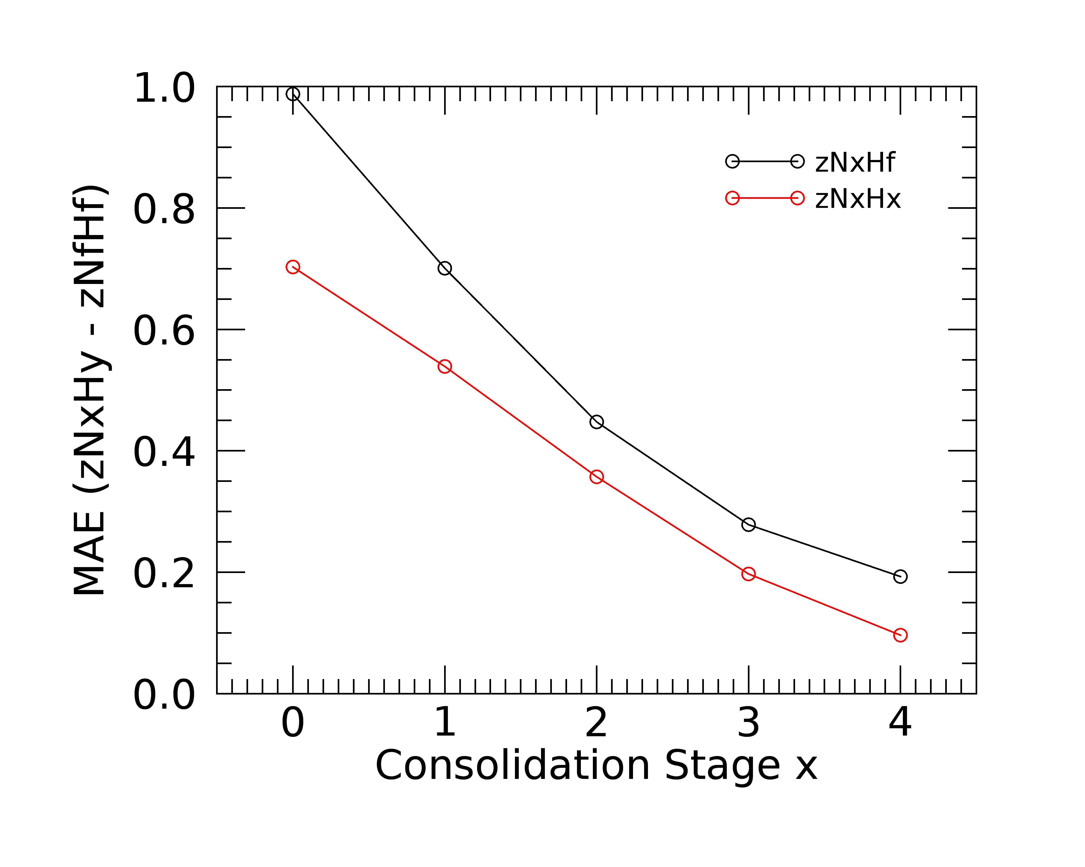
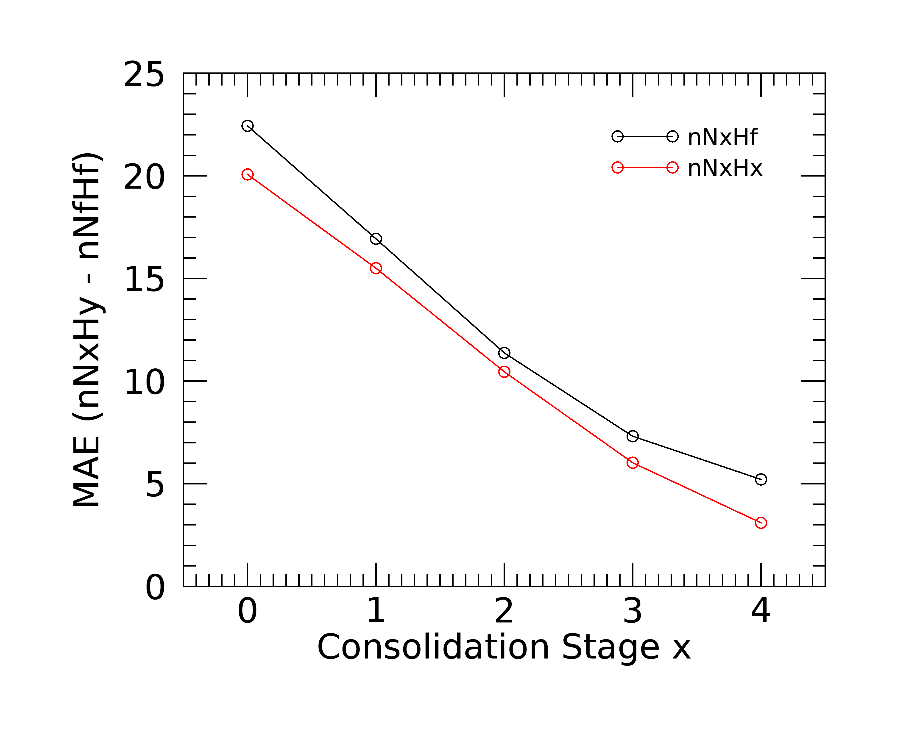
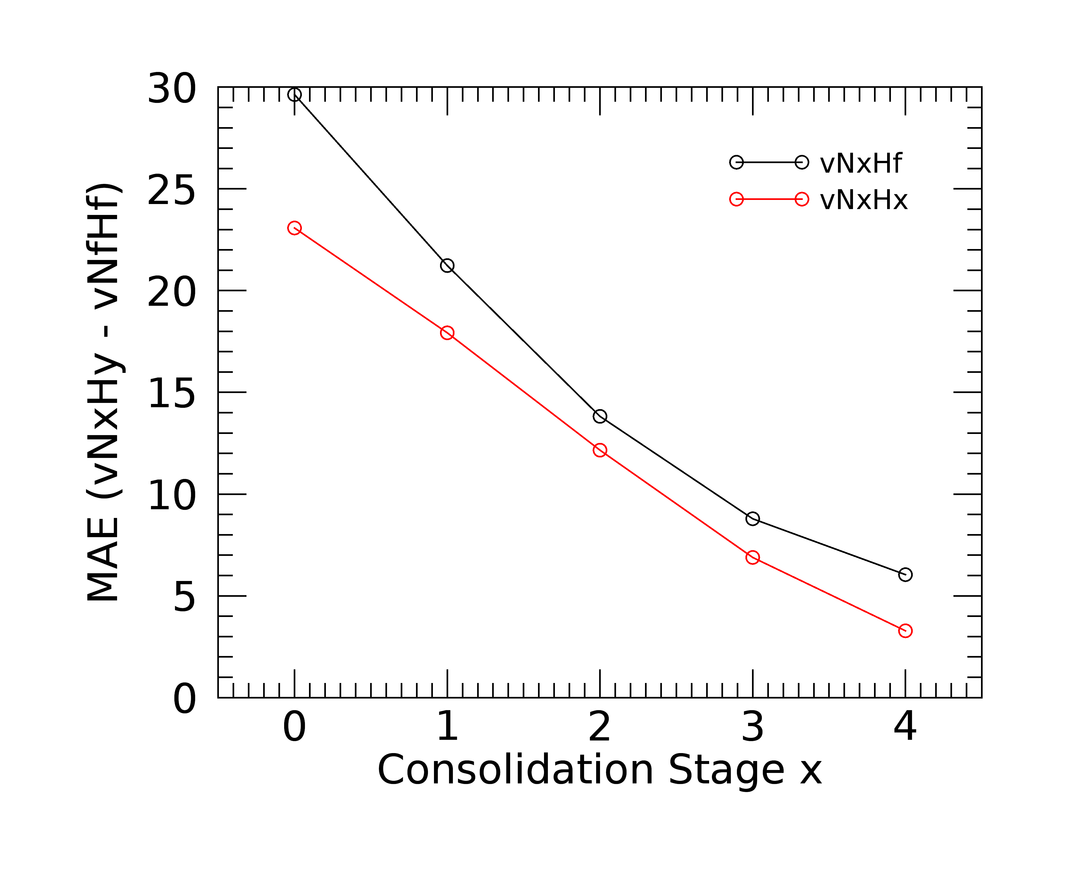
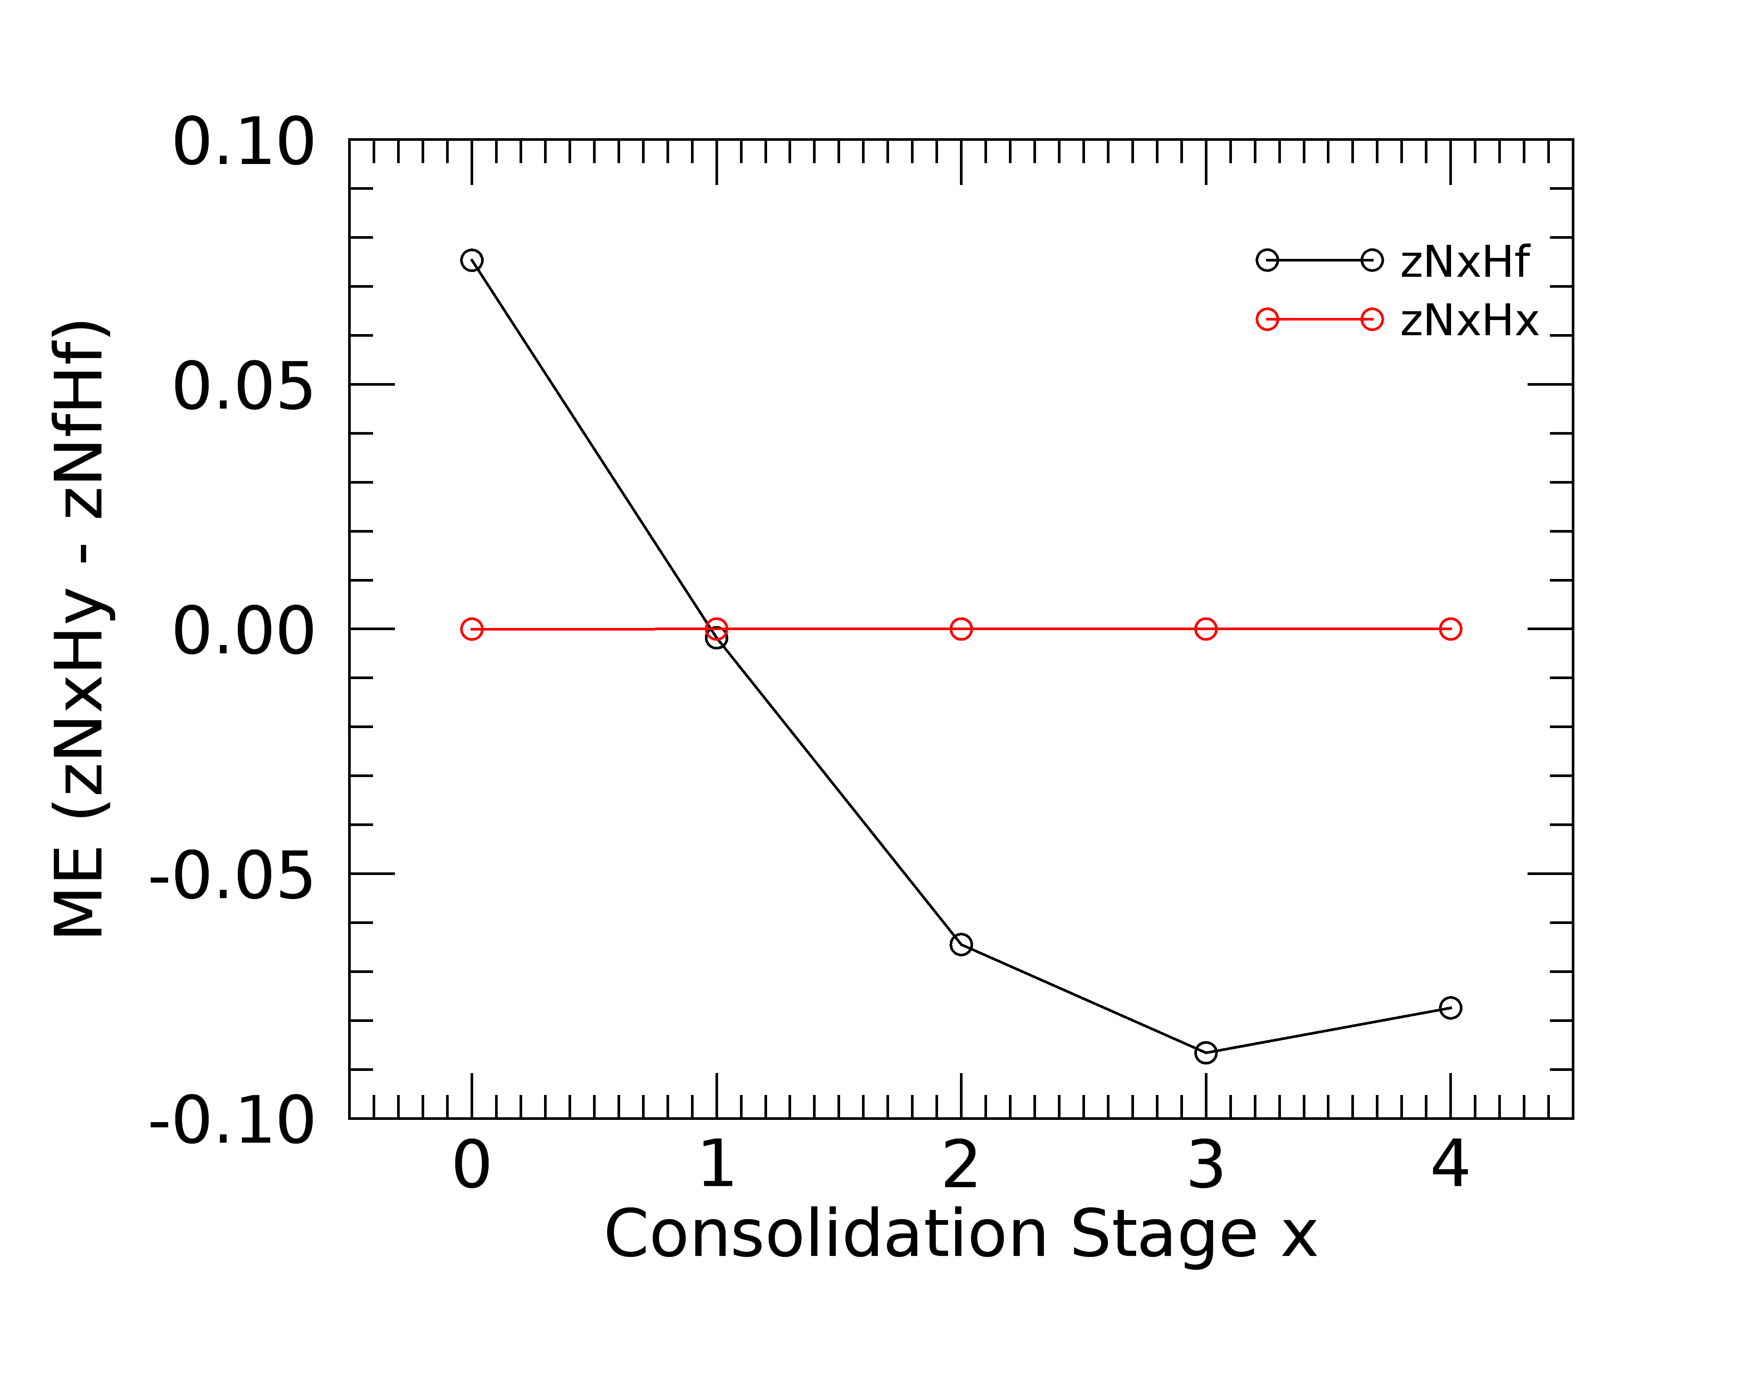
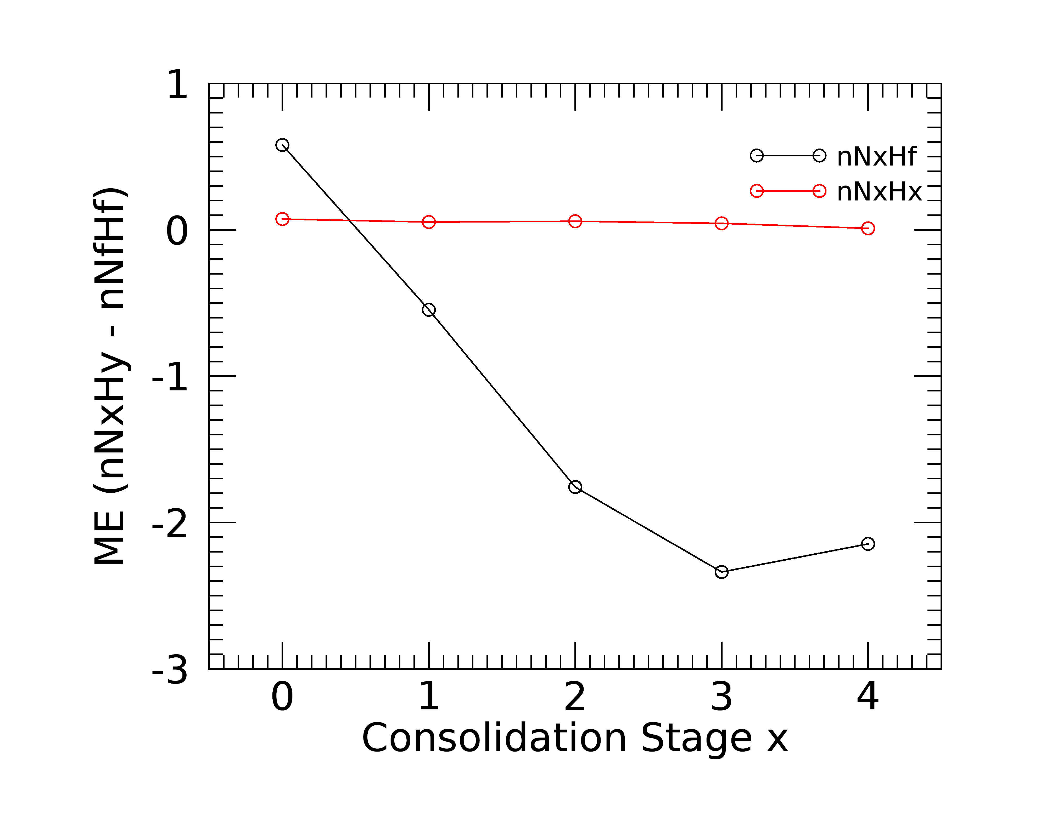
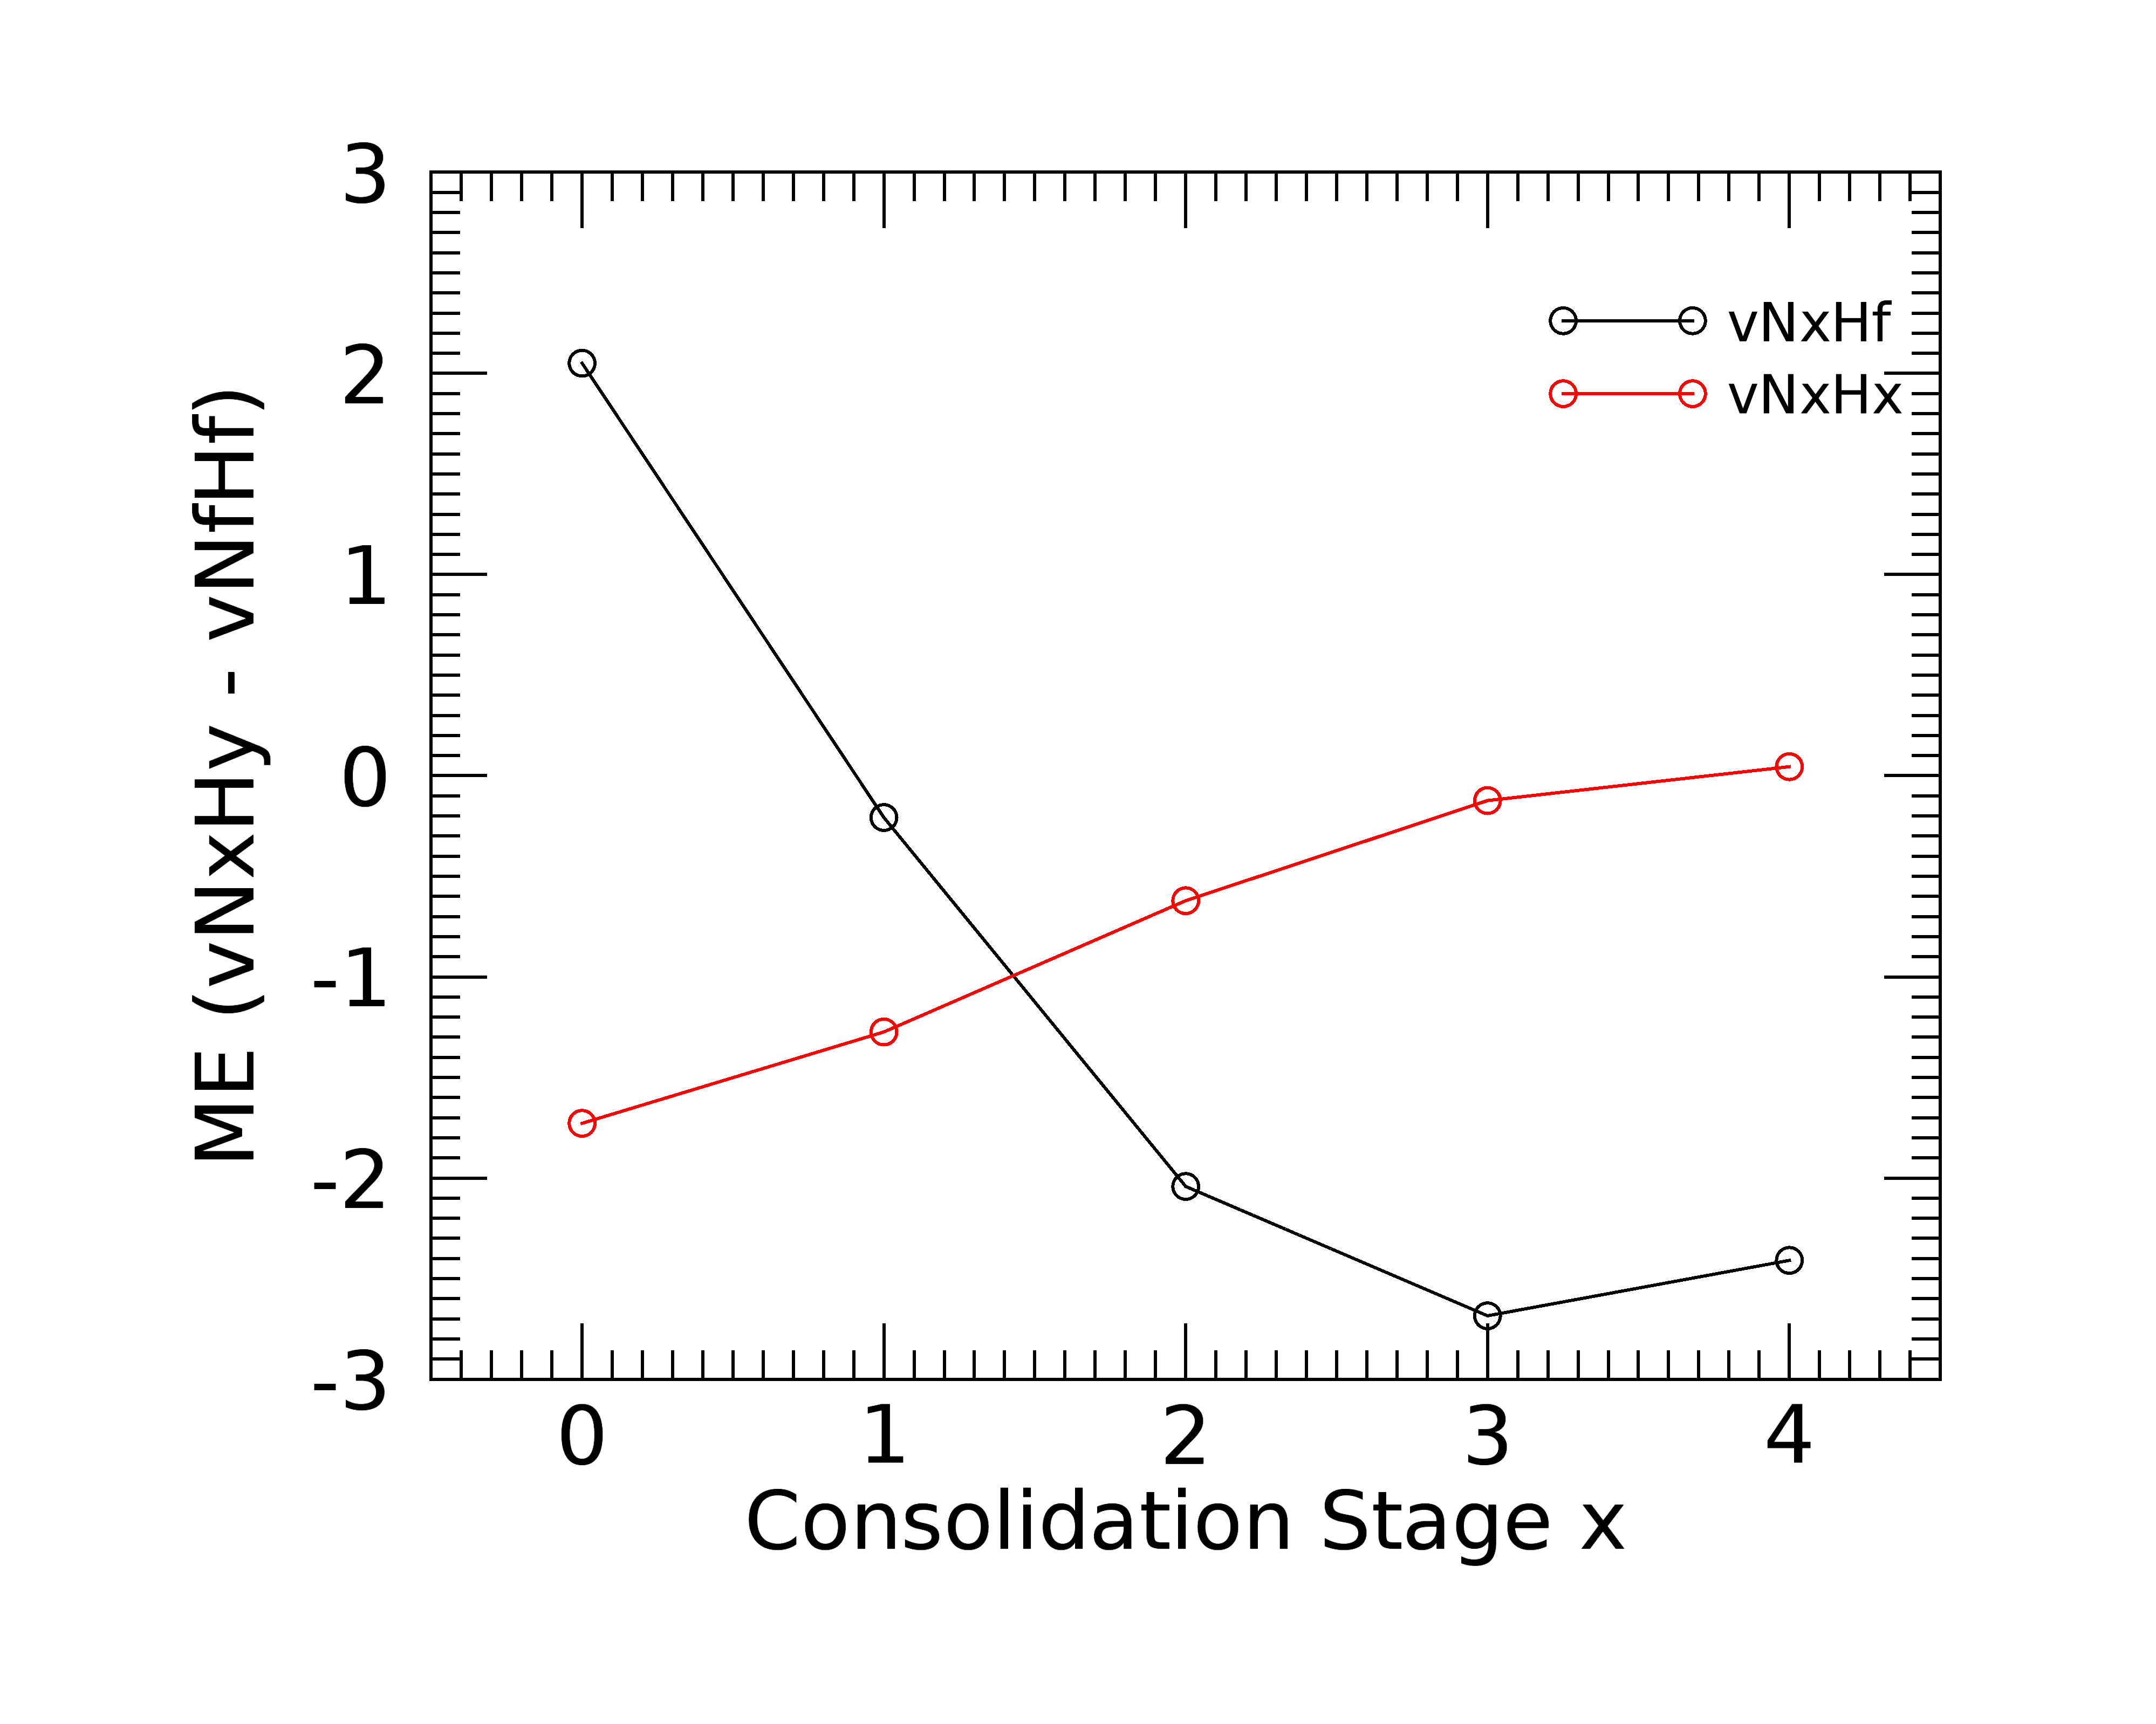
Anomaly error, global stats
Intro
Objectives
Data
Methods
Results
Conclusions
  Z-score
  NEP
  VCI
  MAE
  ME
  Large errors for first consolidation stages
  Error reduced with later stages (timeliness vs. accuracy)
  NxHx option has smaller and unbiased error compared to NxHf
Notes:
Large error, example of NEP

Slide 13
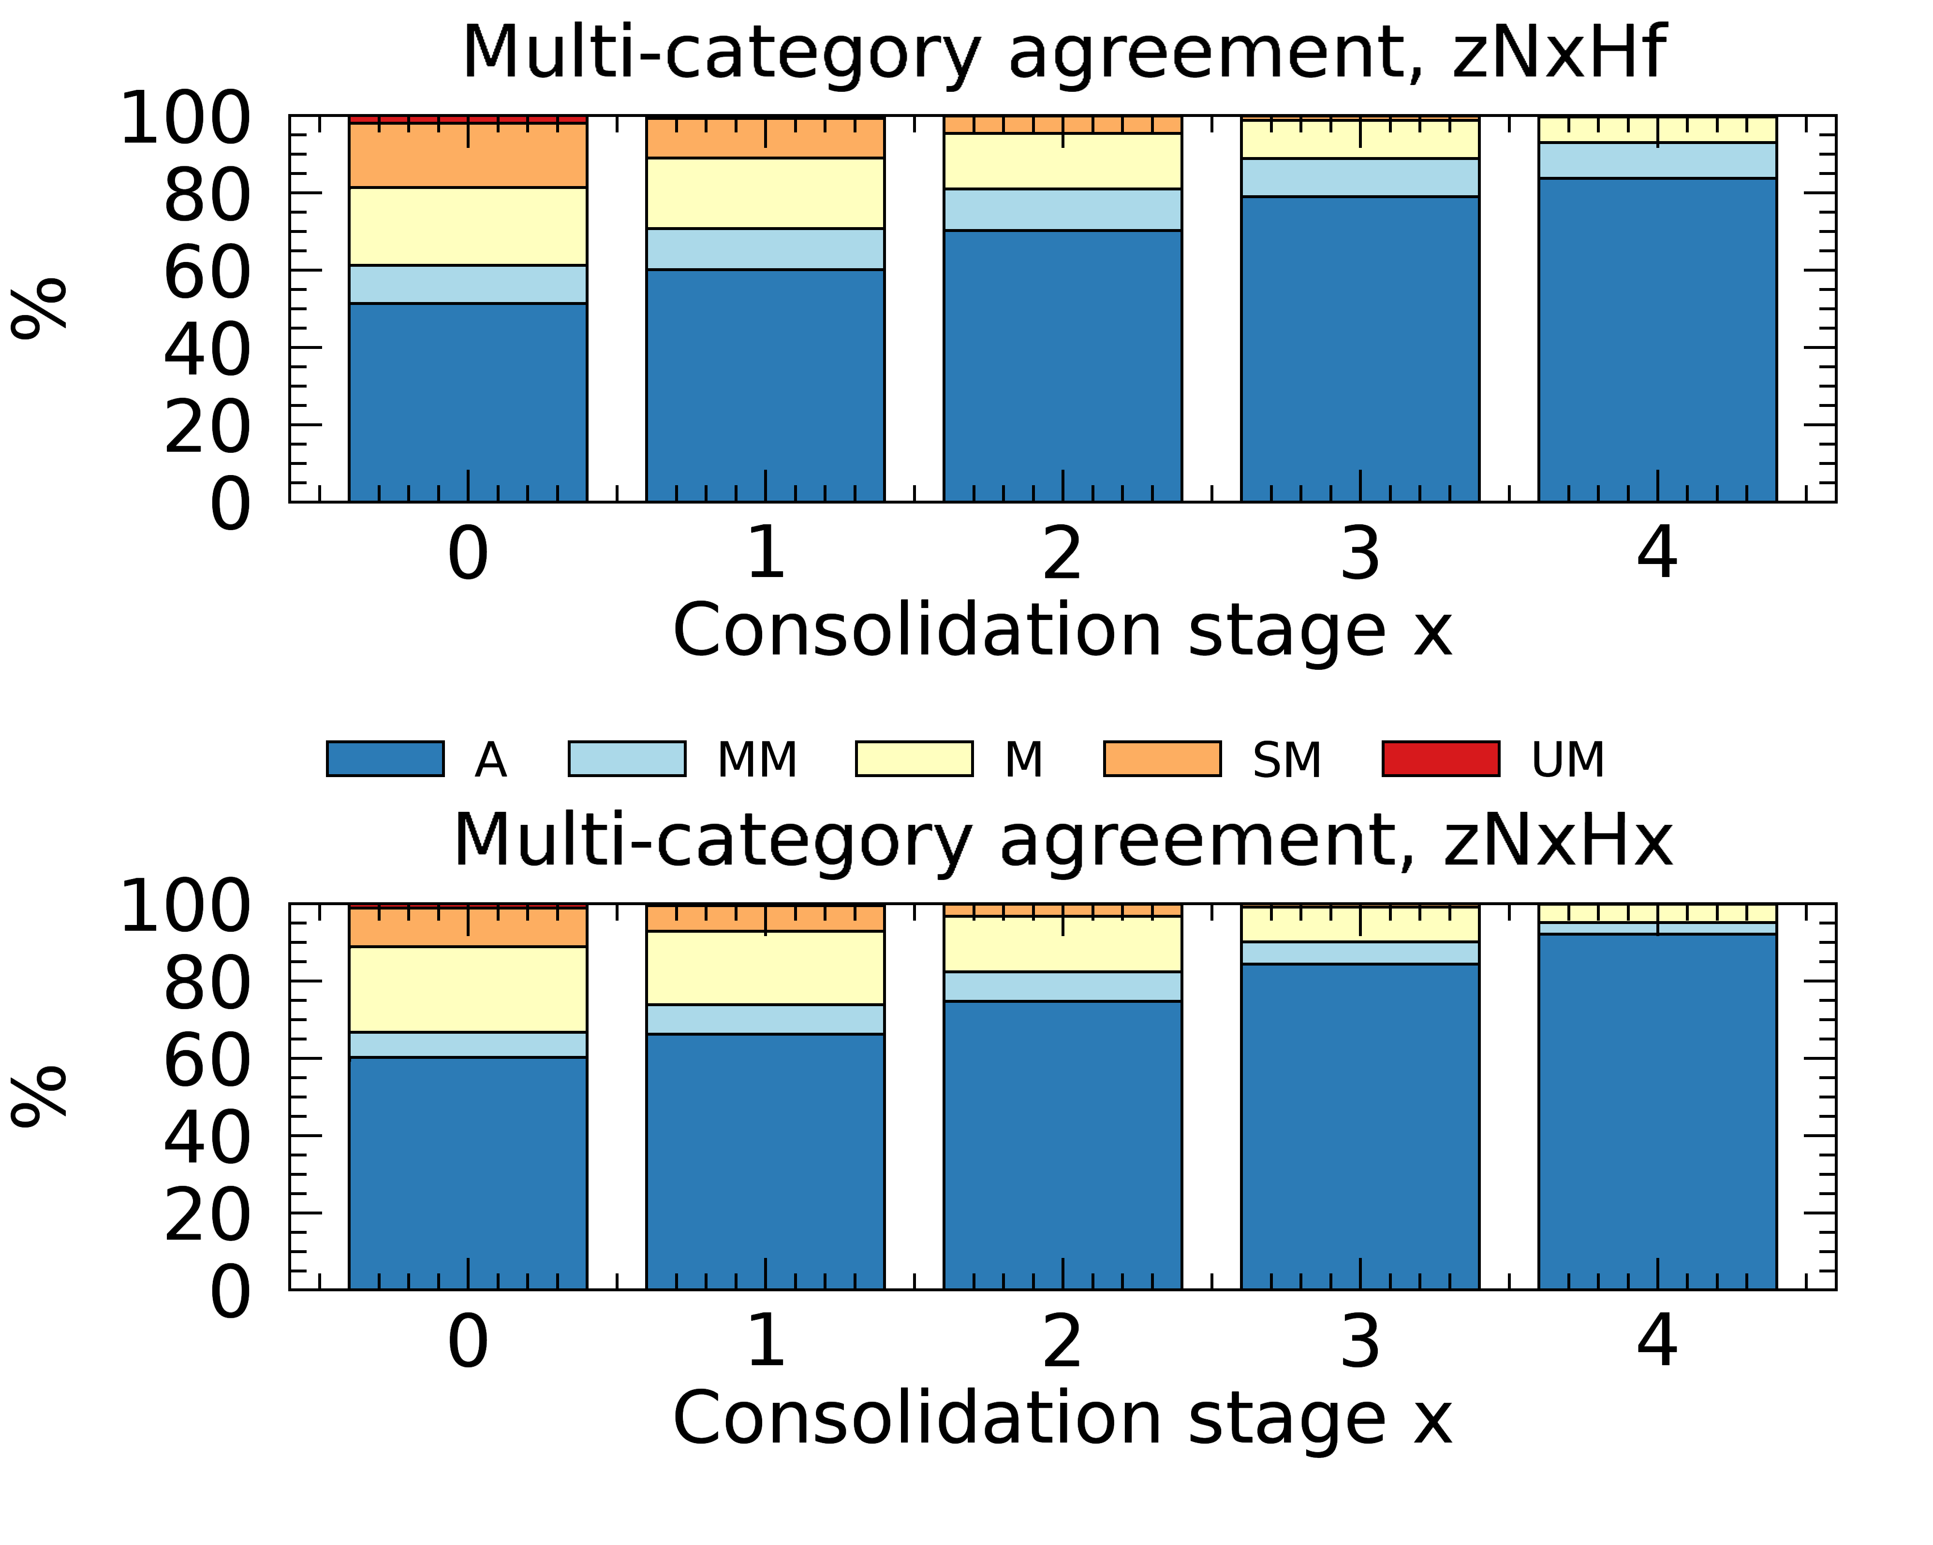
Multi-category classification error, global stats
Intro
Objectives
Data
Methods
Results
Conclusions
Severity of the error the analyst would face in interpreting the anomaly maps
Evaluate the class agreement
NRT vs. Reference f
  Example for Z
  zNxHf
  NxHx strategy better for Z and NEP
  NxHf better for VCI (more sensitive to outliers)
  zNxHx
Notes:
In 5 classes ranging from perfect agreement to unacc. Mismatch
This histograms show the % of agreement classes as a function of consolidation stage

Slide 14
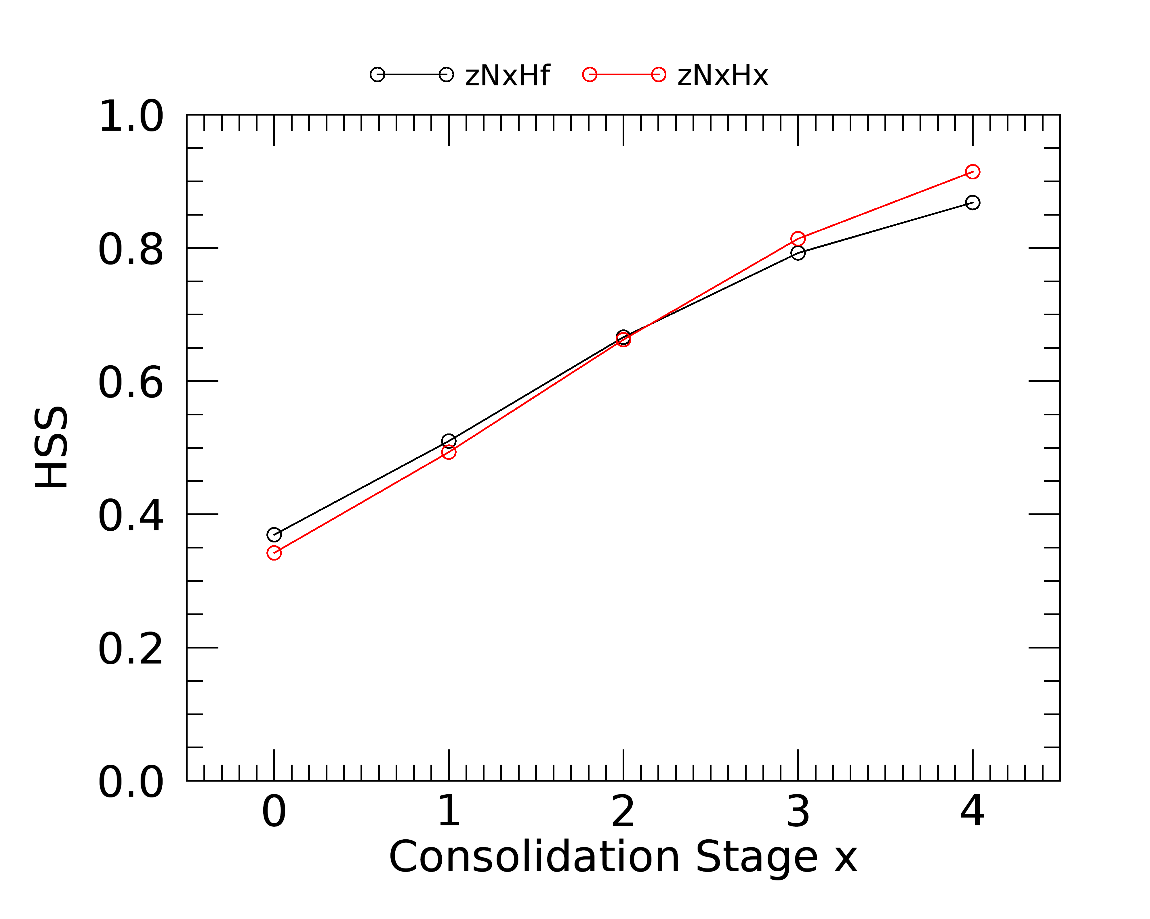
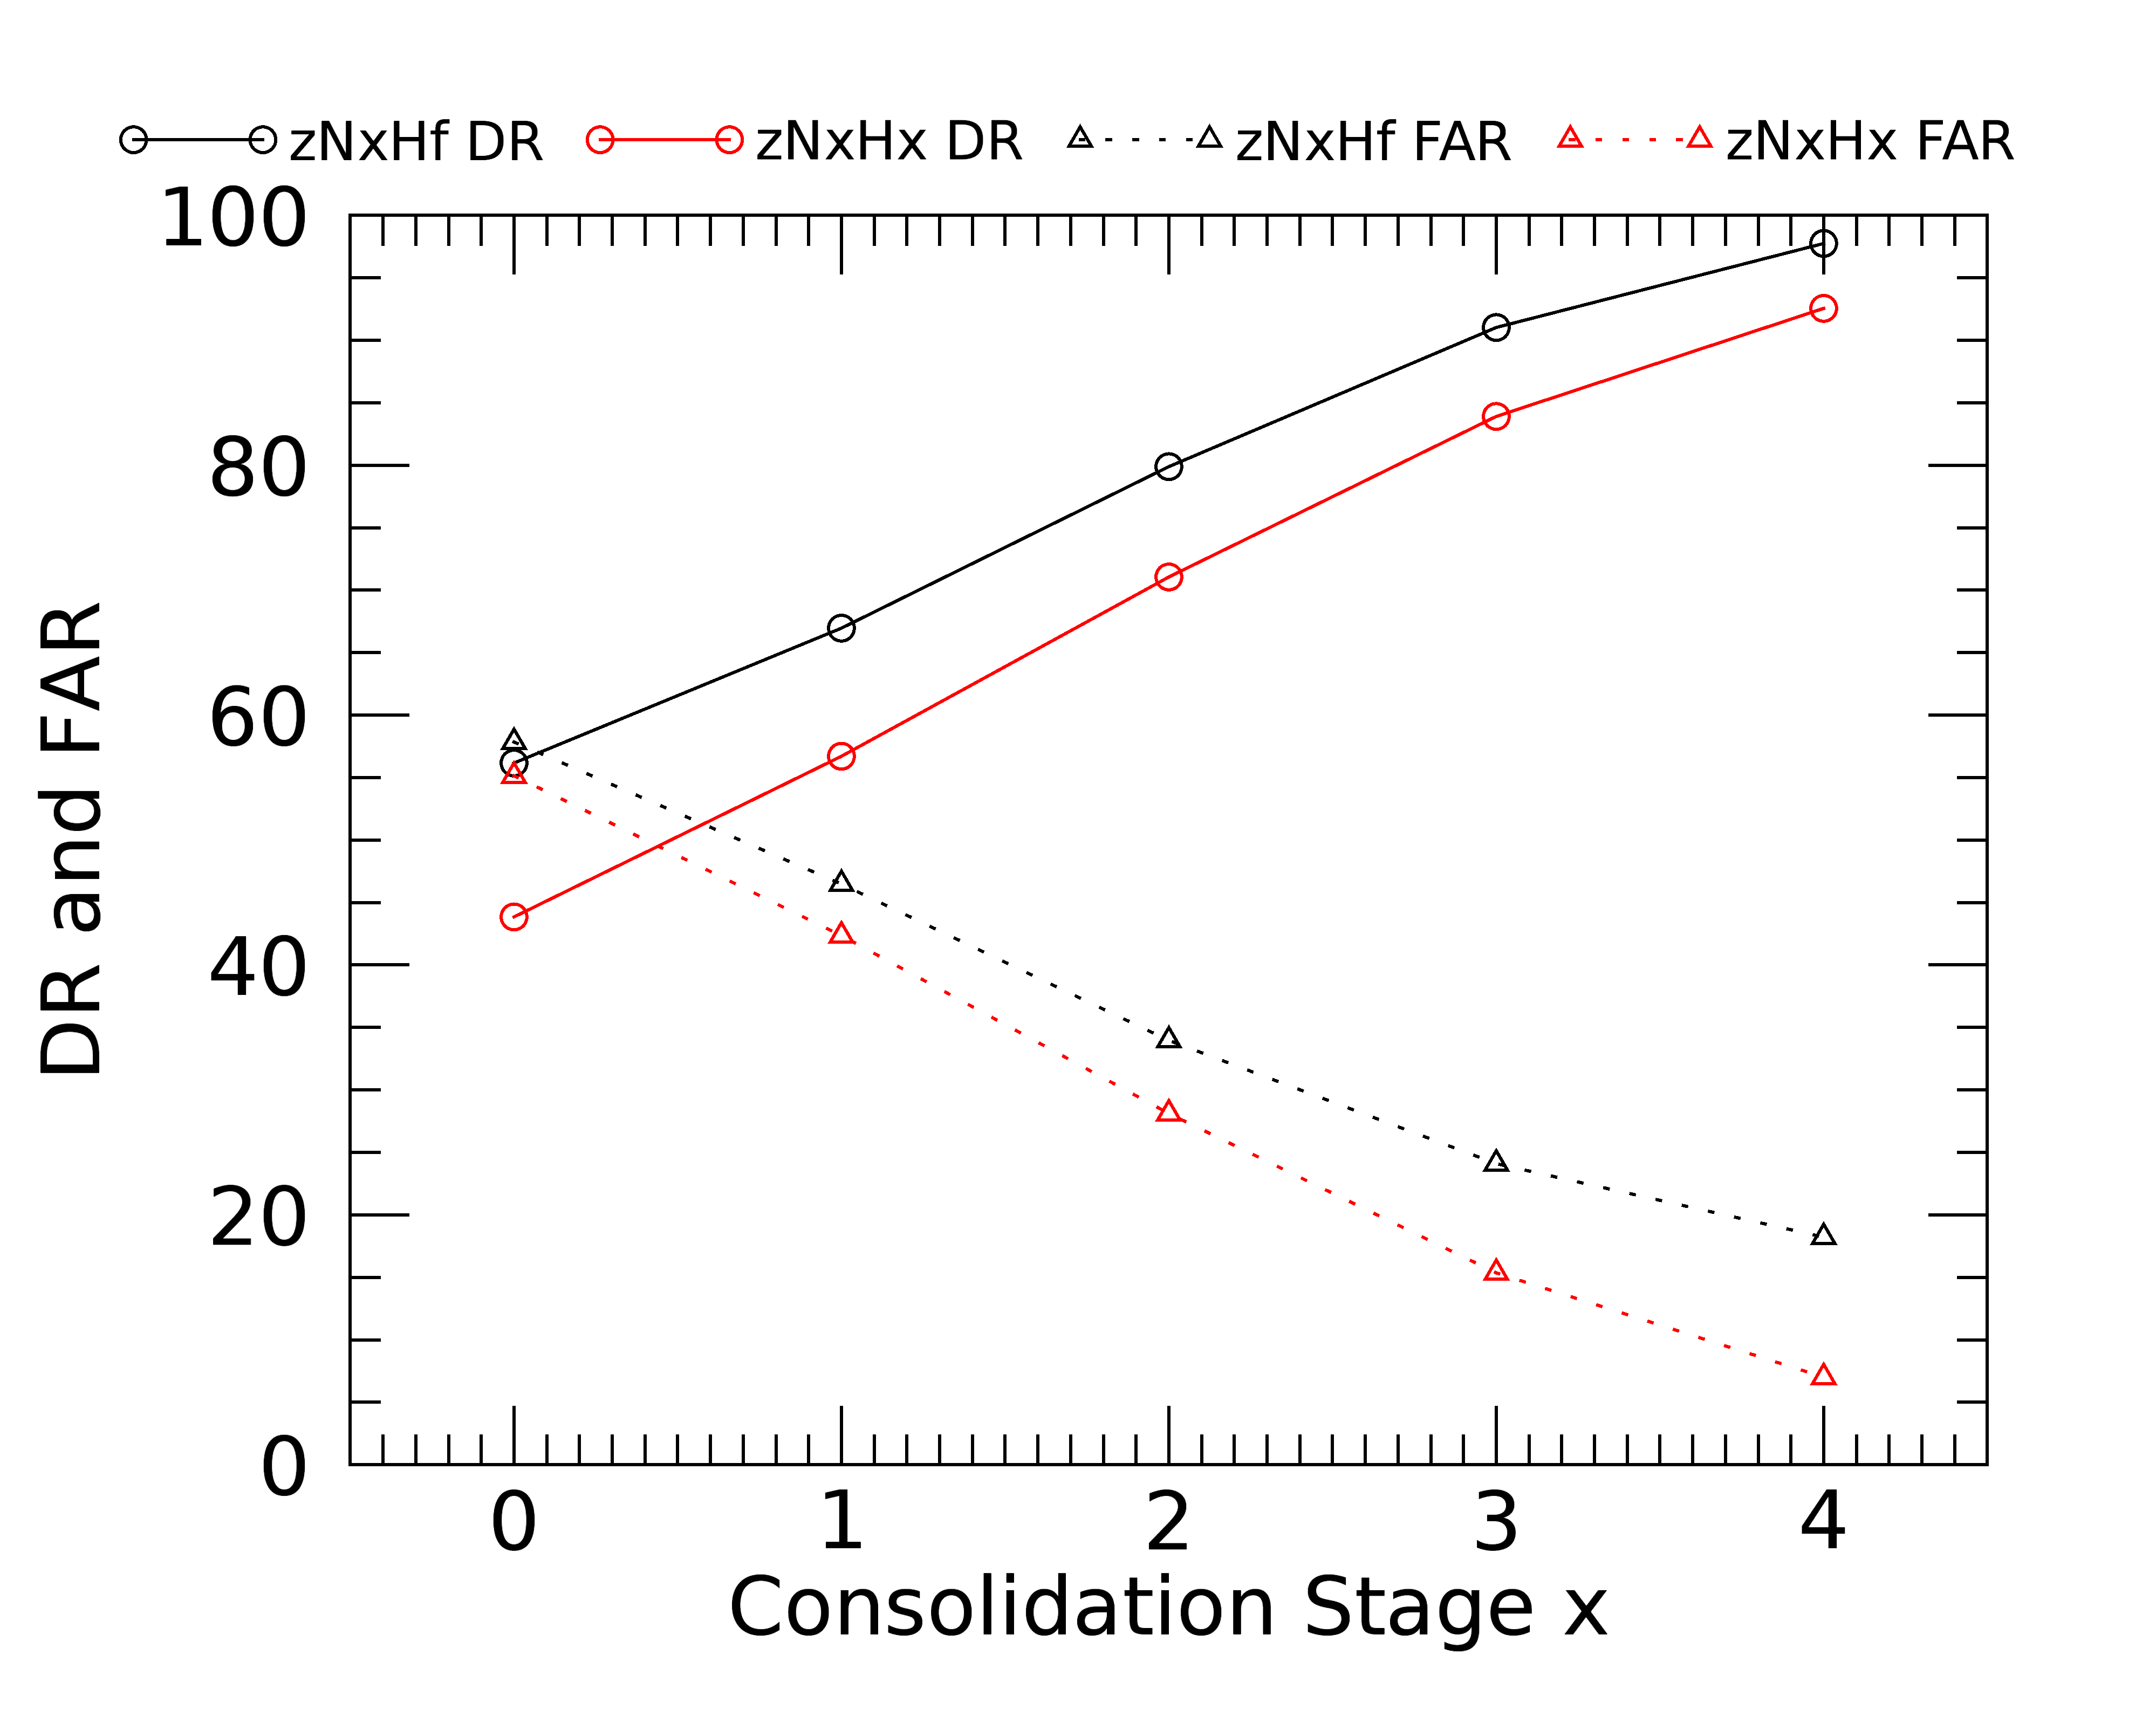
Y/N classification, global stats
Intro
Objectives
Data
Methods
Results
Conclusions
  Example for Z
Detection Rate
Heidke Skill Score
False Alarm Rate
  Poor to moderate agreement in first stages (HSS around 0.4), strong agreement (HSS>0.8) at stages 3 - 4
  NxHf maximize detection rate (with small increase of false alarms)

Slide 15
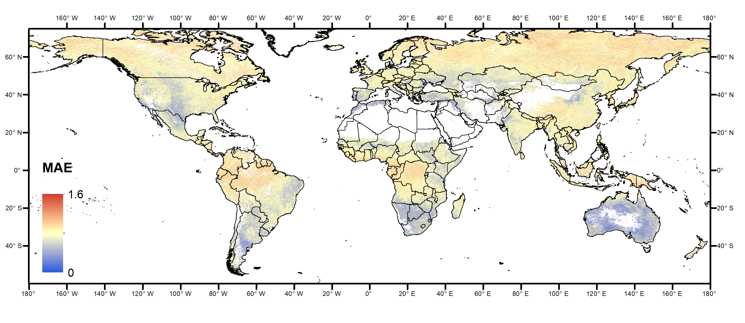
Results
Intro
Objectives
Data
Methods
Results
Conclusions
  Global results, spatial patterns (example for Z)
  zN0H0
  Similar patterns for NEP and VCI
  Large spatial variability
  Larger errors at high latitudes and equator

Slide 16
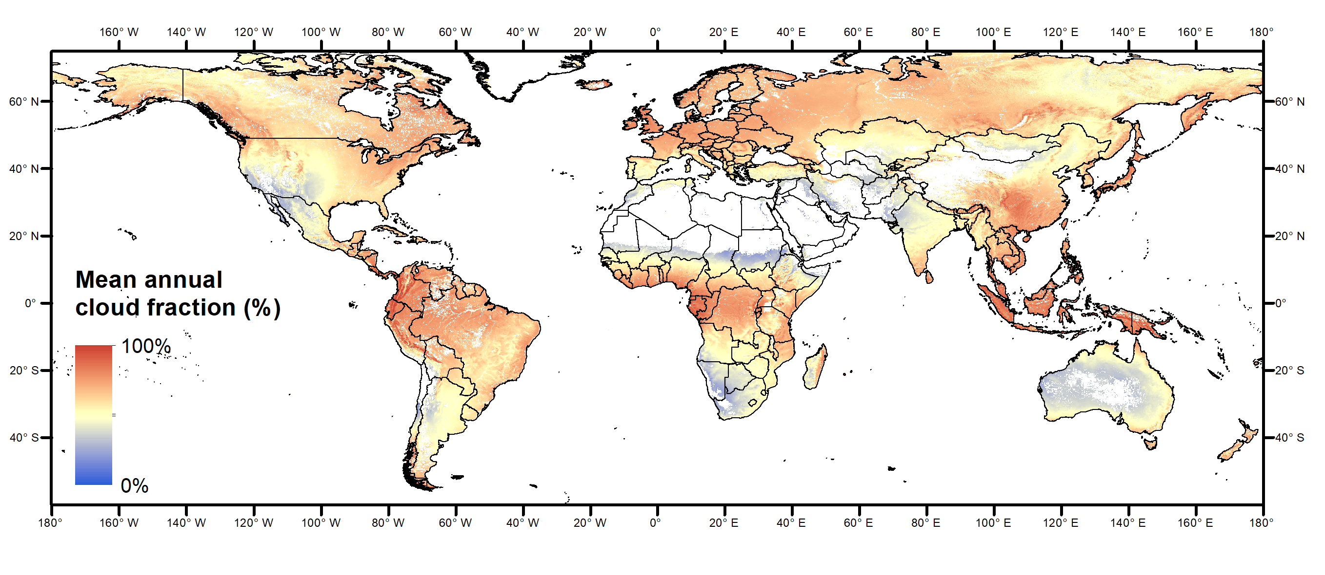
Results
Intro
Objectives
Data
Methods
Results
Conclusions
  Global results, spatial patterns (example for Z)
  zN0H0
  Mean annual cloud cover (Wilson and Jetz, 2016)
  Errors spatially correlated to mean annual cloud fraction (R² = 0.32)
  Possible additional factors explaining the errors at high northern latitudes: snow cover and reduced incident radiation at time of satellite overpass

Slide 17
Intro
Objectives
Data
Methods
Results
Conclusions
  NRT filtering comes with errors that propagates to anomalies
  NRT quality can be characterized when NRT time series are made available by the data producer (hindcasting needed for past observation)
  BOKU NDVI case study:
  Initial consolidation stages are affected by large estimation errors
  Error is reduced with time (accuracy goes with latency as expected)
  Best anomaly computation option depends on application:
  NxHx for computing anomaly stats over a region (e.g. average) and anomaly classes (VCI exception)
  NxHf for “extreme events” detection
  Way forward:
  Assess the NRT anomaly quality of products using different approaches for filtering (COPERNICUS)

Slide 18
Thank you!

Slide 19
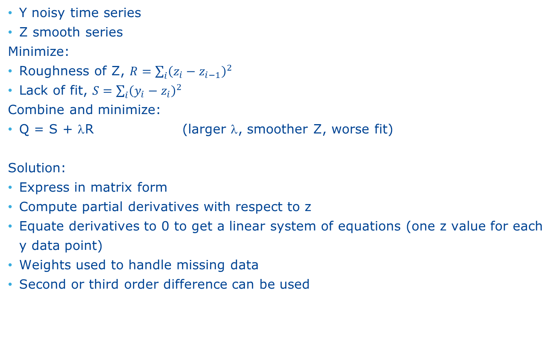
Whittaker
Y noisy time series
Z smooth series
Minimize:
Roughness of Z, $R=\sum_{i}{{\left(z_{i}−z_{i−1}\right)}^{2}}$
Lack of fit, $S=\sum_{i}{{\left(y_{i}−z_{i}\right)}^{2}}$
Combine and minimize:
Q = S + λR (larger λ, smoother Z, worse fit)
Solution:
Express in matrix form
Compute partial derivatives with respect to z
Equate derivatives to 0 to get a linear system of equations (one z value for each y data point)
Weights used to handle missing data
Second or third order difference can be used

Slide 20
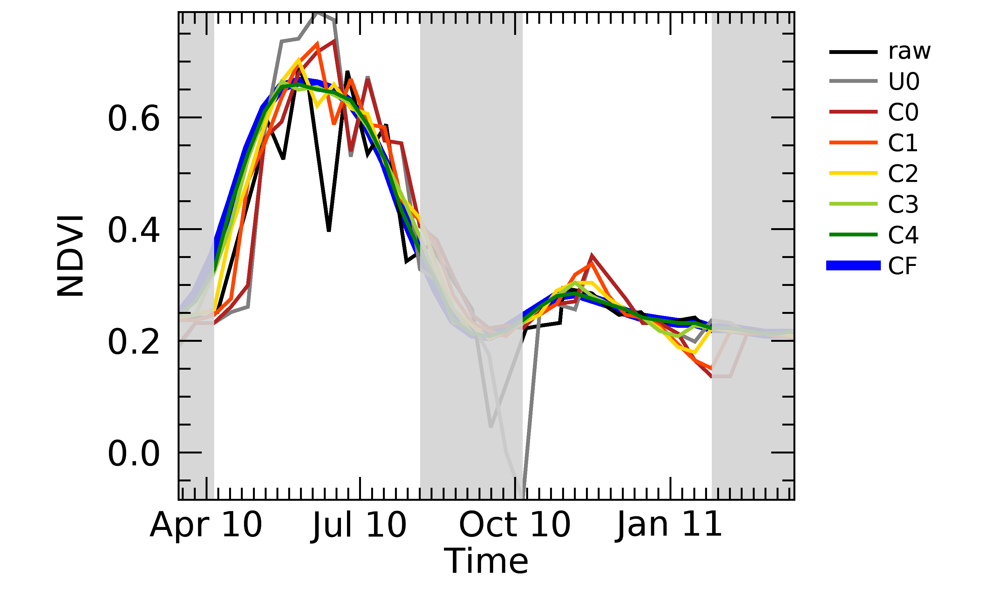
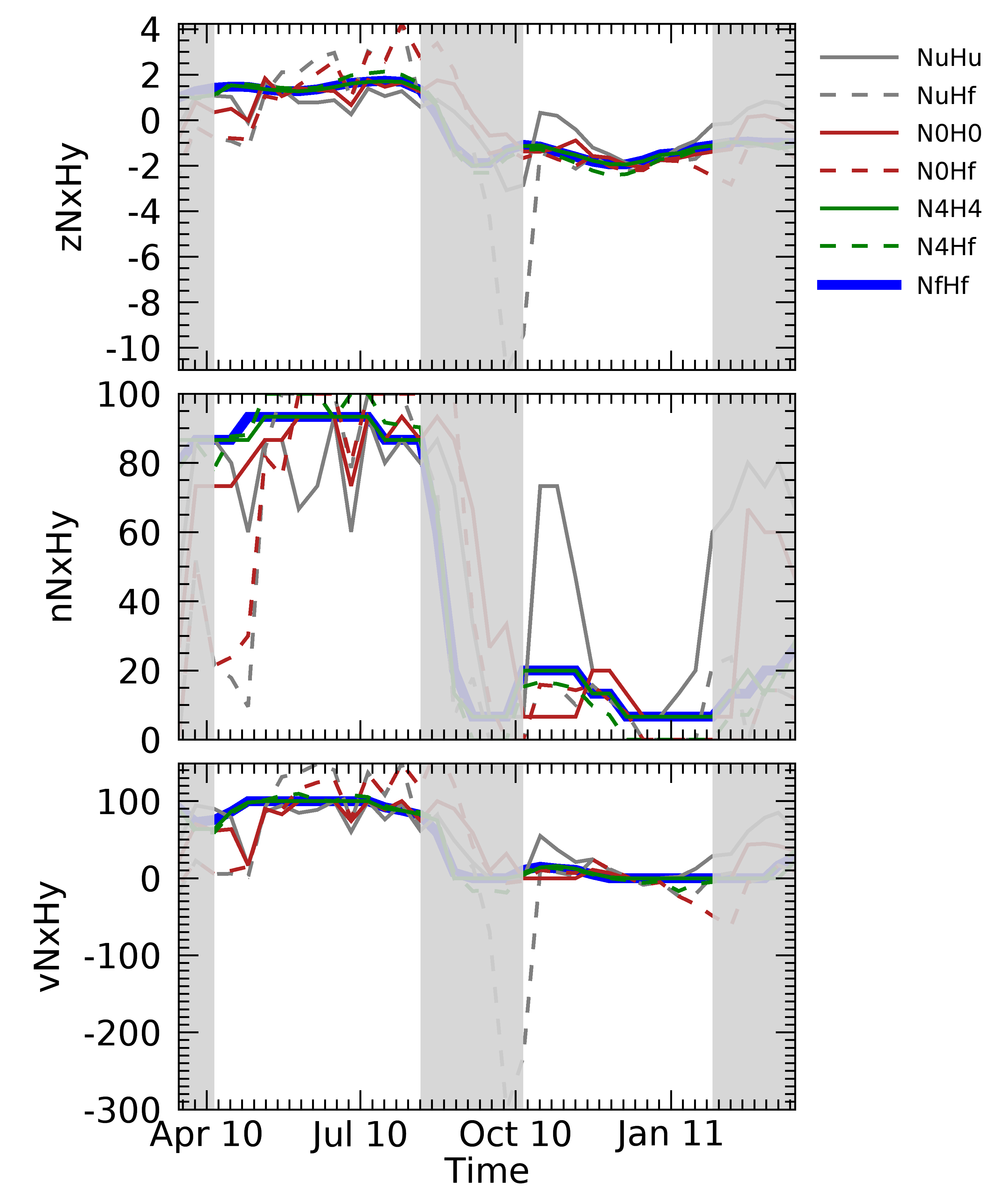
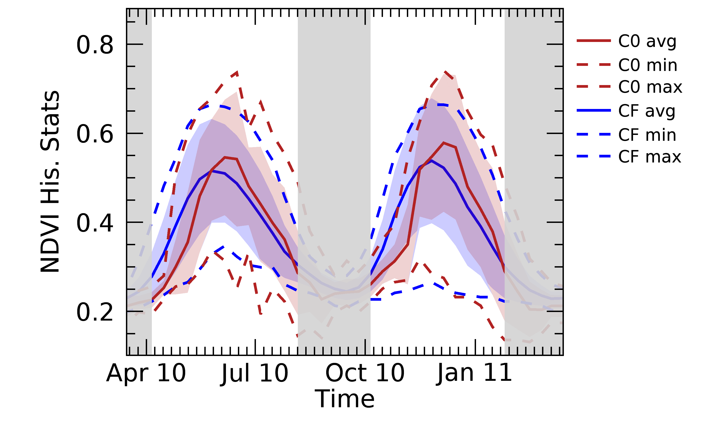
Results
Intro
Objectives
Data
Methods
Results
Conclusions
  Pixel example: crop in Somalia – 2010
  Anomalies C0, C4, f
  Two computation options
  NDVI
f
  His stats, C0 and f
f

Slide 21
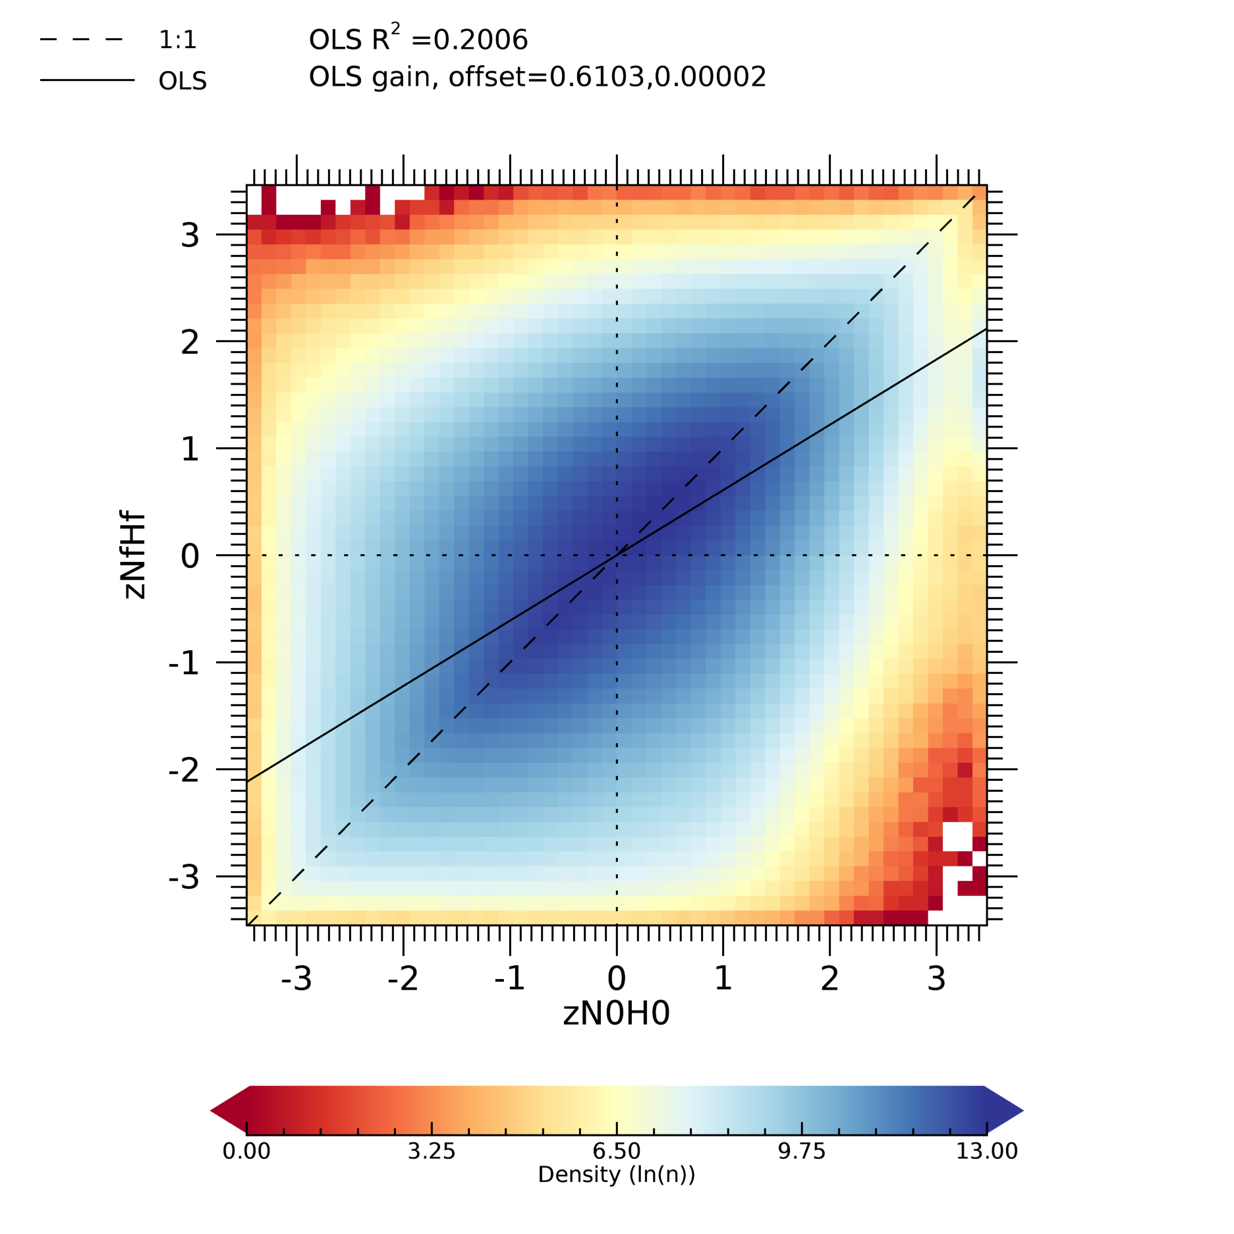
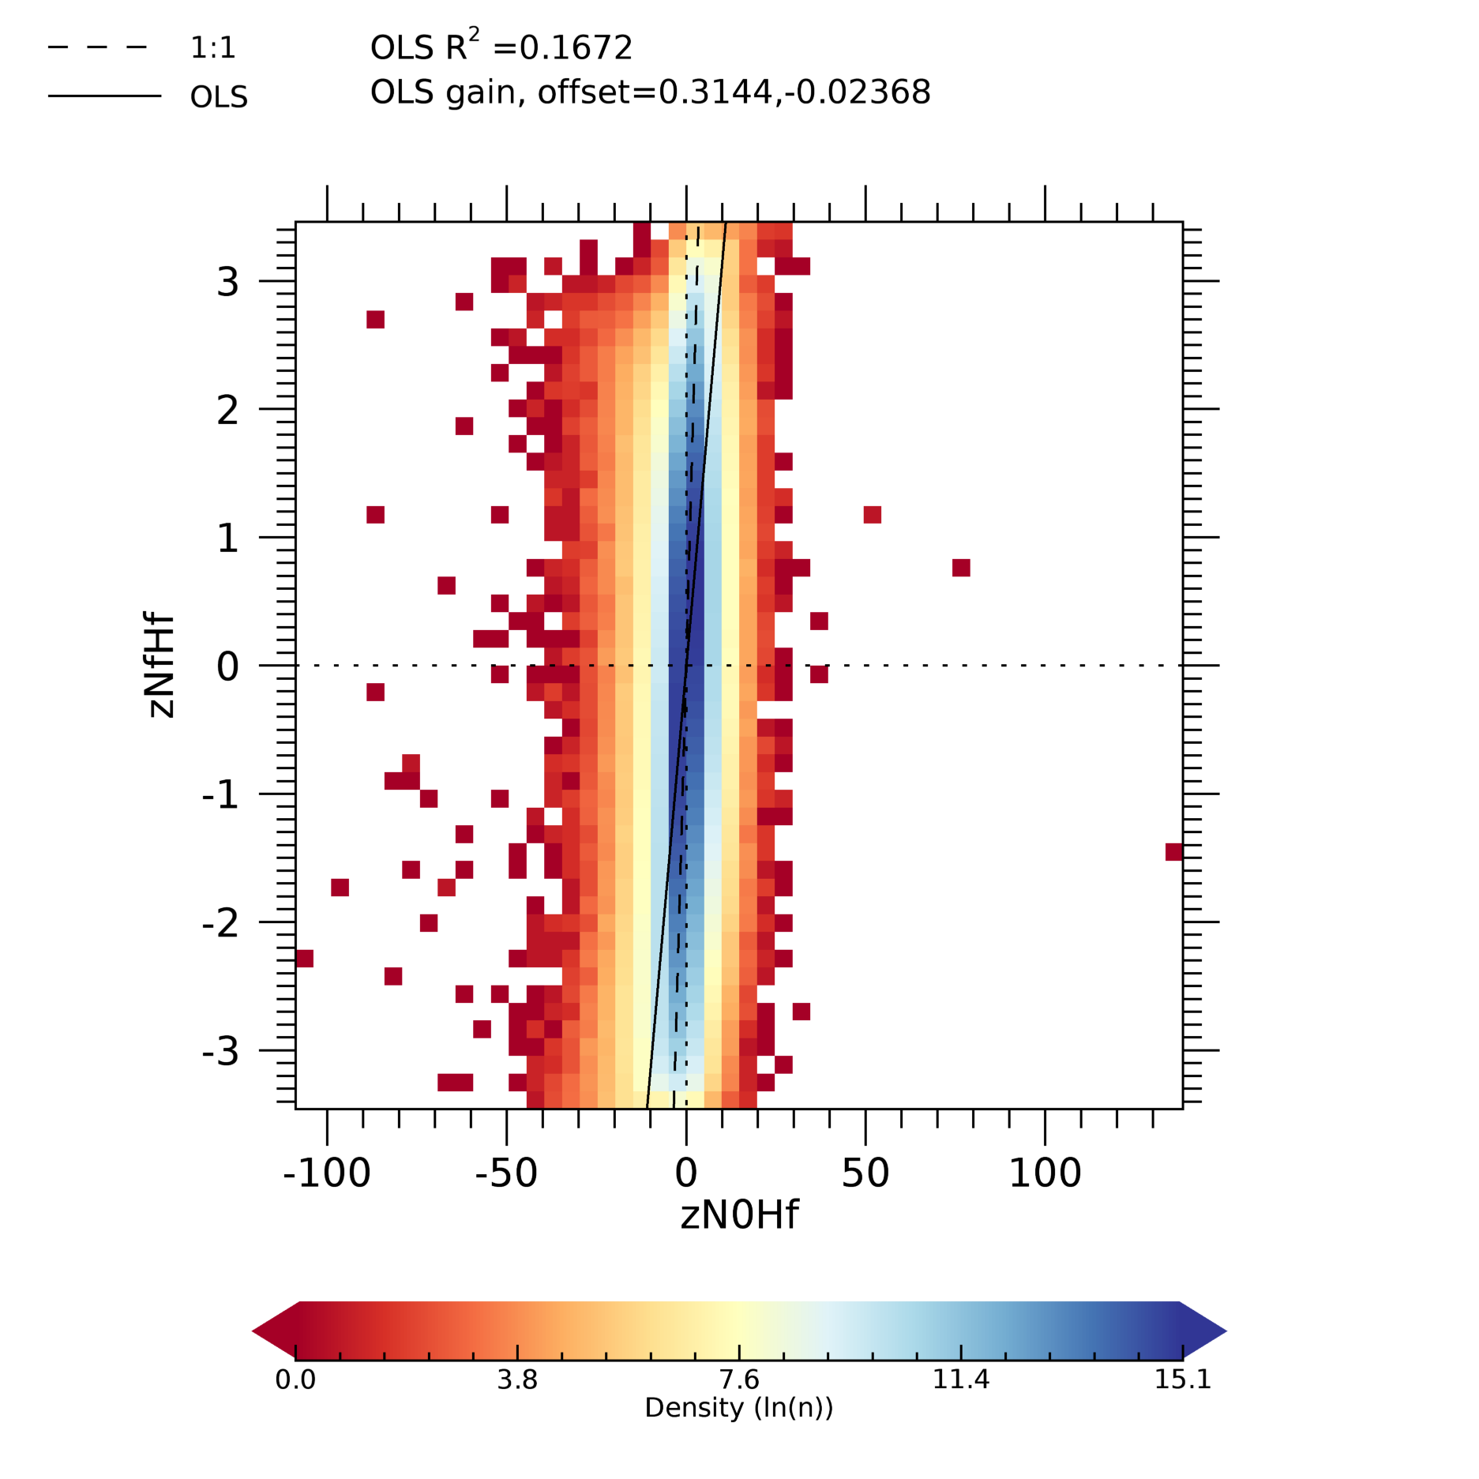
Results
Intro
Objectives
Data
Methods
Results
Conclusions
  Example of difference between aN0H0 and aN0Hf
  zN0H0 vs. zNfHf
  zN0Hf vs. zNfHf
  Variability of reference better explained by N0H0 (larger R² for all stages)
  Variability of NRT > variability reference (OLS slope)
  With option aNxHf (Z and VCI): output range expanded (e.g. VCI can be outside 0-100)

Slide 22
Methods
Intro
Objectives
Data
Methods
Results
Conclusions
  Multi-category anomaly classes
Z-score |  |  | NEP |  |  | VCI
Value | Class |  | Value | Class |  | Value | Class
x ≥ 2 | Extremely good |  | x ≥ 97.7 | Very to extr. good* |  | x ≥ 50 | Better than average
1.5≤ x<2 | Very good |  | 93.3≤x<97.7
1≤x<1.5 | Moderately good |  | 84.1≤x<93.3 | Moderately good
-1<x<1 | Near normal |  | 15.9<x<84.1 | Near normal |  | 35≤x<50 | Normal conditions
-1.5<x≤-1 | Moderately bad |  | 6.7<x≤15.9 | Moderately bad |  | 20≤x<35 | Moderate anomaly
-2<x≤-1.5 | Very bad |  | 2.3<x≤6.7 | Very to extr. bad* |  | 10≤x<20 | Severe anomaly
x ≤ -2 | Extremely bad |  | x ≤ 2.3 |  |  | x < 10 | Extreme anomaly

Slide 23
Methods
Intro
Objectives
Data
Methods
Results
Conclusions
  Yes/no event (of drought)
Z-score |  |  | NEP |  |  | VCI
Value | Class |  | Value | Class |  | Value | Class
x ≥ 2 |  |  | x ≥ 97.7 |  |  | x ≥ 50
1.5≤ x<2 |  |  | 93.3≤x<97.7
1≤x<1.5 |  |  | 84.1≤x<93.3
-1<x<1 |  |  | 15.9<x<84.1 |  |  | 35≤x<50
-1.5<x≤-1 | YES |  | 6.7<x≤15.9 | YES |  | 20≤x<35 | YES
-2<x≤-1.5 | YES |  | 2.3<x≤6.7 | YES |  | 10≤x<20 | YES
x ≤ -2 | YES |  | x ≤ 2.3 |  |  | x < 10 | YES

