Slide 1
Land Product Validation Subgroup
Mission is to foster and coordinate quantitative validation of higher level global land products derived from remotely sensed data in a traceable way, and to relay results so they are relevant to users
Goals are to increase the quality and efficiency of global satellite product validation by developing and promoting international standards and protocols for field sampling, scaling techniques, accuracy reporting, data and information exchange
Focus areas engage the international community in the development of datasets and protocols supporting consistent validation of remote sensing based global land products

Slide 2
LPV Subgroup Structure
Chair: Miguel Román
(NASA GSFC)
Vice-Chair: Fernando Camacho
(EOLab, Spain)
Secretariat: Jaime Nickeson
(NASA GSFC)
11 Focus Areas each with 2 international co-leads
Terms are 3 years
(optional 1 term extension for focus area leads)

Slide 3
LPV Subgroup Focus Areas
Focus Area |  | Leads | Country
Land Cover ¹ |  | Pontus Olofsson Sophie Bontemps | USA Belgium
Biophysical ¹ | LAI | Hongliang Fang Sylvain Leblanc | China Canada
 | fAPAR | Marie Weiss Vacant | France
Surface Radiation ¹ |  | Zhuosen Wang Dominique Carrer Ian Grant | USA France Australia
Fire / Burned Area ¹ |  | Luigi Boschetti Gareth Roberts Andrew Edwards | USA United Kingdom Australia
Soil Moisture ¹ |  | Michael Cosh Carsten Montzka | USA Germany
LST & Emissivity ¹ |  | Frank Gottsche Glynn Hulley | Germany USA
Land Surface Phenology ² |  | Jadu Dash Josh Gray | United Kingdom USA
Snow Cover ¹ |  | Thomas Nagler Vacant | Austria
Above Ground Biomass ¹ |  | Laura Duncanson John Armston Mathias Disney | USA USA/Australia United Kingdom
Vegetation Indices ² |  | Tomoaki Miura Carolien Toté/Else Swinnen | USA Belgium

Slide 4
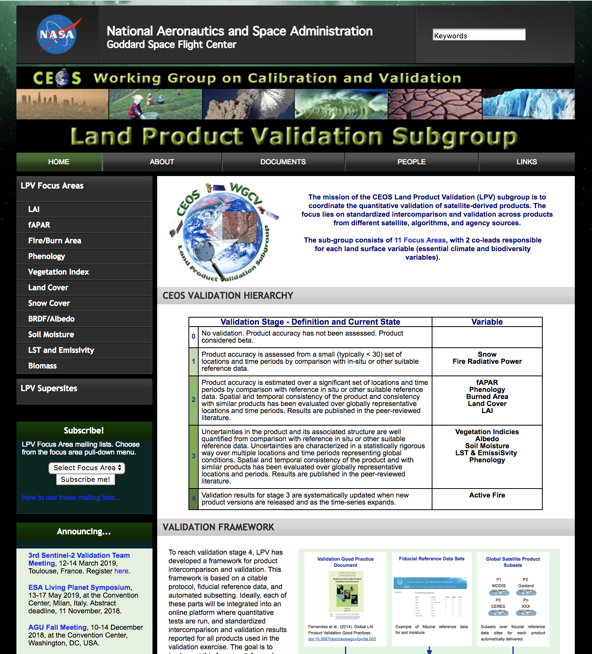
LPV Web Site
Established in 2001
Subscribed member list has grown to nearly 700 members over the years.
Each focus area (ECV) has pull down menu of links to
Home page
References
- Collaboration
- Products
http://lpvs.gsfc.nasa.gov
Notes:
LPV information
Validation stages
Focus Area tabs
Announcements
subscriptions

