Slide 1
USA National Phenology Network:
Data products for calibration and validation of Earth observation data products
Kathy Gerst and Jake Weltzin

Slide 2
USA-NPN Mission
Collect • Store • Share Phenology data and information
Advance Science
Inform Decisions
Communicate & Connect
Notes:
For the past 10 years, we’ve built a system to collect, store and share info with the following goals.

Slide 3
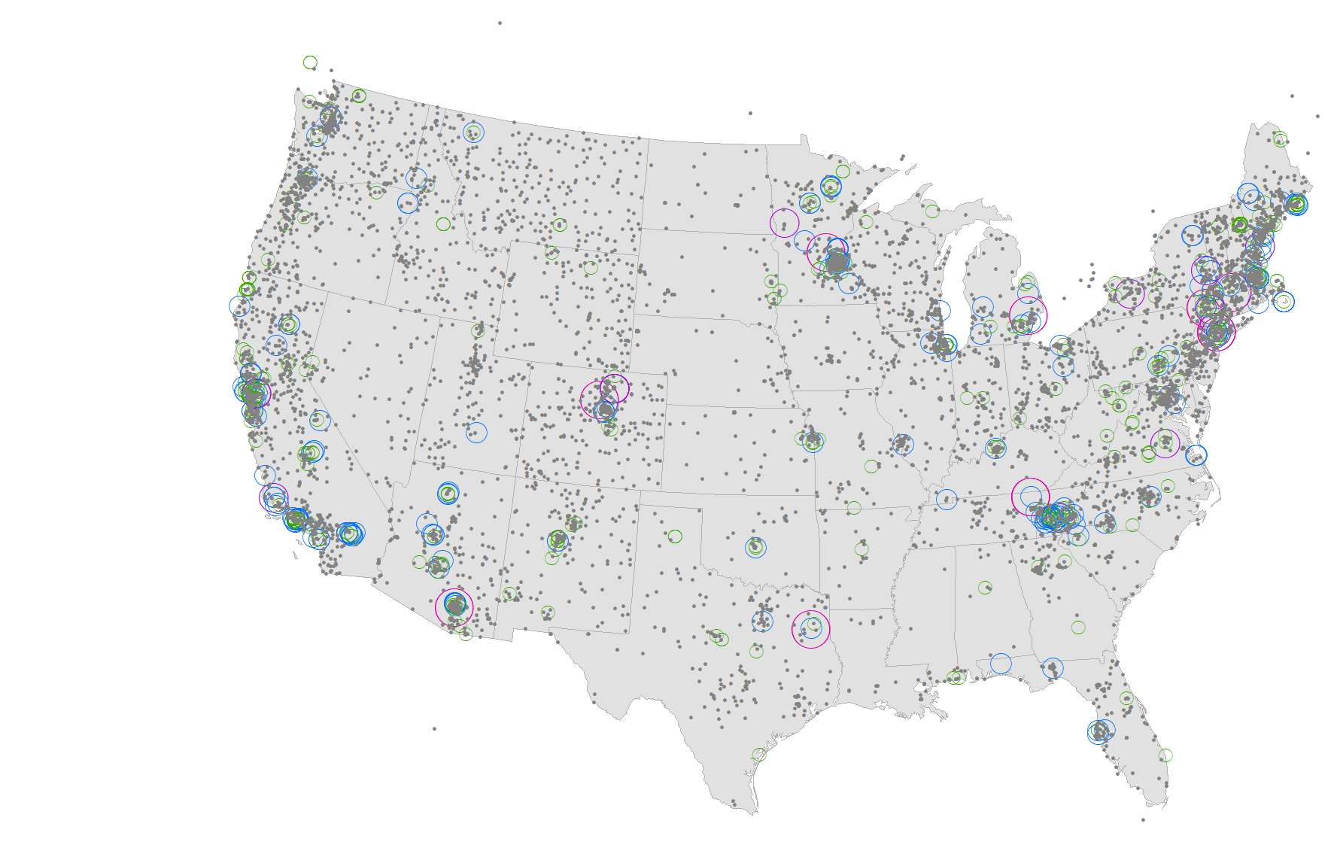
Nature’s Notebook
> 13,000 active observers
> 11,000 active sites
~ 15 million records
> 60 publications
68 data products
Notes:
Published, vetted protocols. High data quality.
Greenwave campaign. Researcher-drive campaigns – Maples, oaks, and poplars – 5 years of targeted data collection.

Slide 4
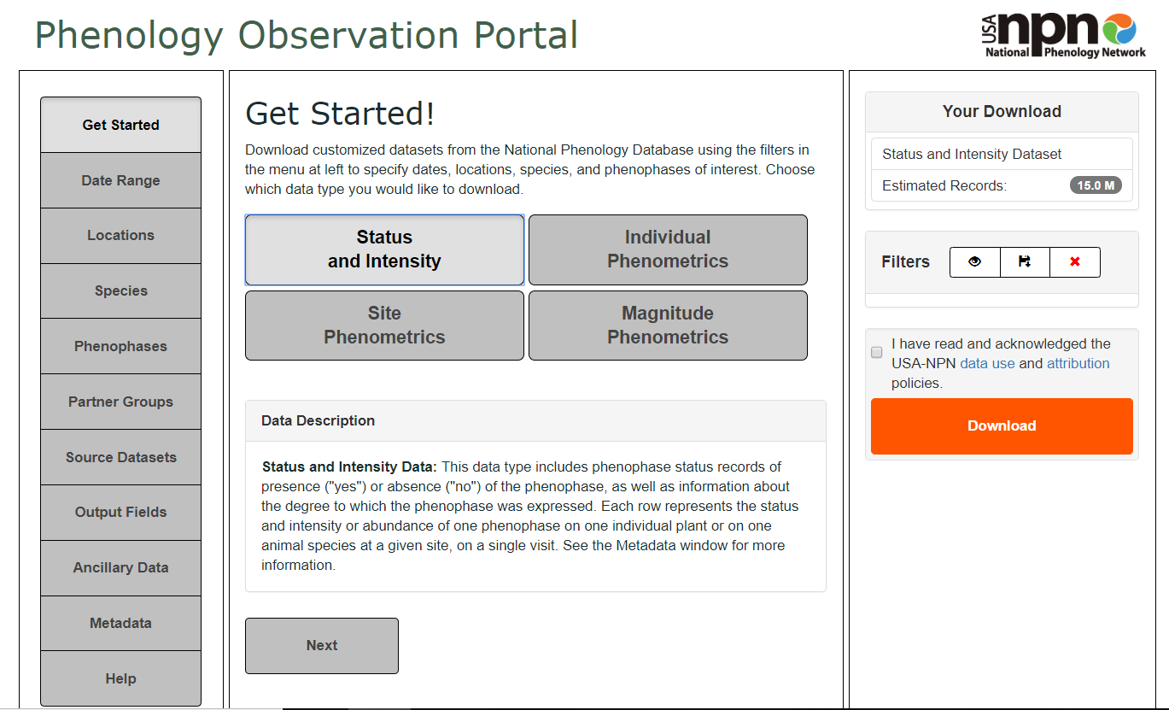
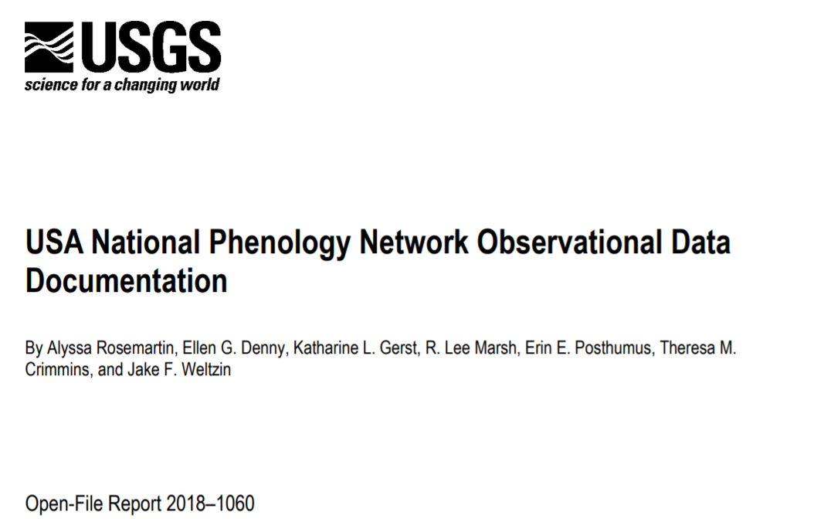
Observational data
www.usanpn.org/data/observational
Notes:
APIs;
Phenometrics- provide info on data quality, precision of onset dates

Slide 5
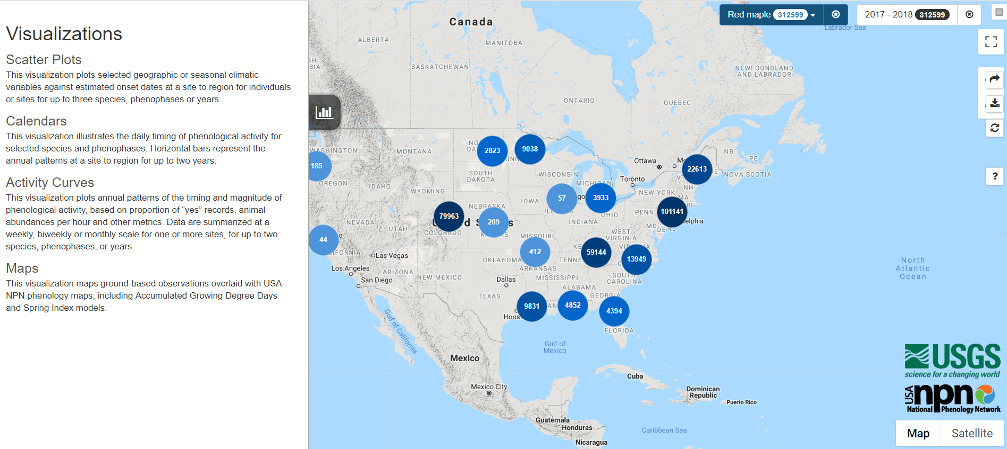
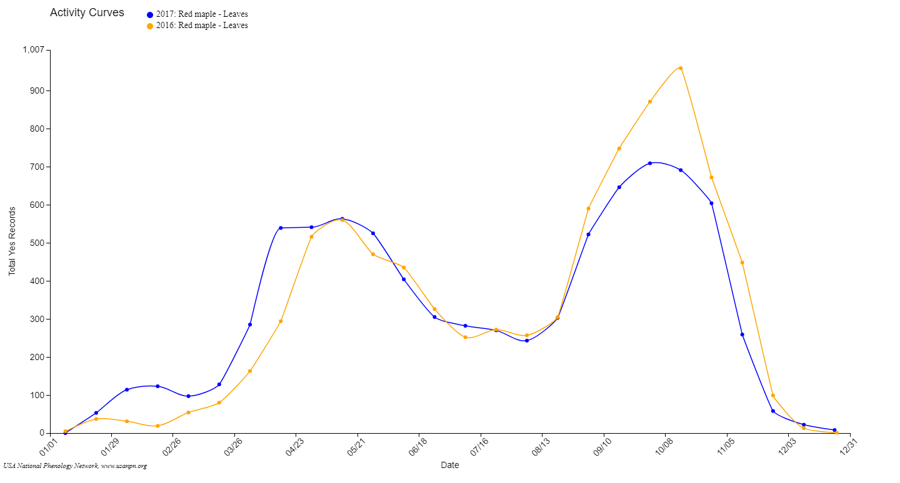
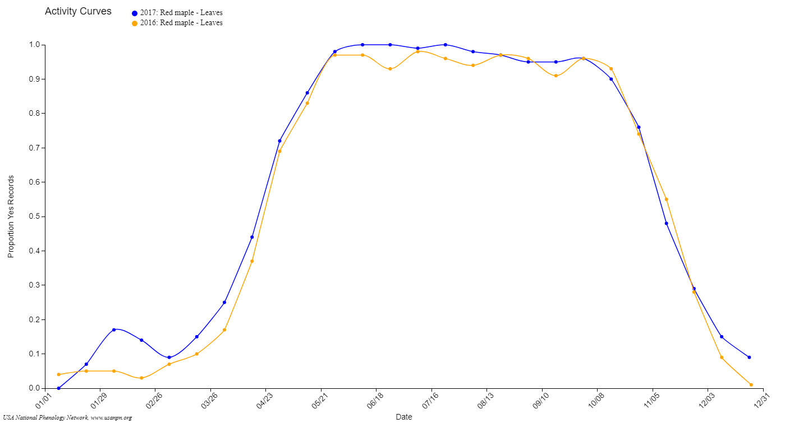
Visualization Tool

Slide 6
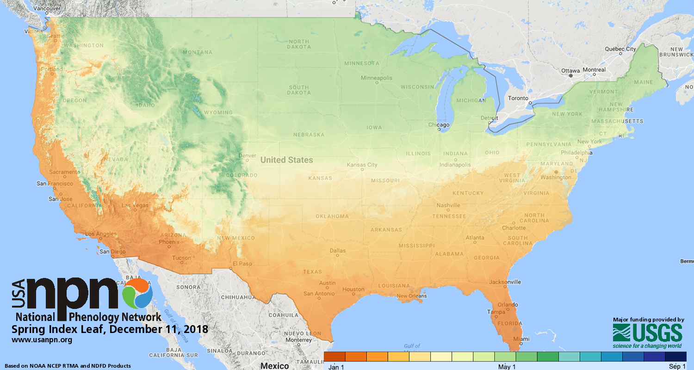
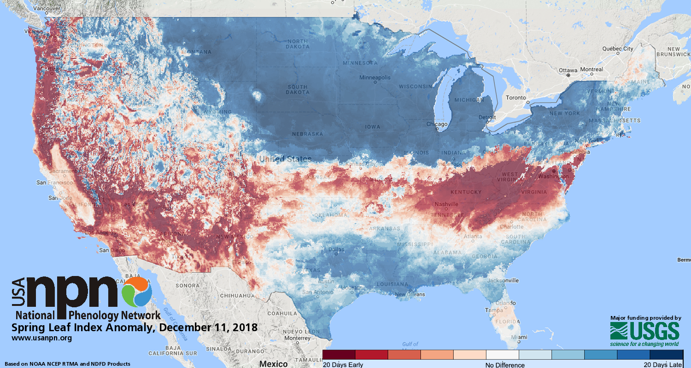
Gridded Spring Indices
Daily @ 2.5 km; 1980 to 6 days from today
Data from NOAA NCEP (URMA, RTMA, NDFD) & PRISM
www.usanpn.org/spring
Obs – Pred (d)

Slide 7
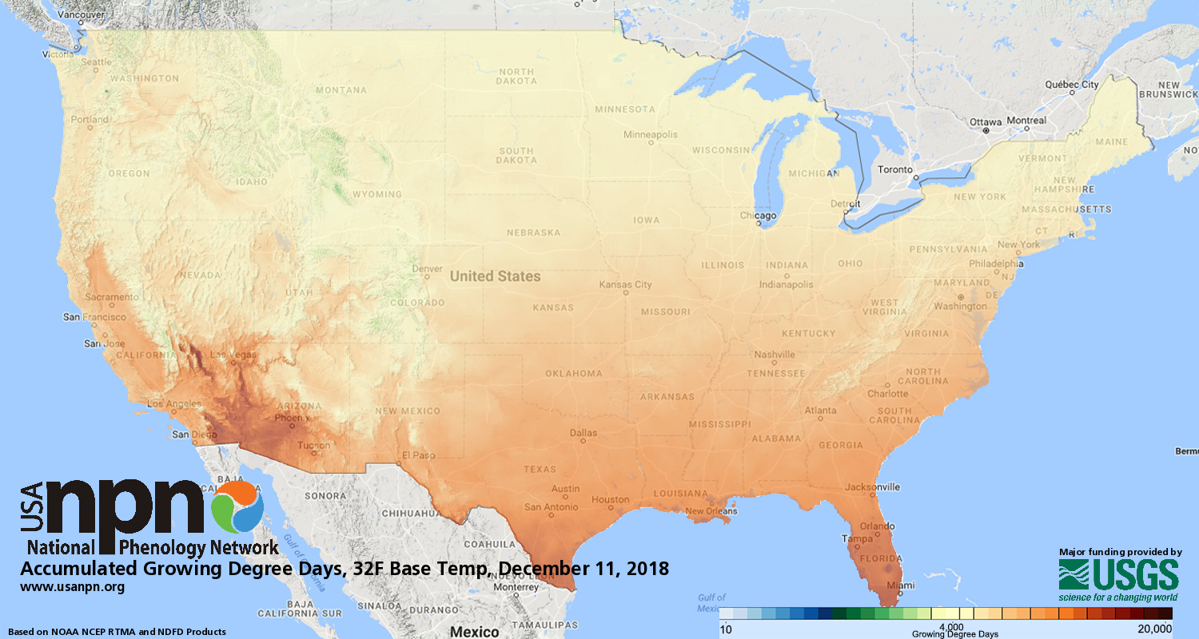
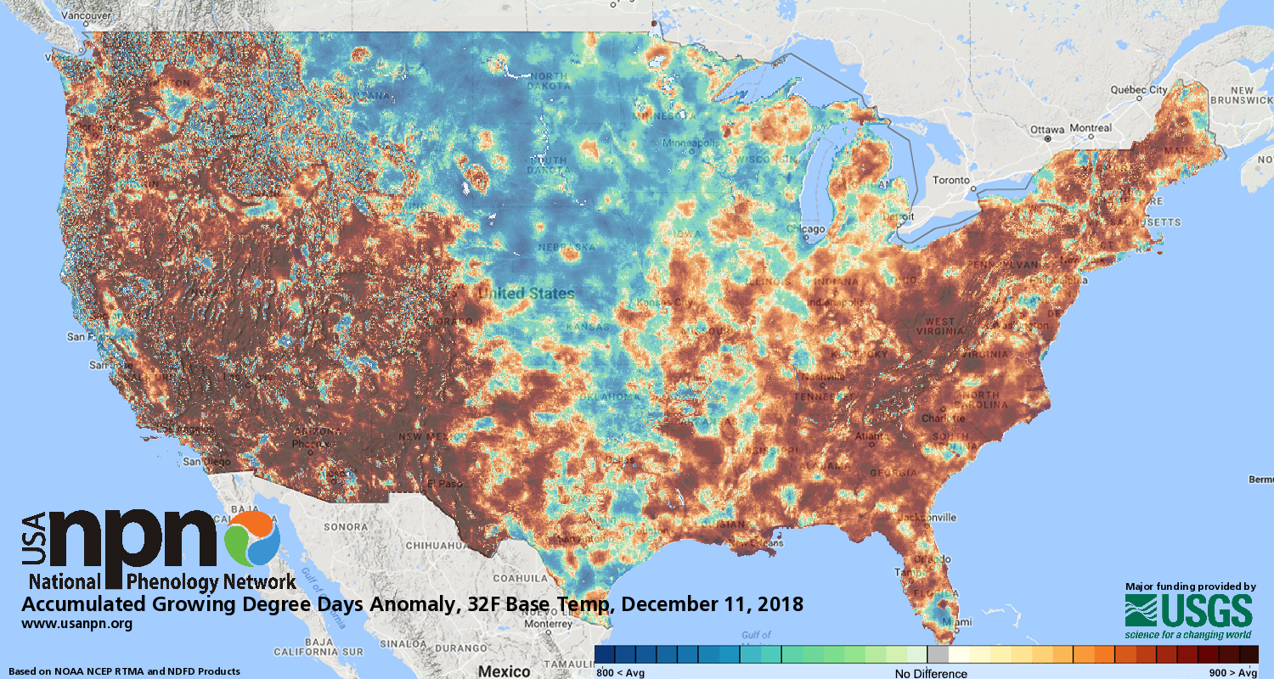
Accumulated Growing Degree Days
Daily @ 2.5 km; 2016 to 6 days from today
Data from NOAA NCEP (URMA, RTMA, NDFD)
32 and 50 degree base temps
Notes:
Also, developing dynamic generation for historical years – flexible start date and base temperature.

Slide 8
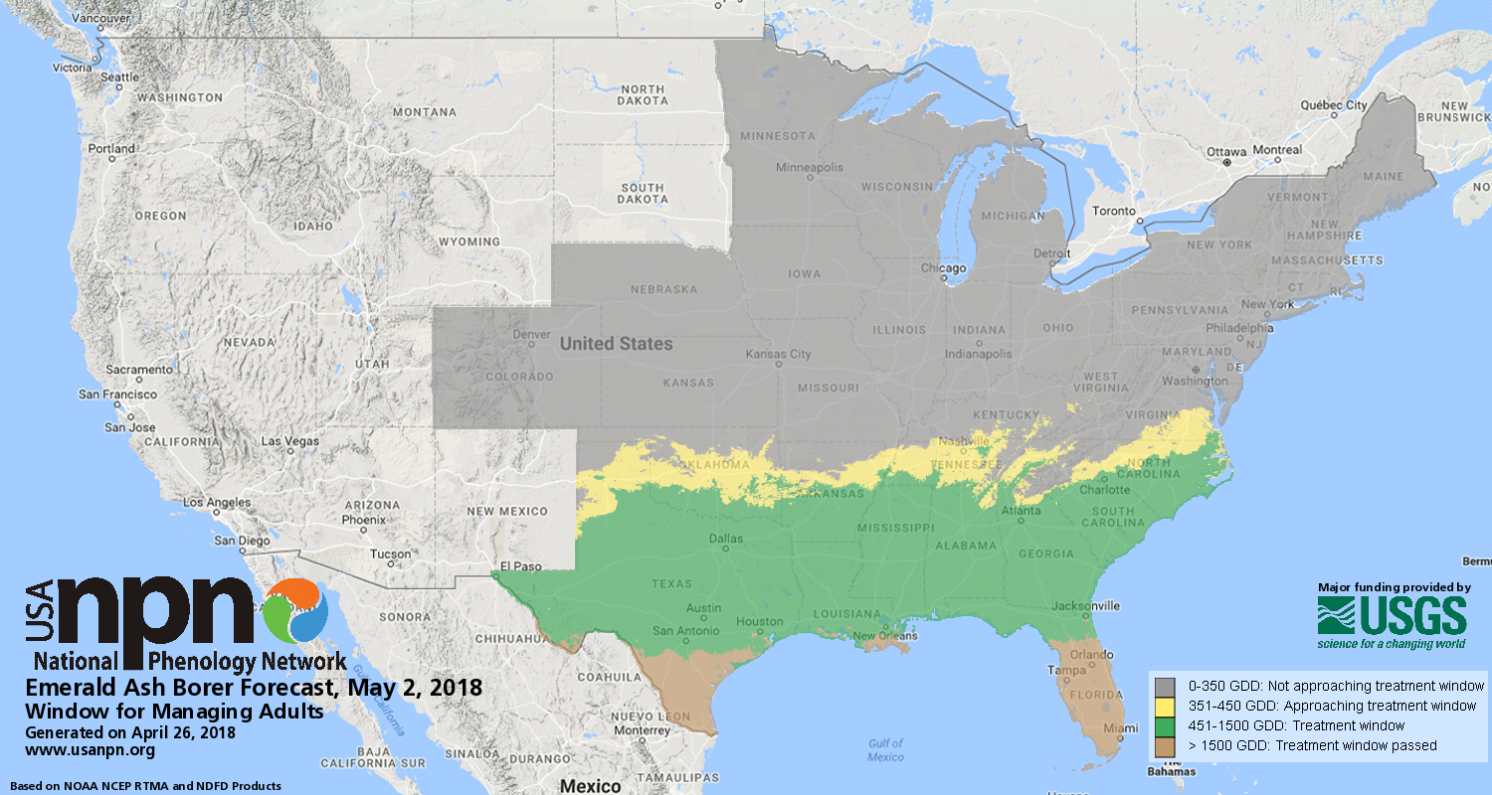
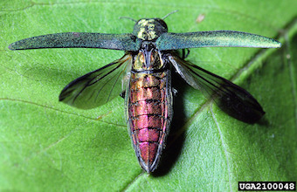
Pheno Forecasts
Notes:
In the future, can do more complicated models and apply to forecast climate data – see Sarah E’s presentation! Forecasting. Currently 5 species. Adding 5 more this year, including an invasive plant, buffelgrass, that relies on precipitation thresholds to know when it will green-up and be susceptible to treatment. Will replicate this overall approach with additional applications – including pollen and disease vector risk.

Slide 9
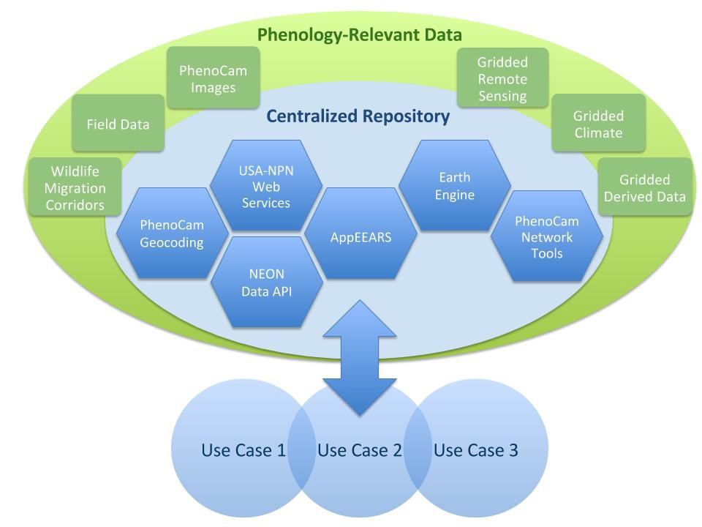
Advanced Phenology Information System
Collaboration w/ U of Arizona, USGS, LP DAAC, NAU, & Conservation Science Partners
USA-NPN developing R package to intersect NPN observations with products available via AppEEARS
https://github.com/usa-npn/rnpn
Notes:
Collaboration with USGS, LP DAAC, NAU, Conservation Science Partners
Will be available via NPN tools, but also via APIs.
MODIS derived phenometrics,

Slide 10
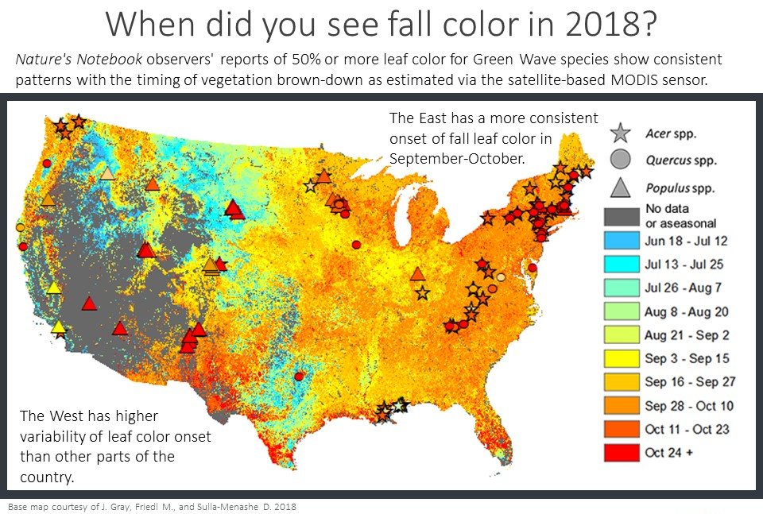
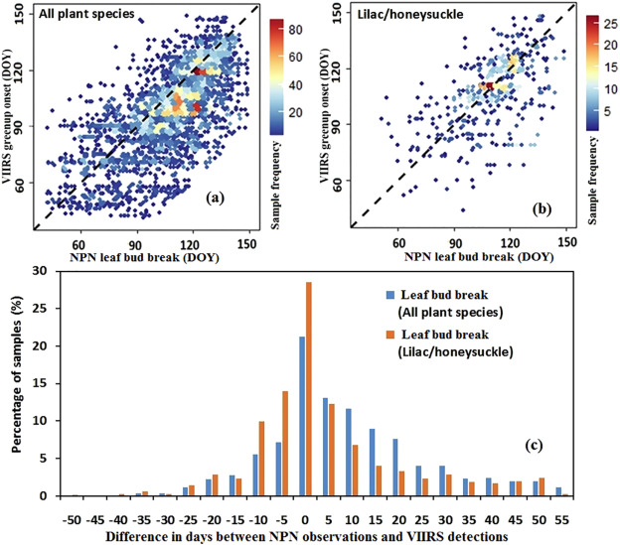
NPN & RS data: Applications
Zhang et al. 2018 Remote Sensing of the Environment
Notes:
validation

Slide 11
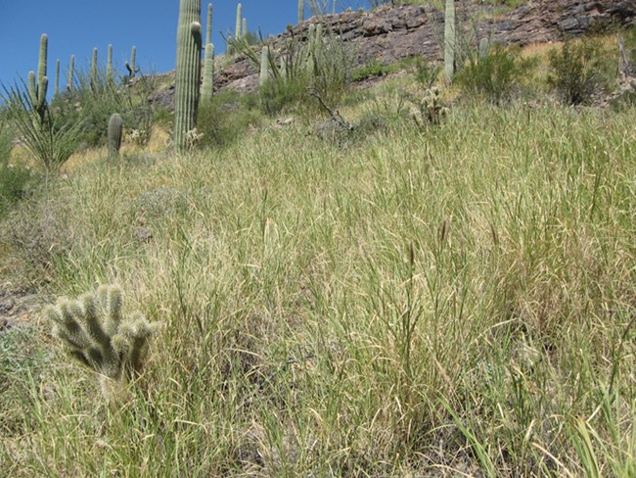
Coming soon…
NEON data integration into NPN database (46 sites)
Spring and Fall leaf models (S. Elmendorf)
Global phenology data portal: https://plantphenology.org/

Slide 12
Friday @ AGU
Understanding Phenological Responses and Feedbacks in Terrestrial Vegetation: Pa0l
tterns, Mechanisms, and Consequences
B51H (8 am – 12:20 pm; posters)
B53C (1:40 pm – 3:40 pm)
B54C (4 pm – 6 pm)

