Slide 1
MODIS and VIIRS NBAR-VI
1
Arthur Elmes, Crystal Schaaf*, and Xiaoyang Zhang**
University of Massachusetts Boston
South Dakota State University
*PI MODIS and VIIRS NBAR Products
**PI VIIRS Phenology Product
Notes:
Good morning. Today I will be presenting for my co-authors, Crystal Schaaf, who is the PI for the MODIS and VIIRS NBAR products, and Xiaoyang Zhang, who is PI of the VIIRS phenology product. I’ll be discussing the MODIS and VIIRS NBAR products used to generate vegetation indices, which in turn are used to create the Global Land Surface Phenology (GLSP) products for MODIS and VIIRS.

Slide 2
Vegetation Phenology
2
Simplified representation of seasonal variation in vegetation
Estimated from Vegetation Indices (e.g. EVI, EVI2, NDVI…) derived from time series of satellite data
Identifies timing of seasonal growth cycles
Greenup, maturity, senescence, dormancy...
VI
(Zhang et al. 2003; RSE; Zhang et al. 2004 GCB; Zhang et al. 2004, GRL)
Notes:
To begin with a basic recap, vegetation phenology describes the seasonality of vegetation. The phenology products I’ll discuss here use global, daily imagery from the VIIRS and MODIS instruments. From these data, we derive phenological metrics based on Vegetation Indices, which in turn come BRDF-corrected reflectance. The phenology products provide information on the transition dates for vegetation, including: Greenup, Maturity, Senescence, and Dormancy.

Slide 3
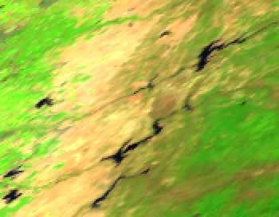
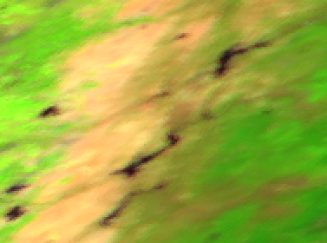
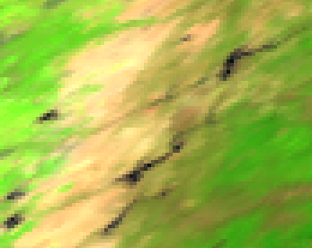
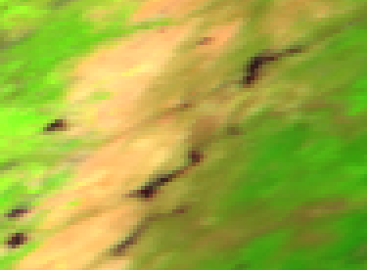
VIIRS and MODIS
3
Spectral difference
M1 M2 M3 M4 M5 M7
M8 M10 M11
I1 I2
…
I3
B3 B4 B1 B2
B5 B6 B7
Only 4 similar bands (3 distinct, overlap of I2 and M7)
No blue band in VIIRS I
VIIRS I bands – gridded 500m (375)
VIIRS M bands – gridded 1km (750)
MODIS bands – gridded 500m
Effective spatial resolution difference
Campagnolo et al., 2016
VIIRS 500m
MODIS 500m
VIIRS 1km
MODIS equivalent 1km
565m × 595m
833m × 618m
1003m × 891m
1091m × 923m
Notes:
The MODIS and VIIRS sensors are broadly similar, and thus provide comparable data (VIIRS has often been called MODIS Lite), BUT the spectral bands are not identical.
Only four bands have similar band locations and widths. VIIRS HAS NO blue band for the higher resolution I bands, meaning EVI2 must be used instead of EVI.
Furthermore, although the VIIRS I bands and MODIS bands 3-7 are both nominally 500 m, their effective resolutions are closer to the figures shown below. The left shows VIIRS I bands and MODIS 3-7, and the right shows VIIRS M bands and MODIS 1km bands.

Slide 4
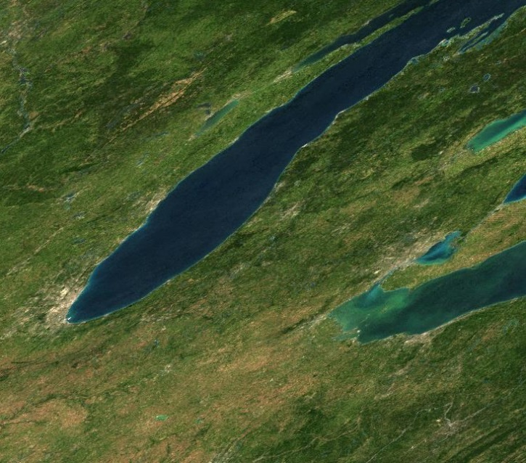
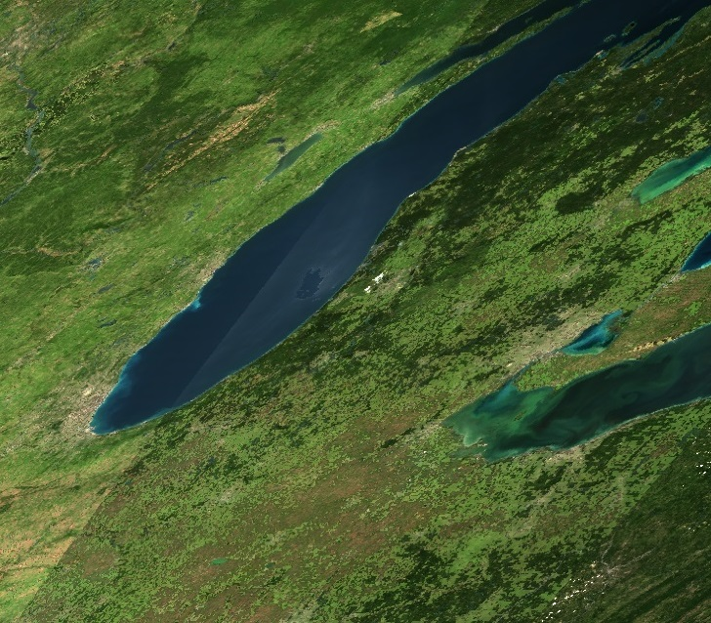
Daily MODIS and VIIRS NBAR products (MCD43 and VNP43)
4
BRDF - Bidirectional Reflectance Distribution Function
Describes the reflective character of the surface
BRDF models are built up by fitting a surface to multidirectional observations built up over a short retrieval period
NBAR - Nadir BRDF Adjusted Reflectance
Corrects all multi-angle obs to nadir
NBAR
Surface reflectances from adjoining swaths
QA - Quality Assurance
Notes:
Nevertheless, we can say that consistent Vegetation Index measurements are produced using the MODIS and VIIRS NBAR products. NBAR stands for Nadir BRDF Adjusted Reflectance; this provides reflectance that accounts for disparities in viewing and solar illumination angles.
The BRDF model is fit to multiple multiangle observations collected over a short 16 day retrieval window. We use the RossThickLiSparse Model for both MODIS (MCD43) and VIIRS (VNP43).
The model needs sufficient observations to adequately sample the viewing hemisphere to capture both the sunlit surfaces and the geometric optical shadowed surfaces (see schematic on right).
Once a BRDF model has been established for each pixel, then angular observations can be corrected to a Nadir view (as on the left).
All retrievals come with extensive QA info describing the quality of the BRDF retrieval, whether it is a snow or snow free retrieval, number of input obs utilized etc.

Slide 5
MODIS and VIIRS NBAR
5
RMSE: 0.0237
BIAS: 0.0130
RMSE: 0.0245
BIAS: 0.0127
RMSE: 0.0201
BIAS: 0.0115
0.0 0.4 0.8 0.0 0.4 0.8 0.0 0.4 0.8
MODIS
NBAR comparison of MODIS band 2 vs VIIRS band I-2 (NIR) over
tile 08v05, Southwest USA, (b) h11v04, upper Midwest USA, and
(c) h16v01, Greenland
These graphs show a comparison of NBAR from three equivalent MODIS and VIIRS tiles for NIR MODIS band 2 and VIIRS band I-2.
Notes:
These graphs show a comparison of NBAR from three equivalent MODIS and VIIRS tiles for NIR MODIS band 2 and VIIRS band I-2 (pretty similar bands from slide 3). Although there are minor deviations, the sensors are in general very consistent.

Slide 6
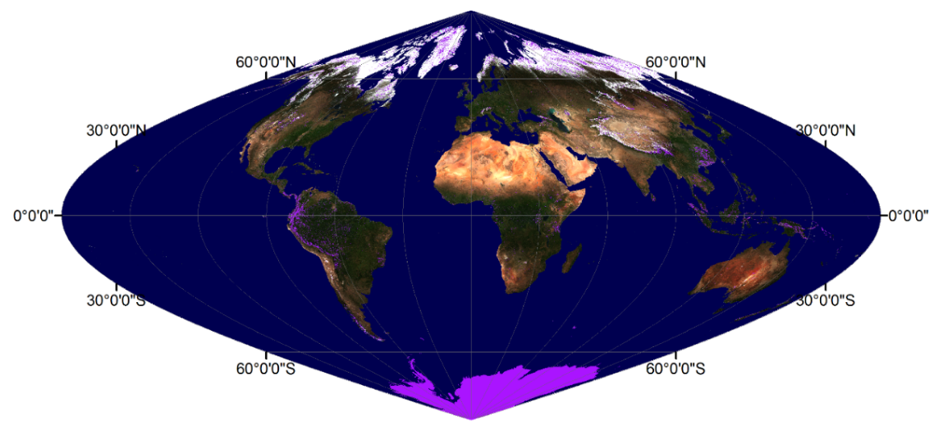
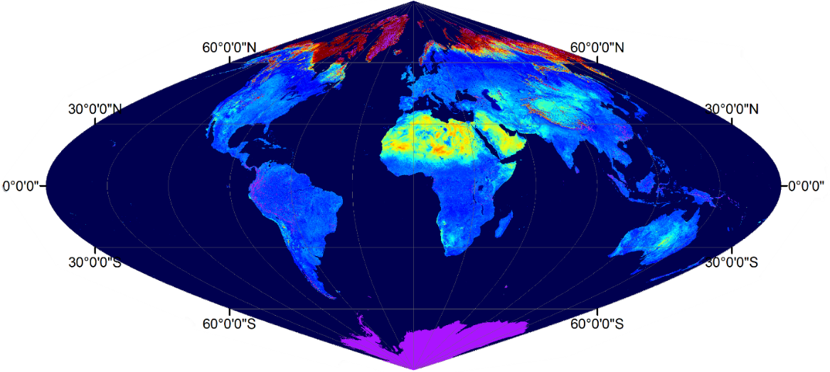
VIIRS NBAR, albedo and QA
6
NBAR (M)
True color composite: Red, Green, Blue: 0-0.4
Shortwave broadband
Albedo (WSA)
QA
0 0.7
High Quality
Low Quality
Fill value
May 9th, 2015
Notes:
VNP43 produces global DAILY BRDF, NBAR, and Albedo (integrals of the BRDF) globally. This daily product uses a 16 day window of observations, and emphasizes the center day as the day of interest. If the day of interest is snowy, then the snowy BRDF is retrieved, if snow-free a snow-free BRDF is retrieved.
NBAR no swath edge – land cover pattern
Albedo energy percent
No numbers, sufficient observation to capture the enough angular information
No day time light - purple

Slide 7
New England Foliage - Autumn Phenology
7
8/28/04
MODIS true color NBAR
Length of growing season
Emergence of leaves
Onset of senescence
9/29/04
10/15/04
Notes:
Returning to phenology, these images show a sequence of MODIS NBAR over the spectacular autumn senescence in New England, as maturity gives way to senescence and dormancy.

Slide 8
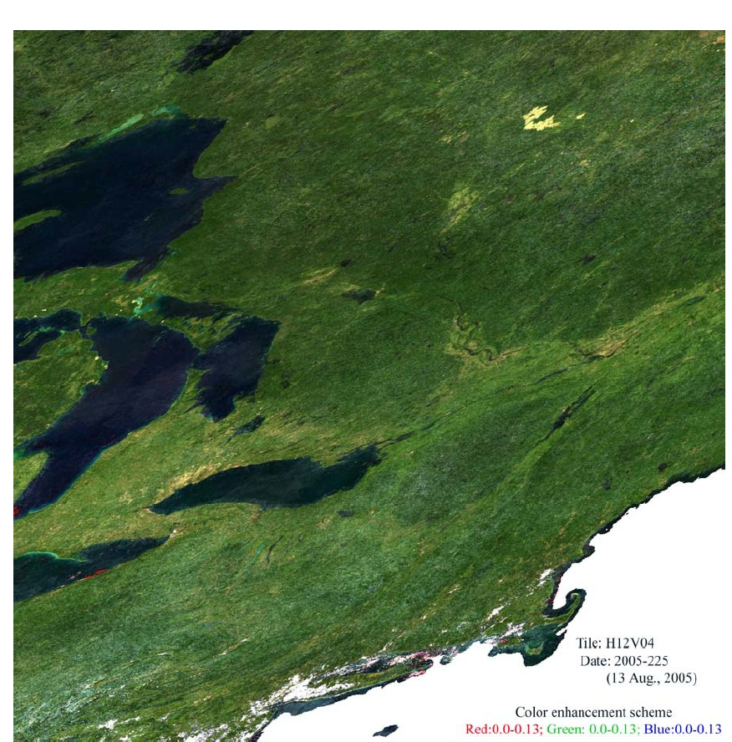
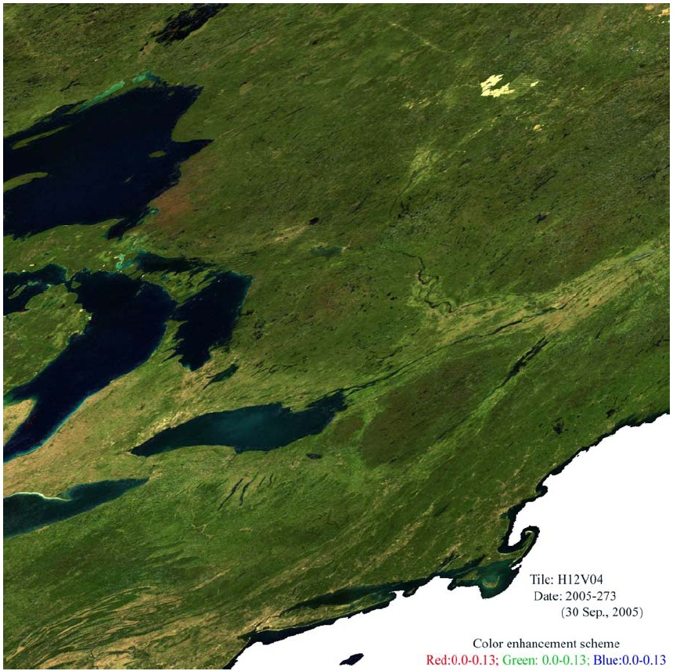
8
New England Foliage
Bartlett Experimental Forest, NH (44.0646°N, 71.2881°W)
Ameriflux and extended NEON site
30km x 30km subset centered on the Bartlett tower
Notes:
In these MODIS images, the Bartlett Ameriflux and extended NEON site is shown. The left hand image from August 2005 has some residual cloud (as compared to right hand Sept 2005 image) although Bartlett is clear.

Slide 9
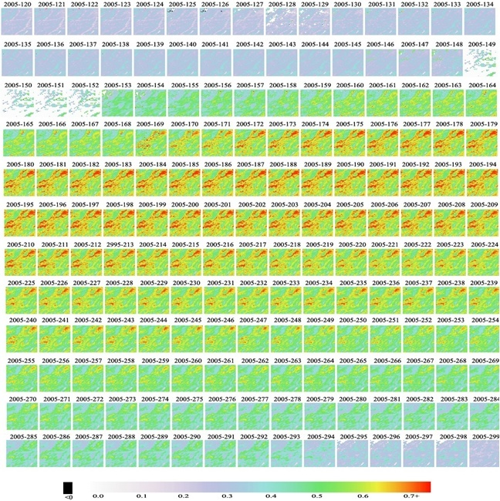
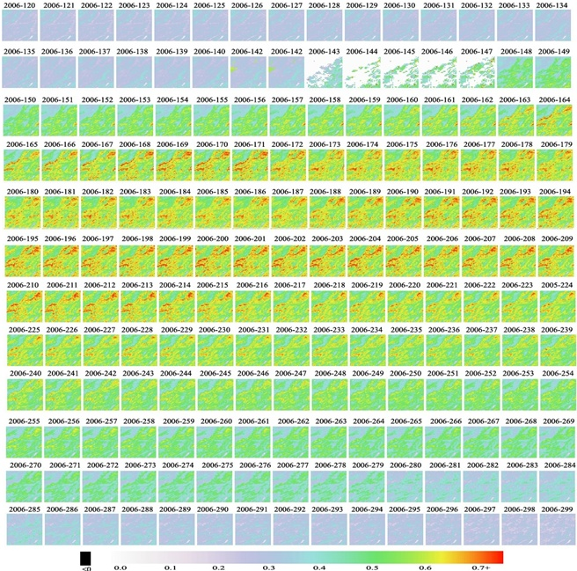
Temporal NBAR-EVI over Bartlett Forest Tower
9
Temporal EVI centered on Bartlett (30km by 30km)
2005 2006
Notes:
These 30km² cutouts show MODIS EVI over the Bartlett site in late May for 2005 and 2006. Some cloudy images are visible in both series (few retrievals possible).

Slide 10
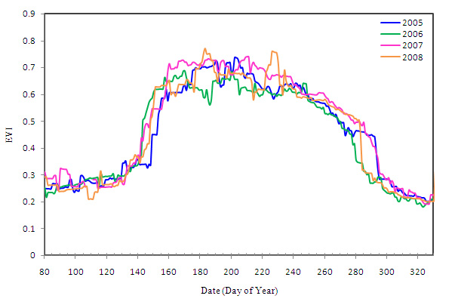
Temporal MODIS NBAR-EVI over Bartlett Forest Tower
10
This graph shows EVI for the Bartlett site cutouts (2005-2008) showing some differences in greenup and senescence.
Notes:
Using the MODIS EVI, it is possible to produce graphs such as this for a given location. This graph shows EVI for the Bartlett site cutouts (2005-2008) showing some differences in greenup and senescence. The GLSP contributes specific DOY metrics for vegetation transition dates, e.g. greenup onset, maturity onset, senescence onset, dormancy onset, etc

Slide 11
Global Land Surface Phenology (GLSP): Collection 1
11
500m global phenology product (VNP12Q2)
Utilizes VNP43 NBAR values to generate EVI2 time series
Output includes seven phenological metrics, five phenological magnitudes, and six quality assurance metrics characterizing the phenology retrievals for each pixel.
Phenological Metrics
Onset Greenness Increase
Onset Greenness Max
Onset Greenness Decrease
Onset Greenness Minimum
Date Mid Greenup Phase
Date Mid Senescence Phase
Growing Season Length
The product uses 3 day composites of NBAR, using pixel of highest QA, or max value if tied.
Notes:
Using VNP43 NBAR, the VIIRS Global Land Surface Phenology is a 500 m product, providing seven phenological dates, five phenological magnitudes, and six quality assurance metrics. VNP12Q2. This product uses EVI2 since there is no I blue band. Here are the references for VIIRS NBAR and GLSP.
The product uses 3 day composites of NBAR, using best QA pixel or max value.

Slide 12
Global Land Surface Phenology (GLSP): Collection 1
12
500m global phenology product (VNP12Q2)
Utilizes VNP43 NBAR values to generate EVI2 time series
Output includes seven phenological metrics, five phenological magnitudes, and six quality assurance metrics characterizing the phenology retrievals for each pixel.
Liu, Y., Wang, Z., Sun, Q., Erb, A. M., Li, Z., Schaaf, C. B., Zhang, X., Román, M. O., Scott, R. L., Zhang, Q., Novick, K. A., Syndonia Bret-Harte, M., Petroy, S., and SanClements, M. (2017). Evaluation of the VIIRS BRDF, Albedo and NBAR Products Suite and an Assessment of Continuity with the Long Term MODIS Record. Remote Sens. Environment, 201, 256–274.
Wang, Z., Schaaf, C. B., Sun, Q., Shuai, Y., & Román, M. O. (2018). Capturing Rapid Land Surface Dynamics with Collection V006 MODIS BRDF/NBAR/Albedo (MCD43) Products. Remote Sens. Environment, 207, 50–64.
Zhang, X., Jayavelu, S., Liu, L., Friedl, M.A., Henebry, G.M., Liu, Y., Schaaf, C.B., Richardson, A.D., and Gray, J. (2018). Evaluation of land surface phenology from VIIRS data using time series of PhenoCam imagery. Agric. For. Meteorol. 256–257, 137–149.
Zhang, X., Lingling Liu, Yan Liu, Senthilnath Jayavelu, Jianmin Wang, Minkyu Moon, Geoffrey M. Henebry, Mark A. Friedl, Crystal B. Schaaf, (2018). Generation and evaluation of the VIIRS land surface phenology product, Remote Sens. Environment, 216, 212-229.

Slide 13
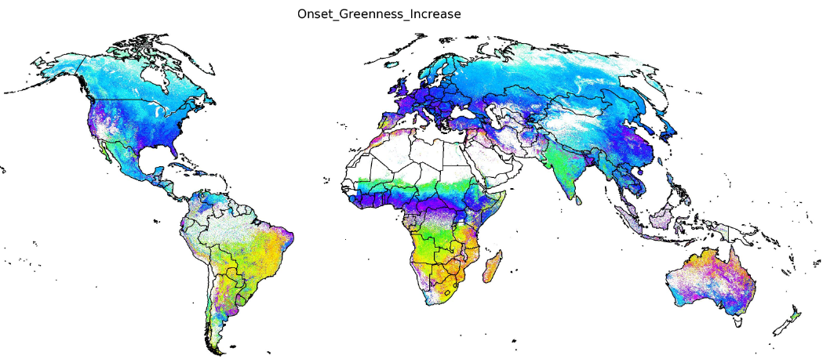
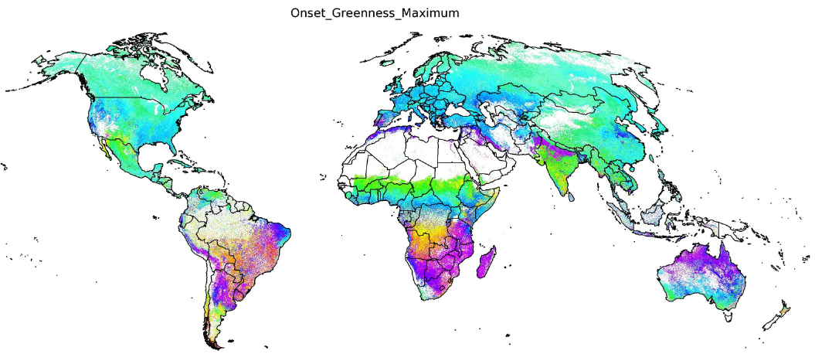
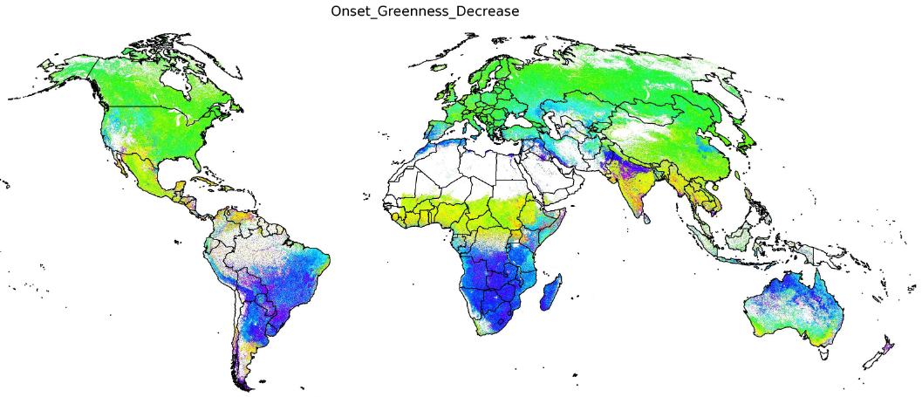
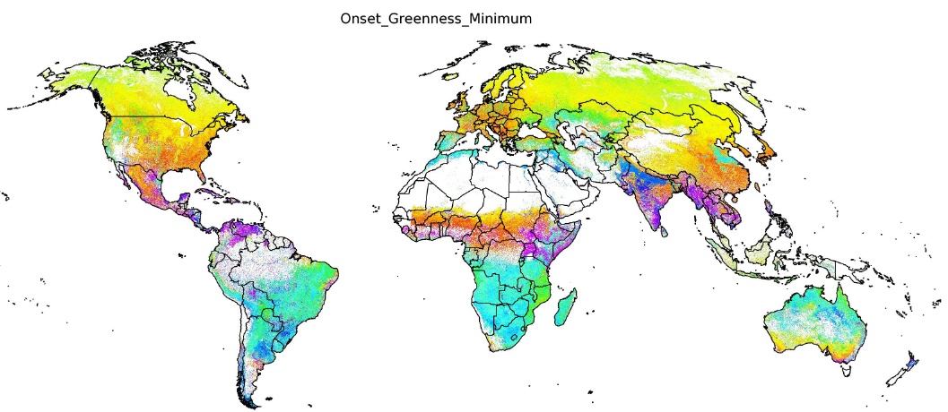
13
500m VIIRS GLSP Product –Phenological Dates (2014)
Greenup Onset
Maturity Onset
Senescence Onset
Dormancy Onset
DOY
Notes:
These maps show the phenological metrics from the VIIRS GLSP 500m (from EVI2, I band NBARs). From the top left we are seeing: Greenup Onset, Maturity Onset, Senescence Onset, and Dormancy Onset.

Slide 14
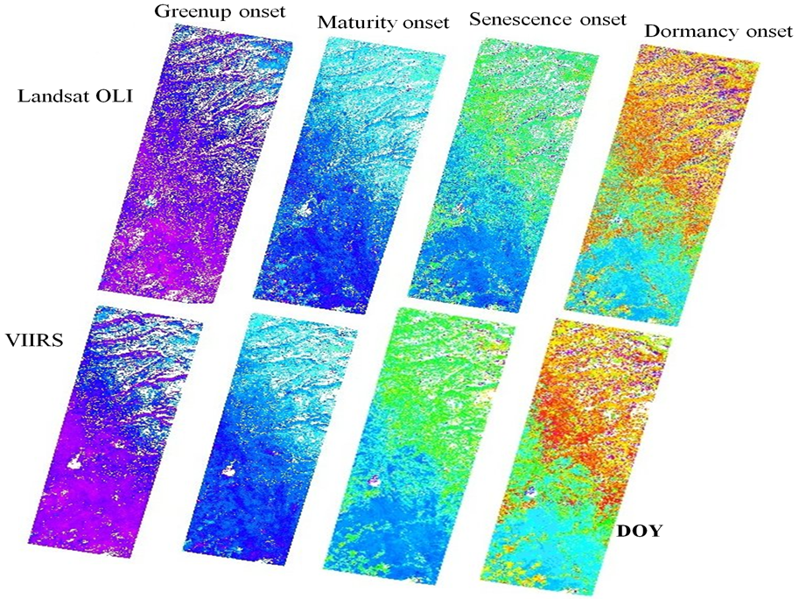
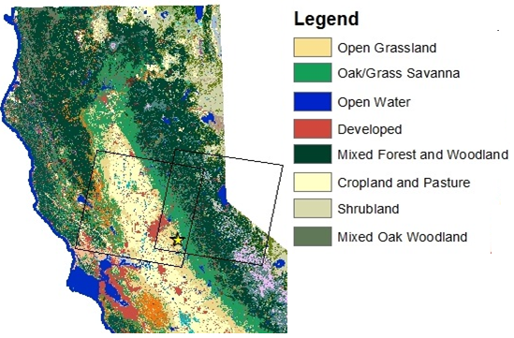
Landsat (30m) and VIIRS (500m) Phenology Comparison
14
Notes:
These images show a comparison of VIIRS and Landsat phenology transition dates, using equivalent Landsat EVI2 time series. Since Landsat is near-nadir it compares well with NBAR. While there are visible spatial patterning differences due to the resolution difference, broadly the two series are in agreement.

Slide 15
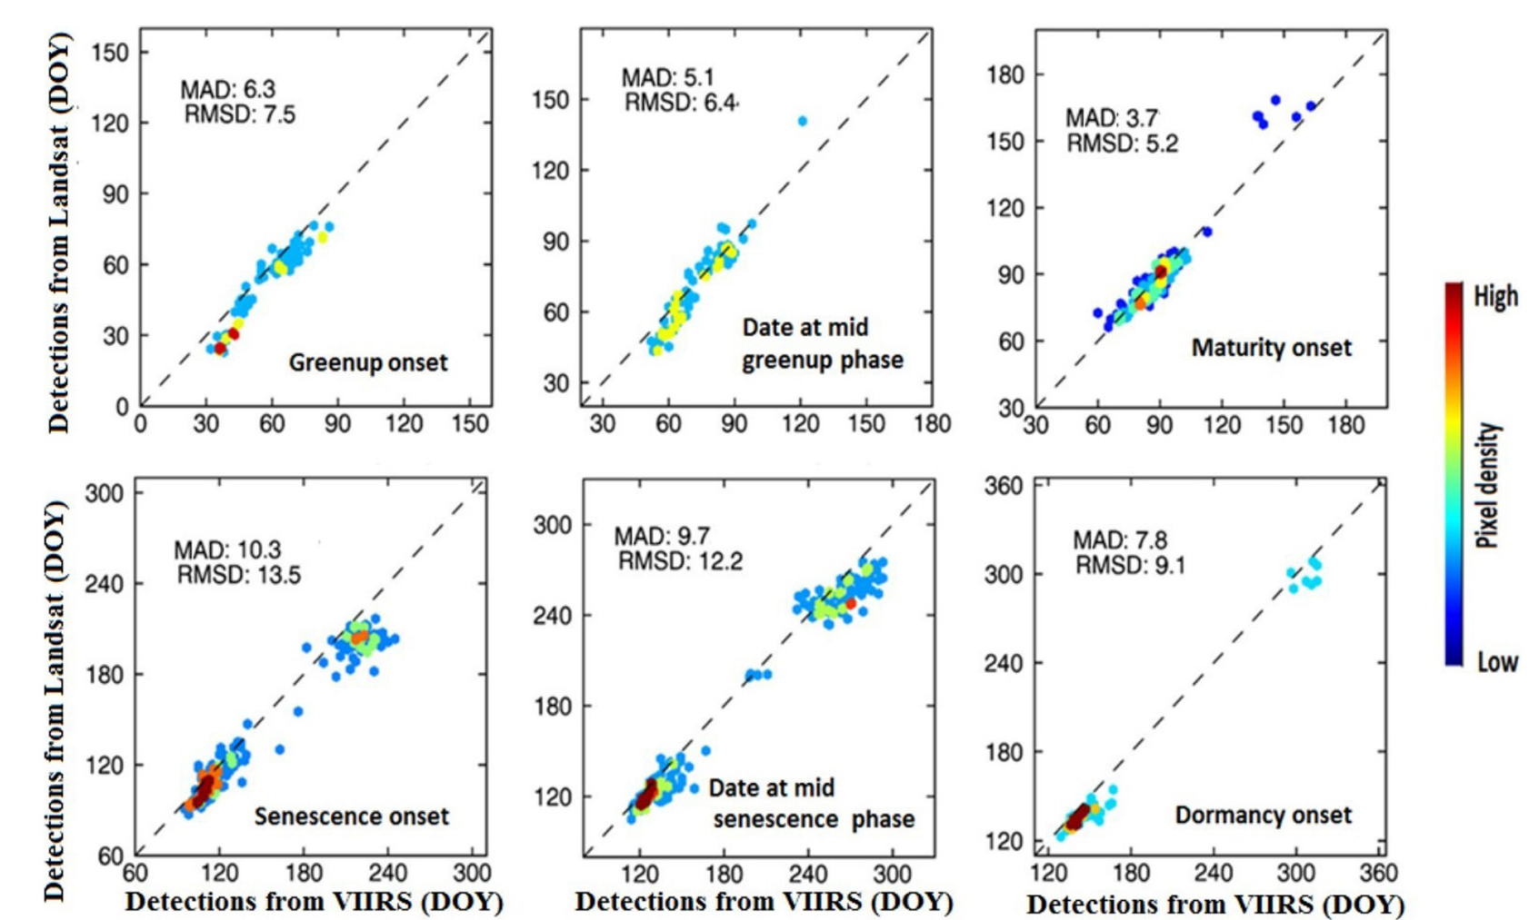
15
Landsat (30m) and VIIRS (500m) Phenology Comparison
Notes:
These graphs quantify the phenological metrics shown in the images on the previous slide. On the x-axis is VIIRS DOY and on the y-axis is Landsat DOY. Mean Absolute Difference and RMSD quantify the agreement. MAD is largest for senescence onset and smallest for maturity onset

Slide 16
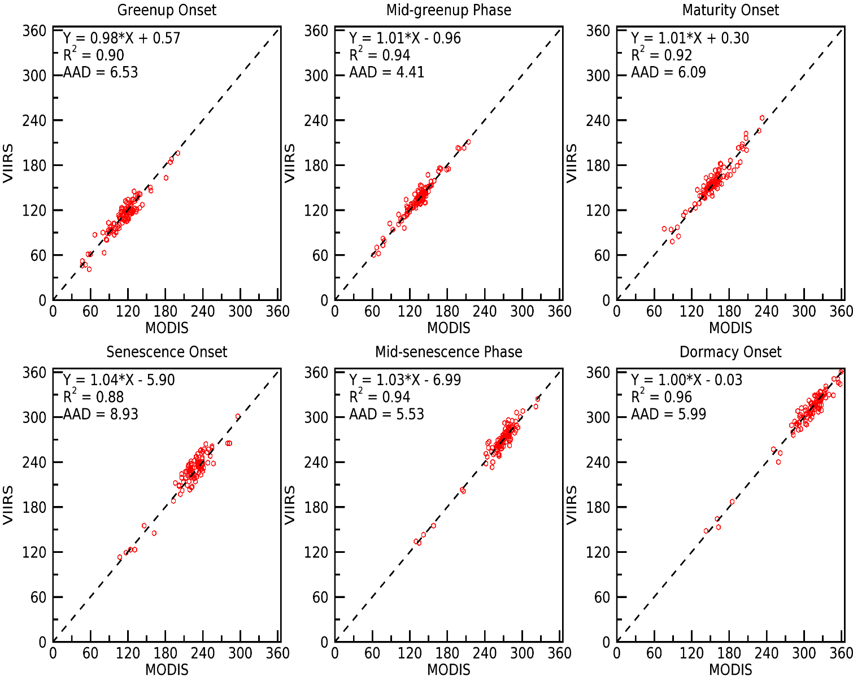
MODIS and VIIRS Phenology Comparison
16
Overall, the greenup onset dates from MODIS and VIIRS products are comparable and without bias, with median differences of < 1 day.
Spatial smoothing of greenup onset dates greatly increases the similarity between the two by to mitigating the effective resolution difference
Agreement between MODIS and VIIRS phenology products is strongly influenced by time series data quality (QA flags)
Notes:
This slide shows a comparison of MODIS and VIIRS phenology products.
Median differences < 1 day
50% and 76% of pixels show greenup onset differences of <5 days and 10 days, respectively, in tiles h11v04
The plots indicate that MODIS and VIIRS show very consistent estimates for the phenological estimates

Slide 17
Summary: MODIS and VIIRS Continuity
17
MODIS and VIIRS NBAR values (MCD43A4 and VNP43IA4) are used to produce global phenology products, using EVI and EVI2.
Initial comparisons show similar phenological transition dates between MODIS and VIIRS phenology
Higher resolution comparisons, including Landsat estimates, also show close correspondence.
Notes:
To summarize:
VIIRS and MODIS phenological datasets are produced using EVI and EVI2, which in turn rely on daily NBAR
Initial comparisons between MODIS/VIIRS appear similar, although further testing in global locations is needed to complement existing CONUS studies
Landsat/VIIRS comparison also looks good, with Greenup and Maturity onset captured very similarly by both.

Slide 18
Thank You! Questions?
Notes:
Thank you. I would be happy to take any questions.

Slide 19
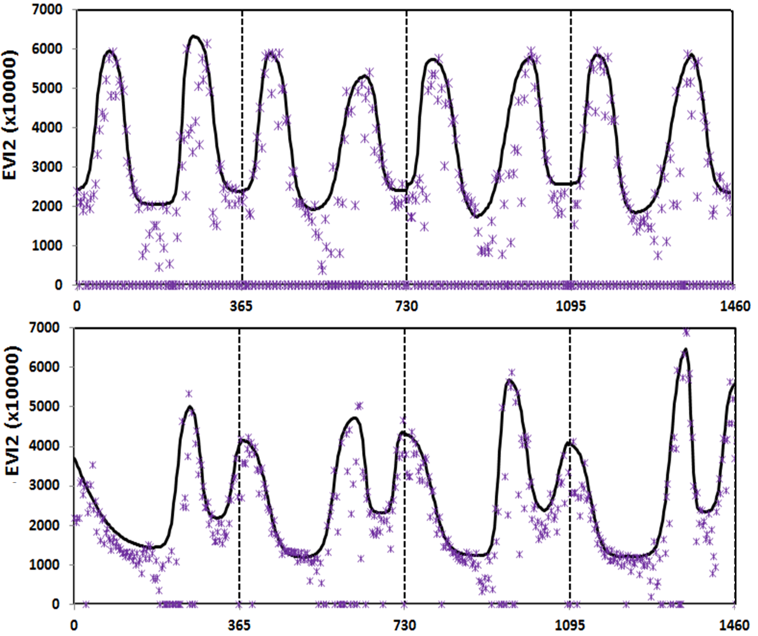
3-day Gap-filled Vegetation Index from 500m
MODIS and VIIRS NBAR
Number of days from 1st January 2013
Notes:
There is also a 3 day gap-filled EVI2 product, calculated from daily MODIS NBAR using only best quality from the QA.

Slide 20
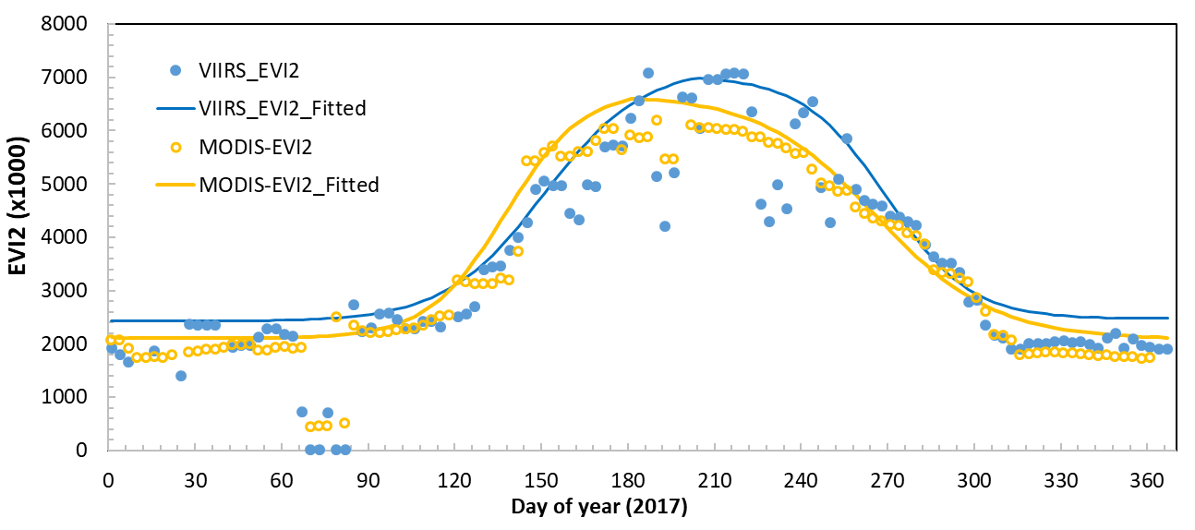
3-Day EVI2 from 500m MODIS and VIIRS NBAR

