Slide 1
Land Cover Focus Area Report
LPS 2019
15 May, Milano

Slide 2
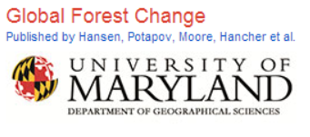
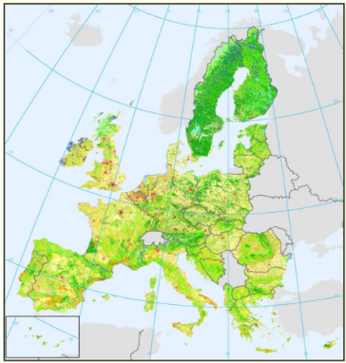
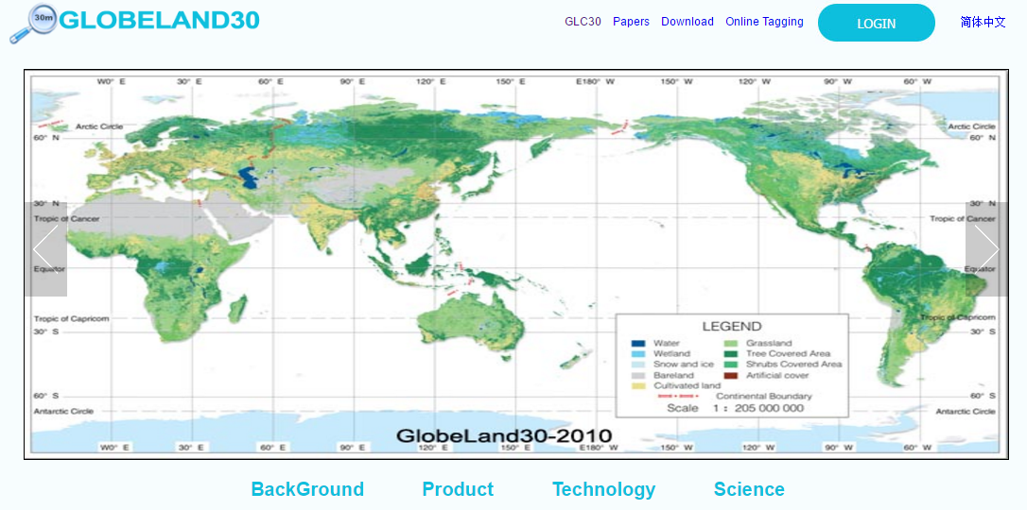
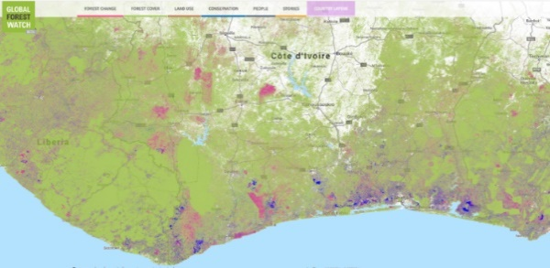
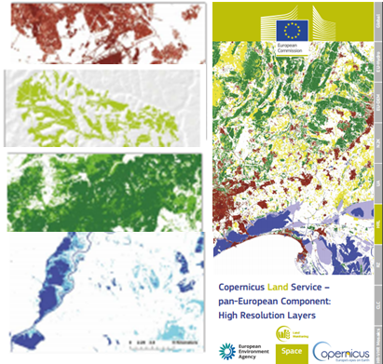
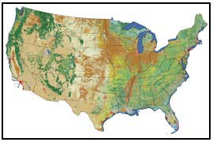
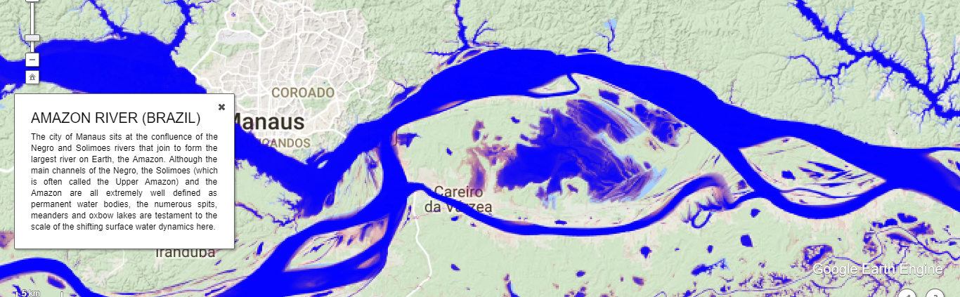
LC validation protocol
Official CEOS-LPV procol from 2006
Since 2006, things have become more complex
Much more capacity for LC maps production & new single-class production
GlobeLand30 (Chen et al., 2015)

Slide 3
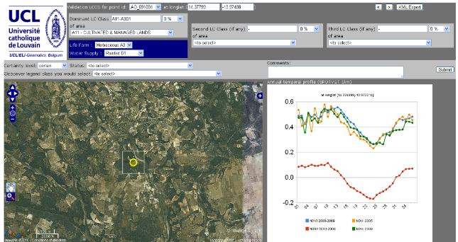
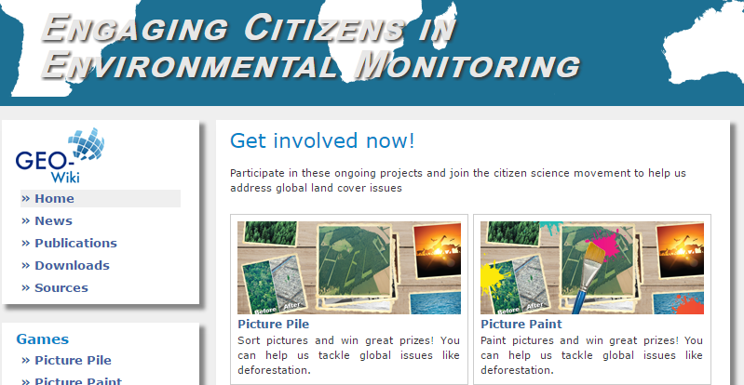
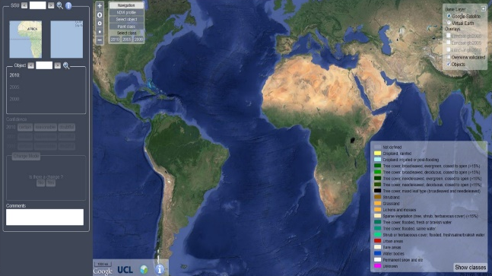
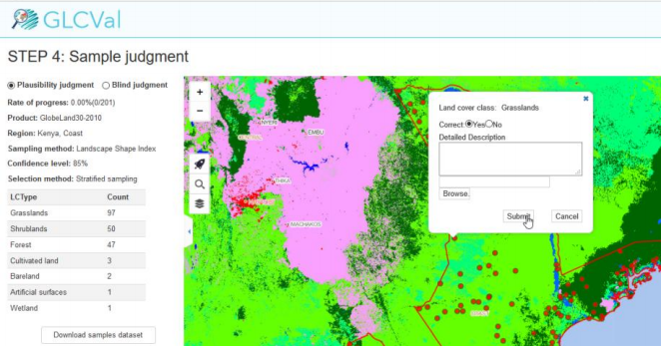
LC validation protocol
Official CEOS-LPV procol from 2006
Since 2006, things have become more complex
Much more sources of « reference data »
From CEOS test-site concept to Google Earth
BOSTON University
GlobCover – CCI projects
http://www.geo-wiki.org/
http://glcval.geo-compass.com/

Slide 4
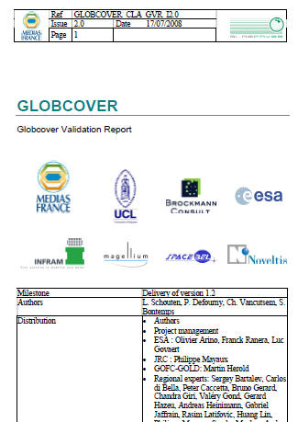
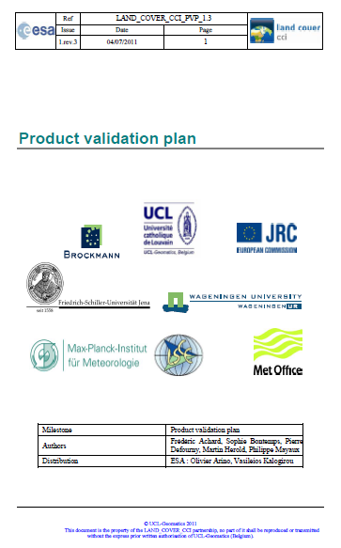
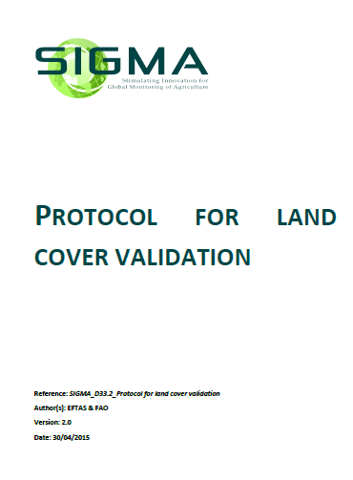
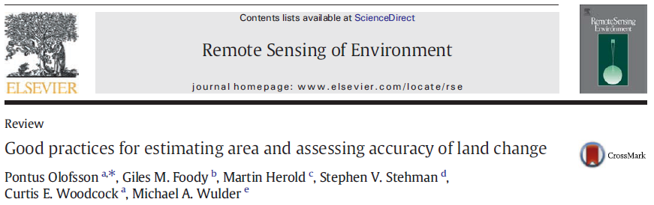
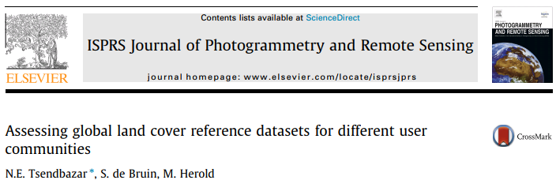
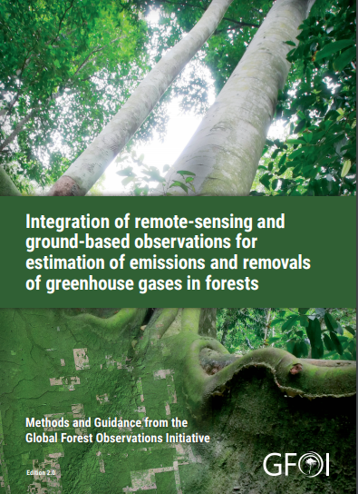
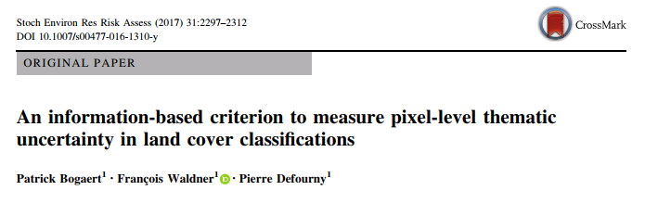
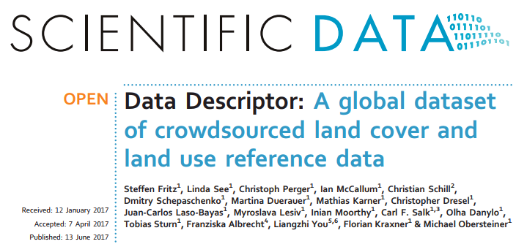
LC validation protocol
Official CEOS-LPV procol from 2006
Since 2006, things have become more complex
New varying reference documents

Slide 5
LC validation protocol
Official CEOS-LPV procol from 2006
Since 2006, things have become more complex
New sensors and CEOS requirements
  High resolution
  LC change
  Land Use
=> Need to update the validation standards

Slide 6
LC validation protocol
Started with cropland validation (one-class product)
Ongoing effort in the JECAM community
GEOGLAM planning to propose Essential Agriculture Variables (EAV’s)
To be generalized to general LC products
GFOI Method and Guidance Documents:
  Modules being developed in response to needs of SilvaCarbon partner countries
  Extensive use in REDD+ countries
  Continuous action
Pragmatic question: how to start?

Slide 7
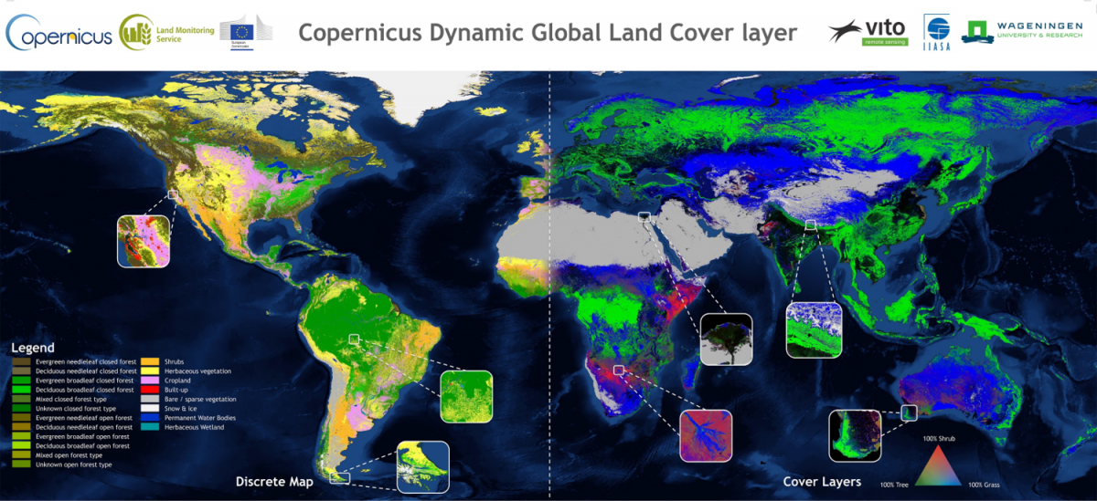
Other actions
Website update (review of LC products)
Newsletter to be issued
Organization of LC validation workshop?

