Slide 1
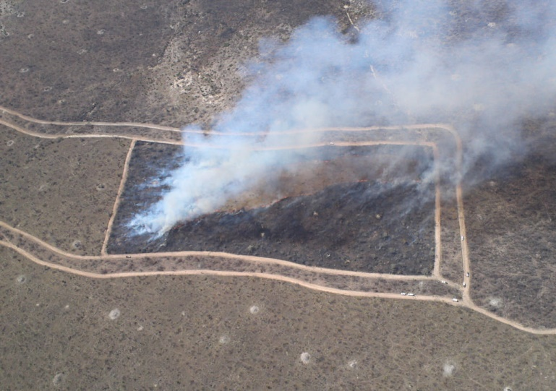
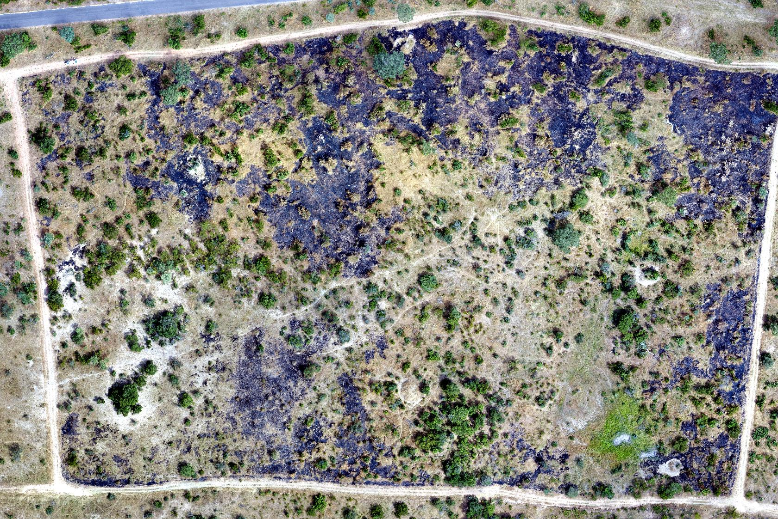
CEOS LPV ‘Fire Disturbance’ (Burned Area & Active Fire/FRP)
Luigi Boschetti, Andrew Edwards & Gareth Roberts

Slide 2
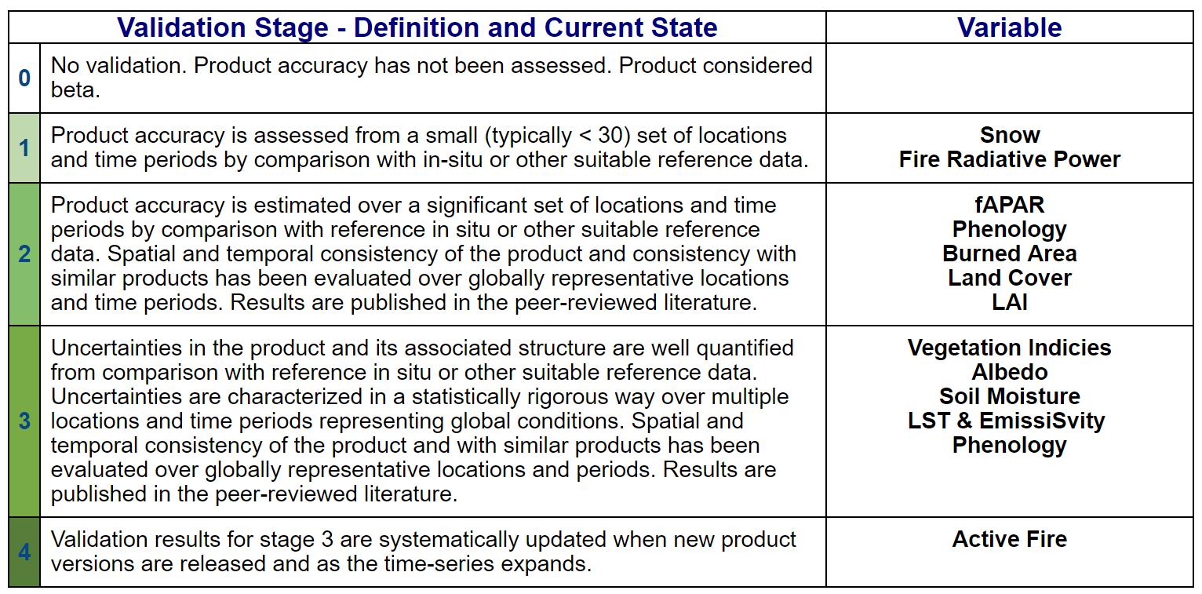

Slide 3
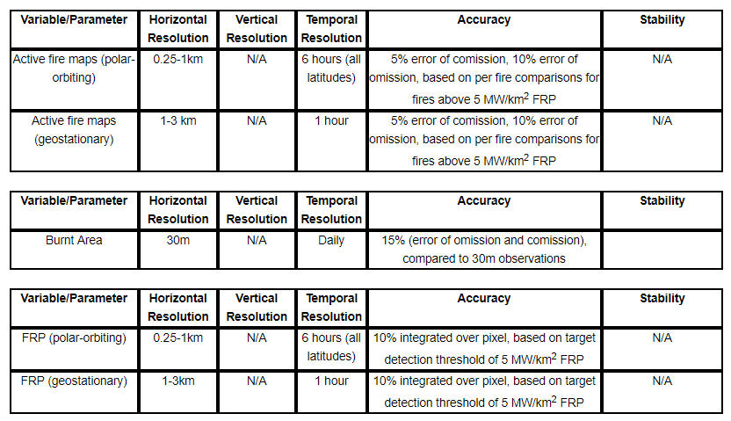
CEOS LPV Fire Disturbance: Current Status
Current ECV fire product requirements (GCOS-200)
Beyond ECVs: fire products have multiple user communities that need validation information (e.g. fire management agencies, GEO GWIS, UN REDD+, emissions and AQ community)

Slide 4
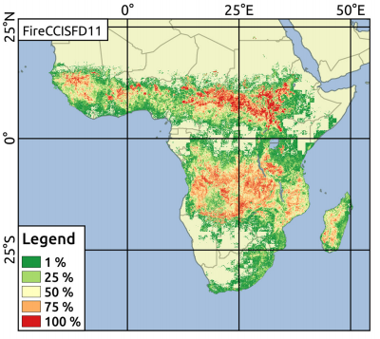
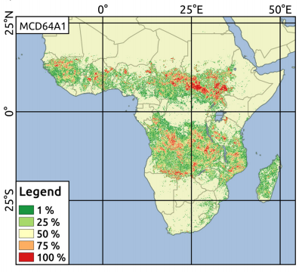
CEOS LPV Fire Disturbance : Papers & Products
Publications
RSE 25th Anniversary Issue
Burned area & Active Fire review papers
‘Remote Sensing’ Fire special issue (2019-2020)
which includes product development validation
Active fire validation : 4 papers (2019)
Burned area validation : 7 papers (2019)
New Burned Area Products
Fire CCI :
FireCCILT10
AVHRR LTDR (1982-2017). Monthly. 0.25°
spatial resolution.
FireCCISFD11
Sentinel-2. 2016. Annual. 20m spatial resolution
Roteta et al., 2019. RSE

Slide 5
CEOS LPV Fire : Burned Area Current Status
Burned Area has well established validation protocol for reference data generation. (Boschetti et al., 2009)
Three aspects emphasized :
Temporal criteria for the selection of reference data
Thematic content of the reference data
Format of the reference data for long term archival
Level 2 – Level 3 validation ongoing

Slide 6
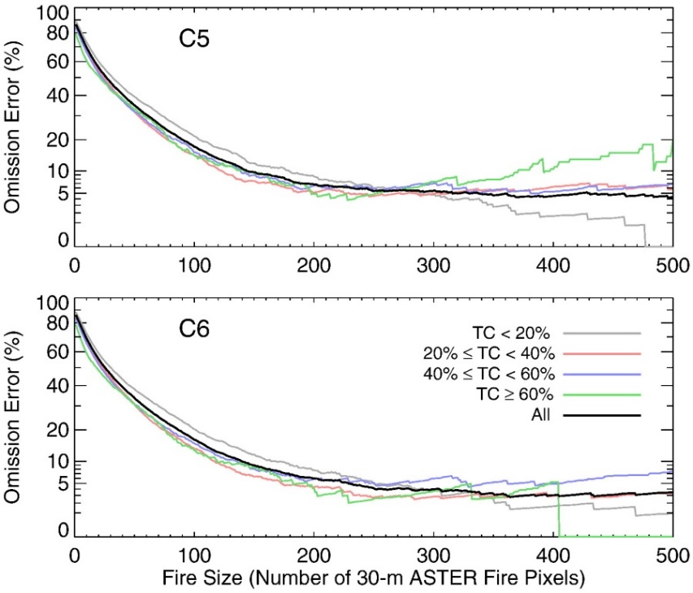
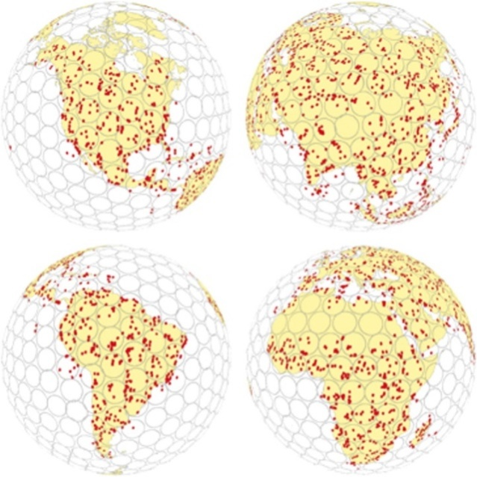
CEOS LPV Fire : Active Fire Current Status
Active fire is currently at validation Stage 4
the product and its associated structure are well quantified
spatial and temporal consistency of the product has been evaluated over globally representative locations and periods
Systematically updated
Largely based on assessment of the MODIS active fire product using spatially and temporally coincident ASTER data (Gigio et al., 2016 and others)
most comprehensive validation of AF product
Global comparison
Seasonal Assessment
Giglio et al., 2016; RSE

Slide 7
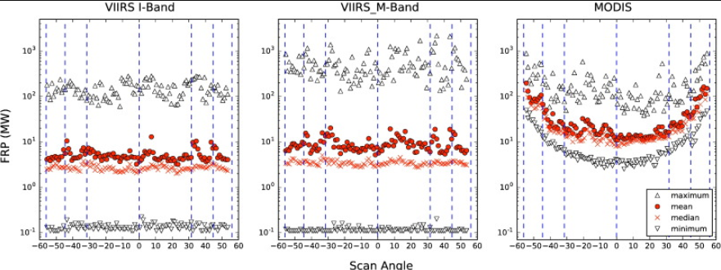
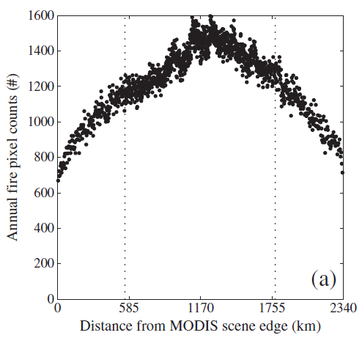
CEOS LPV Fire : Active Fire Current Status
Whilst comprehensive ASTER\MODIS validation has limitations
Limited diurnal sampling
MODIS Terra (morning overpass)
Narrow range of observations
+/- 9° view zenith
Zhang et al., 2018, Remote Sensing
Freeborn et al., 2011, RSE

Slide 8
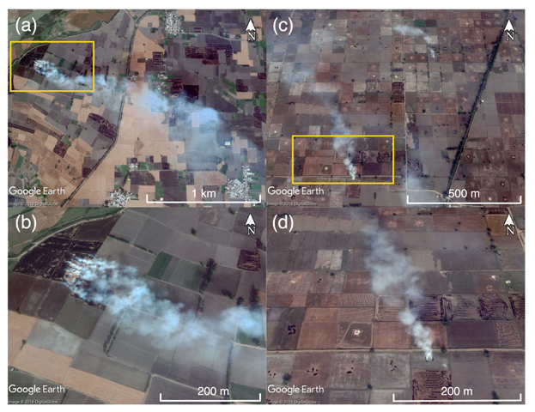
CEOS LPV Fire Disturbance : Active Fire\FRP Current Status
Key difficulties in validating active fire products :
Spatial variability in fire occurrence
Large range in fire size
Small fire omission key unknown
Fieldsites (super-site) not feasible
Prescribed burns
typically small in size
Useful for FRP validation
Fire in FOV of instrument
not always representative of ‘real’ fires
limited in number & spatial coverage
Liu et al., 2019. ERC

Slide 9
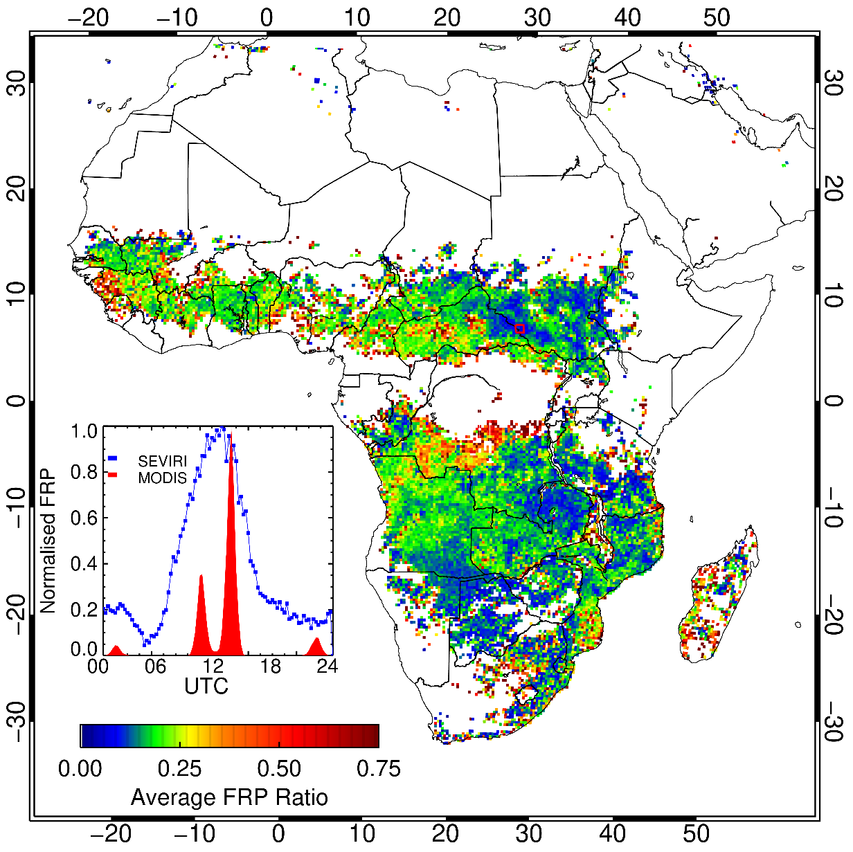
CEOS LPV Fire Disturbance : Active Fire\FRP Current Status
Key difficulties in validating active fire
products :
Temporal variability
Fires vary on short time scales
Require near coincident data for
validation & intercomparison
Diurnal fire cycle has strong spatial
variability
Hampers intercomparison between
sensors

Slide 10
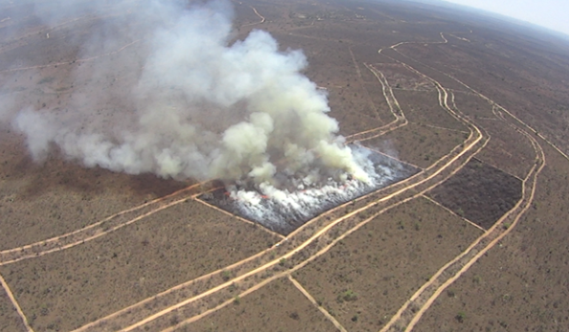
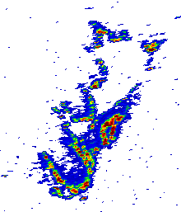
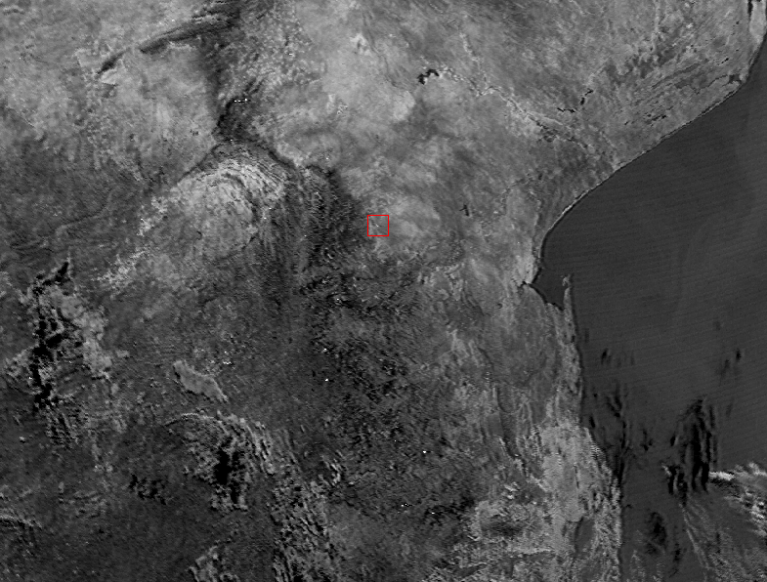
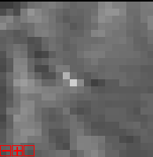
CEOS LPV Fire Disturbance : Active Fire\FRP Validation
FIDEX (ESA validation campaign; Kings College London)
validate FRP from Sentinel-3 mission using helicopter
measurements
South Africa (2017,2018,2019)
Canada (2018)
FRP
>7250W
Total FRP = 20MW
(not corrected for vzen
or atm. effects)
2800W
RGB : 0.65µm, 0.55µm, 0.49µm
RGB : 2.1µm, 1.6µm, 0.86µm
Total FRP = 33 MW

Slide 11
CEOS LPV Fire Disturbance: Future Plans
Finalize the burned area protocol:
Literature now mature to address sampling protocols & accuracy metrics
Relationship to other parameters (e.g. land cover change, albedo) to ensure consistency
Develop validation protocol of AF \ FRP
Aim to develop a draft in the next 1-2 years
Introduce SI traceable units for AF and FRP products
Define a protocol for AF\FRP product intercomparison
geostationary obs. frequency offers greater opportunity
need some understanding of uncertainty of comparison product
Coordinated field campaigns ideal for FRP validation
reliable but limited spatially\temporally, logistically difficult
Generate synthetic dataset to assess fire detection algorithms…..

