Slide 1
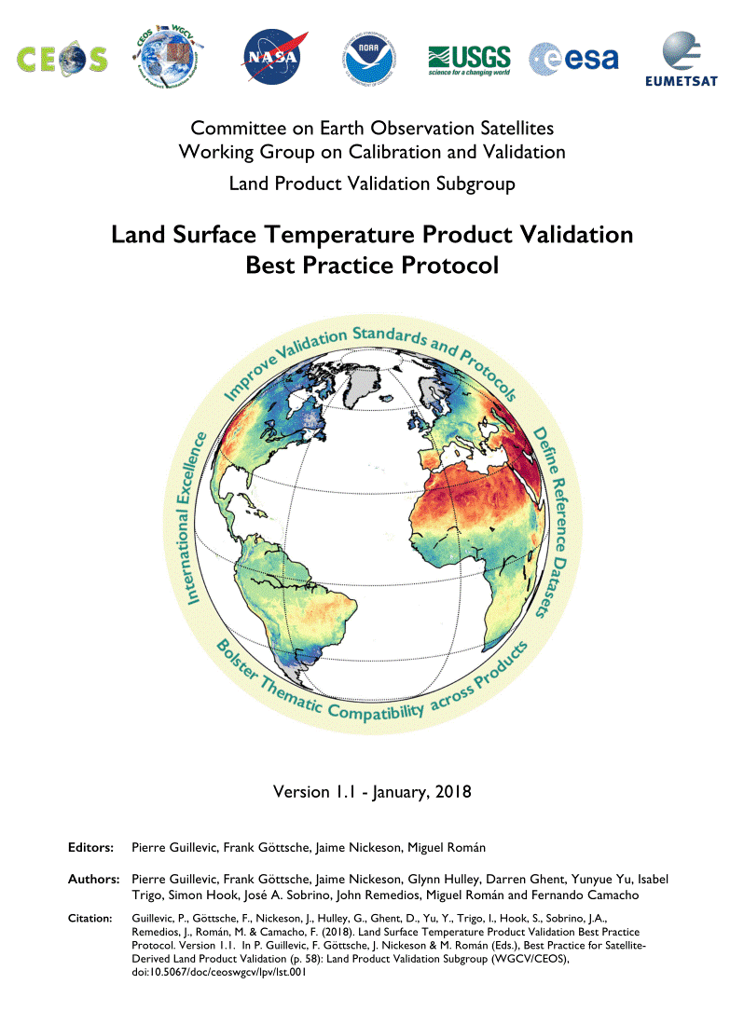
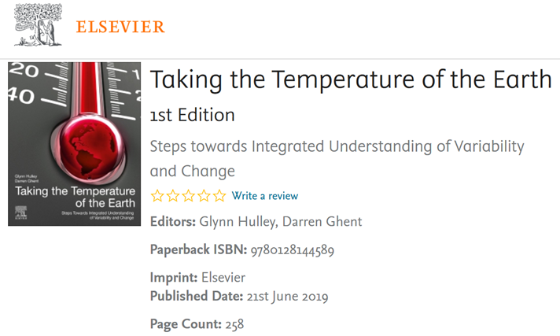
LST validation best practice
‘EarthTemp textbook’
integrated, collaborative approach
observing & understanding various surface temperatures of Earth
describes progress by domain (air, land, sea, lakes and ice)
In Print with Elsevier June 2019

Slide 2
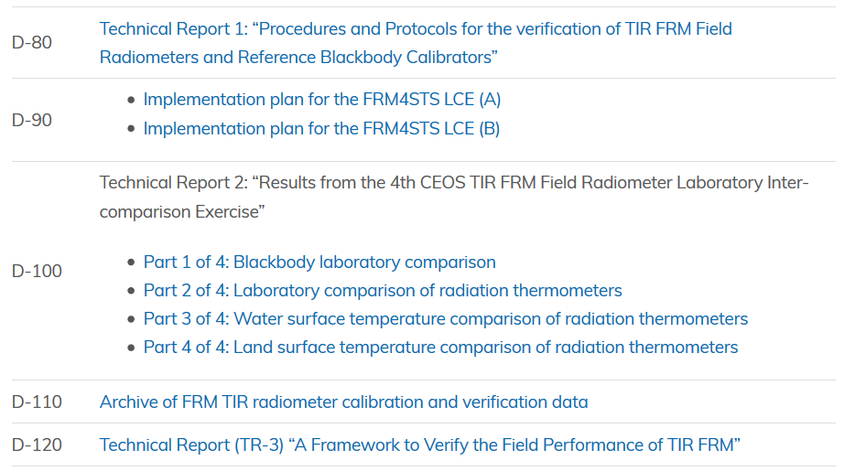
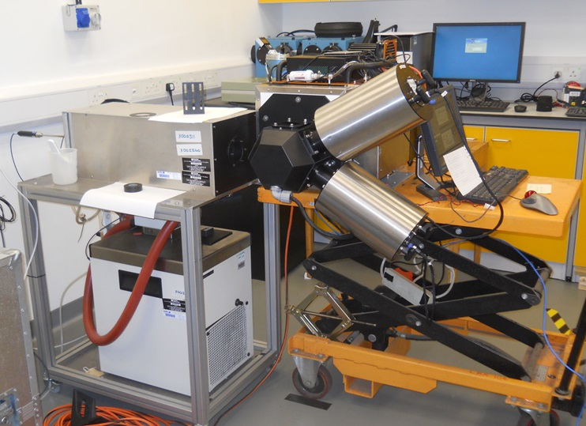
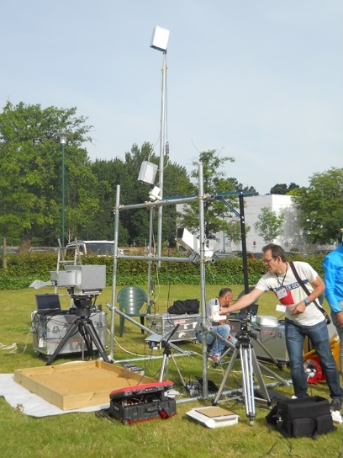
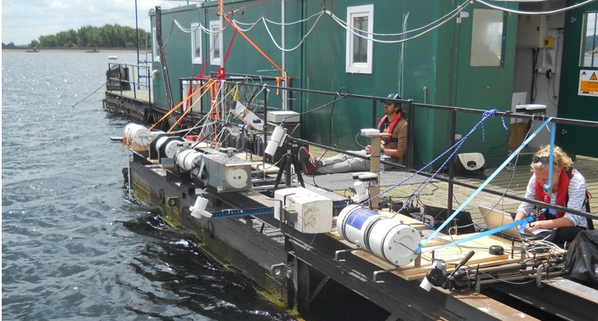
ESA FRM4STS project

Slide 3
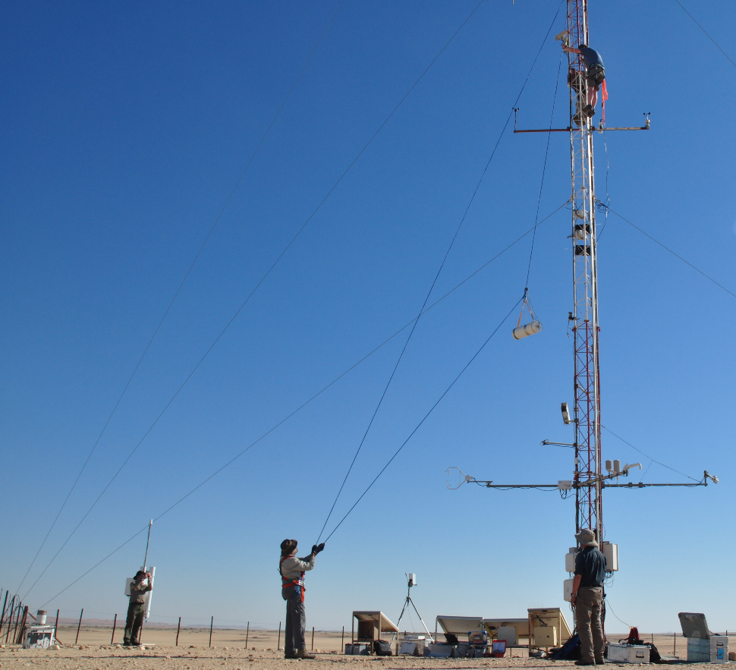
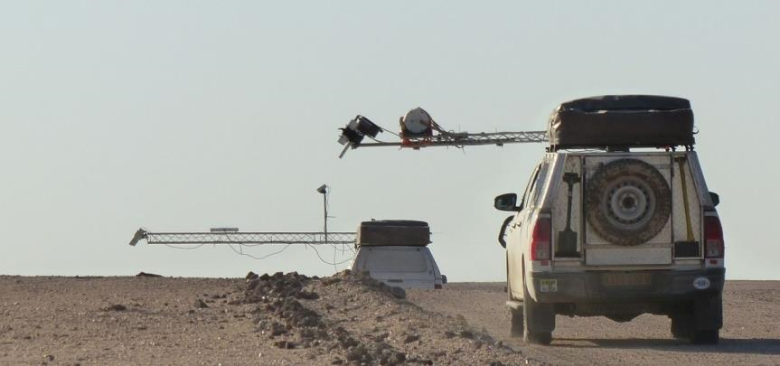
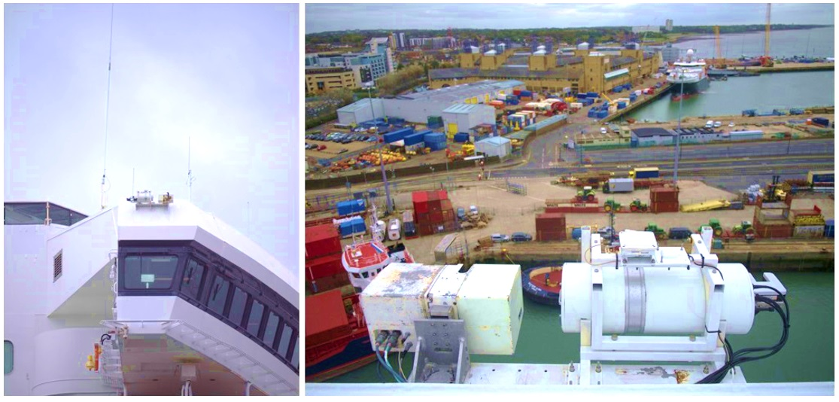
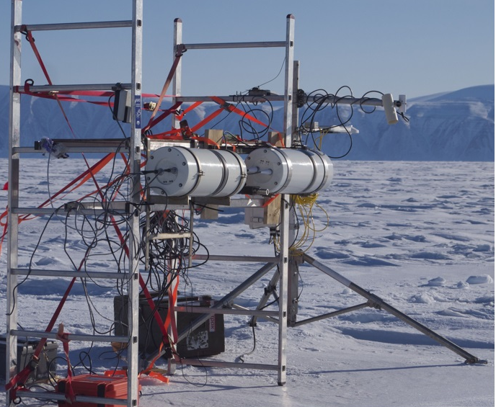
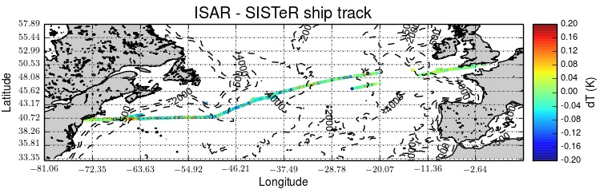
Field inter-comparison experiments
Land
www.frm4sts.org
Sea
Ice

Slide 4
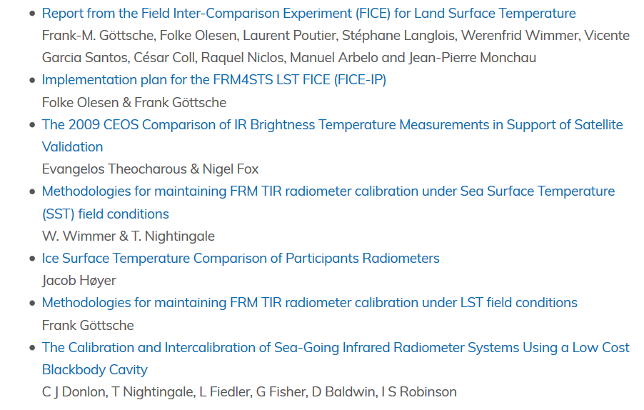
ESA FRM4STS documents

Slide 5
FRM4STS related papers
Theocharous et al. (2019), The 2016 CEOS Infrared Radiometer Comparison: Part II: Laboratory Comparison of Radiation Thermometers. Journal of Atmospheric and Oceanic Technology, doi: 10.1175/JTECH-D-18-0032.1
Water Surface Temperature and Blackbody inter-comparisons: papers in preparation
Coll et al. (2019), Laboratory calibration and field measurement of land surface temperature and emissivity using thermal infrared multiband radiometers. Int. Journal of Applied Earth Observation and Geoinformation, vol. 78, pp. 227-239
Masiello et al. (2018). Physical Retrieval of Land Surface Emissivity Spectra from Hyper-Spectral Infrared Observations and Validation with In Situ Measurements. Remote Sensing, vol. 10, 976
Masiello et al. (2019). SEVIRI Hyper-Fast Forward Model with Application to Emissivity Retrieval. Sensors, vol. 19, 1532

Slide 6
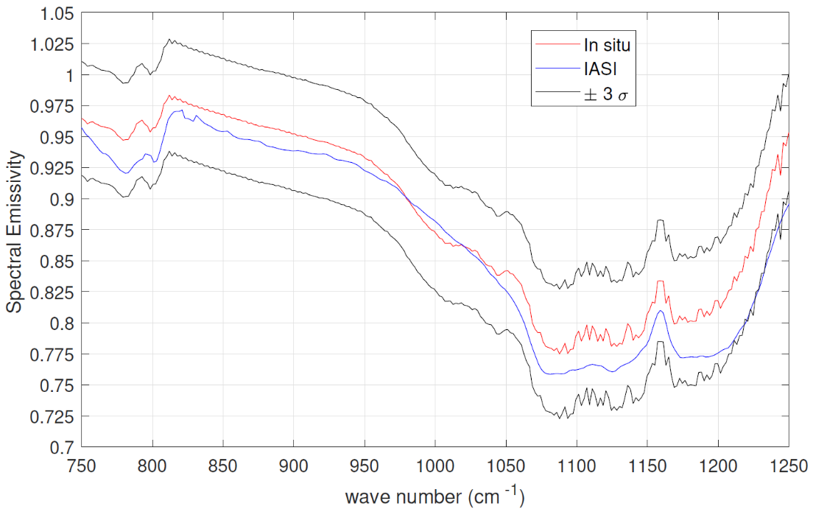
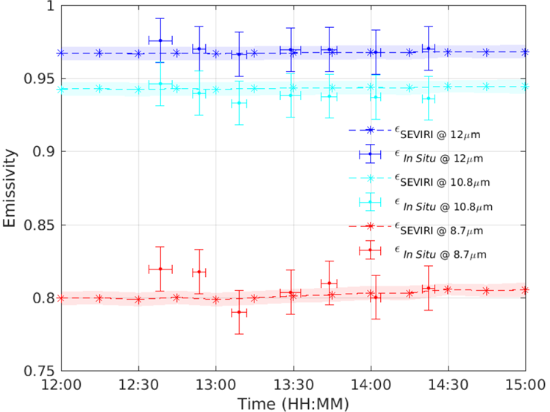
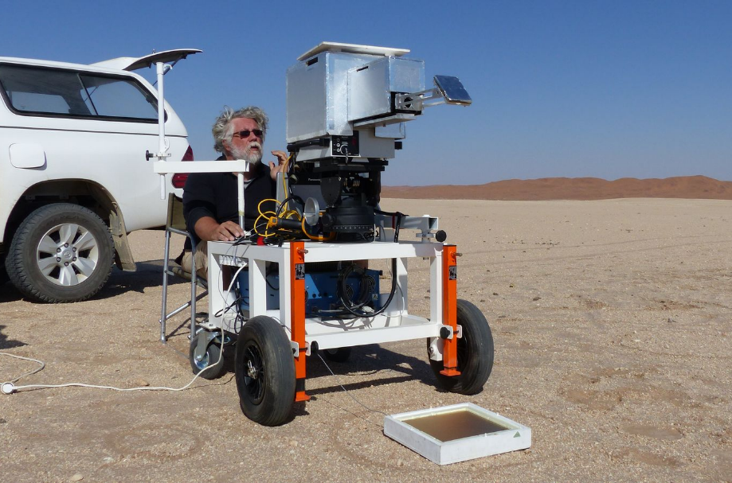
Emissivity Retrieval & Validation
IASI vs in-situ emissivity spectra
Masiello et al. (2018)
SEVIRI vs in-situ emissivity spectra
Masiello et al. (2019)

Slide 7
Status: LST Validation Sites

Slide 8
Surface Heterogeneity at DRA
Gobtemperature Validation and Inter-comparison Report

Slide 9
ESA GlobTemperature (completed)
Single point of access to multi-mission satellite land, lake and ice surface temperature data sets
Merged LST data set from thermal infrared (geo, leo) and passive microwave satellite data
All data sets in harmonised format (netCDF)
Standardized LST inter-comparison & validation
Consistent uncertainty budgets and documentation
Activity continues under ESA CCI programme
www.globtemperature.info

Slide 10
ESA LST CCI project (KO May 2018)
LST across land surfaces globally over 25 years and meet GCOS requirements for climate applications, i.e. achieve CDR quality
Aim: accuracy & precision of the LST ECV of < 1 K
First assessment of LST ECV product stability
Demonstrate coherent and open pre-operational End-to-End processing system for LST ECV Products
Strong validation component: globally representative & consistent in-situ validation and inter-comparison over all major land cover types
cci.esa.int/lst

Slide 11
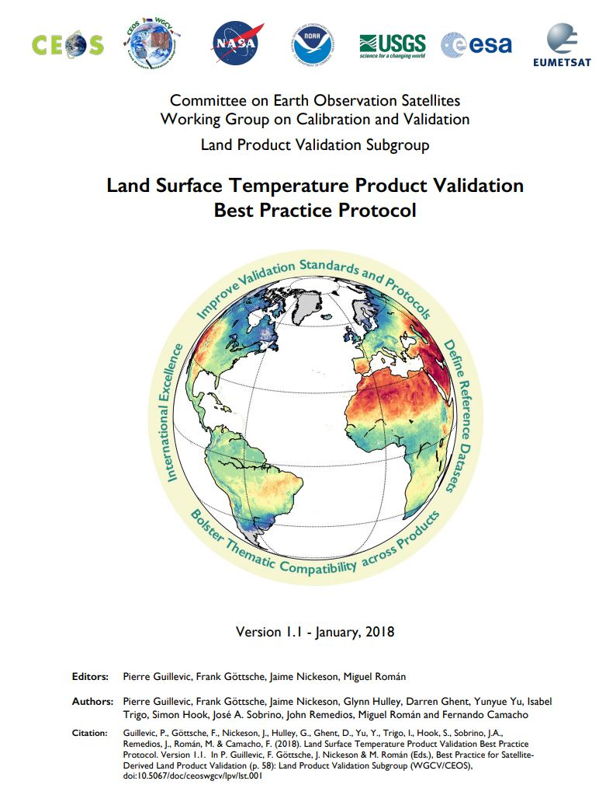
ECOSTRESS LST validation
Three LST Validation Methods:
Temperature-based
Radiance-based
Sensor inter-comparison
Example of all three methods to reach Stage-1 validation for ECOSTRESS Level-2 LST&E products

Slide 13
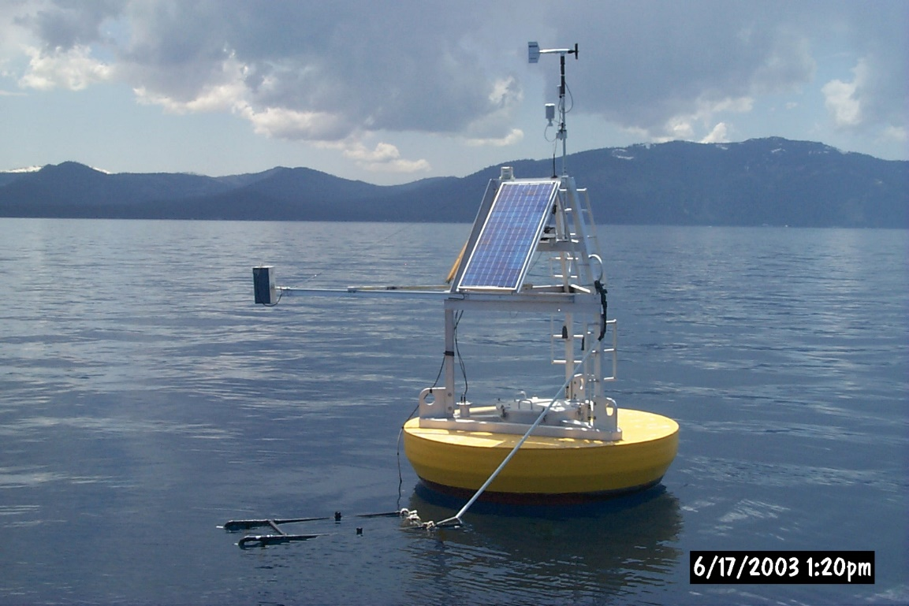
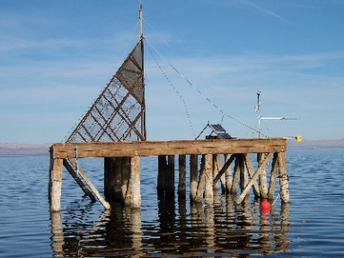
Temperature-based LST validation - Lakes
Lake Tahoe operating since 1999, recording measurements every 2min
Salton Sea since 2007

Slide 14
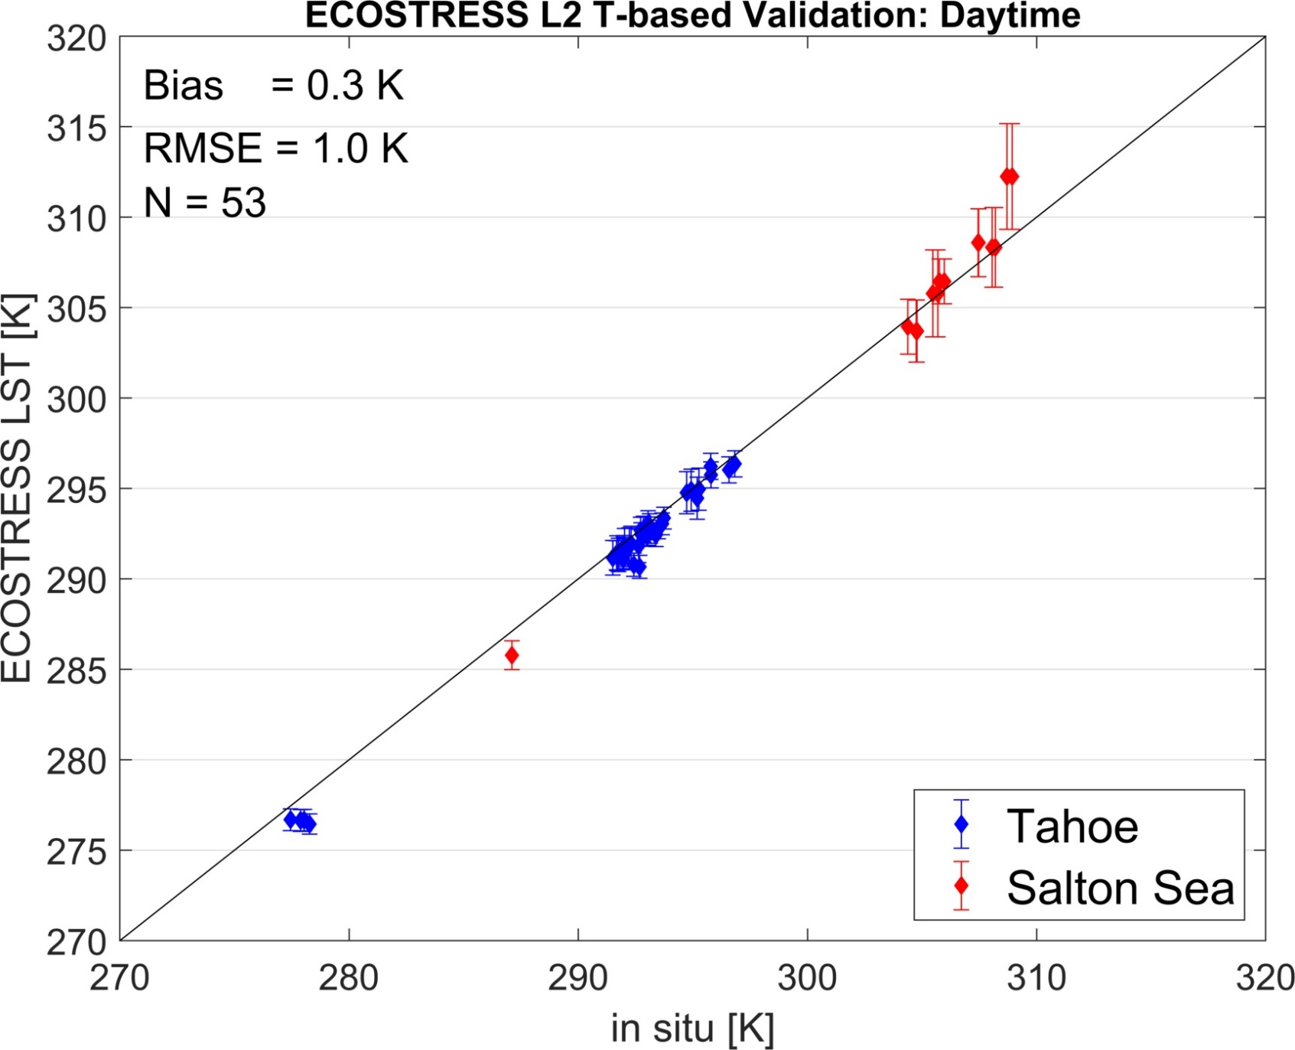
ECOSTRESS T-based validation

Slide 15
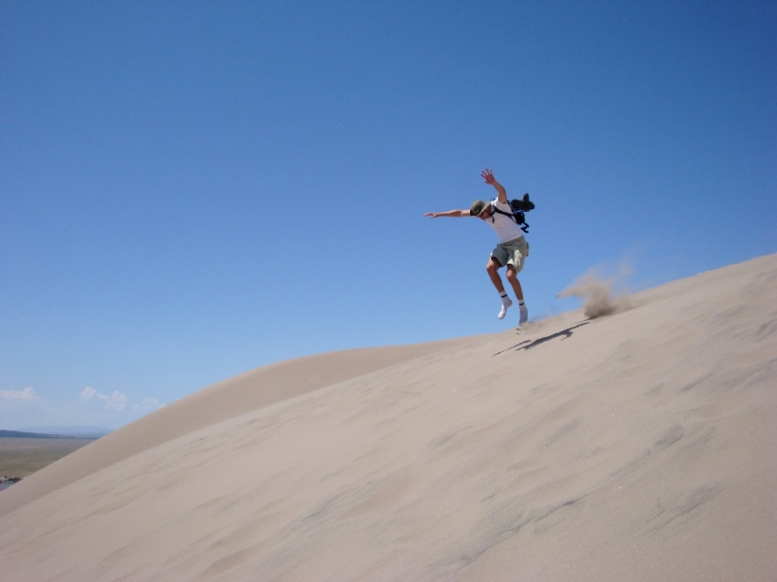
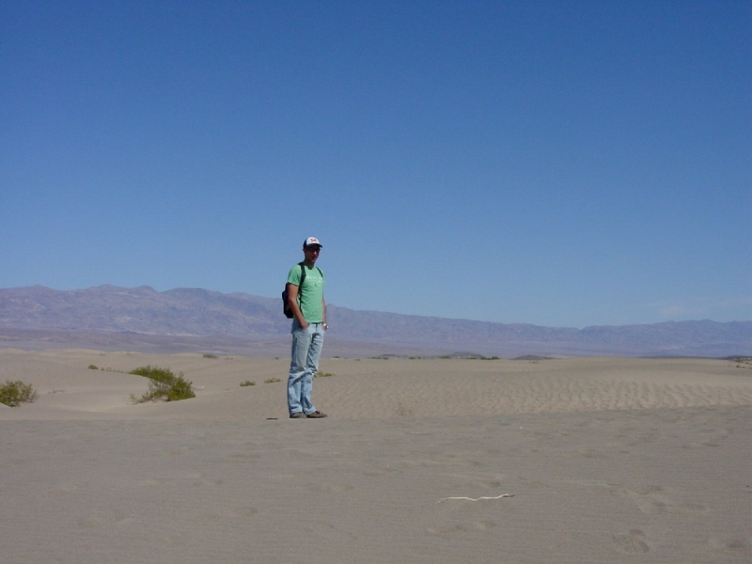
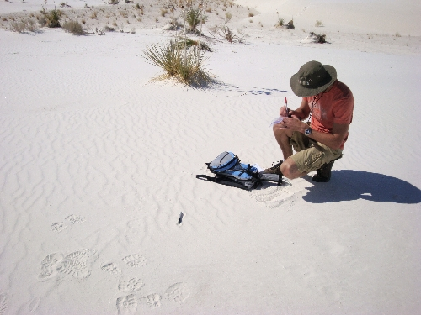
Radiance-based LST validation:
Great Sands, CO
Coral Pink, Utah
Pseudo-invariant sand dune sites
Stovepipe, CA
White Sands, NM
Notes:
Large homogeneous sand sites with consistent mineralogy over time. Sand samples collected in field and emissivity measured in lab.

Slide 16
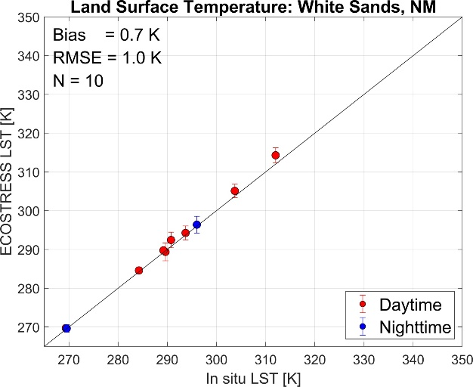
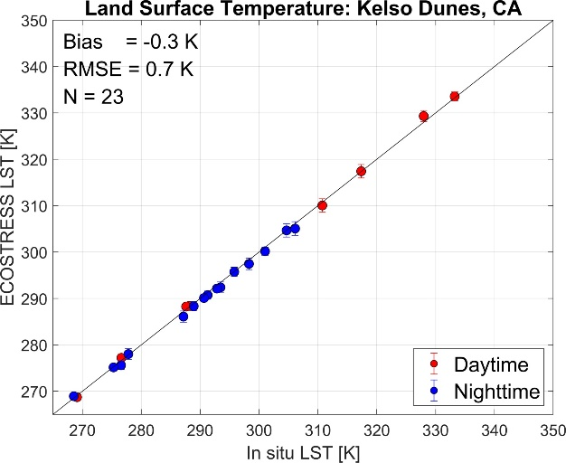
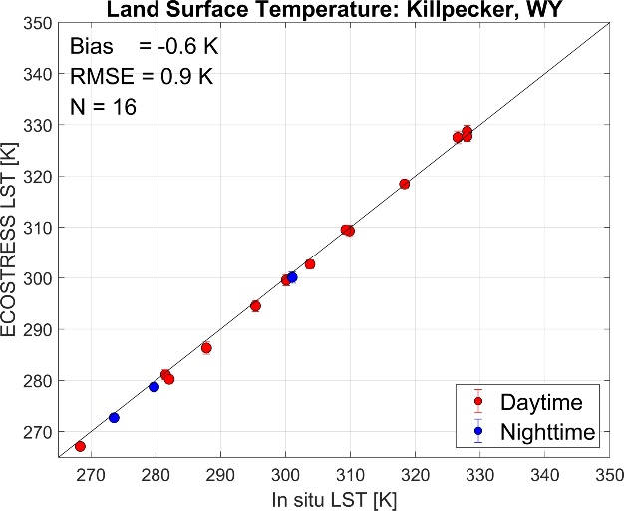
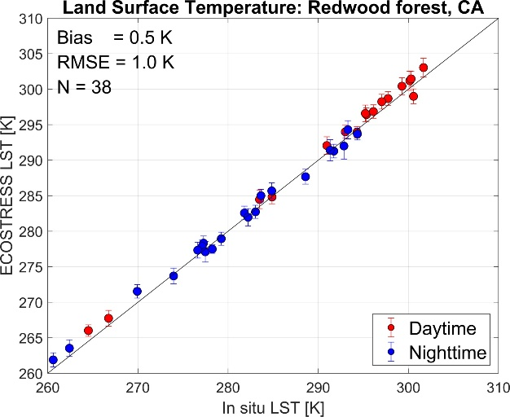
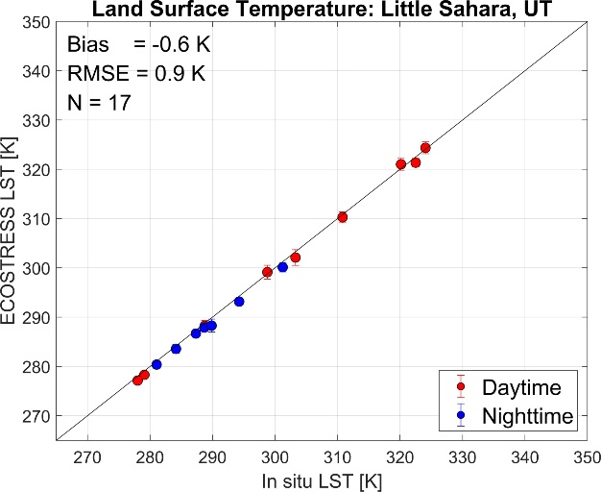
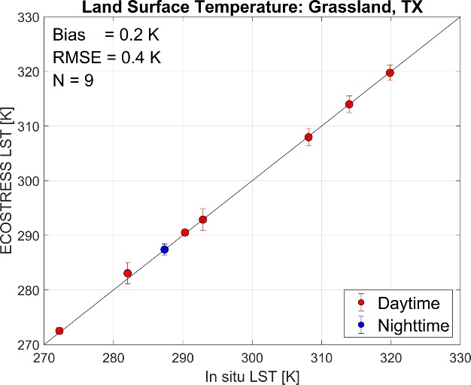
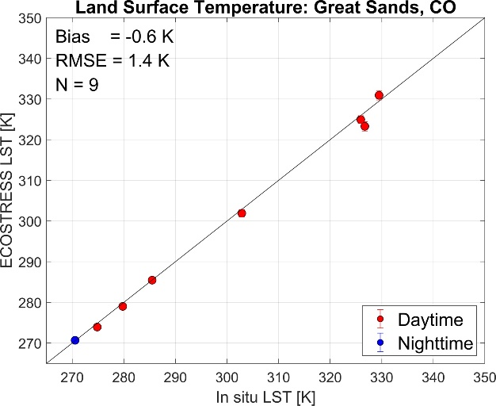
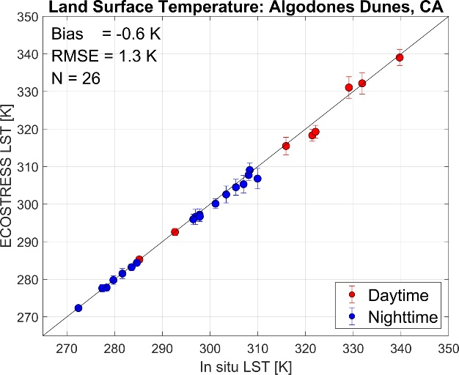
snow
heatwave
R-based validation over wide temperature range (260–345 K) to accuracy of 0.9 K in RMSE
Notes:
Sites that fall close to target validation sites (Tahoe, Salton Sea, LA etc) have more nighttime observations

Slide 17
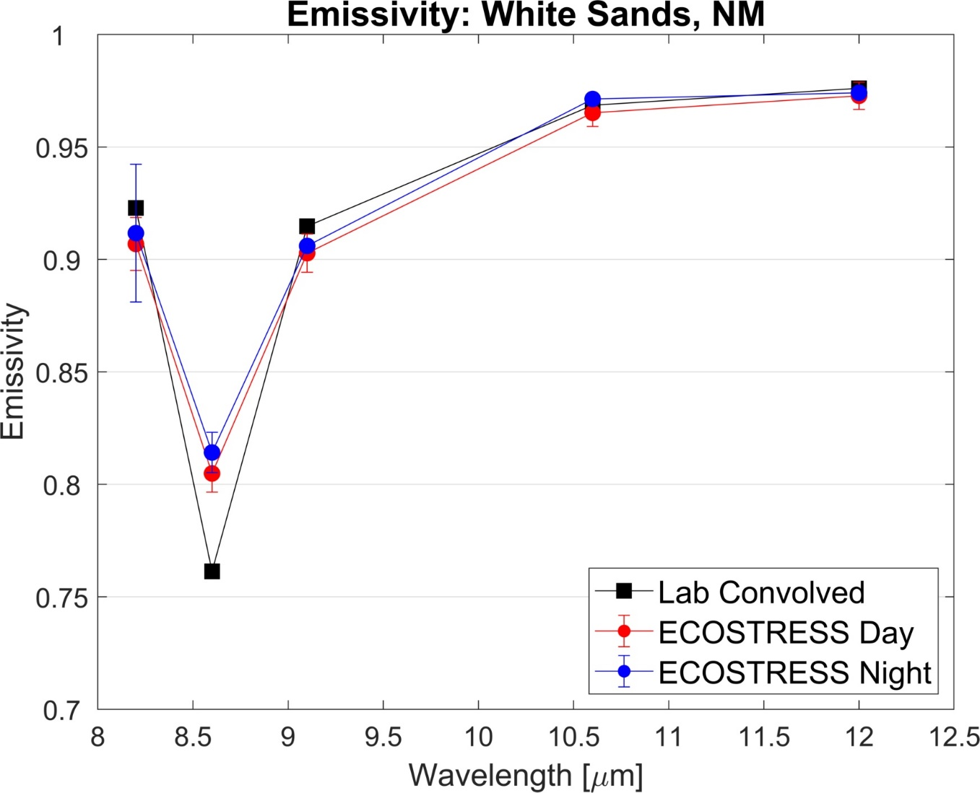
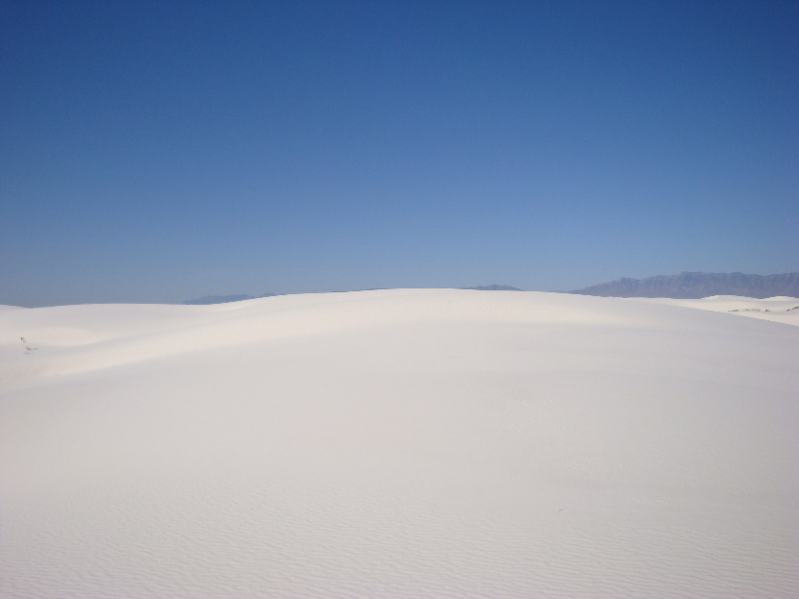
White Sands, NM

Slide 18
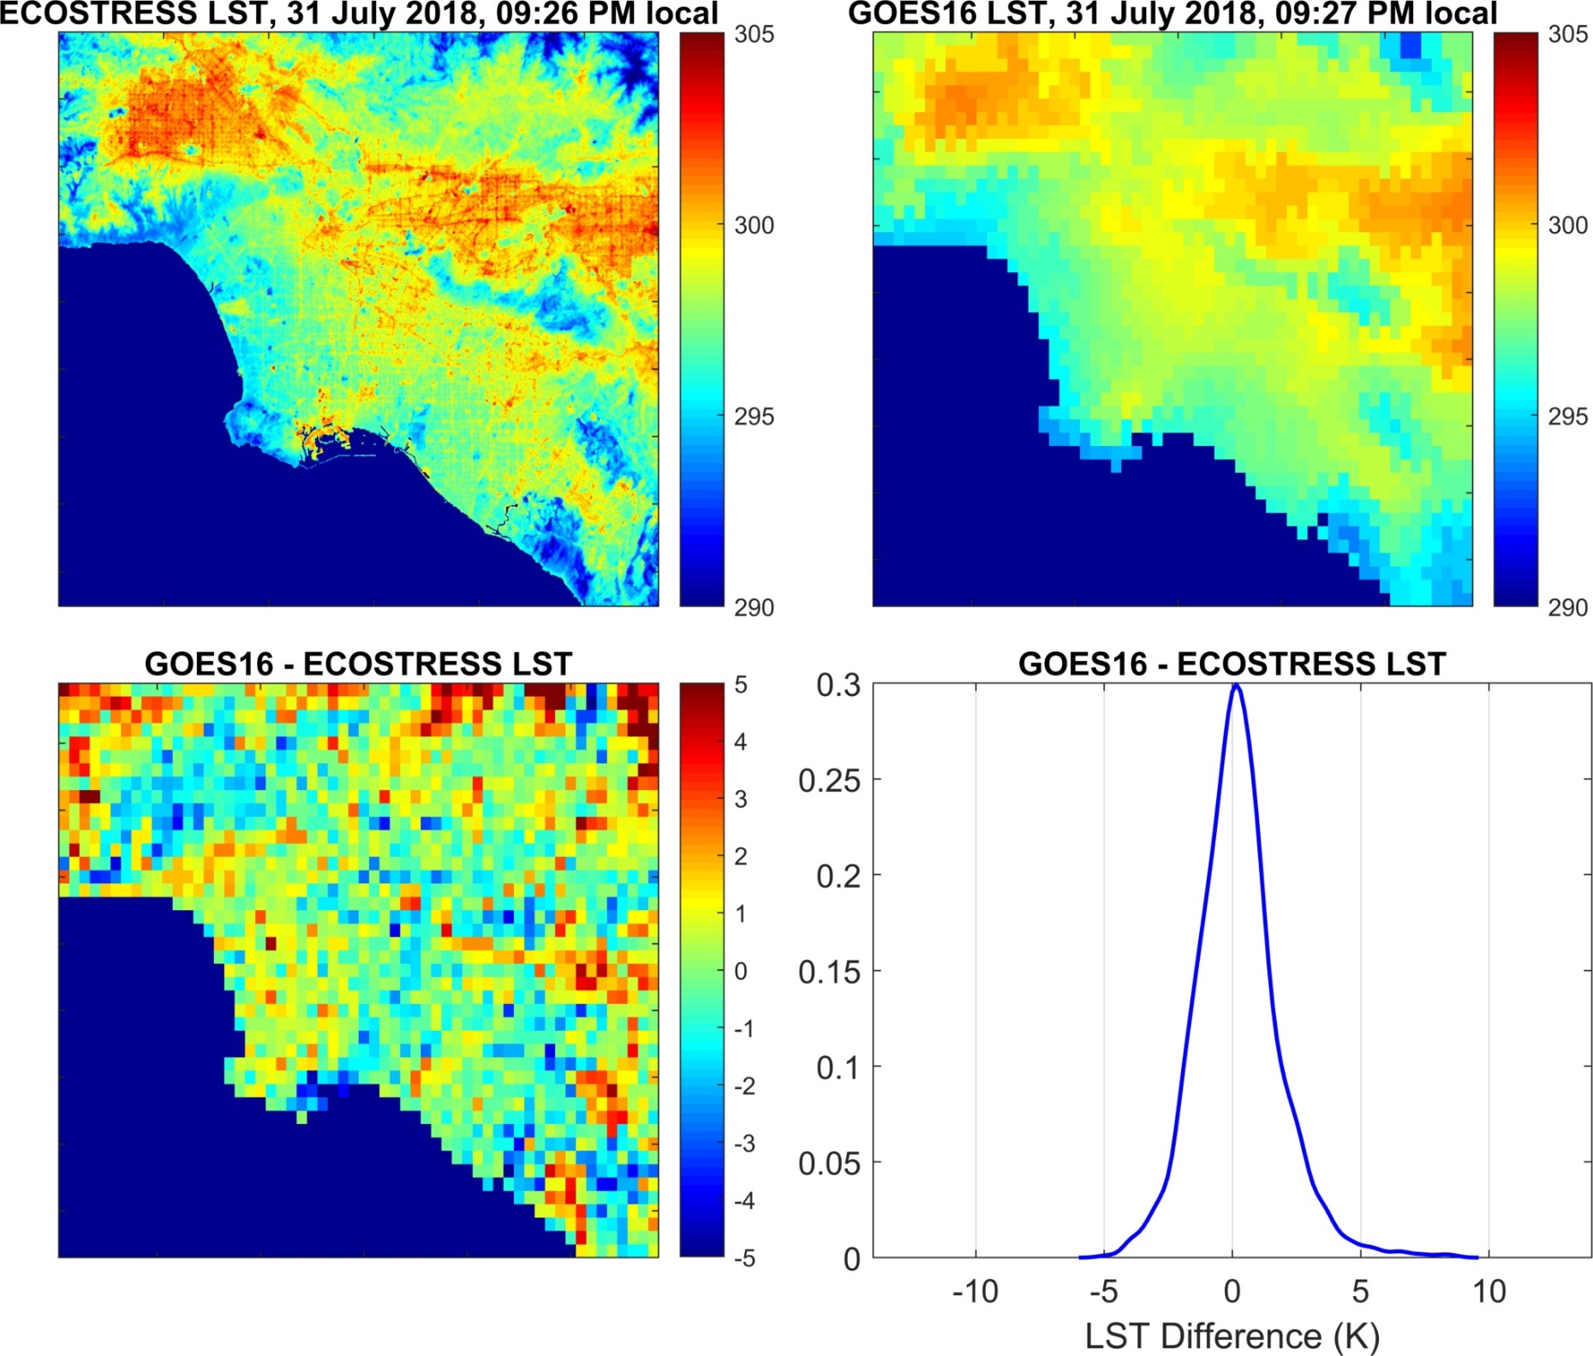
Bias = 0.22 K
RMSE = 1.42 K
Notes:
Low Bias! Two sensors, two algorithms: this is reassuring.
Agregated and matched spatially and to 1 min temporal difference

Slide 19
Summary & Outlook
CEOS LST validation protocol ready to use
‘How to’ FRM4STS documents: calibration of field radiometers, determination of in-situ LST
GlobTemperature (& CCI) Documents
First validation results for ECOSTRESS LST product indicate an RMSE of about 1.0 K
Future: network operated by partners
Standard instrument package
Standard data logger & processing software
Standard data format

