Slide 1
CEOS LPV Soil Moisture
Mike Cosh and Carsten Montzka

Slide 2
CEOS LPV Soil Moisture
The Internation Soil Moisture Network and automated validation procedures

Slide 3
International Soil Moisture Network (ISMN)

Slide 4
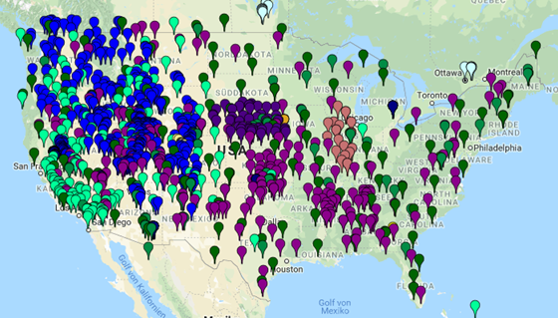
International Soil Moisture Network (ISMN)
Only in situ data and metadata
8 different variables
59 networks (status October 2018)
2438 stations (status October 2018)
Measurements from several depths
Data from 1952 up to near real time
About 10.000 datasets available
Funding assured until mid 2019

Slide 5
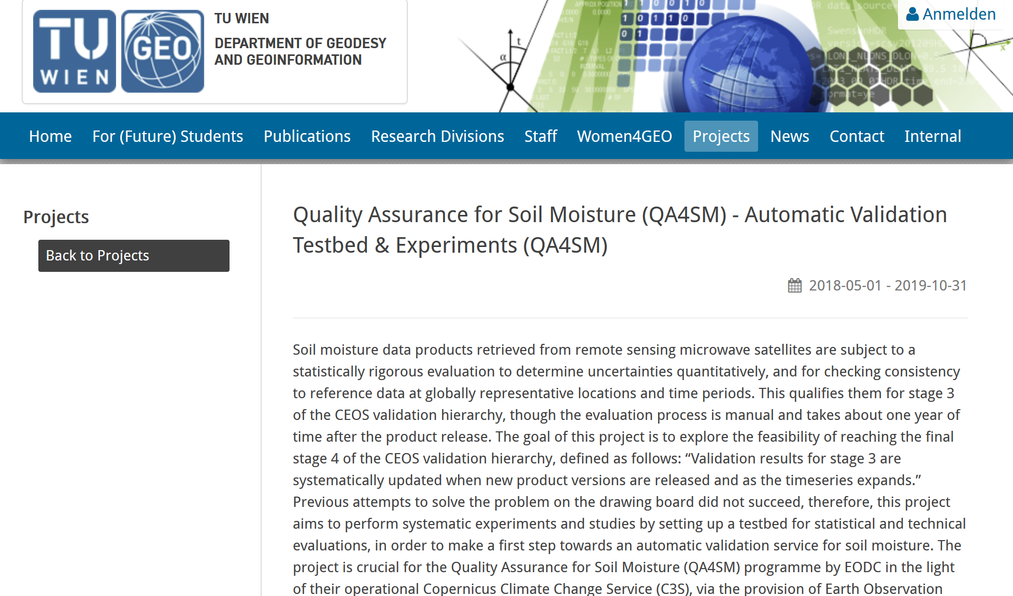
QA4SM

Slide 6
QA4SM online validation tool

Slide 7
QA4SM

Slide 8
QA4SM

Slide 9
CEOS LPV Soil Moisture
Validation Good Practice Document

Slide 10
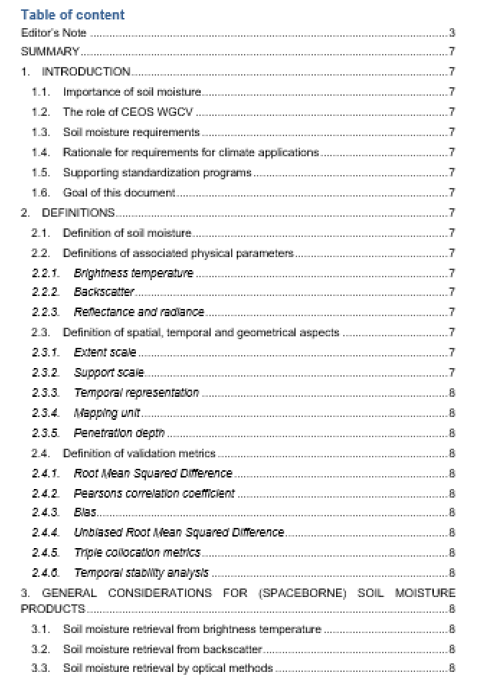
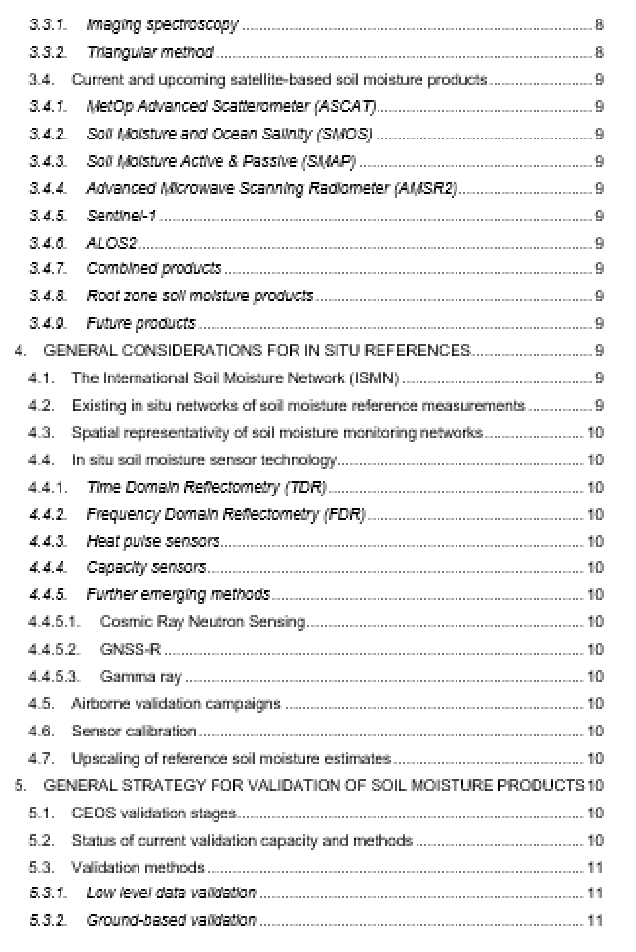
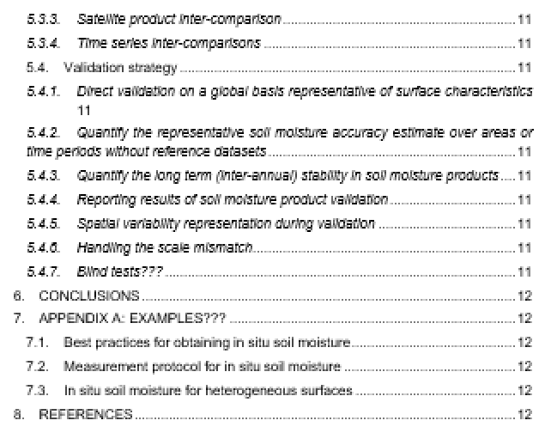

Slide 11
Good Practice Document: Timeline
Invitation to section leads: now
Invitation to community: June 2019
Community review and additional input: October 2019
First draft ready: Spring 2020

