Slide 1






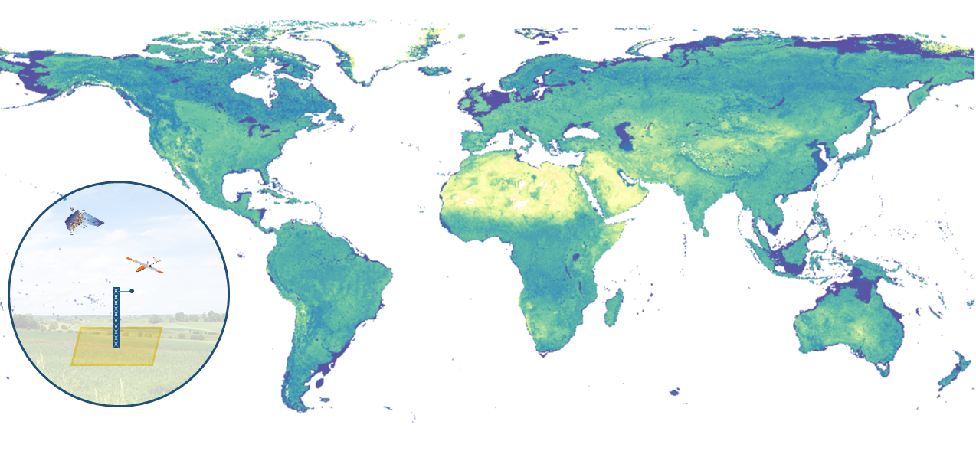
Land Surface Albedo Focus Area
Zhuosen Wang^{1,2}, Dominique Carrer³, Ian Grant⁴, Fernando Camacho⁵,
Jaime Nickeson² ,Jorge Sánchez-Zapero⁵
¹ University of Maryland College Park, College Park MD, United States
² NASA Goddard Space Flight Center, Greenbelt MD, United States
³ National Centre for Meteorological Research, Toulouse, France
⁴ Bureau of Meteorology, Melbourne Victoria, Australia
⁵ Earth Observation Laboratory (EOLAB) at University of Valencia , Valencia , Spain

Slide 3
Surface Albedo Validation Strategy
In-situ tower-based validation
Satellite products inter-comparison
Upscaling high spatial resolution airborne/spaceborne albedo
Stage | Description
Stage 1 Validation | Product accuracy is assessed from a small (typically < 30) set of locations and time periods by comparison with in-situ or other suitable reference data.
Stage 2 Validation | Product accuracy is estimated over a significant set of locations and time periods by comparison with reference in situ or other suitable reference data. The spatial and temporal consistency of the product and with similar products has been evaluated over globally representative locations and time periods. Results are published in the peer-reviewed literature.
Stage 3 Validation | Uncertainties in the product and its associated structure are well quantified from comparison with reference in situ or other suitable reference data. Uncertainties are characterised in a statistically robust way over multiple locations and time periods representing global conditions. Spatial and temporal consistency of the product and consistency with similar products has been evaluated over globally representative locations and periods. Results are published in the peer-reviewed literature.
Stage 4 Validation | Validation results for stage 3 are systematically updated when new product versions are released and as the time-series expands.

Slide 4
In-situ Reference Sites
Networks | Reference/Remark
BSRN | https://bsrn.awi.de/
BSRN-SURFRAD | https://www.esrl.noaa.gov/gmd/grad/surfrad/
FLUXNET | http://fluxnet.fluxdata.org/
NEON | http://www.neonscience.org/
GC-Net | http://cires1.colorado.edu/steffen/gcnet/
PROMICE | https://www.promice.dk/home.html

Slide 5
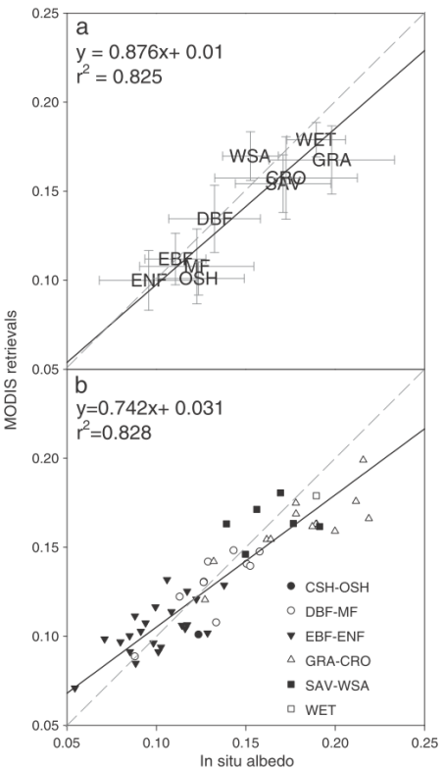
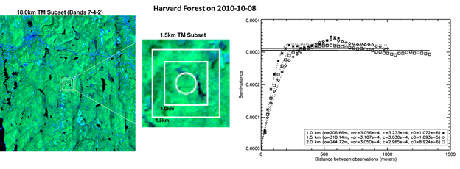
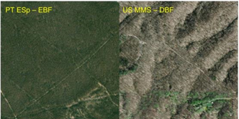
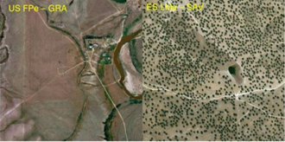
In-situ Tower-based Validation
Spatial representativeness
MODIS albedo retrievals vs. in-situ observations grouped by plant functional types (PFTs) (a), and by individual sites classiﬁed by PFT (b).
Cescatti et al. RSE, 2012

Slide 6
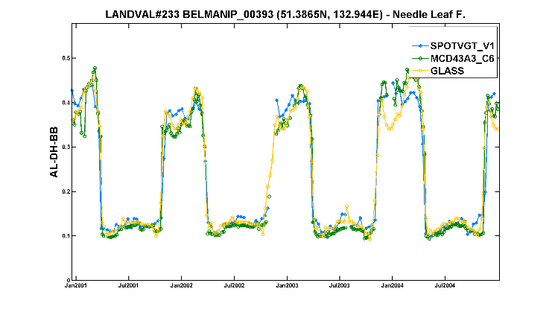
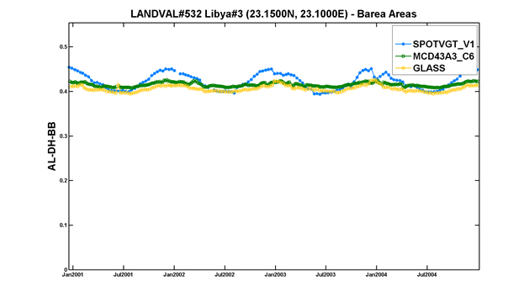
Satellite Products Inter-comparison
Temporal variations of SPOT/VGT V1, MODIS MCD43A3 C6 and GLASS AL-DH-BB retrievals over Needle-Leaf forest (left) and Bare Areas (right) whereas a large seasonality is displayed in the SPOT/VGT albedo product which is not depicted in MODIS and GLASS products and corresponds to a bug in the Earth-Sun distance correction of the SPOT/VGT collection 2 archive which was fixed in collection 3 (Sánchez-Zapero et al., 2018).

Slide 7
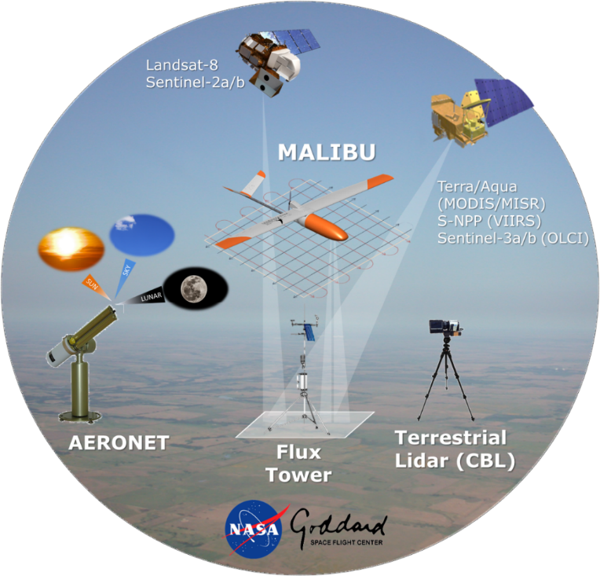
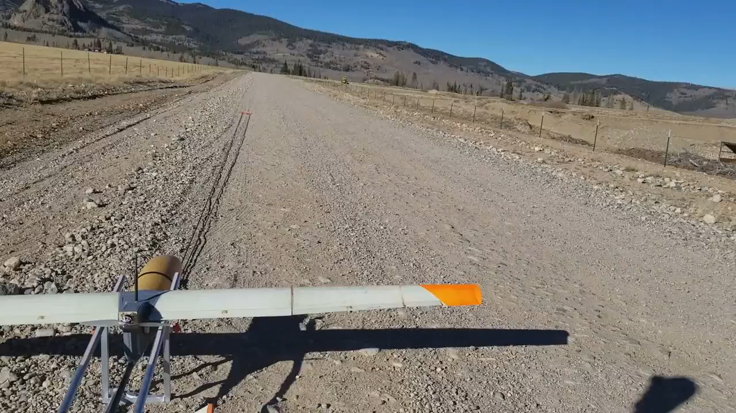
Upscaling High Spatial Resolution Airborne/Spaceborne Albedo
Summary:
Joint NASA GSFC 618/619 effort to develop multi-angular reference datasets for the assessment of BOA reflectance-based products (e.g., BRDF, albedo, NBAR, VI, PRI, LAI/FPAR, snow cover, and phenology metrics).
MALIBU (Multi AngLe Image BRDF Unmanned aerial system)
MALIBU Superswift Deployment at Table Mountain, CO
Benefits:
A cost effective ($300 × Flight Hour), exempted (FAA-S.333 & TCAN) platform, that follows CEOS-WGCV good practice protocols.
https://viirsland.gsfc.nasa.gov/Campaigns.html

Slide 8
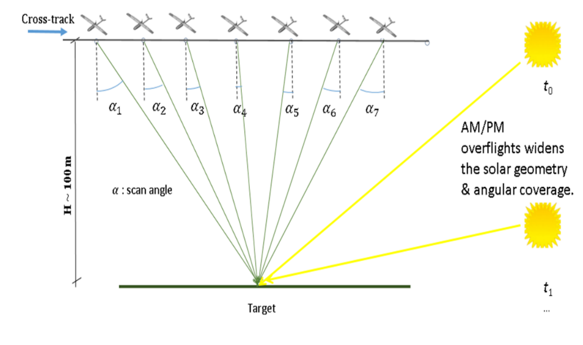
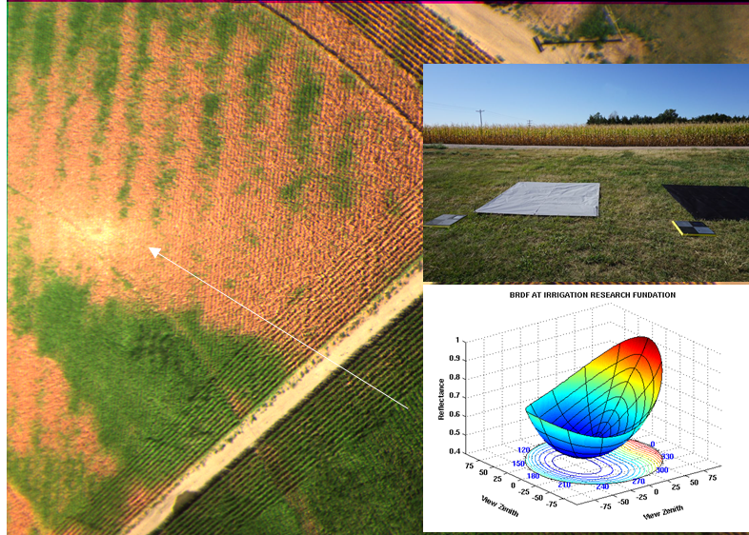
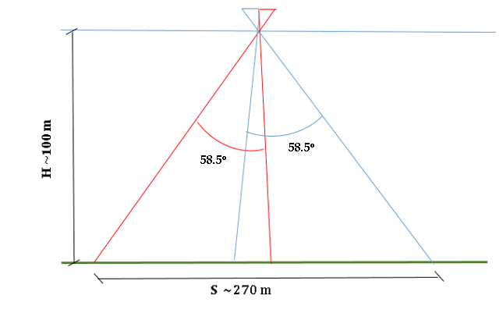
Upscaling High Spatial Resolution Airborne/Spaceborne Albedo
Hot spot region
Yuma cropland, CO, USA

Slide 9
Validation Metrics
Quantity | Current practice | Good practice, add:
Accuracy | Bias; absolute bias | Median error Median and percentiles of residuals Box-plots of residuals vs. Albedo
Precision | Standard deviation | Median absolute deviation Median 3 point difference
Uncertainty | Root mean square error | Scatter plot of match-ups Median and percentiles of absolute residuals, RMSE Box-plots of absolute residuals vs. Albedo
Completeness |  | Gap size distribution Gap length
Stability |  | Time series average, standard deviation, and regression slope Mean error per decade

Slide 10
Surface Albedo Validation Tool
SALVAL: Surface ALbedo VALidation tool
Provide transparency and traceability in the validation process
Integrate the different validation metrics into a tool in which the user can analyze the different validation criteria
Provide consistency in evaluating comparatively the new versions and new products
L. de la Madrid et al., EOLAB

Slide 11
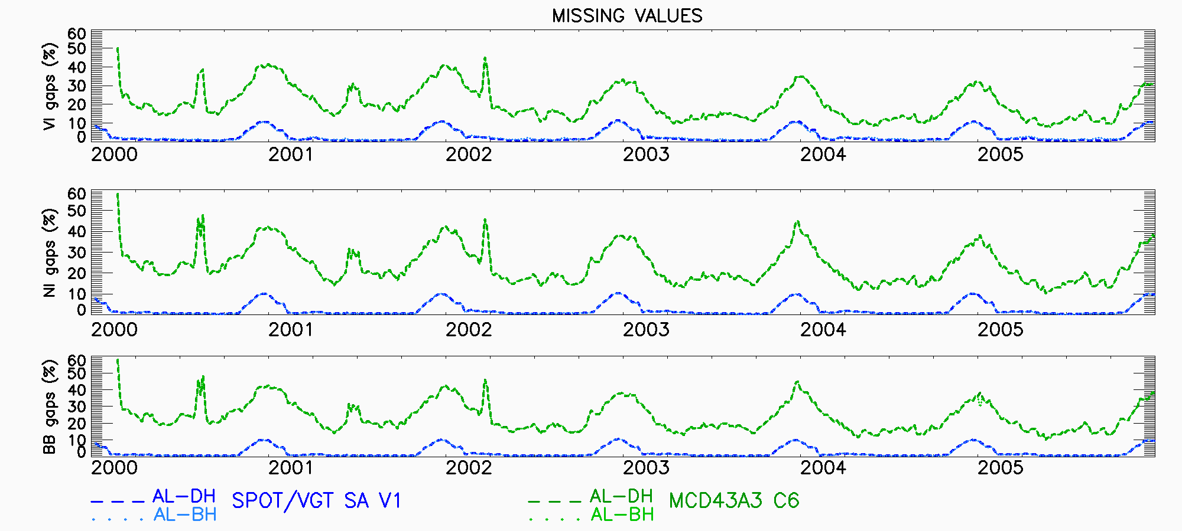
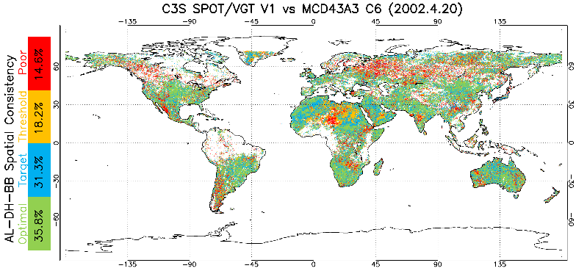
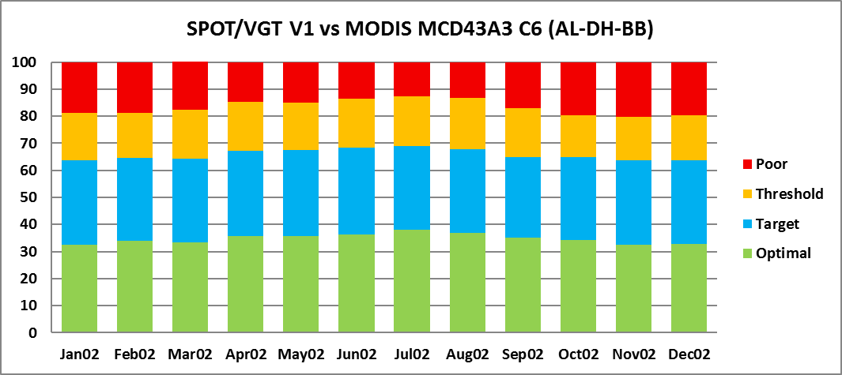
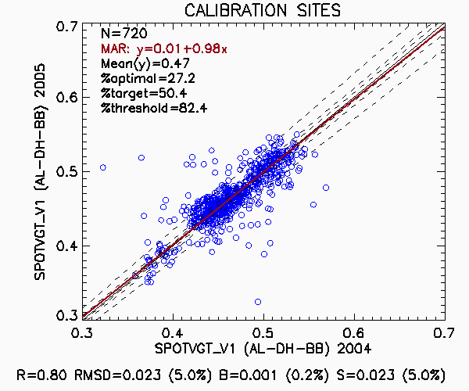
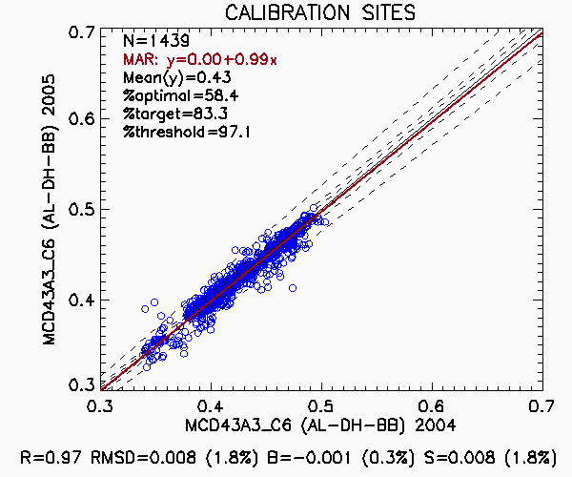
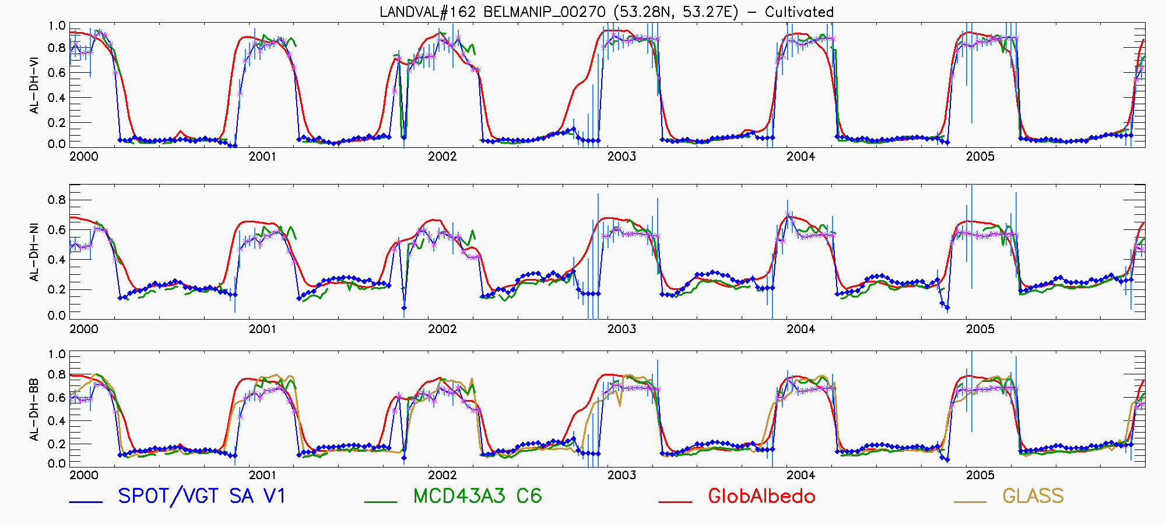
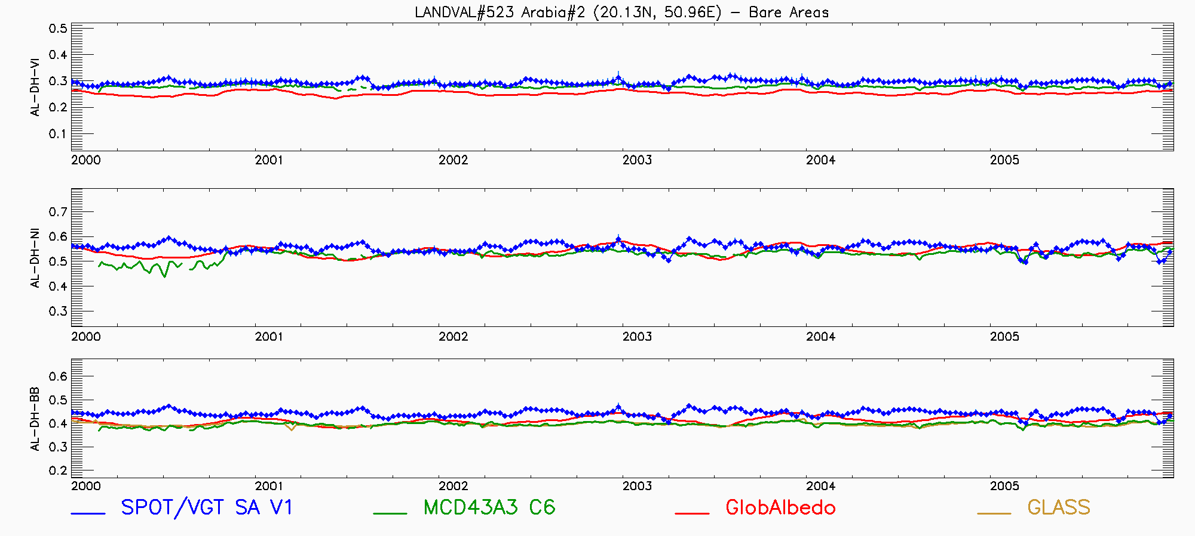
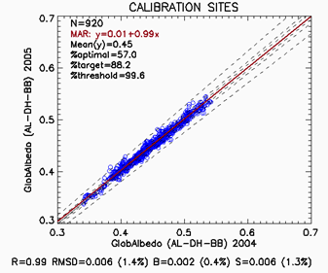
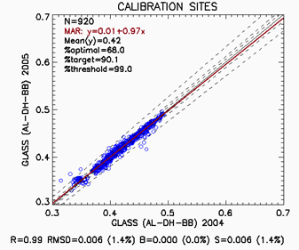
Surface Albedo Validation
Product Completeness
Spatial consistency
Inter-Annual Precision
Temporal consistency

Slide 12
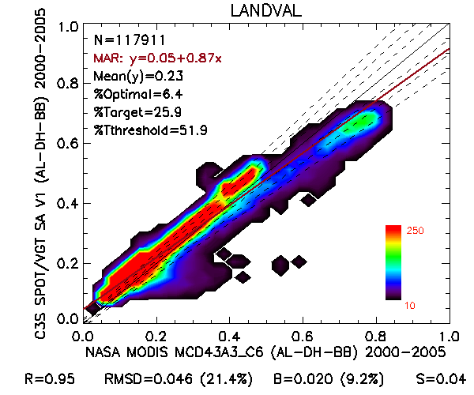
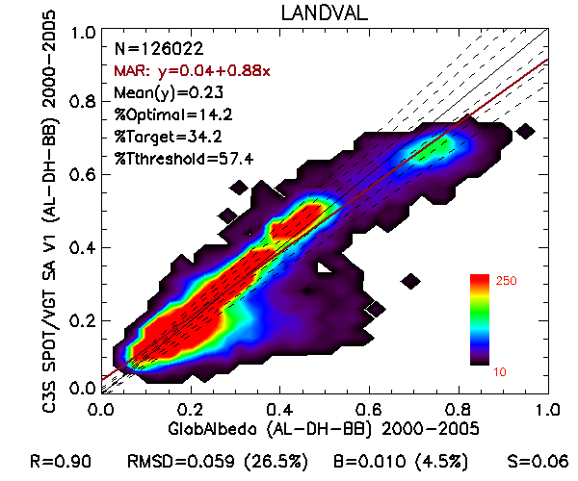
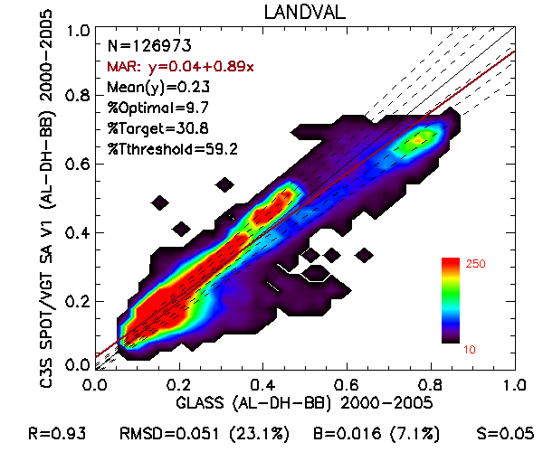
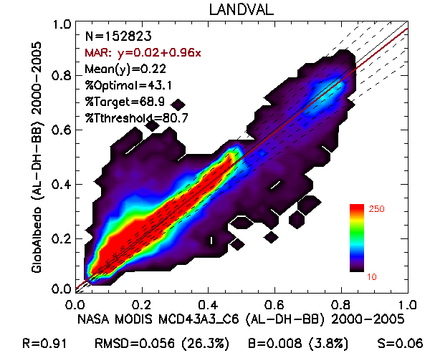
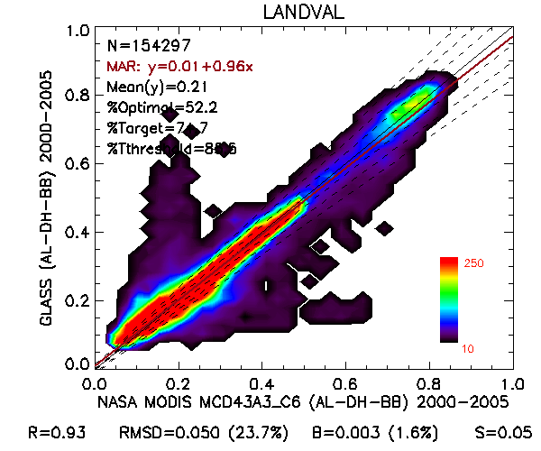
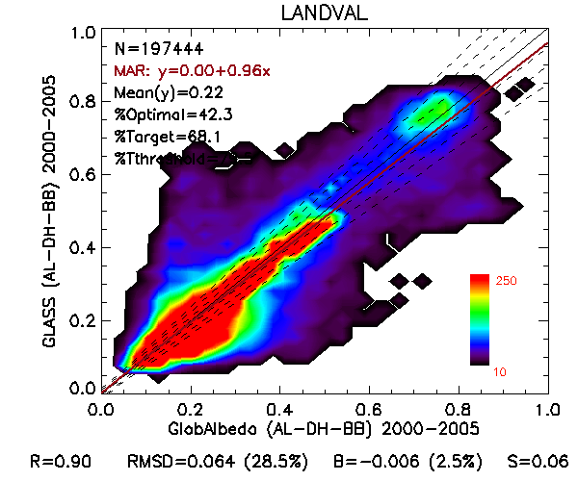
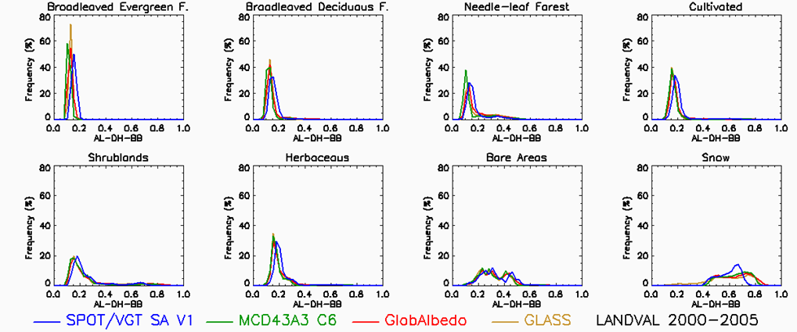
Surface Albedo Validation
Spatio-Temporal Consistency

Slide 13
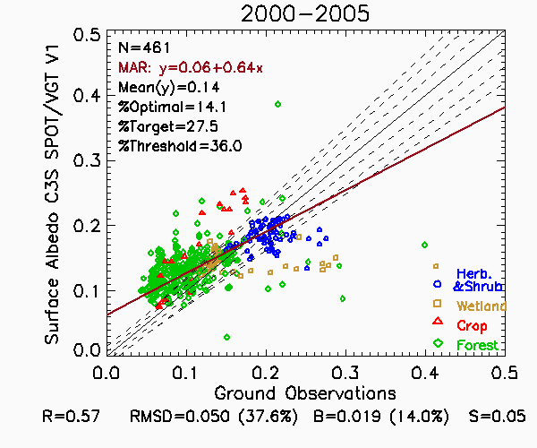
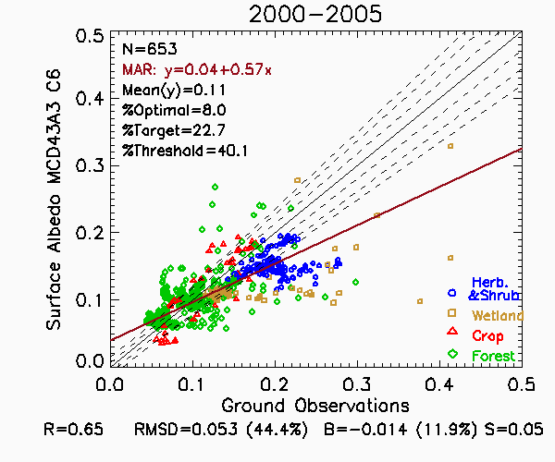
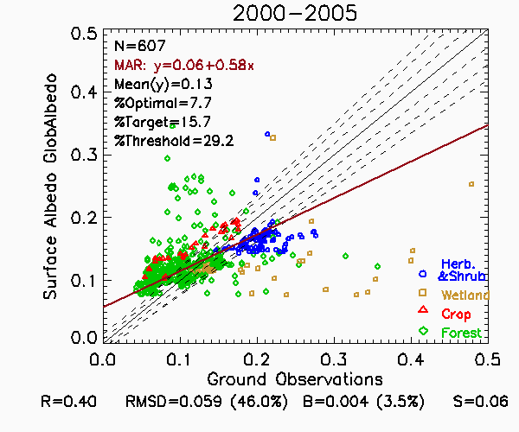
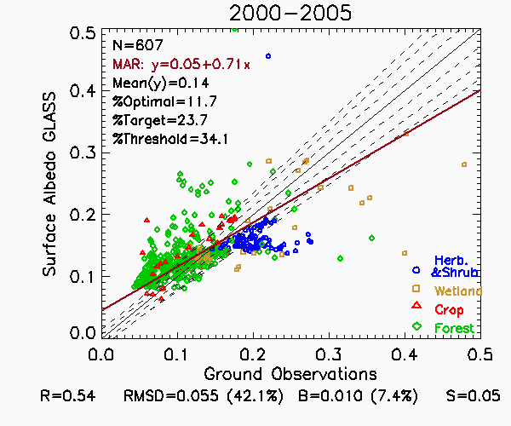
Surface Albedo Validation
Accuracy Assessment

Slide 14
Next Steps
Ground albedo measurements
Newsletters
Website update --- products/papers etc.
Albedo validation papers
Spectral albedo validation
Urban albedo validation
High spatial resolution albedo validation
Provide suggestions for new towers installation (location, height etc.) for albedo validation
Workshop/conference
Provide transparency and traceability in the validation process
Integrate the different validation metrics into a tool in which the user can analyze the different validation criteria
Provide consistency in evaluating comparatively the new versions and new products

