Slide 1
LAI/fAPAR
Decision has been taken to fuse LAI/fAPAR groups
variables are very often measured/estimated at the same time, very close link
Difficulties to find co-lead fo fAPAR
Hongliang Fang (LAI)
Marie Weiss (fAPAR)

Slide 2
Recent Activities
Special LAI/FAPAR session in IGARSS’19 (https://igarss2019.org/)
Session MO4.R12. Monday, 29 July, 16:20 – 18:00.
Registration opening. on Mar 29, 2019.
Attendants welcome to meet after session at dinner.
FAPAR focus area lead Dr. M. Weiss visited Beijing, China (Mar 19-29, 2019)
Gave talks in various institutes about “Derivation of global vegetation products from European medium resolution sensors”
MODIS, GEOV2, and GLASS LAI representatives met and discussed current product uncertainties and further validation activities
Discussed about a platform to share global decametric resolution reference LAI.
Publications
H. Fang, F. Baret, S. Plummer, and G. Schaepman-Strub, 2019. An overview of global leaf area index (LAI): Methods, products, validation, and applications, Review of Geophysics. http://dx.doi.org/10.1029/2018RG000608
Remote Sensing special issue “Remote Sensing of Biophysical Parameters” (deadline: May 22, 2020). Editors: J. GarcíaHaro (U. Valencia), H. Fang (CAS), and M. Campos-Taberner (U. Valencia)
http://www.mdpi.com/journal/remotesensing/special_issues/Biophysical_Parameters

Slide 3
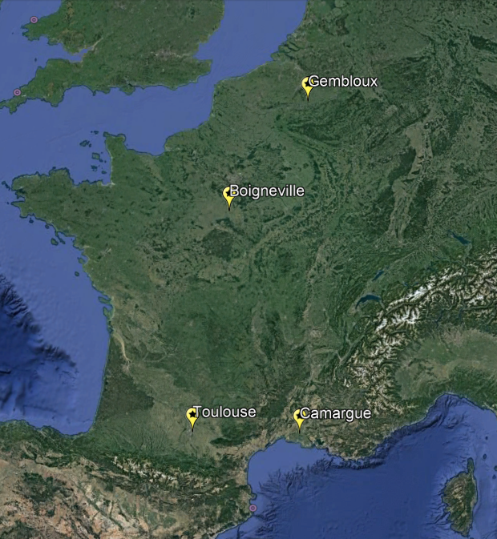
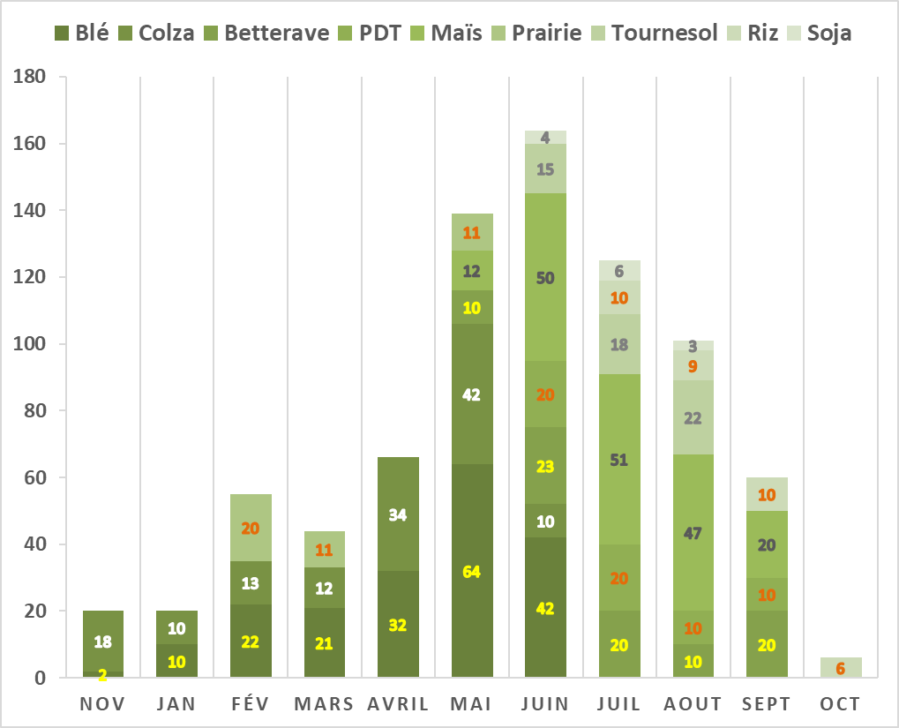
Recent Activities
P2S2 project for S2 LAI/fAPAR validation on going:
814 ESUs sampled in one year (DHP). 9 main crop types
Development of an automatic DHP processing (deep learning) achieved. Datapaper in preparation

Slide 4
Action scheduled for the next future
Review the web pages (LAI done/FAPAR tbd)
Newsletter (end of the month)
Update the LAI protocol document. Complement it with fAPAR (Q4)
Datasharing platform needed!!
S2 is global: super sites are not enough!
Many initiatives to measure LAI and fAPAR at 10m resolution, much more easy than coarse resolution
Characteristics of the datasharing platform
People can freely provide their dataset (either the data or the link to the data) with associated documentation, providing they followed measurement protocols
follow the FAIR principles (Findable, Accessible, Interoperable and Reusable)

Slide 5
Action scheduled for the next future
Existing solution to be explored
INRA ready to share their service
https://data.inra.fr/
DOI attribution to the data or integration of Data having already a DOI
Access available for external people (to be tested)
First test to be done with P2S2
Then integration with other initiatives from the LPV group (Hongliang, Fernando), GBOV (?), Contact FLEX people (?)

