Slide 1
Vegetation Index Focus Area
Tomoaki Miura & Else Swinnen
Activity Summary and Strategic Plan for 2019-2021

Slide 2
Two Vegetation Index Focus Area Workshops
1st Workshop:
VI & LSP Workshop Fort Collins, CO, USA, 9-10 November 2016
2nd Workshop:
VI Workshop Washington, D.C., USA, 12 December 2018

Slide 3
Recommendations Established at the Workshops
CEOS recommends that the validation document of a VI product include:
Product QA information
Uncertainty information obtained via validation (NIST-traceability)
Product inter-comparison results

Slide 4
Recommendations Established at the Workshops
CEOS identifies three components of VI validation:
Uncertainty of VIs in their units (e.g., ΔNDVI)
VI sensitivity to vegetation biophysical/physiological conditions (e.g., LSP, GPP, LAI)
Long-term stability information of VI time series data
Recommended validation data sources (systematic-opportunistic):
AERONET-based surface reflectance data
NEON airborne hyperspectral data
Drone-observational reflectance data
Near-surface remote sensing data: PhenoCam
Field spectrometer time series data: PEN
NPN phenology data
FLUXNET data
Time-lapse digital imagery: PhenoCam, Phenological Eyes Network (PEN)
High resolution satellite data, given that they are validated against ground measurements
Adopted the “time series validation” approach as a standard VI validation methodology where validation focuses on validating the quality of VI time series data as to how well VI products capture seasonal evolution of vegetation

Slide 5
Recommendations Discussed at the Workshops
Discussed that the focus of product inter-comparison was to characterize the differences and their spatial and temporal distribution
Suggested measures
Product completeness
Spatial consistency
Statistical consistency
Temporal consistency
Statistical metrics discussed included:
RMSD (split into its systematic and unsystematic components)
Mean Bias Error, Mean Absolute Error
Precision or repeatability

Slide 6
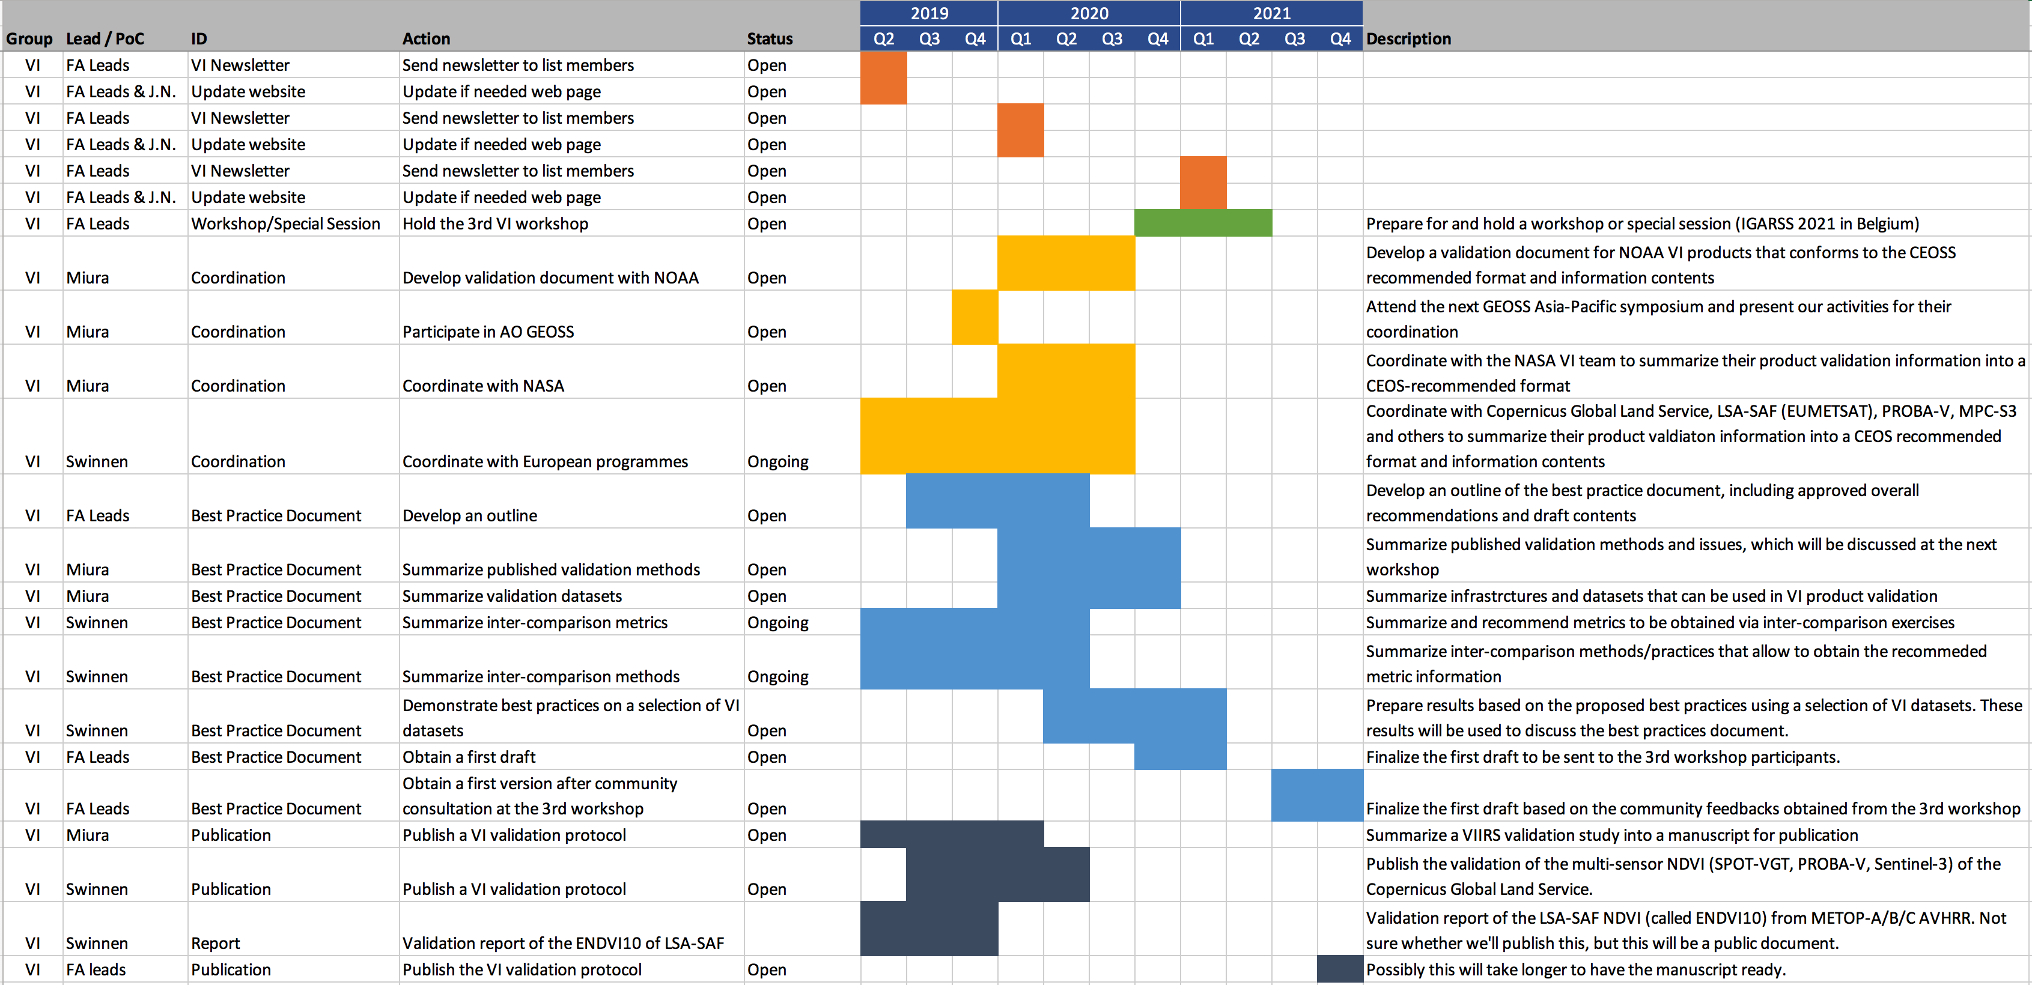
Strategic Plan for 2019-2021
Main Goal: generate the first draft of the VI best validation practices document

