Slide 1
Overview of CGLOPS product quality
Inter-comparison and accuracy assessment
R. Lacaze on behalf CGLOPS-1 and CGLOPS-2 consortia

Slide 2
Copernicus Land Monitoring Service
Land monitoring
Pan-European & Local components
Global Land Service
Imagery and
reference data
Evaluation & User Group
Operations
Ground-Based Observations
Hot Spot Monitoring
Vegetation & Energy
Water & Cryosphere
Distribution & User support

Slide 3
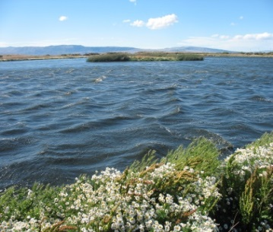
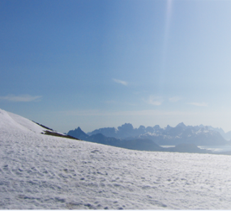
Global Land Operations - Portfolio
VEGETATION
ENERGY
Leaf Area Index (LAI)
Fraction of Absorbed Photosynthetically Active Radiation (FAPAR)
Fraction of vegetation cover (FCOVER)
Normalized Difference Vegetation Index (NDVI)
Vegetation Condition Index
Vegetation Productivity Index
Dry Matter Productivity
Burnt Area
Moderate Yearly Land Cover
Top-of-Canopy reflectance
Surface Albedo
Land Surface Temperature
Surface soil moisture
Soil Water Index
Free and Open Access : https://land.copernicus.eu/global/
WATER
CRYOSPHERE
Lake and river water level
Lake Water Quality
Lake surface water temperature
Water Bodies
Snow water equivalent
Snow cover extent
Lake Ice Extent

Slide 4
CGLOPS Products in LPV topics
Variable | Temporal coverage | Temporal resolution | Spatial coverage | Spatial resolution | Sensor | Timeliness
LAI – FAPAR (FCOVER) | 1999 - present 2014 - present | 10 days | Global | 1 km 300 m | SPOT/VGT PROBA-V | 3 days
Burnt Areas | 1999 - 2018 2014 - present | 1 day | Global | 1 km 300 m | SPOT/VGT PROBA-V | 3 days
NDVI | 1999 - present 2014 - present | 10 days | Global | 1 km 300 m | SPOT/VGT PROBA-V | 3 days
Dynamic land cover | 2015 | 1 year | Global | 100m | PROBA-V | offline
Snow Cover Extent | 2018 – present 2017 - present | 1 day | Northern Hemisphere Europe | 1 km 500 m | VIIRS MODIS | 1 day
Surface Albedo | 1999 - present | 10 days | Global | 1 km | SPOT/VGT PROBA-V | 3 days
Land Surface Temperature | 2010- present | 1 hour | Global | 5 km | Geostationary sensors | 4 hours
Soil Water Index | 2007 – present 2015 - present | 1 day | Global Europe | 0.1° 1 km | ASCAT S1 CSAR+ASCAT | 2 days
Surface Soil Moisture | 2015 - present | 1 day | Europe | 1 km | S1 CSAR | 1 day

Slide 5
Quality assessment approach
External Review
Development
Algorithm Processing chain Thematic Validation
Operations - quality monitoring
Continuously yearly
Validated:
Routine visual check
Semi-automatic statistics & graphs
https://land.copernicus.eu/global/documents/products
Beta
Validated:
Completeness
Spatio-temporal consistency
Accuracy
Validated:
Stability
Impact assessment of specific events
Regional analysis
Thematic Validation:
Following as much as possible, when they exist, the CEOS LPV guidelines
Inter-comparison with existing satellite-derived products (e.g. MODIS)
Comparison against in-situ data, yearly updates to reach LPV Stage 4
Per variable and across variables (using Land Data Assimilation System)

Slide 6
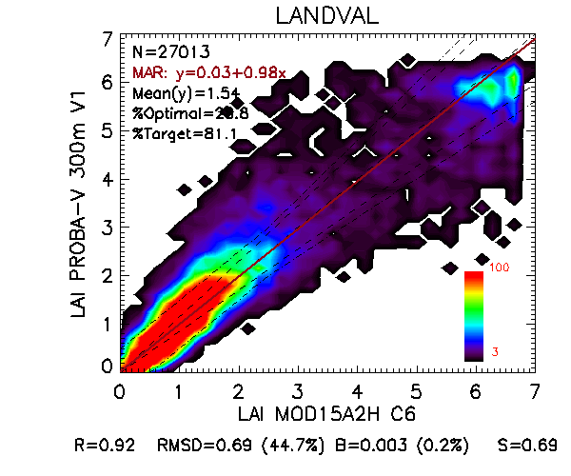
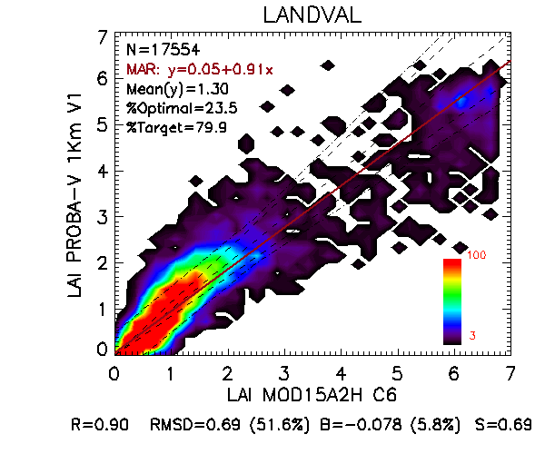
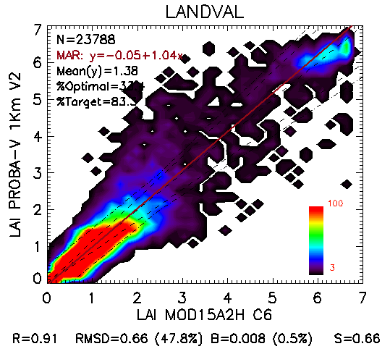
LAI
Retrieval Methodology
Neural network based approach
Collection 1km V1 (based upon BRDF-corrected TOC)
Collection 1km V2 (gap filling and NRT estimate)
Collection 300m V1 (small gap filling and NRT estimate)
In preparation
Collection 1km V2.1: add no climato gap filling layer
Inter-comparison with MODIS

Slide 7
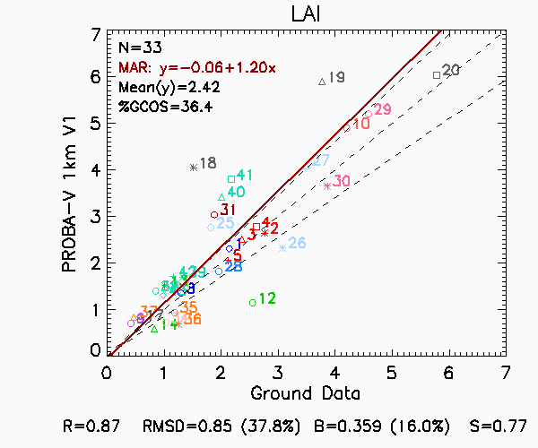
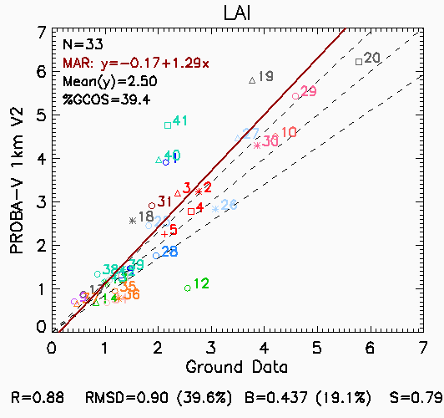
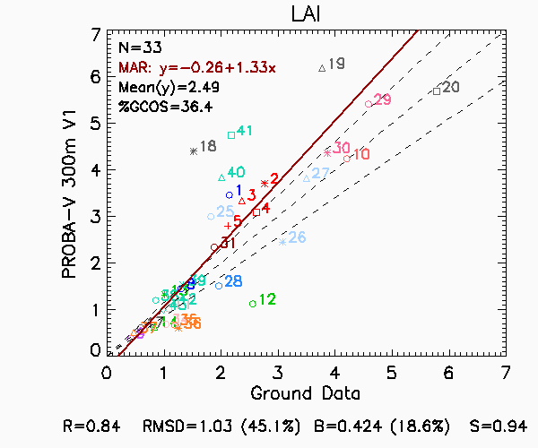
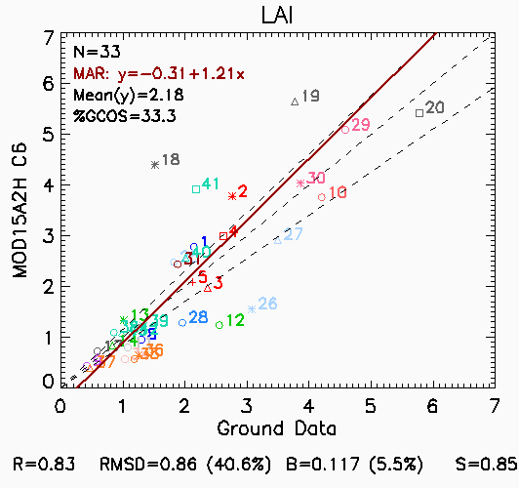
LAI
Retrieval Methodology
Neural network based approach
Collection 1km V1 (based upon BRDF-corrected TOC)
Collection 1km V2 (gap filling and NRT estimate)
Collection 300m V1 (small gap filling and NRT estimate)
In preparation
Collection 1km V2.1: add no climato gap filling layer
Inter-comparison with MODIS
Accuracy assessment using CEOS LPV DIRECT2.0
LAI 1km V1: RMSD=0.85
LAI 1km V2: RMSD=0.90
LAI 300m: RMSD=1.03
MODIS C6: RMSD=0.86
Extracted from validation reports available on http://land.copernicus.eu/global/products/lai

Slide 8
LAI
Retrieval Methodology
Neural network based approach
Collection 1km V1 (based upon BRDF-corrected TOC)
Collection 1km V2 (gap filling and NRT estimate)
Collection 300m V1 (small gap filling and NRT estimate)
In preparation
Collection 1km V2.1: add no climato gap filling layer
Inter-comparison with MODIS
Accuracy assessment using CEOS LPV DIRECT2.0
LAI 1km V1: RMSD=0.85
LAI 1km V2: RMSD=0.90
LAI 300m: RMSD=1.03
MODIS C6: RMSD=0.86
Capture of specific events
PROBA-V LAI V1 PROBA-V LAI V2 MCD15A2H C6 Fire
Extracted from validation reports available on http://land.copernicus.eu/global/products/lai

Slide 9
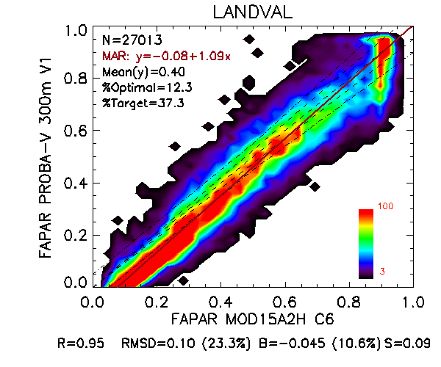
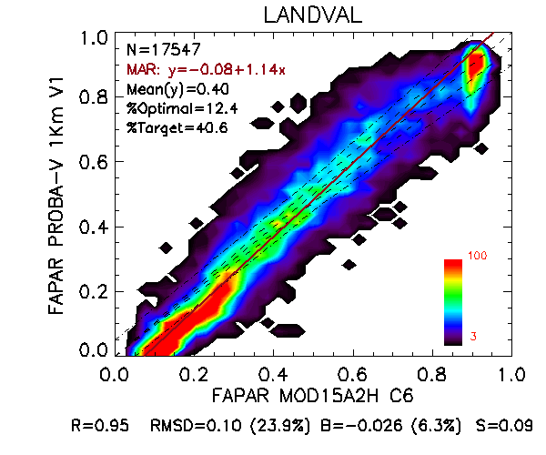
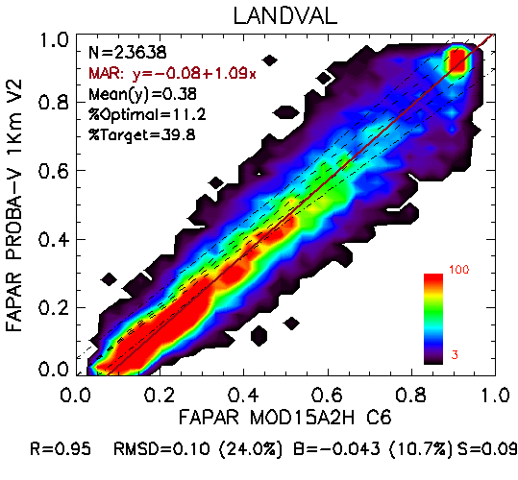
FAPAR
Retrieval Methodology
Neural network based approach
Collection 1km V1 (based upon BRDF-corrected TOC)
Collection 1km V2 (gap filling and NRT estimate)
Collection 300m V1 (small gap filling and NRT estimate)
In preparation
Collection 1km V2.1: add no climato gap filling layer
Inter-comparison with MODIS

Slide 10
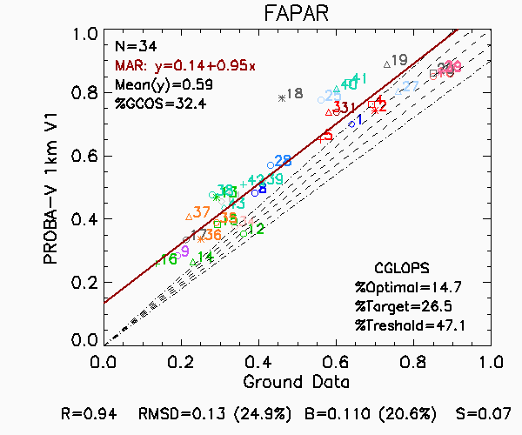
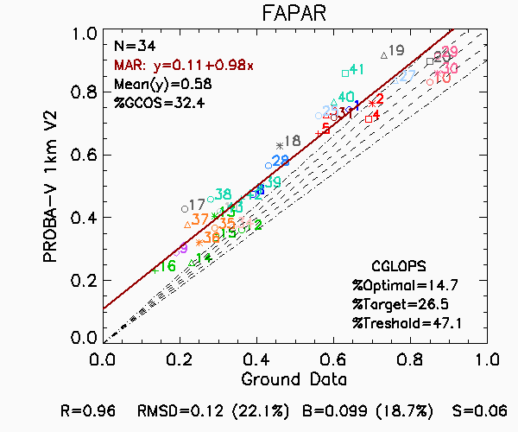
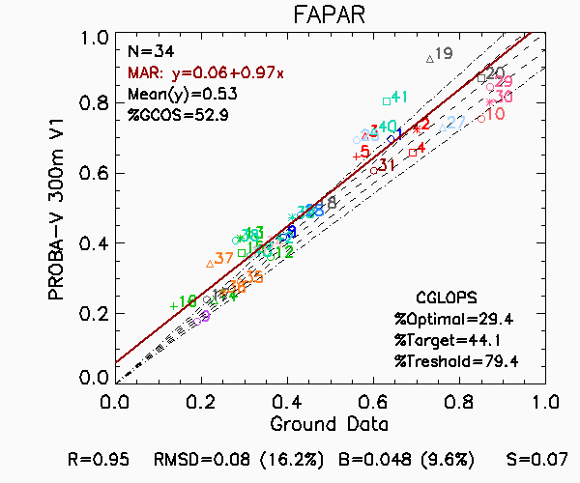
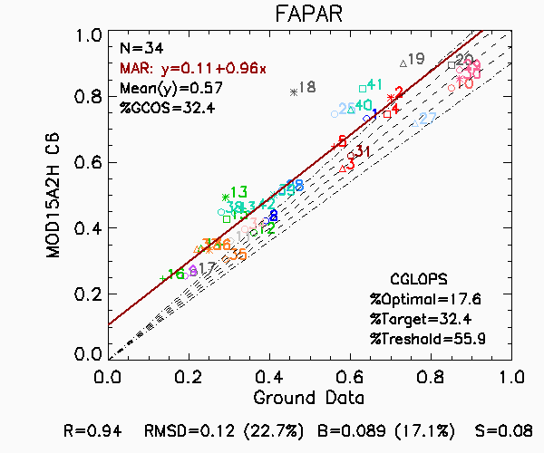
FAPAR
Retrieval Methodology
Neural network based approach
Collection 1km V1 (based upon BRDF-corrected TOC)
Collection 1km V2 (gap filling and NRT estimate)
Collection 300m V1 (small gap filling and NRT estimate)
In preparation
Collection 1km V2.1: add no climato gap filling layer
Inter-comparison with MODIS
Accuracy assessment using CEOS LPV DIRECT2.0
FAPAR 1km V1: RMSD=0.13
FAPAR 1km V2: RMSD=0.12
FAPAR 300m: RMSD=0.08
MODIS C6: RMSD= 0.12
Extracted from validation reports available on http://land.copernicus.eu/global/products/fapar

Slide 11
FAPAR
Retrieval Methodology
Neural network based approach
Collection 1km V1 (based upon BRDF-corrected TOC)
Collection 1km V2 (gap filling and NRT estimate)
Collection 300m V1 (small gap filling and NRT estimate)
In preparation
Collection 1km V2.1: add no climato gap filling layer
Inter-comparison with MODIS
Accuracy assessment using CEOS LPV DIRECT2.0
FAPAR 1km V1: RMSD=0.13
FAPAR 1km V2: RMSD=0.12
FAPAR 300m: RMSD=0.08
MODIS C6: RMSD= 0.12
Capture of specific events
Chile (35.47S, 72.28W)
PROBA-V FAPAR V1 PROBA-V FAPAR V2 MCD15A2H C6 Fire
Extracted from validation reports available on http://land.copernicus.eu/global/products/fapar

Slide 12
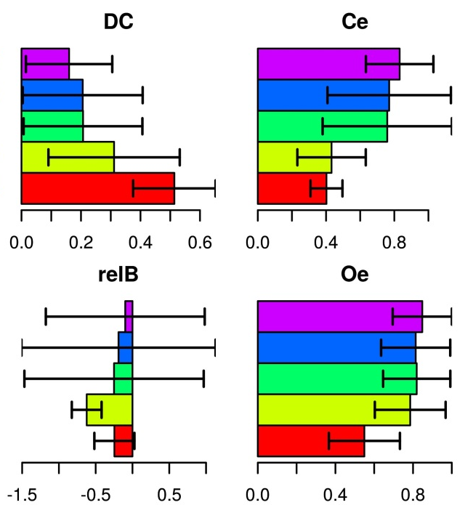
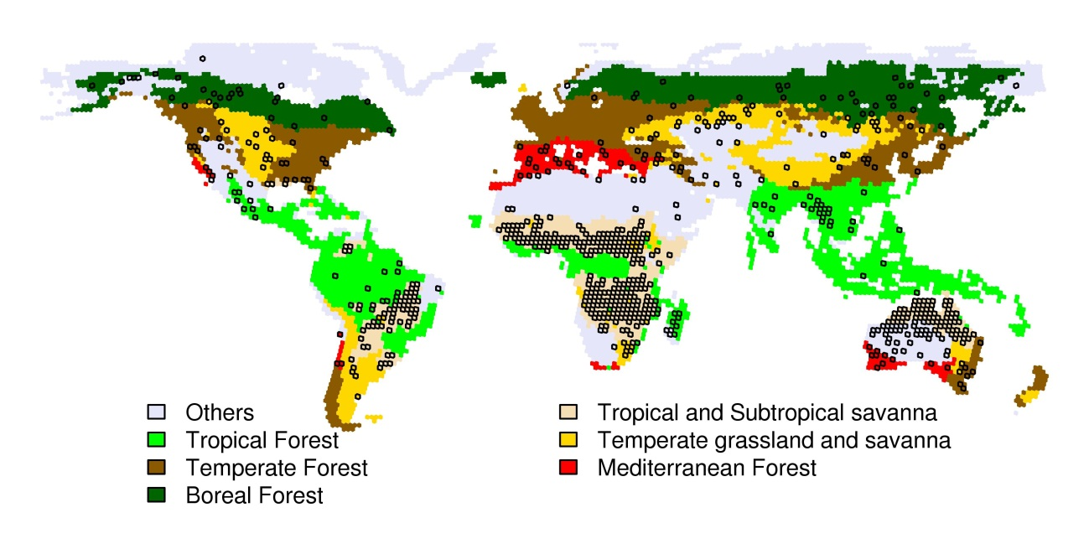
Burnt Areas
Retrieval Methodology
Mean and standard deviation of a temporal index made of daily surface reflectance and average surface reflectance
Collection 1km V1.5
Collection 300m V1.0 & V1.1(water mask)
In preparation
Collection 300m V2: active fire information used, non-NRT product
Inter-comparison with MODIS
Using GEE with Landsat imagery as background
Accuracy (year 2014)
Reference data generated on a joint effort between Copernicus Global Land Service and the Fire Disturbance project of the ESA’s CCI
BA 1km V1.5
BA 300m V1.0
BA 300m V1.1
BA 300m V2.0
MCD64
Thiessen scene areas with at least one unit selected in the sample and biome stratification

Slide 13
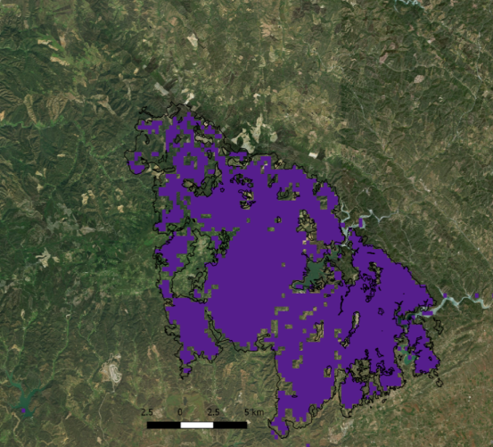
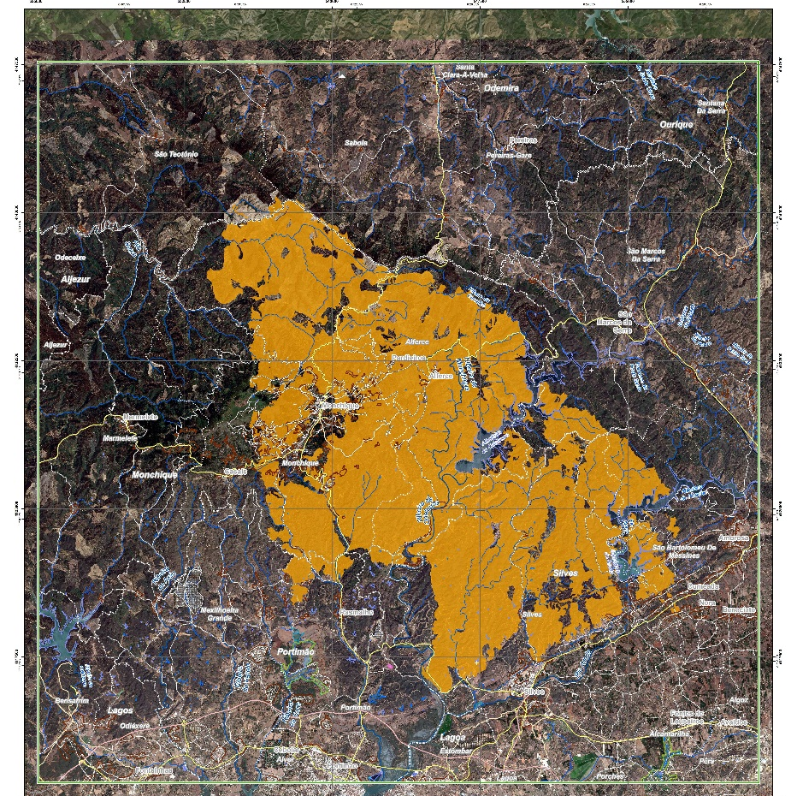
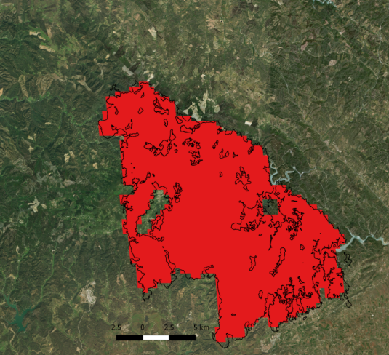
Burnt Areas
Retrieval Methodology
Mean and standard deviation of a temporal index made of daily surface reflectance and average surface reflectance
Collection 1km V1.5
Collection 300m V1.0 & V1.1(water mask)
In preparation
Collection 300m V2: active fire information used, non-NRT product
Inter-comparison with MODIS
Using GEE with Landsat imagery as background
Accuracy
Capture of specific events
Fires delineated by CEMS (EFFIS)
BA 300m
Fire in Taipas Monchique, Portugal, August 2018
MODIS
BA 300m
MODIS
Fire in Le Lavandou, France, July 2017
Extracted from validation reports available on http://land.copernicus.eu/global/ba

Slide 14
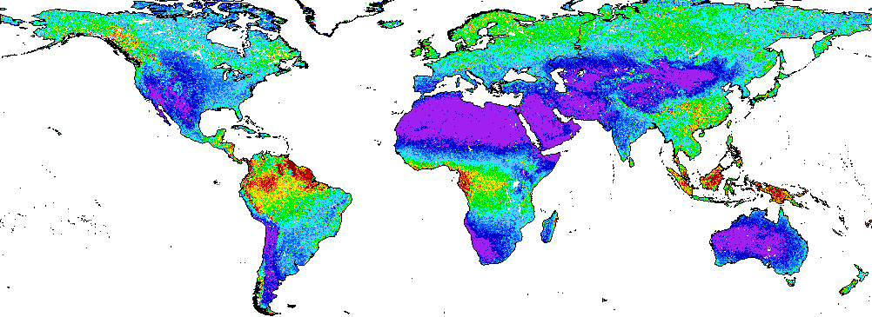
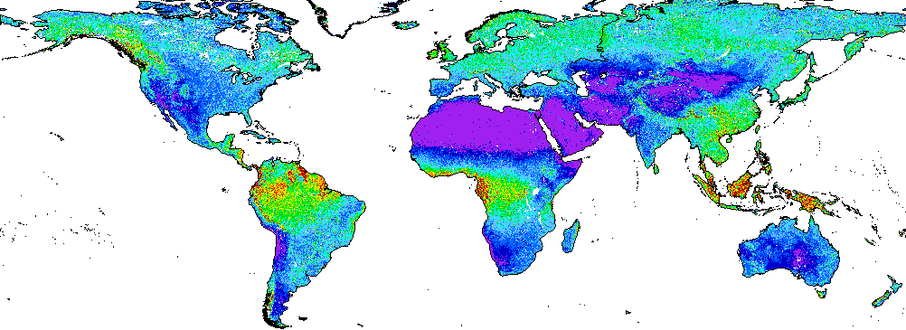
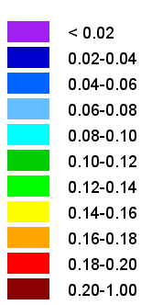
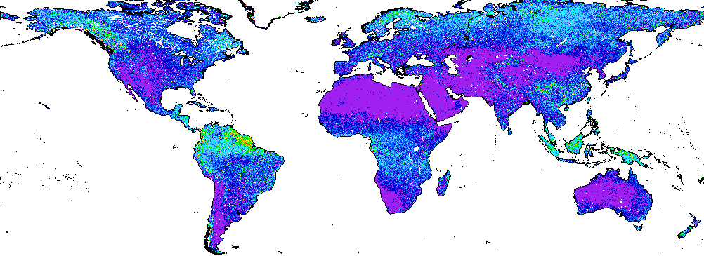
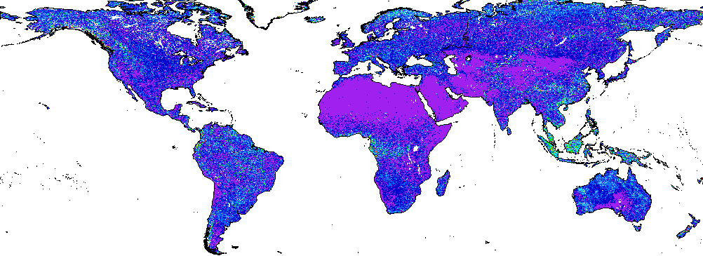
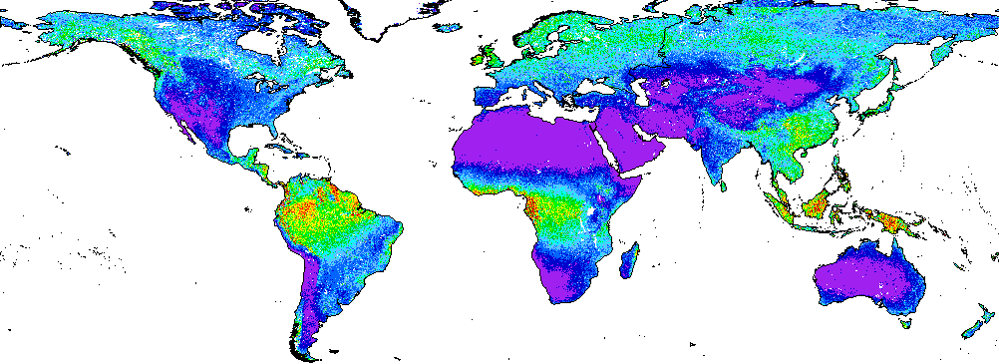
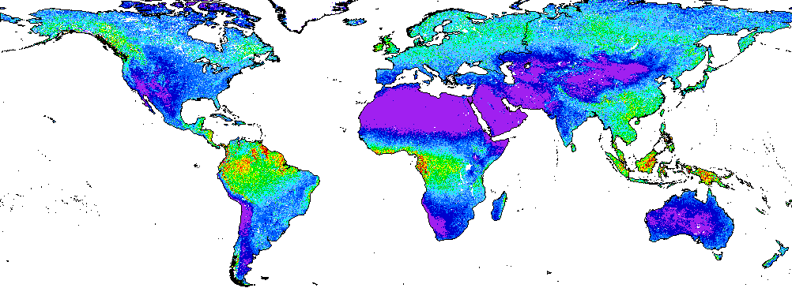
NDVI
Retrieval Methodology
Max NDVI on 10 days composite
Collection 1km V2.2
Collection 300m V1
In preparation: BRDF-corrected NDVI
Collection 1km V3
Collection 300m V2
Inter-comparison with MODIS
Inter-comparison with AVHRR
Accuracy
N.A.
NDVI 1km V3 vs MCD43A4 C6 NDVI 1km V2.2 vs MCD43A4 C6
RMPDu RMPDs RMSD
Average over 2011-2016
Extracted from validation reports available on http://land.copernicus.eu/global/ndvi

Slide 15
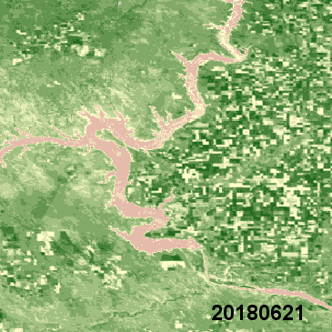
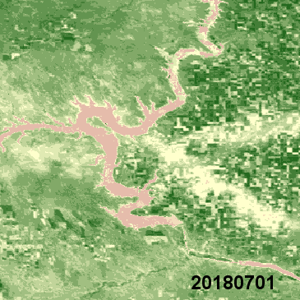
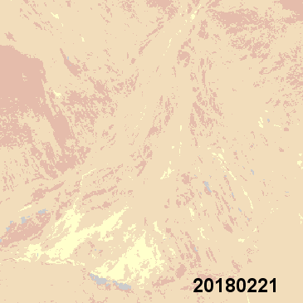
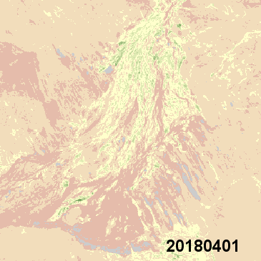
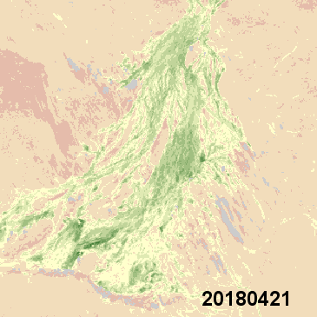
NDVI
Retrieval Methodology
Max NDVI on 10 days composite
Collection 1km V2.2
Collection 300m V1
In preparation: BRDF-corrected NDVI
Collection 1km V3
Collection 300m V2
Inter-comparison with MODIS
Inter-comparison with AVHRR
Accuracy
N.A.
Capture of specific events
Hail storm damages, South Dakota, 27th June 2018
Greening after flooding (3rd March 2018), Queensland, Australia
Extracted from validation reports available on http://land.copernicus.eu/global/ndvi

Slide 16
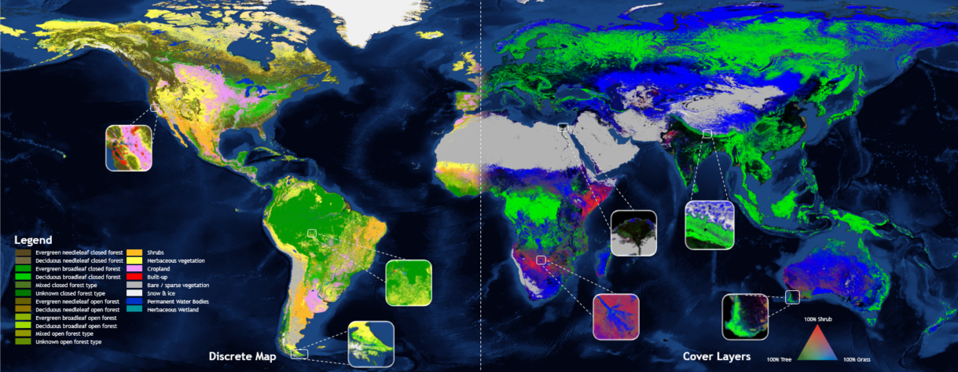
Dynamic Land cover
Retrieval Methodology
Random Forest classifier, decision tree integrating external layers, > 140k training samples at 10m (global)
Collection 100 V1: Africa 2015, 18 discrete classes, 4 continuous layers (shrub, forest, grassland, bare area)
Collection 100m V2: global 2015, 21 discrete classes, 10 continuous layers (shrub, forest, grassland, bare area, crops, urban, moss, snow, permanent & seasonal water)
In preparation
Changes over Africa (2015-2018)
Regional maps 20m (Sentinel-2+Sentinel-1)
Accuracy
Africa 2015 map: OA = 74.3% +/- 1.8%
Global 2015 map: under assessment
During LPS, demonstration sessions 15’ at VITO booth:
Thu 13:15 & 18:15
Fri 12:45
Extracted from validation reports available on http://land.copernicus.eu/global/lc

Slide 17
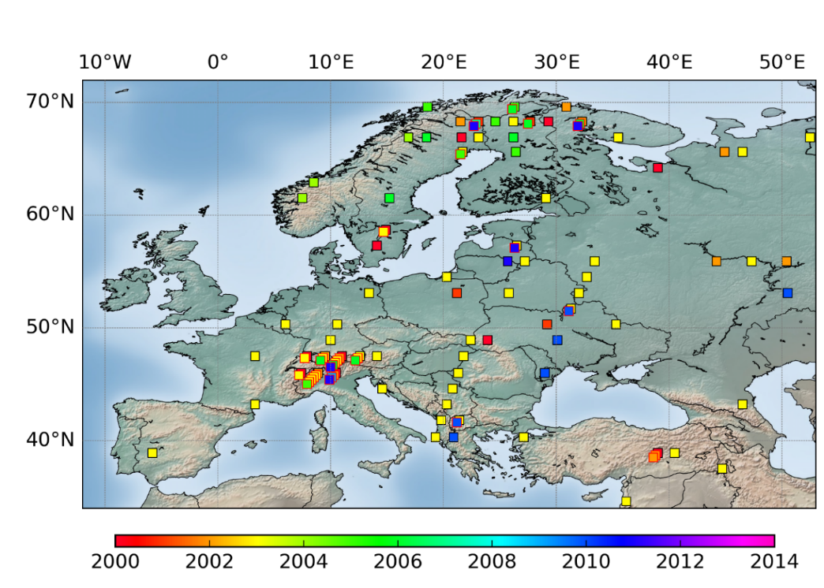
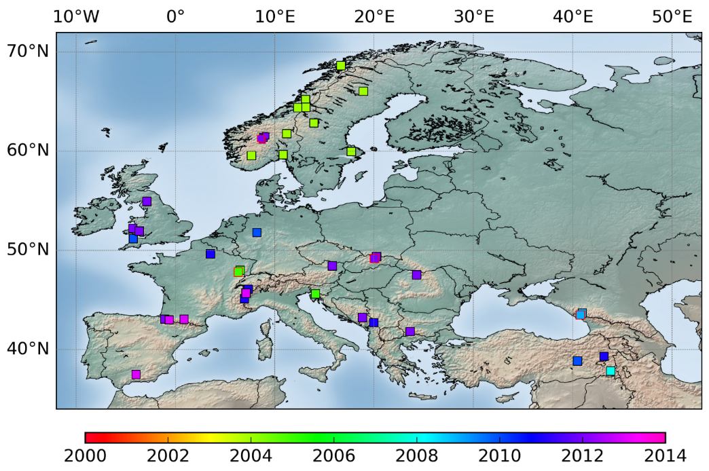
Snow Cover Extent
Retrieval Methodology
classification applied on VIS, MIR and TIR bands; canopy correction to get SCE on the ground under trees
Collection 1km Northern Hemisphere
Collection 500m Europe
In preparation
Collection 1km Global using Sentinel-3A&B SLSTR
Accuracy using HR reference snow maps
TOTAL AREA | Snow maps from Landsat data |  |  |  |  |  | Snow maps from VHR satellite data
MEAN | Salomonson |  | Klein |  | Dozier |  | Manual mapping
unbiased RMSE | 15,32 |  | 15,92 |  | 15,61 |  | 15,36
BIAS | 0,15 |  | -0,75 |  | 0,82 |  | 3,02
Correlation Coefficient | 0,74 |  | 0,72 |  | 0,73 |  | 0,74
RANGE | MIN | MAX | MIN | MAX | MIN | MAX | MIN | MAX
unbiased RMSE | 2,38 | 26,69 | 1,70 | 38,33 | 0,45 | 30,12 | 0,00 | 38,75
BIAS | -19,61 | 13,76 | -33,28 | 28,84 | -17,10 | 98,47 | -13,45 | 44,64
Correlation Coefficient | 0,03 | 0,96 | 0,06 | 0,97 | 0,04 | 0,97 | 0,05 | 0,92
Landsat (top) and VHR optical satellite data
(bottom) used for quality assessment
(the color indicate the year of acquisition)
Extracted from validation reports available on http://land.copernicus.eu/global/sce

Slide 18
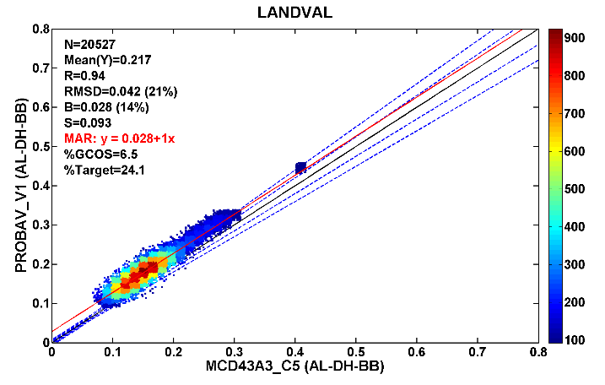
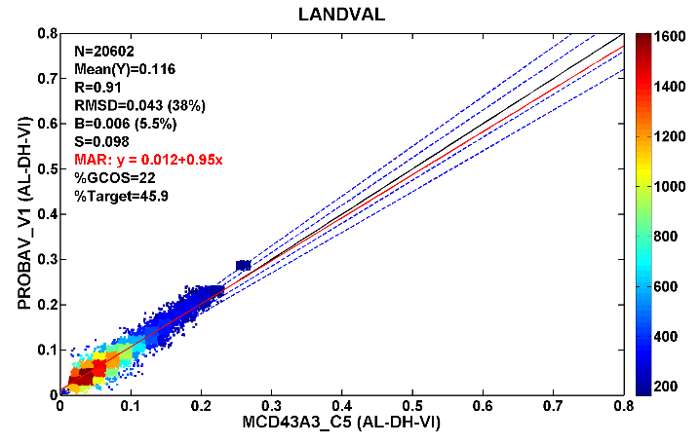
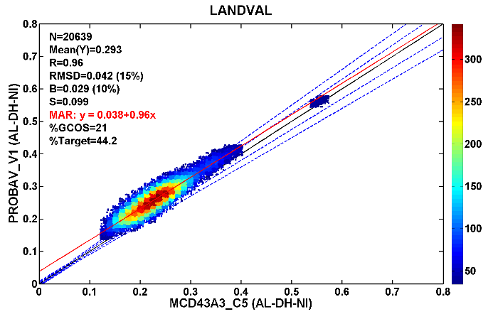
Albedo
Retrieval Methodology
Inversion of semi-empirical kernel-driven reflectance model over 30 days; Broadband albedo calculated for Visible, NIR and total shortwave spectral ranges
Collection 1km V1.4 (SPOT/VGT)
Collection 1km V1.5 (PROBA-V)
In preparation
Continuation using Sentinel-3/OLCI in Copernicus Climate Change Service
Inter-comparison with MODIS
Black-sky albedo VIS (left), NIR (middle) and Broadband (right)
2014
Extracted from validation reports available on http://land.copernicus.eu/global/sa

Slide 19
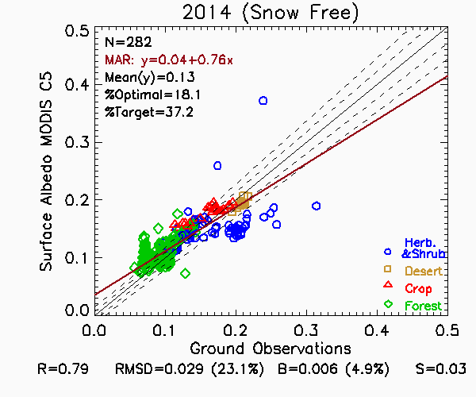
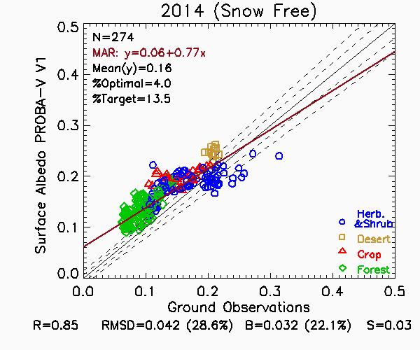
Albedo
Retrieval Methodology
Inversion of semi-empirical kernel-driven reflectance model over 30 days; Broadband albedo calculated for Visible, NIR and total shortwave spectral ranges
Collection 1km V1.4 (SPOT/VGT)
Collection 1km V1.5 (PROBA-V)
In preparation
Continuation using Sentinel-3/OLCI in Copernicus Climate Change Service
Inter-comparison with MODIS
Accuracy using SURFRAD and EFDC database
VGT (snow-free): RMSD=0.030
PROBA-V (snow-free): RMSD=0.042
MC43A3 C5 (snow free): RMSD=0.029
Blue-sky albedo
SURFRAD & EFDC sites
2014
Extracted from validation reports available on http://land.copernicus.eu/global/sa

Slide 20
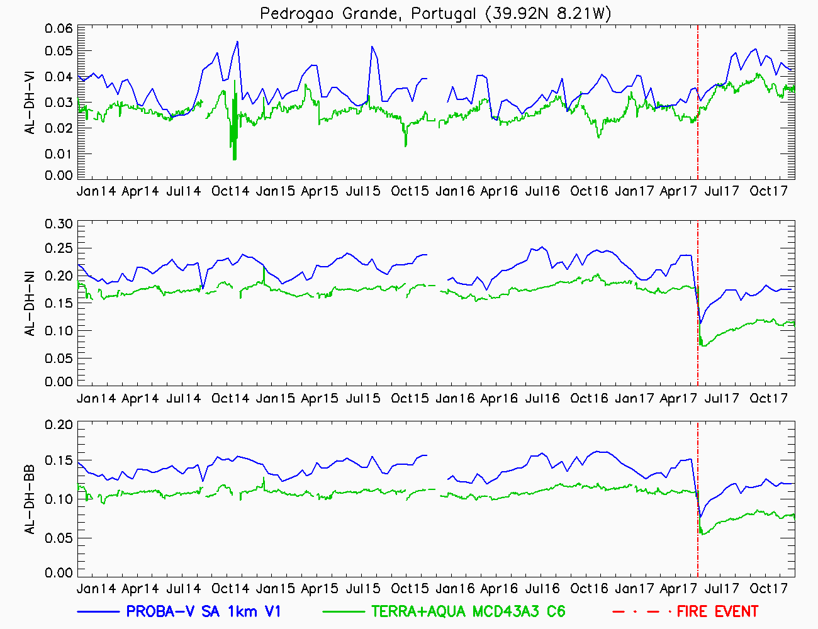
Albedo
Retrieval Methodology
Inversion of semi-empirical kernel-driven reflectance model over 30 days; Broadband albedo calculated for Visible, NIR and total shortwave spectral ranges
Collection 1km V1.4 (SPOT/VGT)
Collection 1km V1.5 (PROBA-V)
In preparation
Continuation using Sentinel-3/OLCI in Copernicus Climate Change Service
Inter-comparison with MODIS
Accuracy using SURFRAD and EFDC database
VGT (snow-free): RMSD=0.030
PROBA-V (snow-free): RMSD=0.042
MC43A3 C5 (snow free): RMSD=0.029
Capture of specific events
Extracted from validation reports available on http://land.copernicus.eu/global/sa

Slide 21
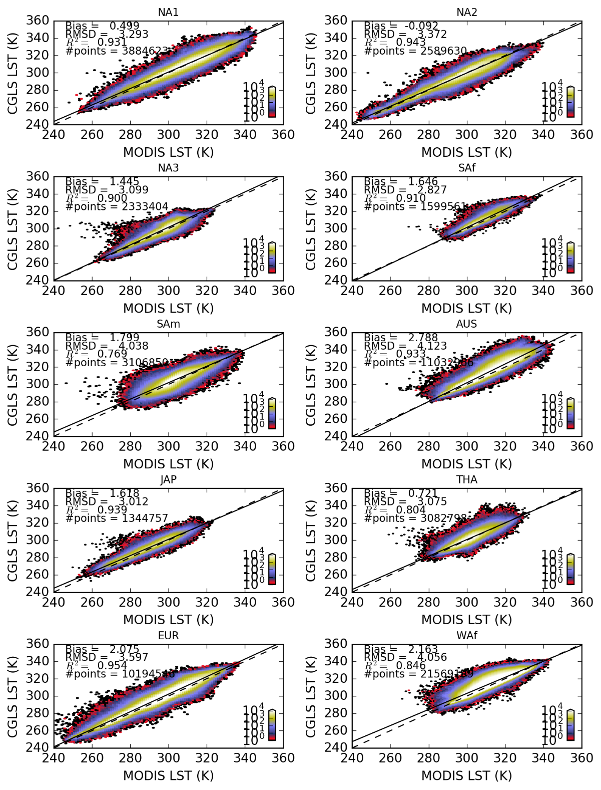
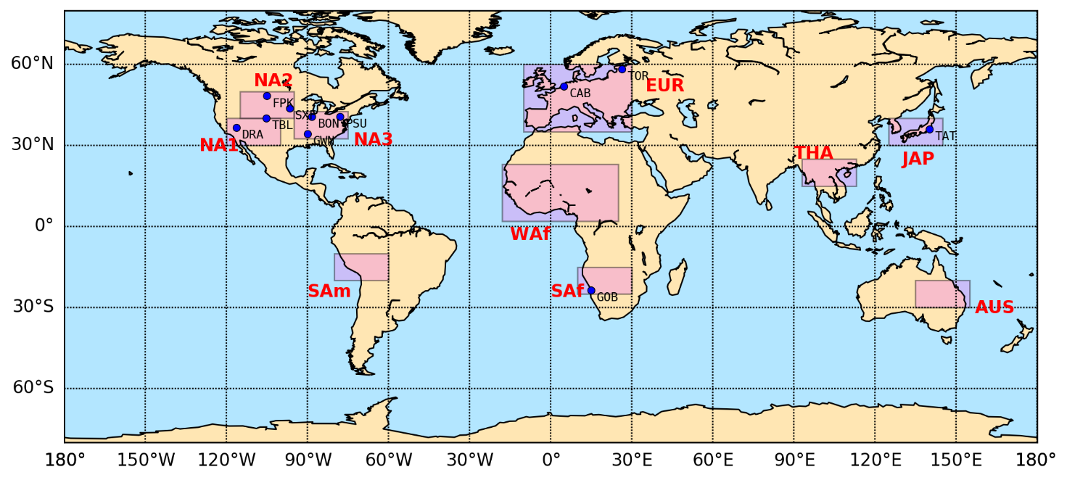
Land Surface Temperature
Retrieval Methodology
Generalized split-window algorithms from two adjacent TIR channels
Collection 5km hourly LST
Collection 5km 10-day LST Daily cycle
Collection 5km Thermal Condition Index
In preparation
Including IODC to fill Asian gap
Inter-comparison with MODIS
Density plots CGLOPS LST vs MODIS C6 LST
Areas located in map above
2017 – daytime
Extracted from validation reports available on http://land.copernicus.eu/global/lst

Slide 22
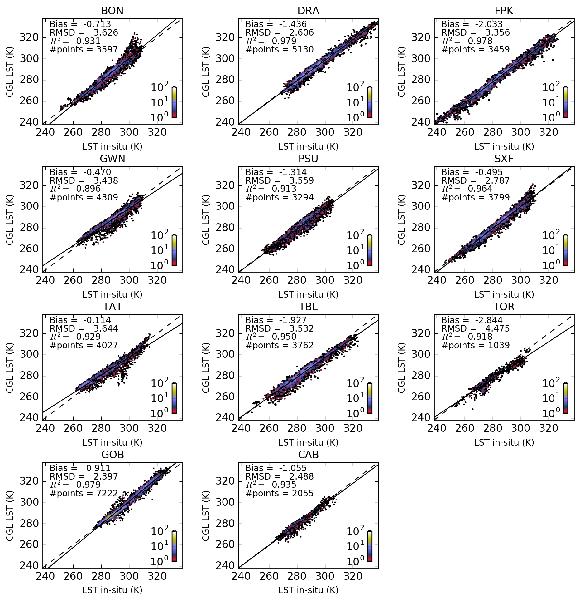
Land Surface Temperature
Retrieval Methodology
Generalized split-window algorithms from two adjacent TIR channels
Collection 5km hourly LST
Collection 5km 10-day LST Daily cycle
Collection 5km Thermal Condition Index
In preparation
Including IODC to fill Asian gap
Inter-comparison with MODIS
Accuracy using BSRN and SURFRAD database
Hourly LST: RMSD = 3.2K
BSRN and SURFRAD stations
2017
Extracted from validation reports available on http://land.copernicus.eu/global/lst

Slide 23
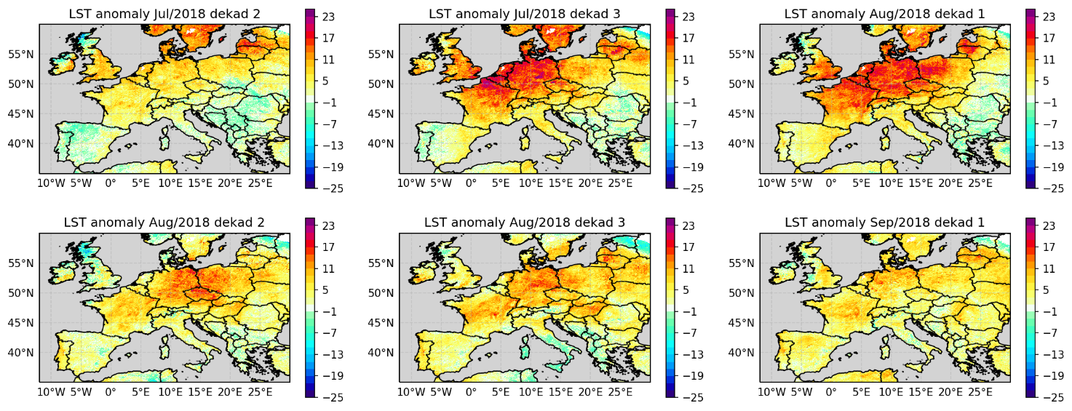
Land Surface Temperature
Retrieval Methodology
Generalized split-window algorithms from two adjacent TIR channels
Collection 5km hourly LST
Collection 5km 10-day LST Daily cycle
Collection 5km Thermal Condition Index
In preparation
Including IODC to fill Asian gap
Inter-comparison with MODIS
Accuracy using BSRN and SURFRAD database
Hourly LST: RMSD = 3.2K
Capture of specific events
Europe heat wave
LST anomaly
(2018 vs mean (2010-2017))
Extracted from validation reports available on http://land.copernicus.eu/global/lst

Slide 24
Soil Water Index and Surface Soil Moisture
Retrieval Methodology
SSM: change detection model applied to model long term dry and wet conditions
Collection 1km SSM V1
SWI: derived from SSM using two-layer water model, adapted to use a recursive formulation and not accounting for soil texture
Collection 0.1° SWI V3
Collection 1km SWI V1
Inter-comparison with GLDAS Noah model
RMSD between SWI T=1 and GLDAS Noah
2007-2017
Extracted from validation reports available on http://land.copernicus.eu/global/swi

Slide 25
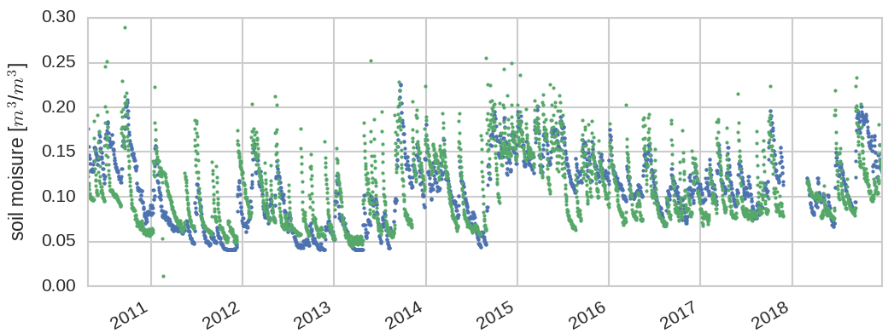
Soil Water Index and Surface Soil Moisture
Retrieval Methodology
SSM: change detection model applied to model long term dry and wet conditions
Collection 1km SSM V1
SWI: derived from SSM using two-layer water model, adapted to use a recursive formulation and not accounting for soil texture
Collection 0.1° SWI V3
Collection 1km SWI V1
Inter-comparison with GLDAS Noah model
Accuracy using ISMN database
SWI T=1: RMSD = 0.077
SWI T=100: RMSD = 0.051
RMSD between SWI T=1 and in-situ ISMN data
2007-2017
SWI T=5
in-situ data
USCRN-station Edinburg-17-NNE
Extracted from validation reports available on http://land.copernicus.eu/global/swi

Slide 26
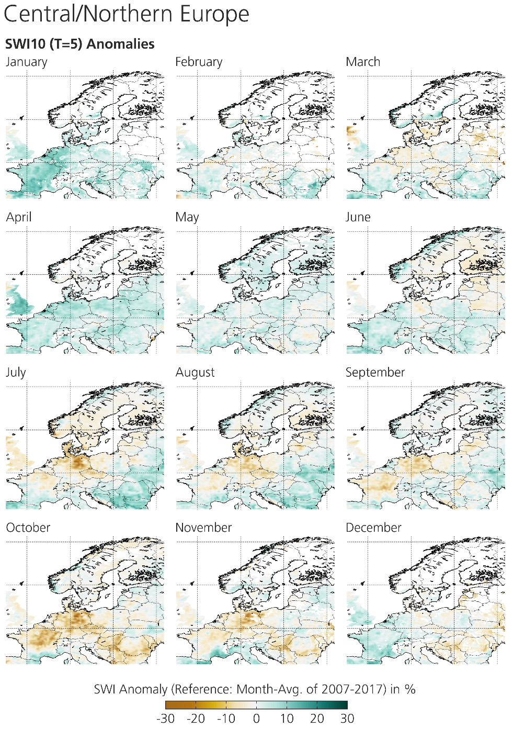
Soil Water Index and Surface Soil Moisture
Retrieval Methodology
SSM: change detection model applied to model long term dry and wet conditions
Collection 1km SSM V1
SWI: derived from SSM using two-layer water model, adapted to use a recursive formulation and not accounting for soil texture
Collection 0.1° SWI V3
Collection 1km SWI V1
Inter-comparison with GLDAS Noah model
Accuracy using ISMN database
SWI T=1: RMSD = 0.077
SWI T=100: RMSD = 0.051
Capture of specific events
SWI10 T=5 anomaly
2018 vs mean (2007-2017)
Extracted from validation reports available on http://land.copernicus.eu/global/swi

Slide 27
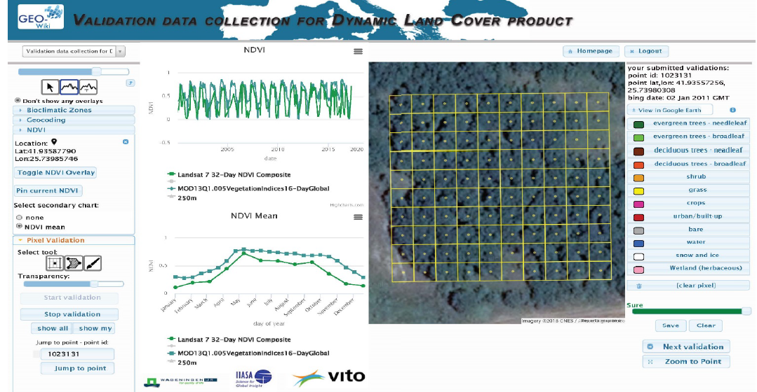
Recommendations
Increase efforts to set-up guidelines for validation protocols
LAI, LST, Albedo protocols are existing. Other topics?
Update Land cover guidelines (released in 2006)
Consider the geo-wiki.org contribution to gather validation data at 10m resolution

Slide 28
Recommendations
Increase efforts to set-up guidelines for validation protocols
LAI, LST, Albedo protocols are existing. Other topics?
Update Land cover guidelines (released in 2006)
Consider the geo-wiki.org contribution to gather validation data at 10m resolution
Contribute to build a reference database of ground-based measurements
GBOV is a valuable initiative…

Slide 29
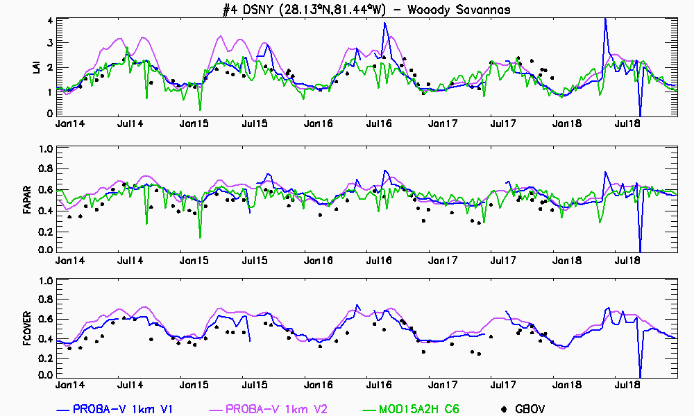
Indeed …
Quite good agreement between satellite products and GBOV dataset for most of the sites (i.e. BLAN, DSNY, GUAN, HARV, JERC, STER, ORNL, SCBI, SERC, TALL, WOOD).
PROBA-V 1km V1
PROBA-V 1km V2
MOD15A2H C6
GBOV
Quality indicator of GBOV providing the number of the valid observations at the primary high-resolution was used: observations with less than 70% of valid data were flagged (red dots). Vertical bars correspond to GBOV uncertainties.

Slide 30
But …
Large discrepancies in magnitude between all satellite products and GBOV ground-based values, mainly at the maximum peak of the vegetation cycle (e.g. CPER, JORN, NIWO)
In few cases (e.g. BART), satellite products and GBOV disagree in winter time, probably because the illumination geometry was not considered in the multi-temporal up-scaling approach of GBOV
PROBA-V 1km V1
PROBA-V 1km V2
MOD15A2H C6
GBOV
Quality indicator of GBOV providing the number of the valid observations at the primary high-resolution was used: observations with less than 70% of valid data were flagged (red dots). Vertical bars correspond to GBOV uncertainties.

Slide 31
And …
Temporal variations of satellite products whereas GBOV observations show no seasonality (i.e., MOAB, ONAQ and OSBS)
Unreliable GBOV values as observed in STEI and UNDE forest sites. GBOV 300m number of valid observations was found useful to discard unreliable data
PROBA-V 1km V1
PROBA-V 1km V2
MOD15A2H C6
GBOV
Very low values were also observed over few sites – RM values were investigated
Discarded IF < than 70% of valid HR values

Slide 32
Recommendations
Increase efforts to set-up guidelines for validation protocols
LAI, LST, Albedo protocols are existing. Other topics?
Update Land cover guidelines (released in 2006)
Consider the geo-wiki.org contribution to gather validation data at 10m resolution
Contribute to build a reference database of ground-based measurements
GBOV is a valuable initiative… but …
Need to discuss (or revise) the uncertainty calculation which provides very low values useless to filter GBOV LP data.
What is expected
(simple average)
and useful
20m resolution 300m resolution
Aggregation

Slide 33
Recommendations
Increase efforts to set-up guidelines for validation protocols
LAI, LST, Albedo protocols are existing. Other topics?
Update Land cover guidelines (released in 2006)
Consider the geo-wiki.org contribution to gather validation data at 10m resolution
Contribute to build a reference database of ground-based measurements
GBOV is a valuable initiative… but …
Need to discuss (or revise) the uncertainty calculation which provides very low values useless to filter GBOV LP data.
Strong need to validate the up-scaling approaches that deviate from the LPV protocols
Mandatory to make GBOV a reliable reference database.

Slide 35
Comparison with GBOV data - LAI
1km
300m

Slide 36
Comparison with GBOV data - FAPAR
1km
300m

