Slide 1
GBOV (Ground-Based Observation for Validation): A Copernicus service for the validation of Land products
C. Lerebourg, G. Bai, E. Ronco, V. Bruniquel (ACRI-ST, France)
J. Dash, L. Brown, H. Morris (U. of Southampton, UK)
D. Ghent, E. Dodd (U. of Leicester)
P. Muller, R. Song (U. College London)
E. Lopez-Baeza (U. of Valencia)
M. Clerici, N. Gobron (JRC, Italy)
09/05/2019

Slide 2
GBOV’s objectives
GBOV aims at facilitating the use of observations from operational ground-based monitoring networks and their comparison to Earth Observation products
Component 1
Collection of multi-year ground-based observations of high relevance for the understanding of land surface processes from existing global networks.
Component 2
Upgrade of existing sites with new instrumentation or establishing entirely new monitoring sites to close thematic or geographic gaps.
Component 3
Implementation and maintenance of a database for the distribution of Reference Measurements (RMs) and the corresponding Land Products (LPs ; match-ups)
LP are derived to match CGLS products
LP only should be used for EO products validation

Slide 3
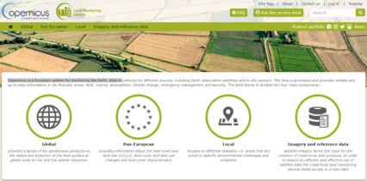
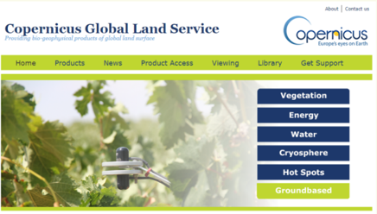
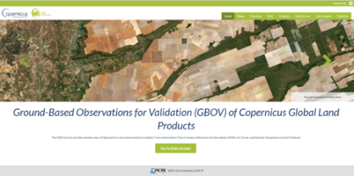
Ground-Based Observations for Validation (GBOV)
Land Monitoring Service
https://land.copernicus.eu
GBOV is attached to the GLOBAL land monitoring service
https://land.copernicus.eu/global
And is accessible under the “Groundbased” tab
https://land.copernicus.eu/global/gbov
https://gbov.acri.fr
@CopernicusGBOV

Slide 4
Component 1
Collection of ground data from existing sites

Slide 5
Data base summary

Slide 6
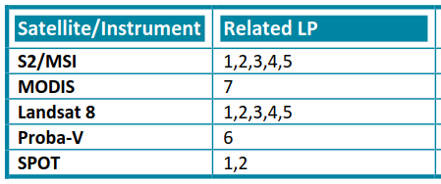
Data base summary

Slide 7
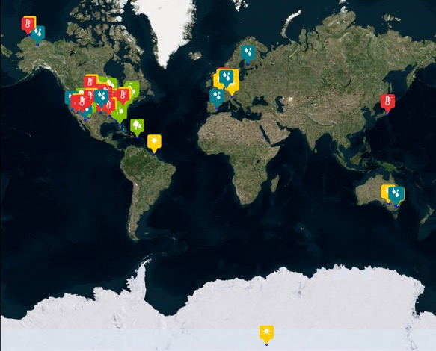
Data base summary
53 sites
20 short wave sites (LP1 & LP2)
20 vegetation sites (LP3, 4 & 5)
10 soil moisture sites (LP6)
13 LST sites (LP7)
2 <= time series <= 4years
To be extended in phase 2

Slide 8
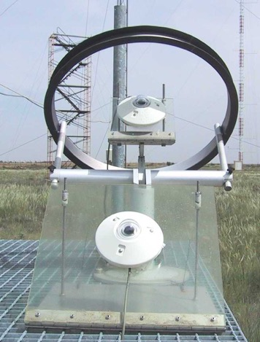
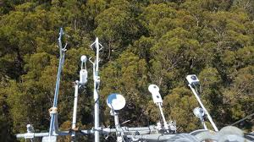
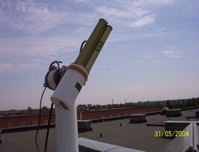
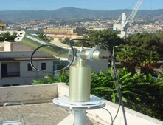
Short wave products RM1,3 & LP1,2

Slide 9
GBOV short wave radiometry
2 Reference Measurements (RMs) and 2 Land Products (LPs)
https://land.copernicus.eu/global/gbov/public/docs/products/GBOV-ATBD-RM1-LP1-LP2_v1.2-Energy.pdf
Reference Measurements
RM-1 short wave radiation
RM-2 thermal radiation
RM-3 Atmospheric properties
RM-4 Transmission through canopy
RM-5 Soil BRF/BHR/DHR
RM-6 FIPAR
RM-7 LAI
RM-8 LES
RM-9 Surface Temperature
RM-10 Soil moisture
RM-11 Meteo properties
Land Products
LP-1 Surface Reflectance
LP-2 Surface Albedo
LP-3 LAI
LP-4 FAPAR
LP-5 Fcover
LP-6 Soil moisture
LP-7 LST
SurfRad

Slide 10
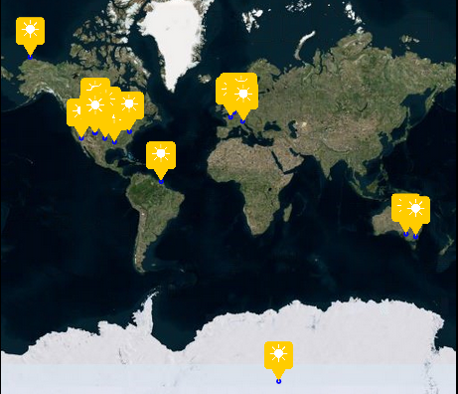
GBOV short wave radiometry
20 sites in total:
FLUXNET (10 sites)
SURFRAD (7 sites)
BSRN (3 sites)

Slide 11
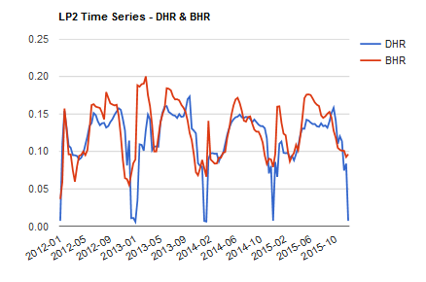
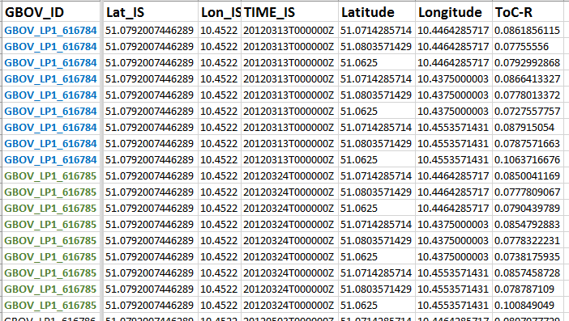
GBOV short wave radiometry
Reference Measurements
Land Products (1km)
3km

Slide 12
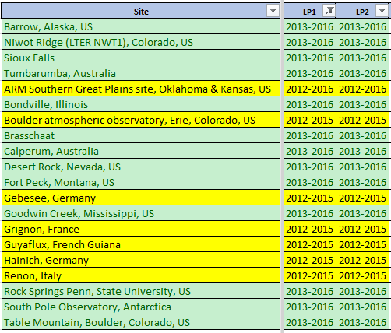
Status and plan for 2019
Status
LP1 960 (macropixels)
LP2 960 (macropixels)
Plan
Extension of the data base up to December 2018

Slide 13
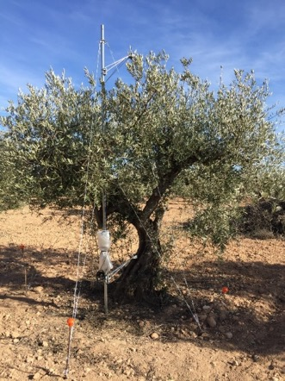
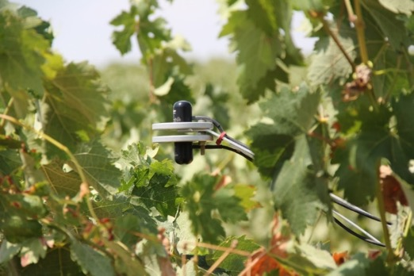
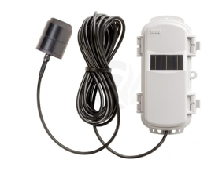
Vegetation Products RM4,5,6,7 & LP3,4,5

Slide 14
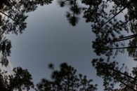
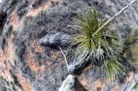
GBOV VEGETATION
4 Reference Measurements (RMs) and 3 Land Products (LPs)
https://land.copernicus.eu/global/gbov/public/docs/products/GBOV-ATBD-RM4-RM6-RM7_v1.2-Vegetation.pdf
https://land.copernicus.eu/global/gbov/public/docs/products/GBOV-ATBD-LP3-LP4-LP5_v1.2-Vegetation.pdf
DHP
Land Products
LP-1 Surface Reflectance
LP-2 Surface Albedo)
LP-3 LAI
LP-4 FAPAR
LP-5 Fcover
LP-6 Soil moisture
LP-7 LST
Reference Measurements
RM-1 short wave radiation
RM-2 thermal radiation
RM-3 Atmospheric properties
RM-4 Transmission through canopy
RM-5 Soil BRF/BHR/DHR
RM-6 FIPAR
RM-7 LAI
RM-8 LES
RM-9 Surface Temperature
RM-10 Soil moisture
RM-11 Meteo properties

Slide 15
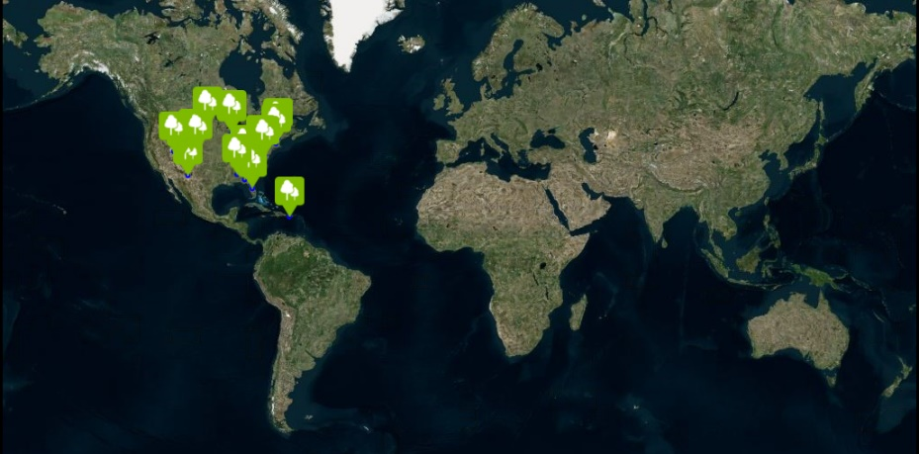
GBOV VEGETATION
20 NEON sites

Slide 16
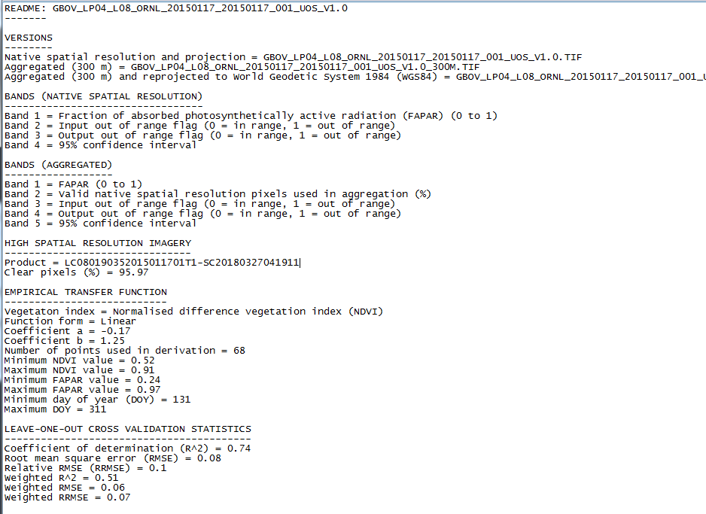
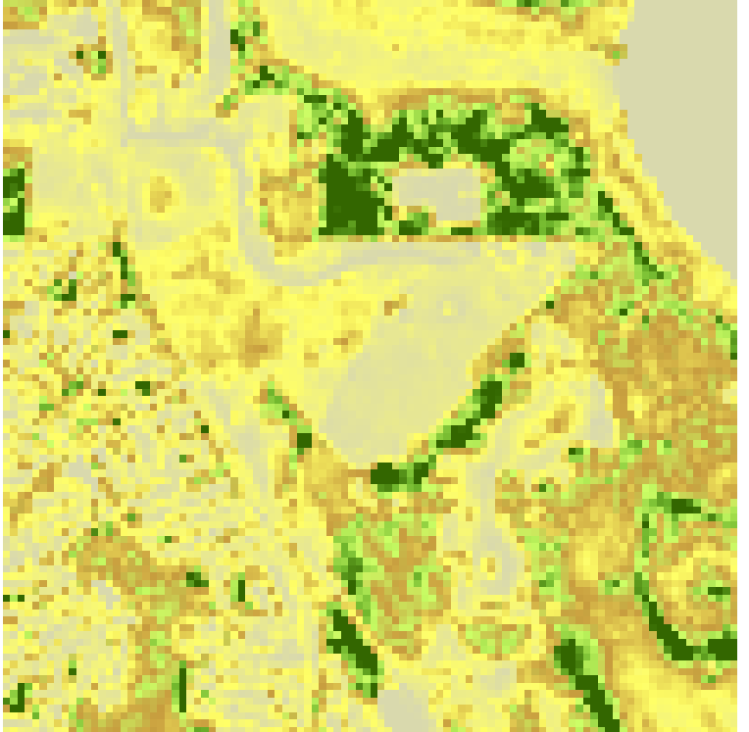
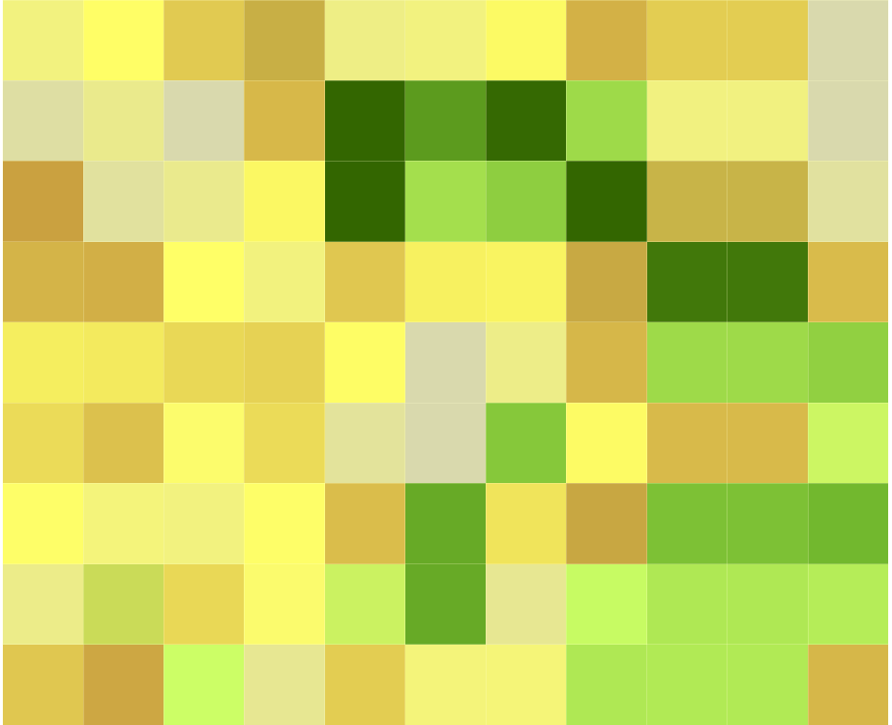
GBOV VEGETATION
Reference Measurements
Land Products
including quality indicators and uncertainties
20m res
300m res
300m res WGS84
3km

Slide 17
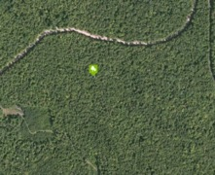
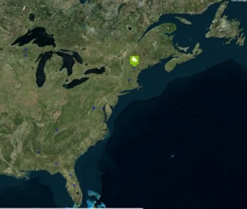
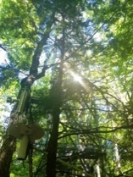
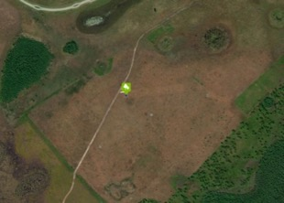
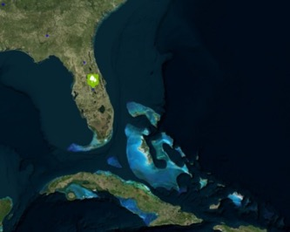
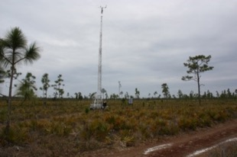
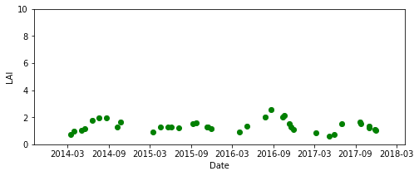
Exemple of GBOV LAI time series
Bartlett Experimental Forest
IGBP : Mixed Forest
Biome: Temperate broadleaf and mixed forests
LandCoverClass: Tree cover, mixed leaf type
Disney Wilderness Preserve
IGBP : Woody Savanna
Biome: Temperate conifer forests
LandCoverClass: Grassland

Slide 18
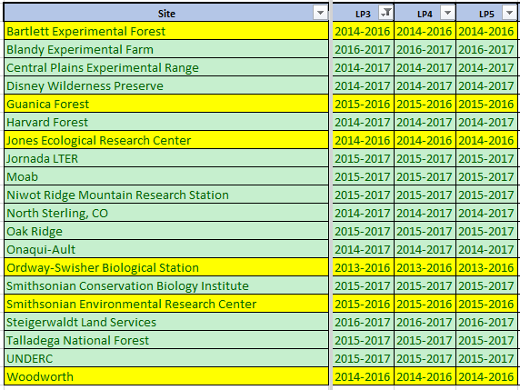
Status and plan for 2019
50673 DHP images processed to generate 7755 RMs (2585 each)
RMs upscaled to generate 2,232 LPs between 2013 and 2017
LP-3 (LAI) 744 LP-4 (FAPAR) 744 LP-5 (FCOVER) 744
In comparison, the existing CEOS LPV validation database for vegetation (DIRECT 2.0) contains just 242 samples
Plan
Extension of the data base up to December 2018
Improvements of uncertainties

Slide 19
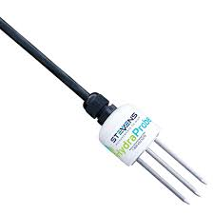
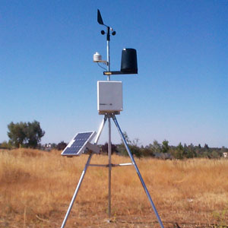
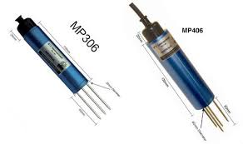
Soil Moisture products RM10,11 & LP6

Slide 20
GBOV Soil Moisture
2 Reference Measurements (RMs) + 1 Land Product (LP)
https://land.copernicus.eu/global/gbov/public/docs/products/GBOV-ATBD-RM10-RM11-LP6_v1.2_SoilMoisture.pdf
Reference Measurements
RM-1 short wave radiation
RM-2 thermal radiation
RM-3 Atmospheric properties
RM-4 Transmission through canopy
RM-5 Soil BRF/BHR/DHR
RM-6 FIPAR
RM-7 LAI
RM-8 LES
RM-9 Surface Temperature
RM-10 Soil moisture
RM-11 Meteo properties
Land Products
LP-1 Surface Reflectance
LP-2 Surface Albedo)
LP-3 LAI
LP-4 FAPAR
LP-5 Fcover
LP-6 Soil moisture
LP-7 LST

Slide 21
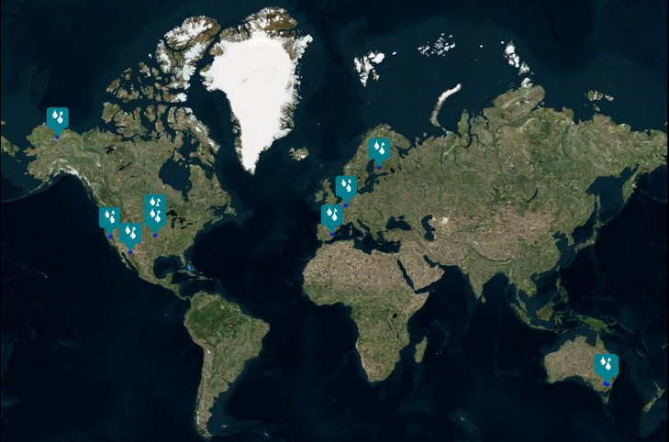
Soil Moisture
10 sites over Europe, North America and Australia

Slide 22
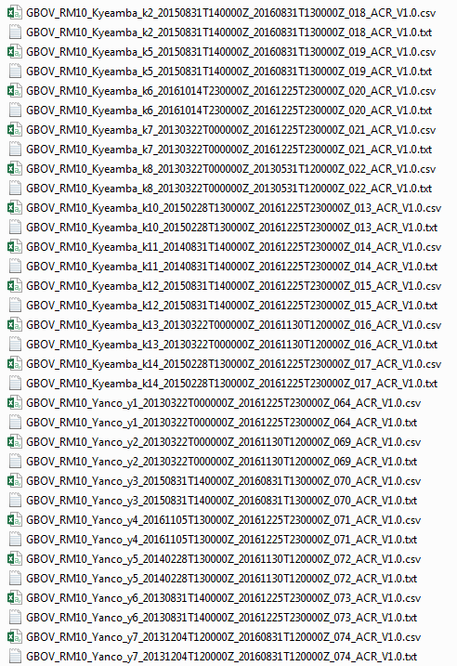
Soil Moisture
Reference Measurements
Land Products
3 SSM (recommended to use TDVI)
8 SWI (1, 5, 10, 15, 20, 40, 60 &100cm)

Slide 23
Exemple of SSM time series
Comparison of the three proposed methods over the Valencia Anchor Station (2014)

Slide 24
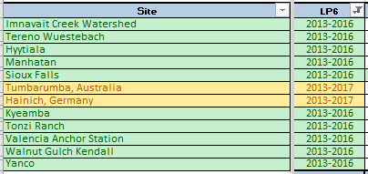
Status and plan for 2019
Status
LP6 480 matchups
Plan
Extension of the data base up to December 2018
2 new sites
Tumbarumba
Hainich

Slide 25
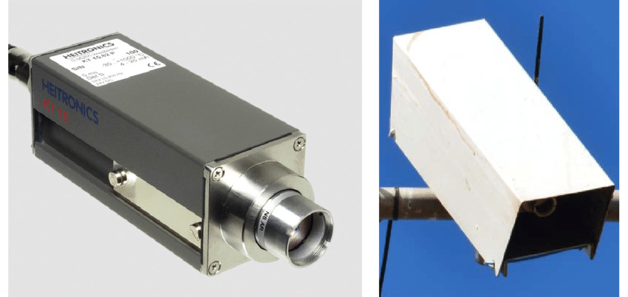
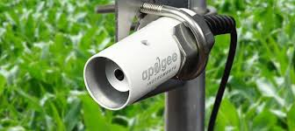
Long wave products RM2,8,9 & LP7

Slide 26
GBOV Land Surface Temperature
3 Reference Measurements (RMs) and 1 Land Product (LP)
https://land.copernicus.eu/global/gbov/public/docs/products/GBOV-ATBD-RM2-RM8-RM9_v1.3-LST.pdf
https://land.copernicus.eu/global/gbov/public/docs/products/GBOV-ATBD-LP7_v1.1-LST.pdf
Land Products
LP-1 Surface Reflectance
LP-2 Surface Albedo)
LP-3 LAI
LP-4 FAPAR
LP-5 Fcover
LP-6 Soil moisture
LP-7 LST
Reference Measurements
RM-1 short wave radiation
RM-2 thermal radiation
RM-3 Atmospheric properties
RM-4 Transmission through canopy
RM-5 Soil BRF/BHR/DHR
RM-6 FIPAR
RM-7 LAI
RM-8 LSE
RM-9 Surface Temperature
RM-10 Soil moisture
RM-11 Meteo properties
SurfRad

Slide 27
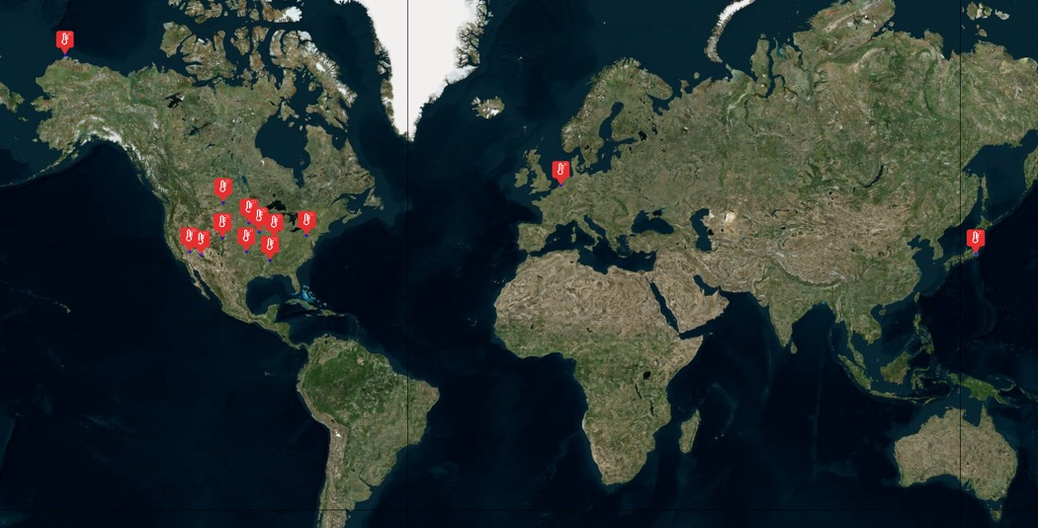
GBOV Land Surface Temperature
13 sites

Slide 28
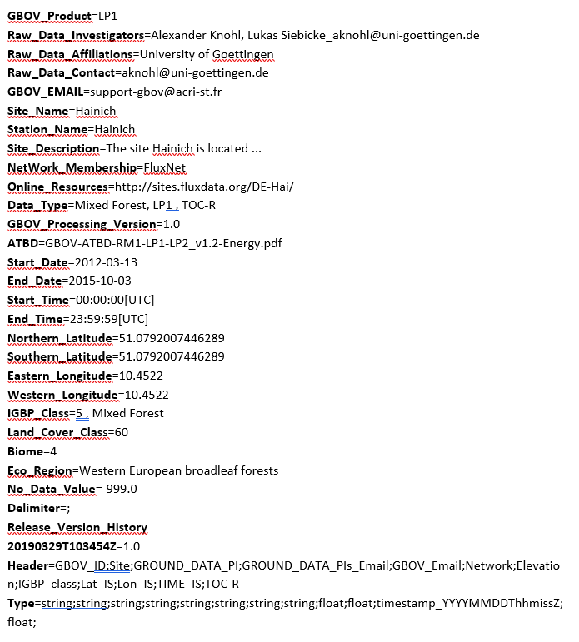
Land Surface Temperature
Reference Measurements
Land Products (5km)
1 daily
1 night time
Including uncertainties

Slide 29
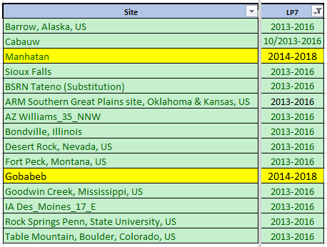
Status and plan for 2019
Status
614 daily matchups
614 night time matchups
Plan
Extension of the data base up to December 2018
2 new sites: Manhatan, Gobabeb

Slide 30
Component 2
Installation of new instrumentation on existing sites

Slide 31
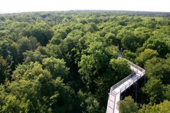
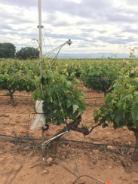
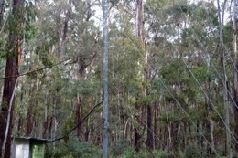
Status and plan for 2019 - 2020
Upgrade of existing sites with new instrumentation
Reduce geographical gap (Europe and Australia)
3 new vegetation sites
Hainich national park - Broadleaved Deciduous (CEOS LPV supersite)
Valencia Anchor station - Mediterranean crop
Tumbarumba - Broadleaved Evergreen (CEOS LPV supersite)

Slide 32
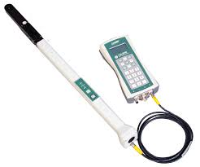
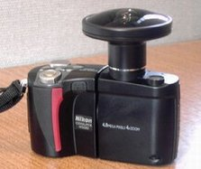
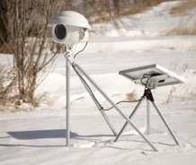
GBOV Vegetation
Reference Measurements
Continuous
PAR network (all sites) Apogee SI121
Automated Hemispherical camera (on Hainich site)
Field visits (all sites, at least 12 times during year)
LAI (LiCor)
Digital Hemispherical Photographs
Unique Setup!

Slide 33
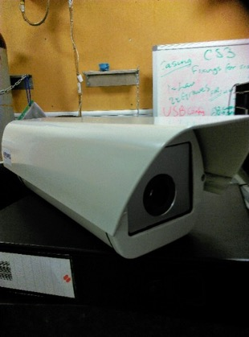
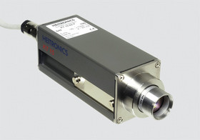
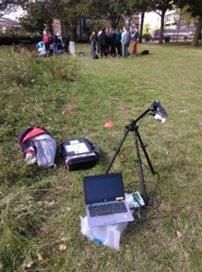
GBOV LST
Reference Measurements
Continuous LST on Tumbarumba and Hainich
LW_in (Apogee SI121) and
LW_out (Heitronics KT15.85)
Field visit (at least 12 times during year)
LSE & LST Cimel 312

Slide 34
GBOV aerosol
Reference Measurements
Continuous on Hainich and Tumbarumba
AOT + VSF (Cimel 318 ; to be attached to AERONET)

Slide 35
Valencia Anchor station
PI Ernesto Lopez Baeza (UVEG)
Long term monitored site (IGBP: crop land ; wine yard)
Infrastructure
15m height tower + small radiometry tower + Eddy convariance station (New)
Internet connection for communication to be improved
Powered through solar panels
Field trips are routinely performed by UVEG
Once a month during winter
Every two weeks during the growing season
Operational infrastructure used in GBOV includes
Meteo and Soil moisture data

Slide 36
Valencia Anchor

Slide 37
Valencia Anchor

Slide 38
Valencia Anchor
28/03/18 FRUIT TREE
27/07/17 VINE 1
27/07/17 VINE 2
27/07/17 VINE 3
10/05/18 VINE 1
10/05/18 VINE 2
10/05/18 VINE 3
10/03/17 VINE 1
10/03/17 VINE 2
10/03/17 VINE 3

Slide 39
Tumbarumba station
PI William Woodgates (CSIRO)
Long term monitored site (IGBP: Evergreen Broadleaf)
Infrastructure
70m height tower with two platforms
40m height canopy
Internet connection on top of the tower ➔ data transfer facilitated
Power through diesel generator and batteries ➔ no power limitation
Regular field trips are routinely performed
CEOS super site
Operational infrastructure used in GBOV includes
TOC-R and Albedo
Soil Moisture in 2019

Slide 40
Tumbarumba

Slide 41
Tumbarumba

Slide 42
Hainich
PI Alexander Knohl & Lukas Siebicke, Uni of Goettingen
Long term monitored site (IGBP: Mixed Forest)
infrastructure
Flux tower (scaffolding type) height above canopy
Shed with main power (2° power line available)
Internet connection
Main species
Fagus sylvatica (hêtre commun/Beech
Fraxinus excelsior (Frêne élevé/ Ash)
Regular field trips are routinely performed
Lidar airborn campains organized every three years
CEOS super site
Operational infrastructure used in GBOV includes
TOC-R and Albedo
Soil Moisture in 2019

Slide 43
Hainich - spring

Slide 44
Hainich - Summer

Slide 45
Component 3
Data access and documentation

Slide 46
Web portal overview
https://land.copernicus.eu/global/gbov
@CopernicusGBOV

Slide 47
Data usage

Slide 48
Eight tabs (1)
Fancy images
GBOV news (data release, project events
Conferences
Publications …
Project overview
Site description (country, coordinates, PIs IGBP, Biome, network …

Slide 49
Eight tabs (2)
Product User Manual, ATBDs, RM and LP definition
Data access page (select variables, sites and time frame
FAQ and link to contact us
GBOV service activity statistics

Slide 50
GBOV Data Policy
Free and open access
BUT
Required to acknowledge Copernicus and GBOV service partners
Offer co-authorship to site captains if their data are used in peer reviewed papers

Slide 51
Acknowledgments

Slide 52
Naming convention & Data Format

Slide 53
Naming convention

Slide 54
File content

