Slide 1
CEOS Land Product Validation Meeting Milan, 15 May 2019
Working Group on Calibration and Validation
Land Product Validation Subgroup
Introduction & Meeting Objectives
F. Camacho, J. Nickeson
Notes:
LPV established as subgroup in 2000.

Slide 2
Working Group on Calibration and Validation
Land Product Validation (LPV) – 11 FA (2 co-leaders)
Chair Fernando Camacho EOLAB / U.Valencia
Vice-Chair Vacant
Secretariat Jaime Nickeson SSAI/NASA GSFC
Notes:
Mission: to ensure international coordination of civil space-based Earth observation programs and promotes exchange of data to optimize societal benefit for a sustainable future for humankind.

Slide 3
LPV Focus Areas and Co-leaders
Working Group on Calibration and Validation
Snow Cover*, Sea Ice | Thomas Nagler (ENVEO, Austria) |  | Vacant
Surface Radiation (Reflectance, BRDF, Albedo*) | Zhuosen Wang (NASA GSFC) |  | Dominique Carrer (Meteo-France) |  | Ian Grant (Australia)
Land Cover and Land Use Change* | Pontus Olofsson (Boston University) |  | Sophie Bontemps (University of Louvain)
FAPAR* | Vacant |  | Marie Weiss (INRA)
Leaf Area Index* | Sylvain Leblanc (Natural Resources Canada) |  | Hongliang Fang (Chinese Academy of Science)
Fire* (Active Fire, Burned Area) | Luigi Boschetti (University of Idaho) | Gareth Roberts (U. Southampton, UK) |  | Andrew Edwards (Charles Darwin U.)
Land Surface Temperature* (LST and Emissivity) | Glynn Hulley (NASA JPL) |  | Frank Goettsche (KIT, Germany)
Soil Moisture* | Michael Cosh (USDA ARS) |  | Carsten Montzka (Jülich Research Centre)
Land Surface Phenology | Joshua Gray (University of Montana) |  | Jadu Dash (University of Southampton, UK)
Vegetation Index | Tomoaki Miura (University of Hawaii) |  | Else Swinnen (VITO)
Above Ground Biomass* | Laura Duncanson (GSFC) | John Armston (UMD/UQ, Australia) |  | Mat Disney (U. College London, UK)
*Essential Climate Variable (ECV) as defined by GCOS
Co-lead: sitting, recent, vacant, ex-officio
Notes:
Restructured a few years ago, now following essential climate variables. Several focus area co-leads presenting variable-specific results.

Slide 4
LPV Subgroup Objectives
Working Group on Calibration and Validation
To foster and coordinate quantitative validation of global land products derived from remotely sensed data, in a traceable way, and to relay results to users.
To increase the quality and efficiency of global satellite product validation by developing and promoting international standards and protocols for:
Field sampling
Scaling techniques
Accuracy report and use
Data and information exchange
To improve quality of ground references used for product validation
Field campaigns for fiducial references
Identification of sites and supersites for validation
To provide feedback to international structures for:
Requirements on product accuracy and quality assurance
Terrestrial ECV measurement standards
Notes:
Formed in 2000 as part of NASA’s EOS validation program – validating MODIS land products
The mission of the CEOS Land Product Validation (LPV) subgroup is to coordinate the quantitative validation of satellite-derived products. The focus lies on standardized intercomparison and validation across products from different satellite, algorithms, and agency sources.

Slide 5
Meeting Objectives
Working Group on Calibration and Validation
Discuss the LPV overall strategy and priorities for the coming years
To know where we are, and where we are going: Define action plan for 2019-2022
Exchange information with Copernicus services and foster collaboration for validation of satellite products

Slide 6
The LPV Validation Heirarchy
Working Group on Calibration and Validation
Action: Be careful when updating the web page content to make it consistent !
Action: Need to introduce fiducial concept in the hierarchy table

Slide 7
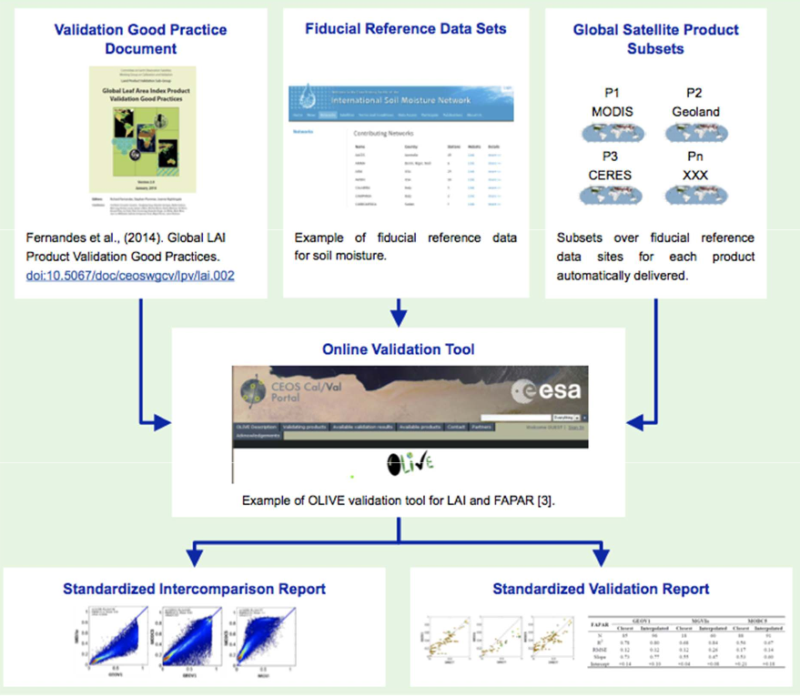
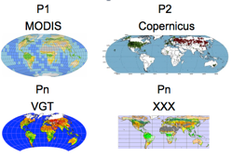
The LPV Validation Framework
Working Group on Calibration and Validation
Lead Agency: NASA
Lead Agencies: Various
Lead Agencies: USGS/NOAA
Lead Agencies:
ESA/NASA/USGS
Lead Agency: ESA/NASA/USGS

Slide 8
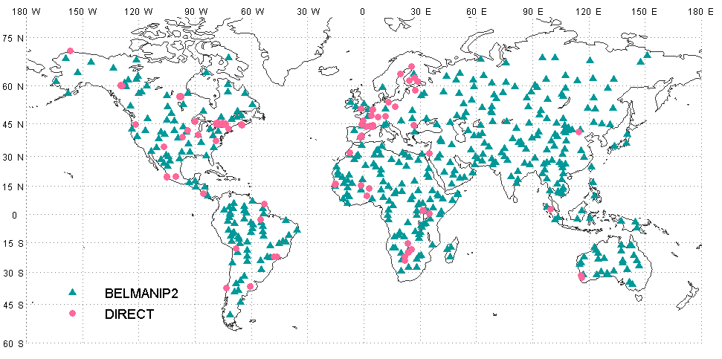
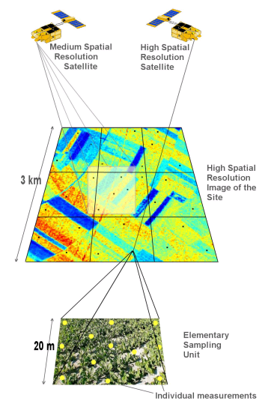
Working Group on Calibration and Validation
Leaf Area Index Validation Protocol
Location of reference for validation (direct) and inter-comparison studies.
CEOS cal/val portal
Spatial sampling used for validation upscaled using high-resolution imagery to match the kilometric satellite resolution.
DIRECT database updated in 2017
DIRECT 2.0:
140 sites - 242 samples
2000-2017 period
https://lpvs.gsfc.nasa.gov
Notes:
Formed in 2000 as part of NASA’s EOS validation program – validating MODIS land products

Slide 9
Working Group on Calibration and Validation
Recent Achievements

Slide 10
Working Group on Calibration and Validation
LPV Supersites
Super characterized (canopy structure and bio-geophysical variables) site following well- established protocols useful for the validation of satellite land products (at least 3) and for radiative transfer modeling approaches.
Active, long-term operations, supported by appropriate funding and infrastructural capacity.
Supported by airborne LiDAR and hyperspectral acquisitions (desirable).
Action: Review supersites over Europe (FRM4Veg, FLEX, GBOV) & expand over Asia (2021)
Notes:
The CEOS Land Product Validation subgroup adopted the EOS Land Validation core sites back in the early MODIS era, and augmented the list with more European and international coverage in the mid 2000's. But many of these sites were not longer active, and our needs and strategy for ground reference sites have changed over time. The LPV thus undertook an effort to define and evaluate several study sites that could fulfill the needs of mulitple products within our focus areas.
We have defined sites that we refer to as LPV Supersites as:
Super characterized (canopy structure and bio-geophysical variables) site following well- established protocols useful for the validation of satellite land products (at least 3) and for radiative transfer modeling approaches.
Active, long-term operations, supported by appropriate funding and infrastructural capacity.
Supported by airborne LiDAR and hyperspectral acquisitions (desirable).
The supersites were selected primarily from well known and established networks, and several were also nominated by each of the LPV focus areas, and then all sites were evaluated for their suitability by ranking them first based on the availability of data (active site) and their spatial representativeness. After this the variables were ranked based on how many key variables could be validated with a given site, whether structural information were available for the site, and if atmospheric and other properties were measured. The sites were also ranked according to global region and by land cover. All of this information was combined to come up with a score for each site and a cut-off was established for accepting a given site. The subset of sites that we have initially adopted using this criteria are shown on the map below, and in this spreadsheet.

Slide 11
Working Group on Calibration and Validation
CEOS CARBON Strategy
LPV Biomass group is contributing to the CARBON strategy (CEOS WP 2019-2021 ): biomass validation protocol, identification of carbon supersites, paper on biomass validation

Slide 12
Working Group on Calibration and Validation
Validation is evolving…
…traceable uncertainty and fiducial reference measurements required
(Dash et al., 2019)

Slide 13
LPV Strategy (2019-2021)
Working Group on Calibration and Validation
Lead Agency: NASA
Lead Agencies: Various
Lead Agencies: USGS/NOAA
Global sampling
Operational Services

Slide 14
LPV Strategy (2019-2021)
Working Group on Calibration and Validation
As a Chair my primary goal is to increase the validation stage of global satellite LAND products while assuring the good functioning of LPV.
Strategy based on 4 main items:
Continuous Development of Good Practices for global satellite land product validation
Improving ground references to achieve higher validation stage by improving uncertainty characterization and spatio/temporal coverage: Fiducial Reference Measurements, identification of supersites ( e.g., European Network of Supersites), databases for cal/val.
Promote validation and intercomparison exercises (products and algorithms) with CEOS main agencies in collaboration with operational services (e.g., Copernicus Services)
Improve LPV communication with stakeholders ( web page, newsletter, symposiums, thematic workshops)

Slide 15
CEOS-LPV 5-Year Roadmap
Working Group on Calibration and Validation
Working Group on Calibration and Validation
CEOS-LPV 5-Year Roadmap
< 2018 2019 2020 2021 >2022
Vision
Operational Validation Framework (Lead : USGS/NOAA)
Operational Validation in Services (Lead : EC Copernicus)
All missions support validation & validation is on-going
Uncertainty information determined through standard practices & protocols
Algorithms are iteratively improved based on validation results
LST & Albedo protocols
Burned Area, VI, FAPAR, Soil Moisture , LC, Phenology Protocols
CEOS Carbon Actions
Biomass Protocol (Lead : NASA/ESA)
protocols for Snow (Lead : ESA)
2
WGCV ACIX (Lead: ESA)
Biomass validation & Intercomparison (NASA/ESA)
WGCV ACIX- 2 , Cloud Masking IX (Lead: ESA)
Field Data
Definition of LPV Supersites , carbon supersites, supporting FRM campaigns (Lead: ESA)
New Missions
Biomass
Sustained Missions
a/b
b
Morning
c
EPS-SG
Afternoon
Landsat 9
Terra/Aqua/S-NPP
JPSS-1
JPSS-2

Slide 16
Communicating LPV Goals and Actions
Largely done via the web site
Requires that each focus area regularly reviews and updates their pages to keep them current
The community letters are also important. We want those on the listserv to feel a part of LPV. We want them to participate in focus area meetings, and to exchange information about their activities, particularly when related to field work and reference data collection.
We also want consensus on the protocols and to participate where needed/desired. The more of this that takes place, the more likely it is to be readily taken up and promoted by the community.
I highly encourage you to add new young scientists to your lists. These list have been around for YEARS, and people retire and also change institutions. Please quickly scan for these institutional updates. I received one update recently that was solely changes to addresses.
I am tracking the updates, shown in the table on the next slide. It is maintained on the wiki. Please let’s get this wrapped up by June and get those community letters out!
Many thanks to the focus areas that have already provided feedback and updated their pages or are working on them.

Slide 17
LPV Updates

Slide 19
https://lpvs.gsfc.nasa.gov

