Slide 1
Ongoing and Future Field and Airborne Cal/Val efforts: some thoughts and updates
Martin Herold Wageningen University
CEOS WGCV LPV meeting
Prague, 10. May 2016

Slide 2
List of global/regional land cover reference datasets
Dataset name | Provider | Main use for | Coverage | Availability for web portal | Reference
GLC 2000 | EC JRC | Validation | Worldwide | Granted | Mayaux, et al., 2006
IGBP | Boston U. | Training | Worldwide | Granted | Scepan, et al., 1999
VHSR db | Boston U. | Validation | Worldwide | Granted but not ready | Olofsson, et al., 2012
GlobCover 2005 | ESA/UCL | Validation | Worldwide | Granted | Bicheron et al., 2008; Defourny, et al., 2011
GlobCover 2009 | ESA/UCL | Validation | Worldwide | Granted | Bontemps, et al., 2011
Landsat GLC map | China | Validation | Worldwide | Granted | Gong, et al., 2013
GLCNMO | International Steering Committee for Global Mapping | Training/Validation | Worldwide | Granted | Tateishi, et al., 2011
LC CCI | ESA | Validation | Worldwide | Granted but not ready | Achard et al., 2011
FAO FRA | FAO | Validation | Worldwide | Granted | Potapov, et al., 2011;FAO & JRC, 2012
MODIS training (STEP db) | Boston U. |  | Worlwide | Granted | Strahler et al., 2003;Friedl, et al., 2010
GEO-WIKI | GEO-WIKI site | Calibration/Validation | Worlwide | Granted | Fritz, et al., 2009; Fritz, et al., 2011a
VIEW-IT |  |  | Worlwide | Granted | Clark & Aide, 2011b
NELDA dataset | NELDA |  | Northern Eurasia | Granted
TREES | EC JRC | Validation | Worldwide | Waiting
Global Human Settlement Layer | EC-JRC | Validation | Several countries | Waiting
Global urban ground truth data | University of Tokyo | Validation | Worldwide | Granted

Slide 3
Climate modelling (ECV) community requirements and suitability of land cover validation datasets
Requirements | Criteria
Statistically rigorous (accurate and precise) overall and class specific accuracy estimates | Probability sampling
 | Proper representation of important classes
Compatibility in combining and augmenting the samples | Easily combined and augmented sampling scheme
Flexible thematic land cover characterization | Classification scheme and thematic detail of the legend
 | Hierarchical classifiers provided
Temporal coverage | Multi-date (1990-2000-2005-2010)
Stability over multi-date datasets | Stable multi-date sample
Spatial resolution | Appropriate spatial detail
Qualify flag information available | Verified and interpretation confidence recorded
http://www.gofcgold.wur.nl/sites/gofcgold_refdataportal.php
Tzendbazar et al., 2014. ISPRS Journal

Slide 4
The GlobBiomass reference dataset
~ 15,000 plots in the tropics
~ 100,000 plots in Europe
Avitabile et al., 2016, GCB
Map and reference data online at:
www.wageningenur.nl/grsbiomass
Dataset 04/2016
Notes:
And 12 sub-national or national biomass maps (high resolution, locally calibrated).
Currently we do not have formal permission from data owners to use the data for GlobBiomass (need to ask them), so maybe it is not appropriate to call it the GlobBiomass reference dataset...?

Slide 5
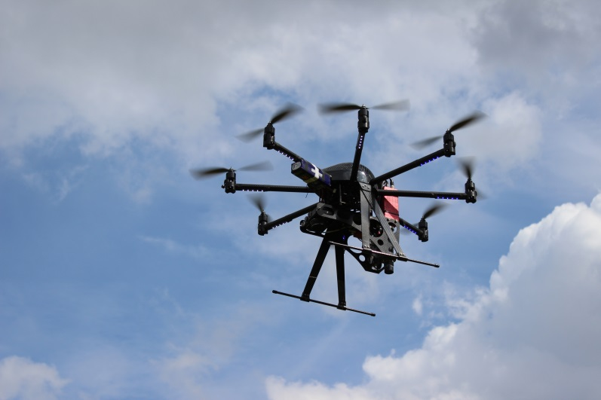
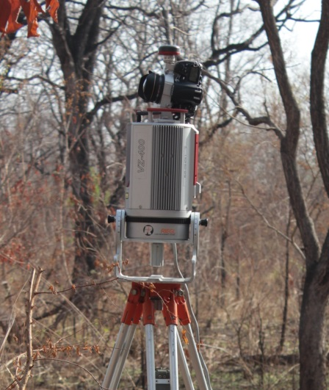
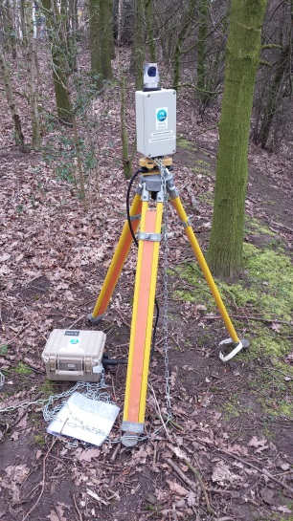
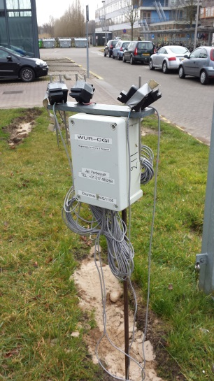
Dense vegetation time series Cal/Val
Missing cal/val sites for high density time series (>1 week) over dynamic vegetation
Forest ecosystems: largest discrepancies between LAI datasets, and impact of dynamics and changes
New sensing opportunities: UAVs, terrestrial laser scanning, passive sensors etc.
Hyperspectral UAV/drone
Hemispherical LIDAR
Vegnet LIDAR
PASTIS 57
WU UAV Facility (http://wageningenur.nl/uarsf)
WU Lidar Facility (http://wageningenur.nl/lidar)

Slide 6
Cal/val site Speulderbos/NL 2015/16+
Data Streams – ground & airborne
Instrument | Technology | Samples | Temporal density
Nikon DSLR with Sigma circular fisheye | Digital Hemispherical Photography | 21 per plot Plots A to E | 1 x week
Riegl VZ-400 | Terrestrial Lidar | 5 per plot Plots A to E | 1 x week
PASTIS 57 | Photodiodes @ 57° | 4 per plot Plots A to C | 2 min
Vegnet | IML @ 57° | 1-3 in Plot B | 1 x day
Rikola on UAV | Programmable superspectral camera (16 bands) | Plot A & B | 1 x week
WU UAV Facility (http://wageningenur.nl/uarsf)
WU Lidar Facility (http://wageningenur.nl/lidar)

Slide 7
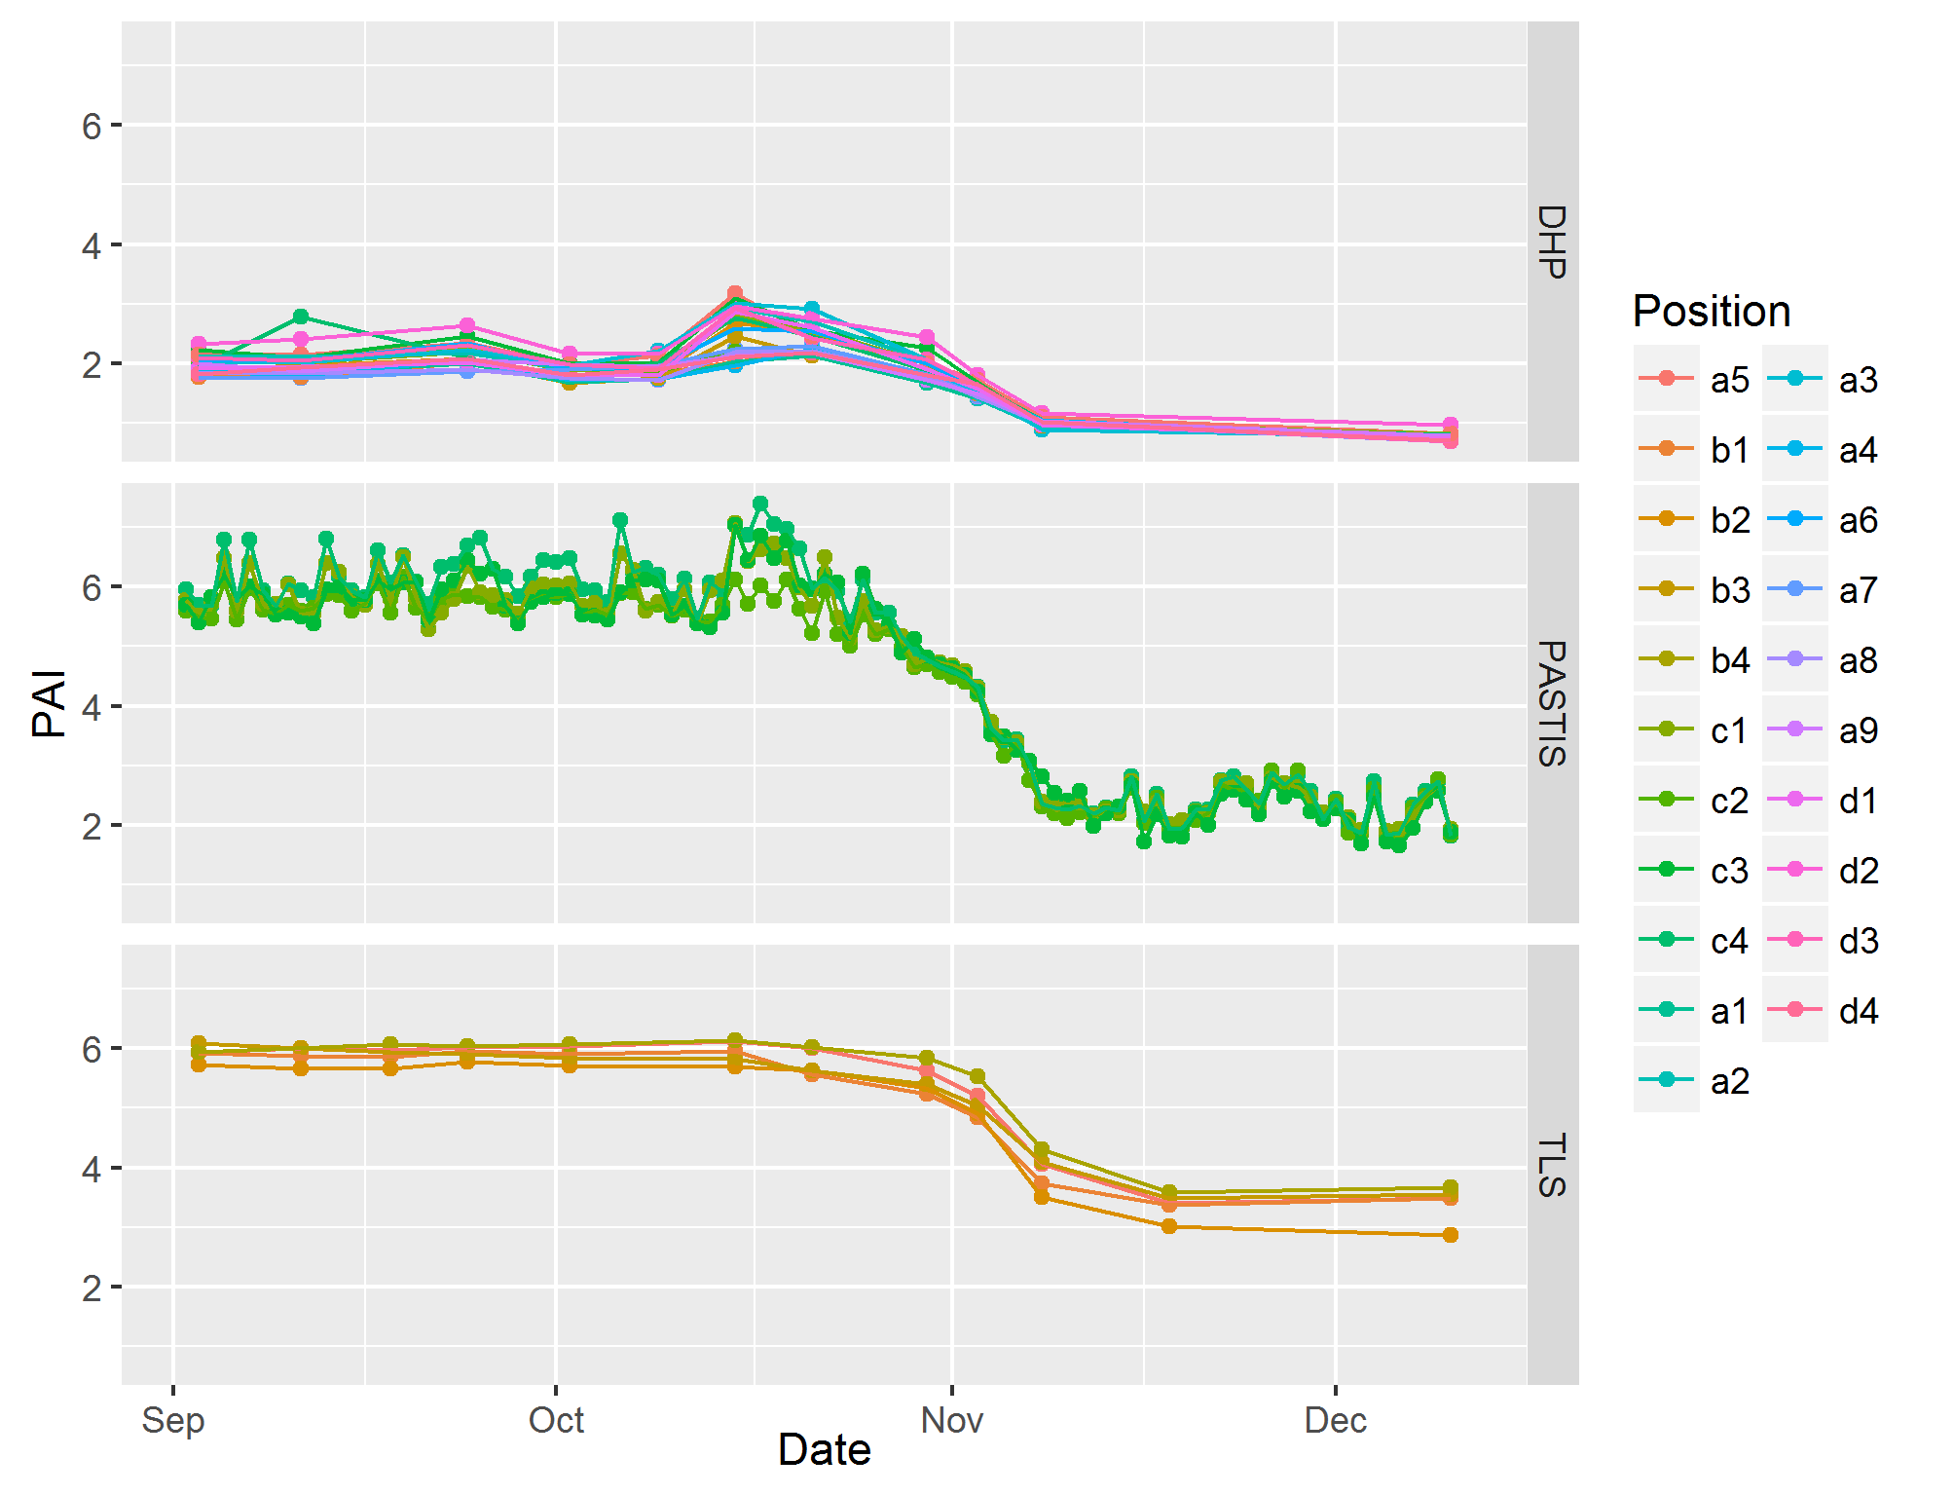
Preliminary results – ground based
DHP: simple segmentation algorithm (kmeans) still delivers unrealistic results
+ weekly UAV
Sensor comparison for plot B

Slide 8
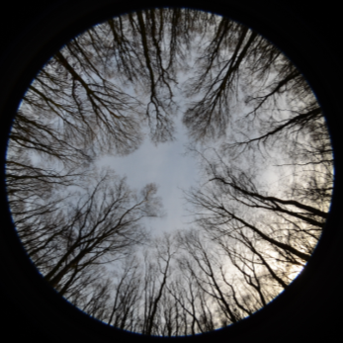
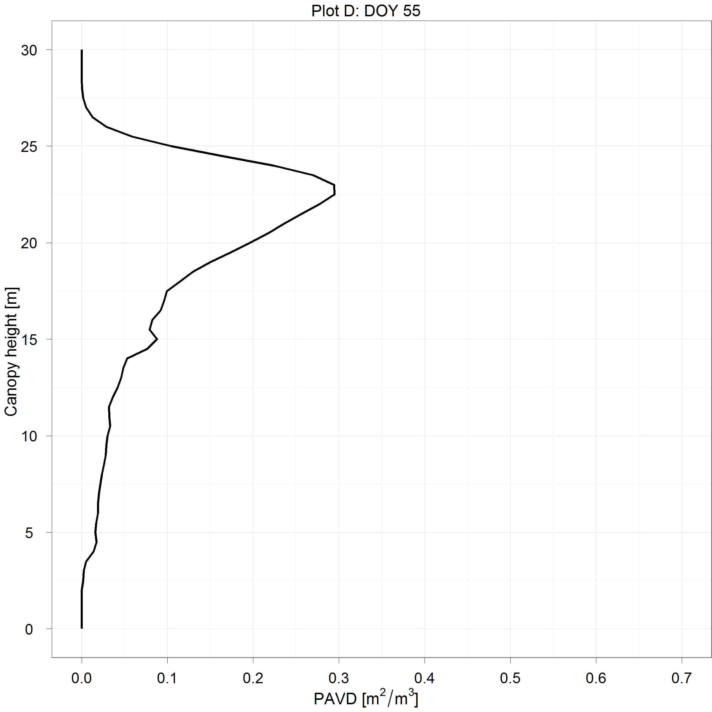
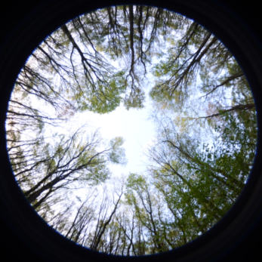
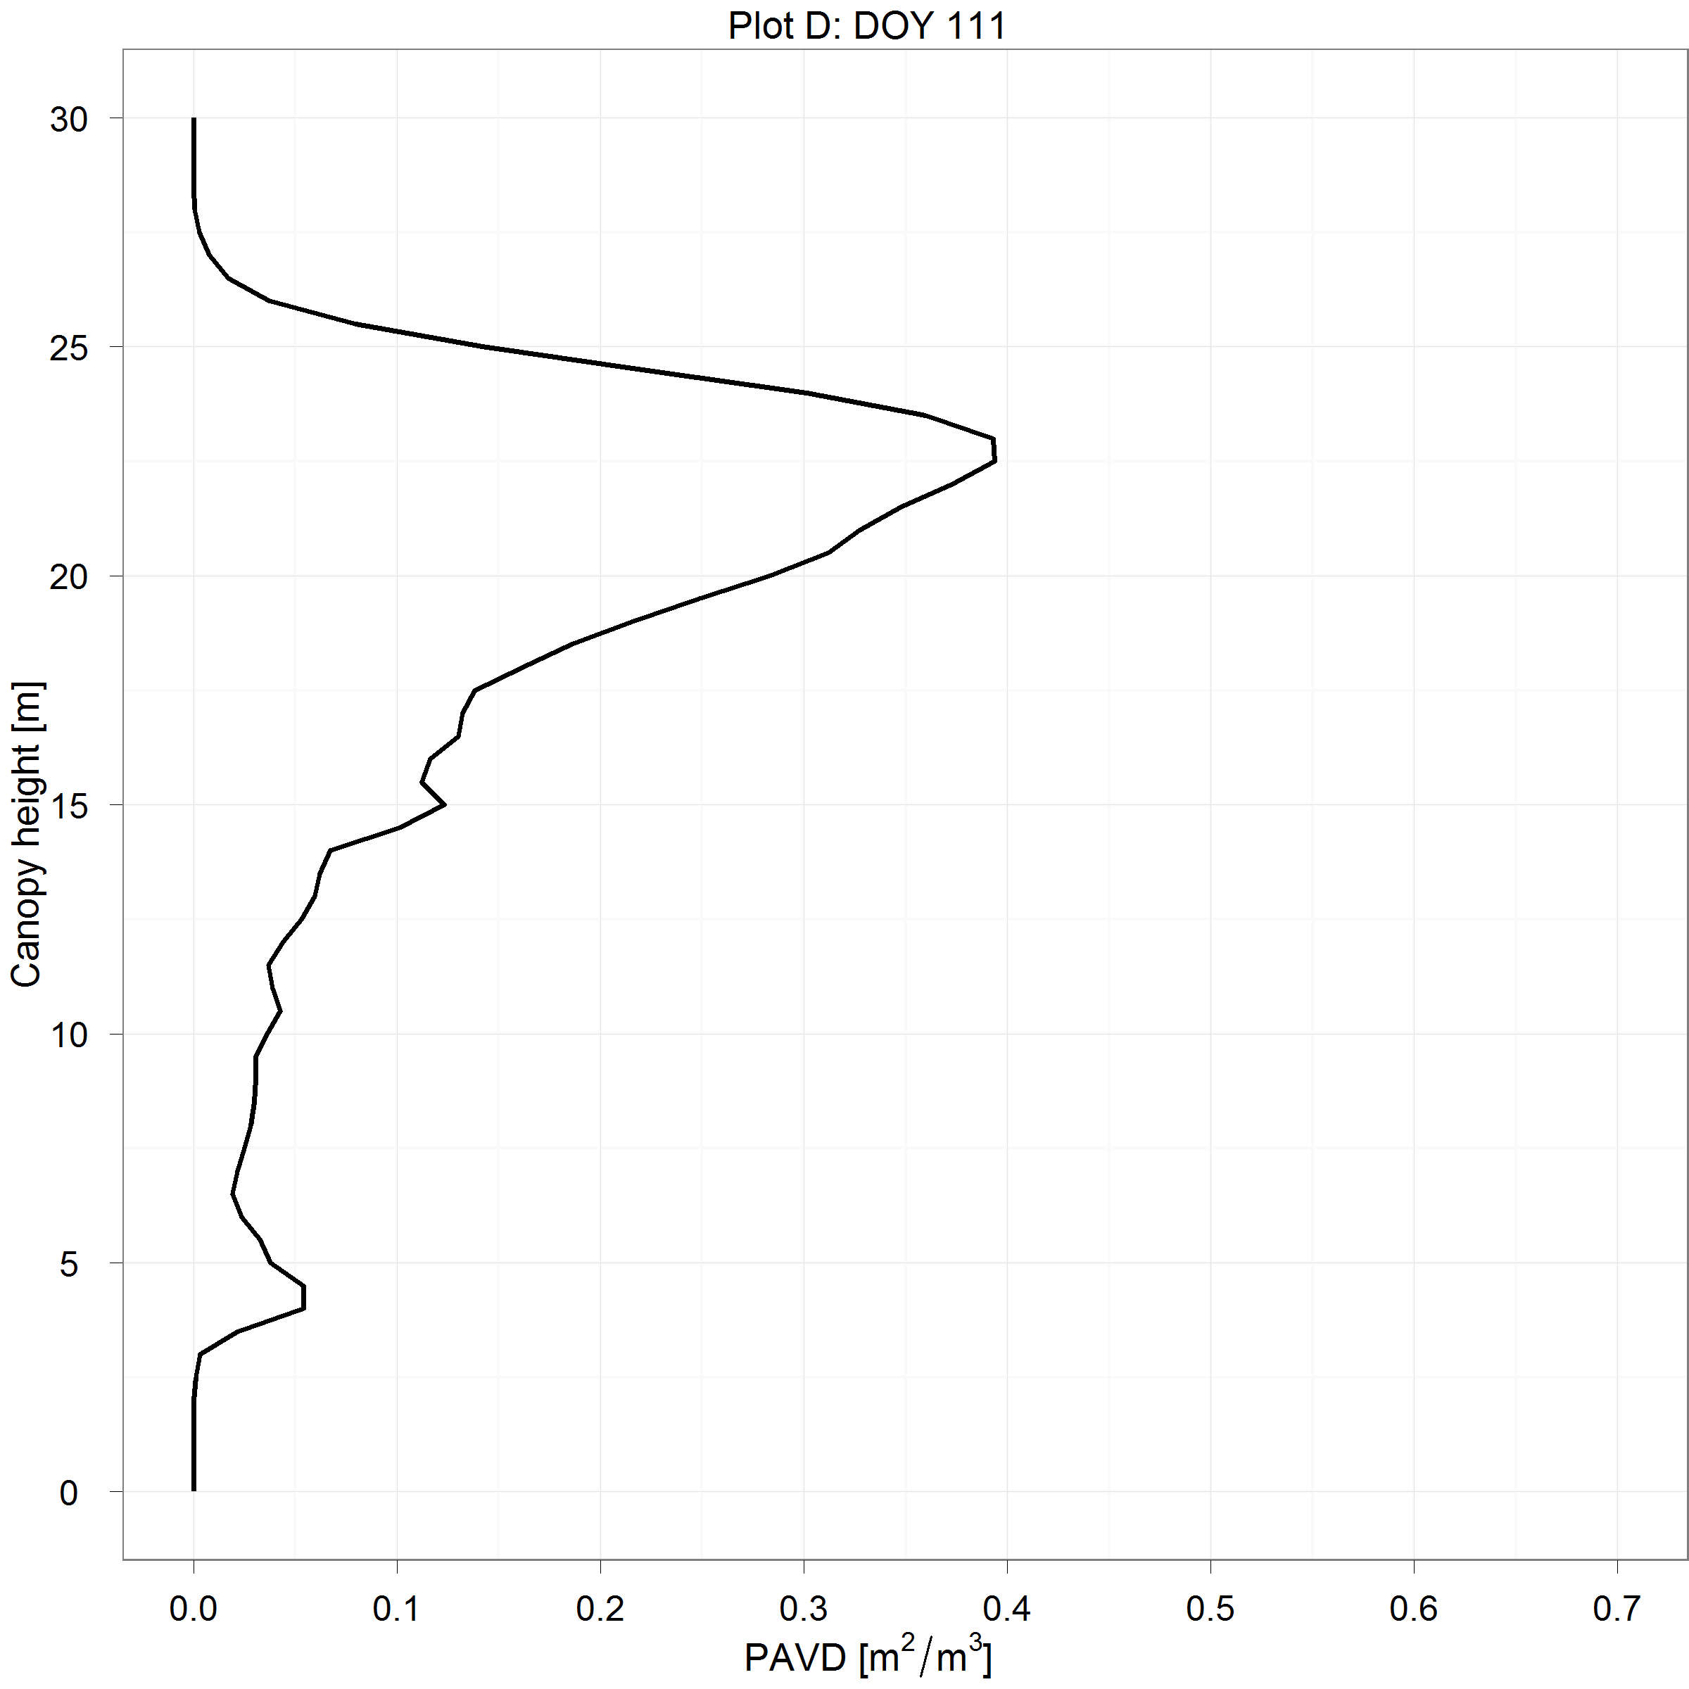
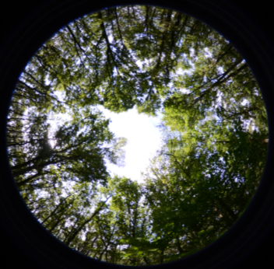
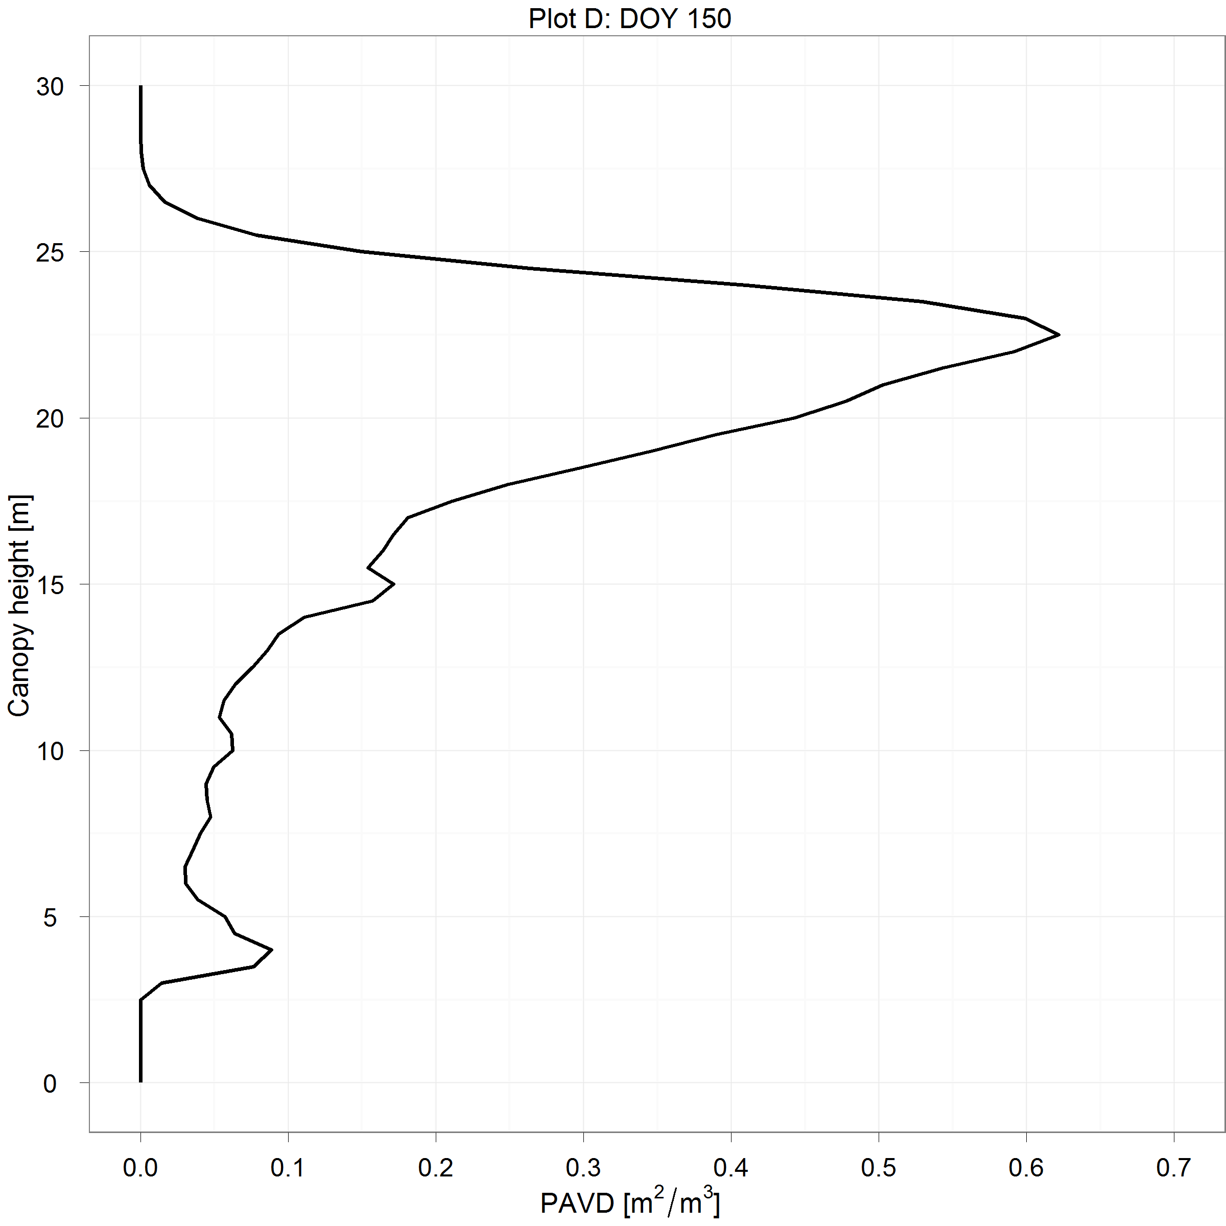
Monitoring leaf development with TLS
DHP
TLS
TLS profile
24/02
21/04
30/05
Calders et al., 2015, AFM

Slide 9
Monitoring canopy development
Calders et al., 2015, AFM

Slide 10
How terrestrial LIDAR works in forests
www.wageningenUR.nl/lidar
www.youtube.com/wurLiDAR

Slide 11
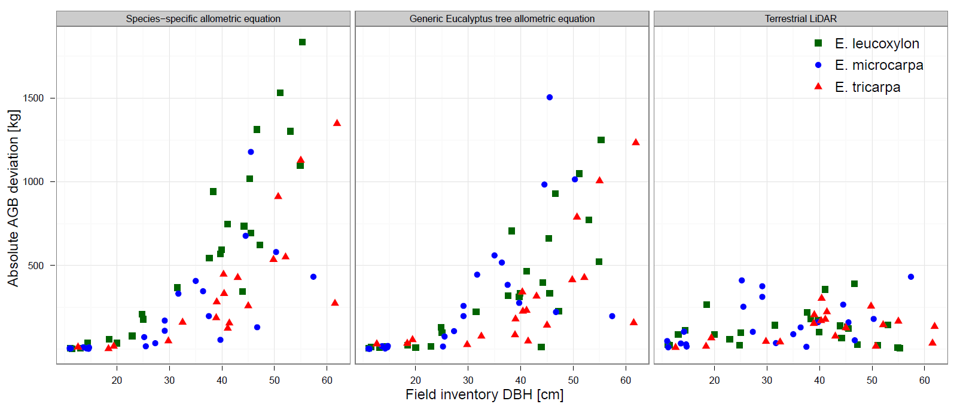
LiDAR for AGB
AGB from TLS & allometry :
At plot level:
allometry: underestimation of 29.9 to 36.6%
TLS: overestimation of 9.7 %
Calders et al., 2015, MEE

Slide 12
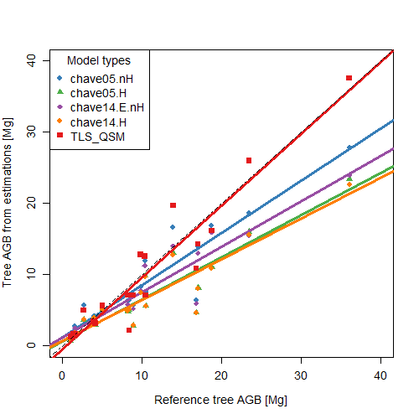
LiDAR for AGB
Gonzales/Lau et al., in review

Slide 13
Remarks and discussion points
Open source data and tools for cal/val: other experiences and how to push that
Continuous and consistent dense-time series cal-val (for vegetation parameters)
T-LIDAR as new tool and what are steps towards community consensus approaches
Cal/val for biomass estimations from space: role and activities for CEOS LPV

