Slide 1
ECV Protocol Status Reports and Coordination Process
Guillevic P., Camacho F., Nickeson J. and Roman M.

Slide 2
Context and Objectives
Uncertainty estimates are essentials for wide acceptance of land products and development of long-term climate data records
Provide land products validation protocols and best practices to CEOS and the scientific community
Land products & protocol release:
Leaf Area Index 2015
Surface albedo, LST, FAPAR, burned area 2018
Surface reflectance and VI 2018
Biomass 2019
Phenology, ET, soil moisture,.. 2020

Slide 3
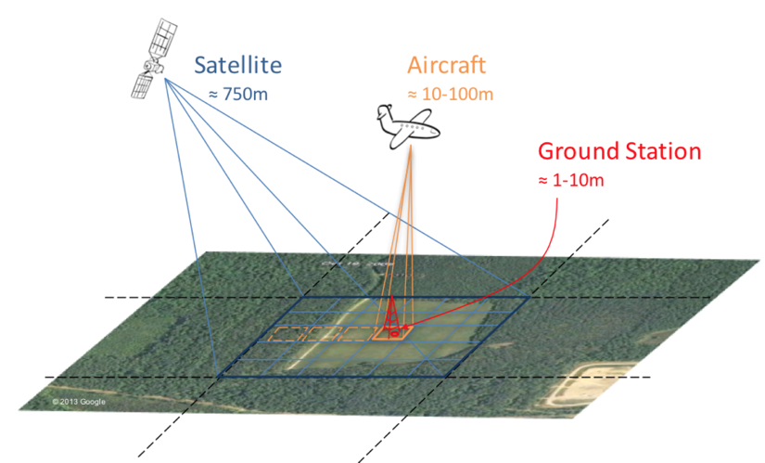
Main validation requirements
Characterize in situ measurements and validation datasets at satellite product resolution including uncertainty estimates
Characterize product uncertainties and identify issues with algorithm, ancillary data, geometric considerations, temporal drift

Slide 4
LPV protocol template
Based on LAI protocol released in 2015
Validation protocols depend on products:
LAI, Albedo, FAPAR, LST products validation may have similar challenges and follow similar protocols
LAI protocol not be appropriate for Burned area and surface type, for example
Contribution from each product team is needed !

Slide 5
LPV protocol template - From LAI protocol
Introduction and rationale
Importance of the product
Requirements from GCOS (Action items for ECVs)
Product requirements
Definitions
Definition of product
Definitions of associated physical/retrieval parameters
Definition of other key terms (common to most of the products: elementary Sampling Unit,…)

Slide 6
LPV protocol template - From LAI protocol
General considerations for satellite validation (common to most of products)
CEOS validation stages
Reference product estimates: spatial representativeness, accuracy and precision, upscaling methods, sampling
Reporting of statistics
General strategy for validation of global products
Current products
Uncertainty related to ancillary data used by retrieval algorithm: sensor noise, cloud mask, geometric considerations, temporal considerations
Status of current validation capacity

Slide 7
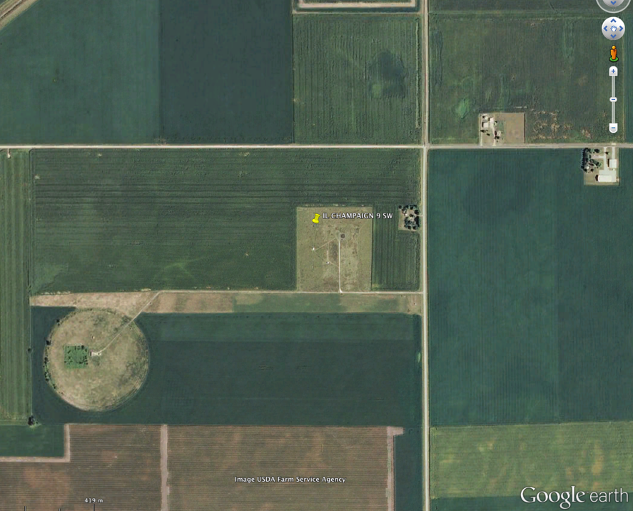
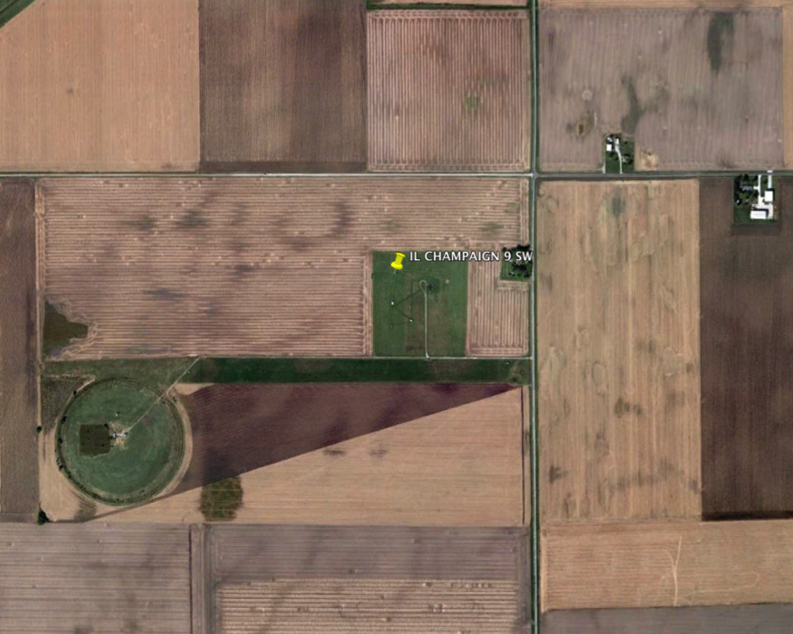
Example: Spatial vs. temporal variability Bondville/Champaign, IL
Before the harvest
After the harvest
Station 1
Station 1
Station 2
Station 2
1 km
Seasonal and interannual variations of the contribution of the surrounding area to coarse radiometric measurements over croplands

Slide 8
LPV protocol template - From LAI protocol
Continued
Validation requirements/strategy
Direct validation on a global basis accounting for seasonal conditions
Quantify the representative of product accuracy
Quantify the precision of product estimates
Quantify the long-term stability of retrievals
Identify issues with algorithm
Challenge to validation strategy
Status of current validation strategy
Data: ground, airborne, satellite
Method: In situ reference estimates, performance assessment

Slide 9
LPV protocol template - From LAI protocol
Recommended approach for global product validation
Reference datasets
Traceability, scaling method
Co-location, geolocation uncertainty, binning uncertainty
Validation metrics
Definitions (accuracy, bias, precision, completeness)
Stratification of performance statistics (based on representative sampling of product within a spatial and temporal stratification)
Ensemble inter-comparison
Reporting results

Slide 10
Expected team contributions
First draft/protocol template for each product available on google docs shared with product team members
Drafts for Albedo and LST partially filled
Once the first draft is completed, will be distributed among scientific community to get the needed consensus
Short-term action for team members:
Adjust sections/content depending on product
Provide information about methods used in the community
Upload other existing protocol documents (in google drive), or references of previous validation work
Book captain for each protocol?
Thank you!

Slide 11
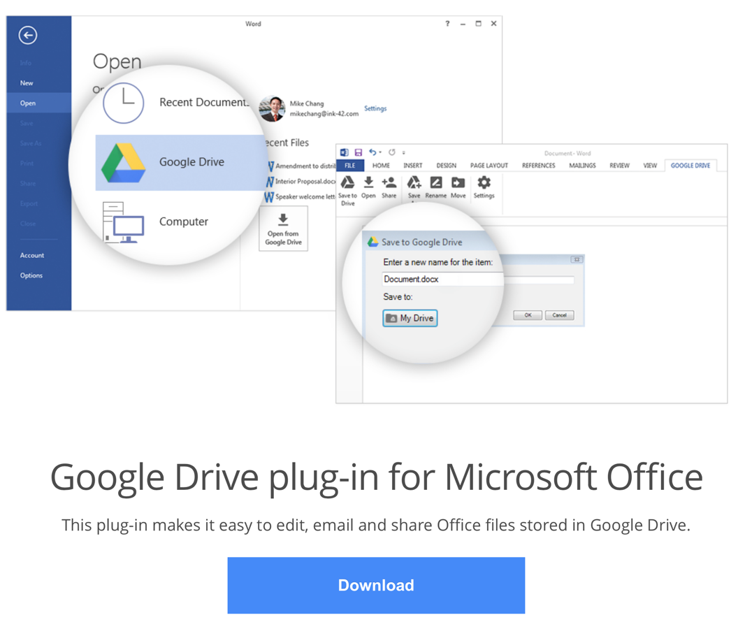
MS Office and Google docs
https://tools.google.com/dlpage/driveforoffice

