Slide 1

WGCV Chair report to LPV
K. Thome
NASA/GSFC
LPV
Frascati, Italy
March 2, 2018

Slide 2
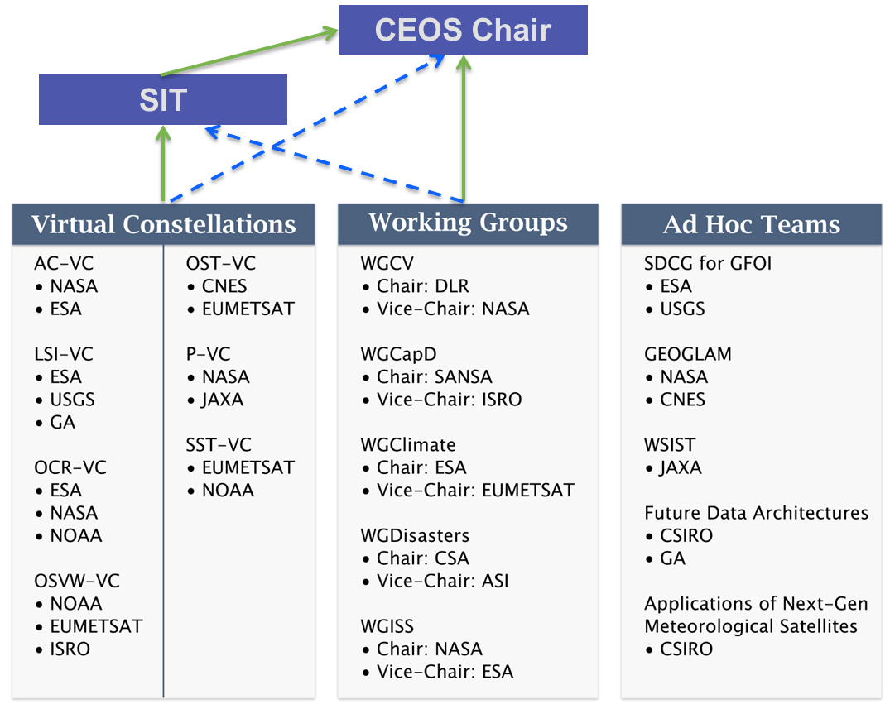
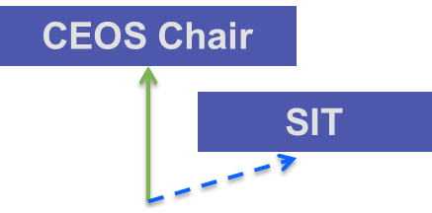
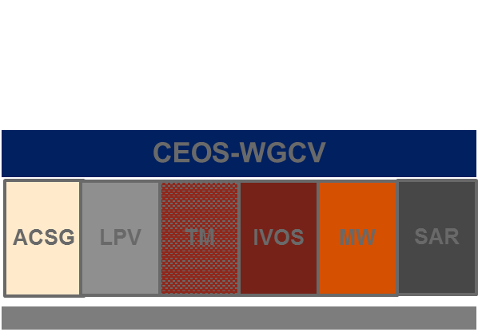
CEOS organization reminder
LPV is one of six subgroups that are part of WGCV that reports to the Strategic Implementation Team and CEOS Chair
Interaction with other CEOS bodies (Virtual Constellations, WGs)
Interaction with other bodies (example: GSICS)
Topics which are relevant for several subgroups
General topics (for example: validation metrics, protocols,…)

Slide 3
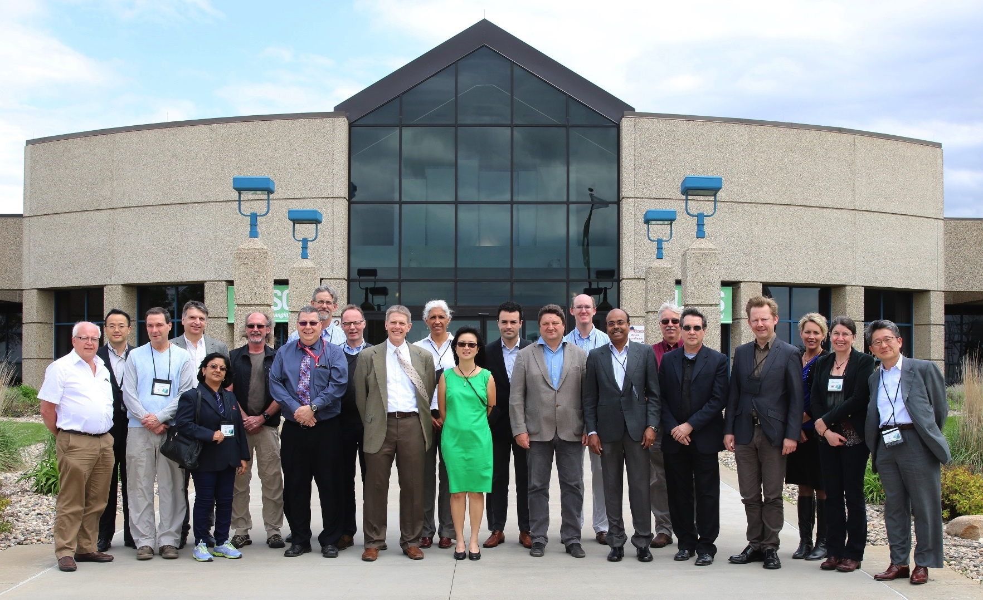

WGCV chair report
WGCV-related meetings for past 12 months
IVOS Subgroup March 13-17, 2017 in Tucson, Arizona USA
LSI-VC and MRI Framework March 20-22, Frascati
WGISS April 3-7, Annapolis, Maryland USA
ACIX task team April 11-12 in Frascati
CEOS SIT April 24-26 in Paris
WGCV-42 May 16-19 in Sioux Falls, South Dakota USA
CEOS SIT in Frascati, Sept. 11-14
CEOS Plenary in Rapid City, South Dakota October 17-20

Slide 4
WGCV report
Key activities from 2017
  CEOS Work Plan Deliverables
  Highlighted with discussions related to ACIX, RADCALNET, Carbon, WGCV subgroups
  Interactions with other entities
Meetings / Workshops
Conclusion
WGCV-42 meeting hosted by
USGS in Sioux Falls, United
States

Slide 5
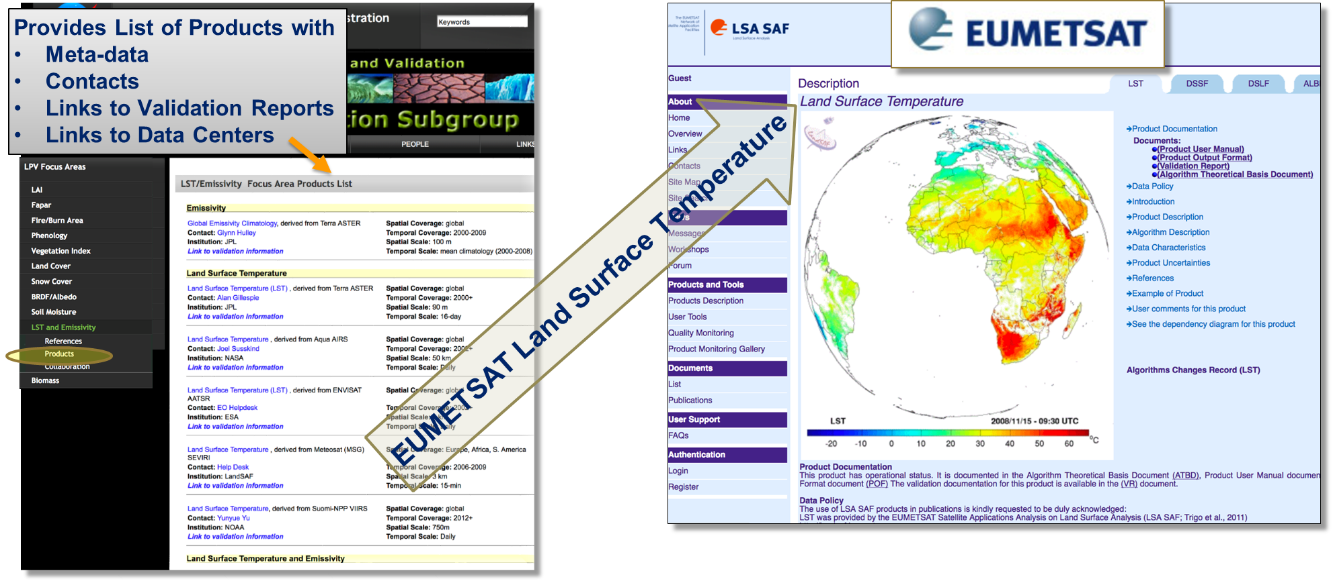
WGCV LPV Validation Reports
Documenting validation framework and protocols
One example - Land Surface Temperature & Emissivity Focus Area

Slide 6
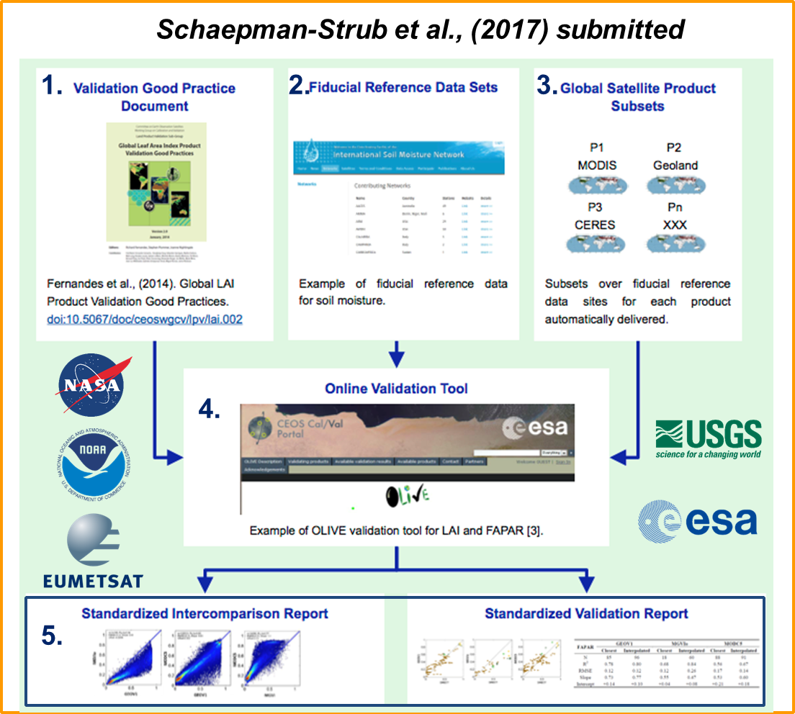
LPV and validation framework
CEOS WGCV LPV has established a framework with the aim of independent validation and consistent uncertainty reporting across products as main output

Slide 7
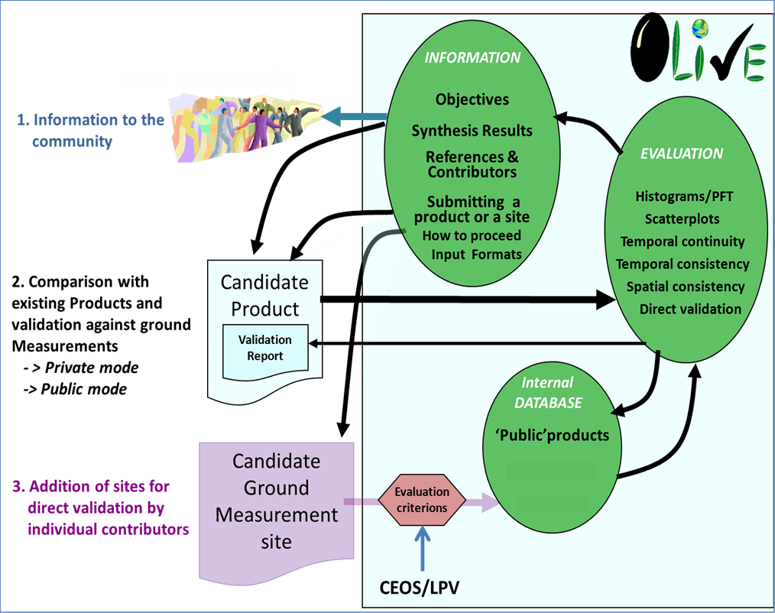
LPV’s OLIVE
Online Platform for Intercomparison - OnLine Validation Exercise (OLIVE)
Guidance for online platform for intercomparison of terrestrial carbon products.
Results of LPV efforts being formalized to allow closure of CARB-19 and likely closure of Carbon Task Force’s Action #08

Slide 8
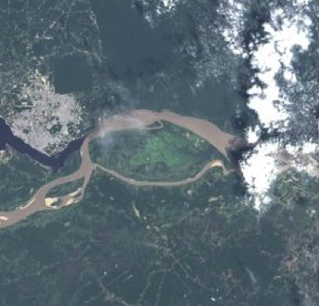
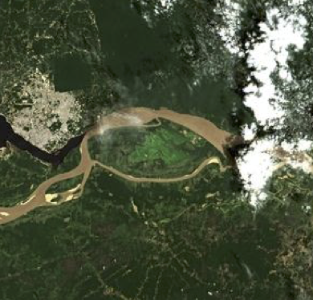
Atmospheric Correction Intercomparison ACIX
Sensors Processors
1 | ACOLITE [Belgium]
2 | ATCOR [Germany]
3 | Brockmann [Germany]
4 | FORCE [Germany]
5 | GA-PABT [Australia]
6 | LaSRC [USA]
7 | LAC [France]
8 | MACCS [France]
9 | OPERA [Belgium]
10 | SCAPE-M [Germany]
11 | SeaDAS [USA]
12 | Sen2Cor [France&Germany]
CV-13: Intercomparison of atmospheric correction models
Better understanding of the different uncertainty contributors and help in improving the AC processors
Definition of the inter-comparison protocol - discussed at first workshop
Application of the AC processors - Participants applied their AC schemes for test sites keeping processing parameters constant
Analysis of the results - ACIX coordinators processed the results submitted by all participants in early 2017

Slide 9
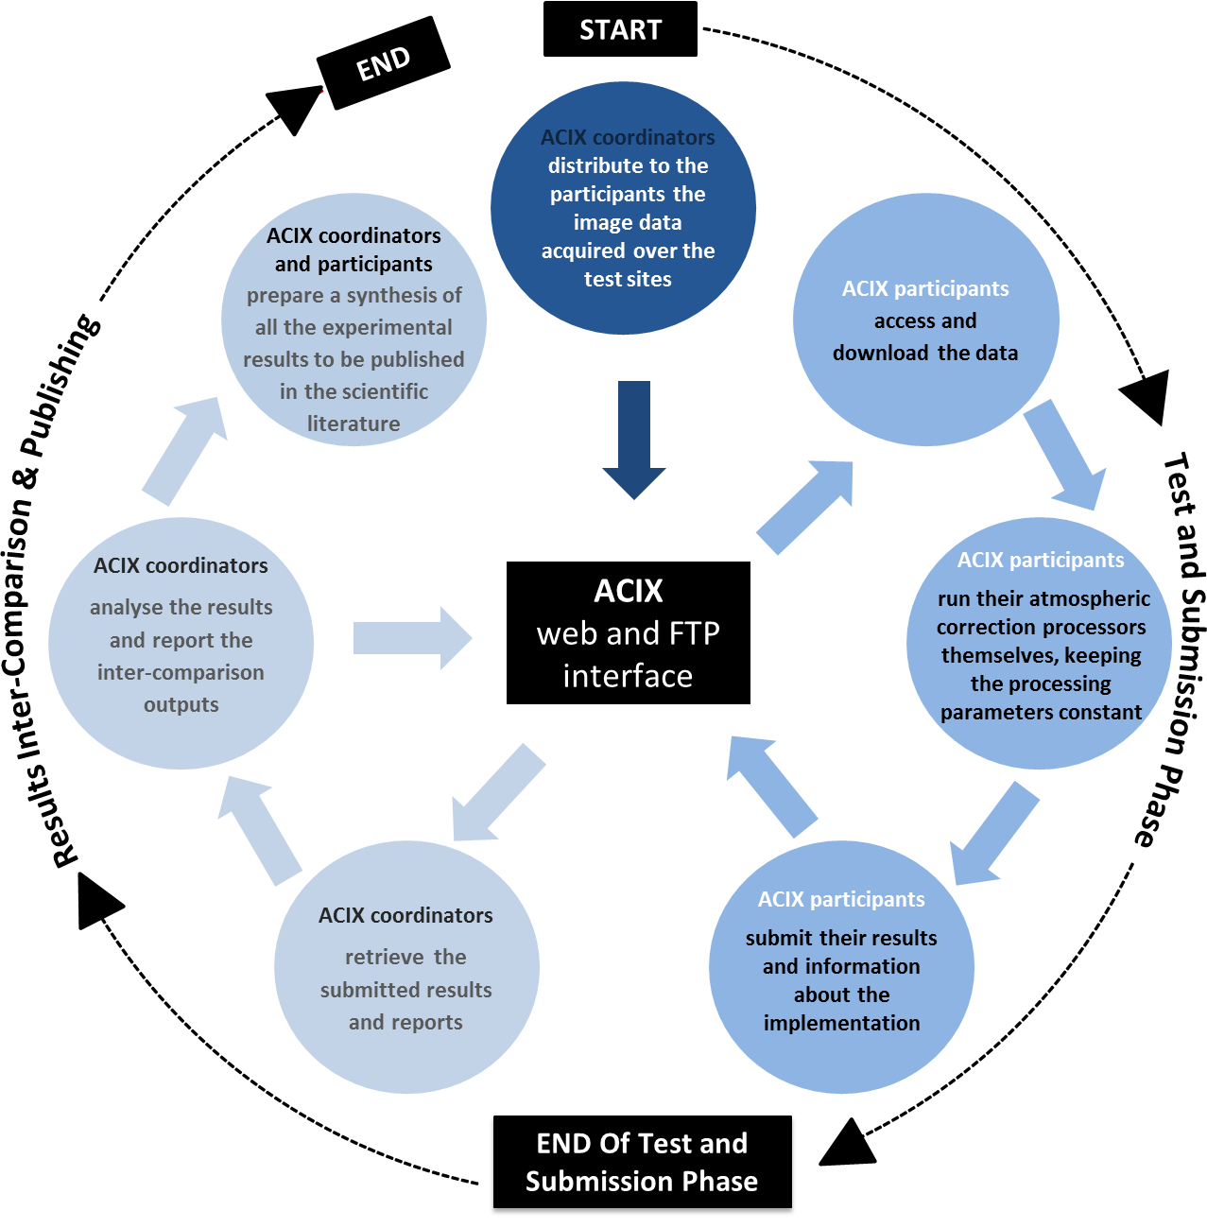
Atmospheric Correction Intercomparison ACIX
Results presented during 2nd ACIX workshop held in April 2017
Lessons learned on how to improve atmospheric correction schemes
Results pointed to the importance of per-pixel quality flags to ensure accurate atmospheric correction
You are here

Slide 10
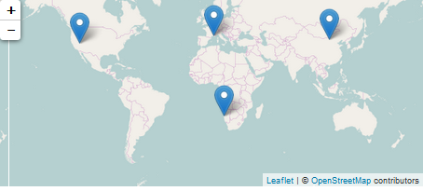
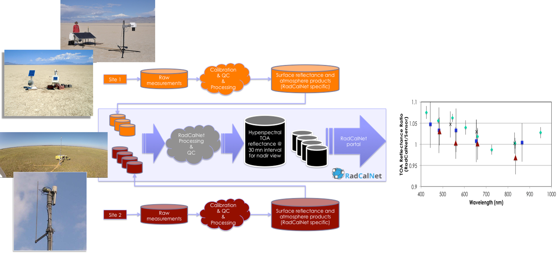
RadCalNet - Radiometric Calibration Network
Network of instrumented sites dedicated to the Radiometric Calibration of EO optical sensors developed in IVOS Subgroup
Automated processing including quality control
Traceability vs. SI standard

Slide 11
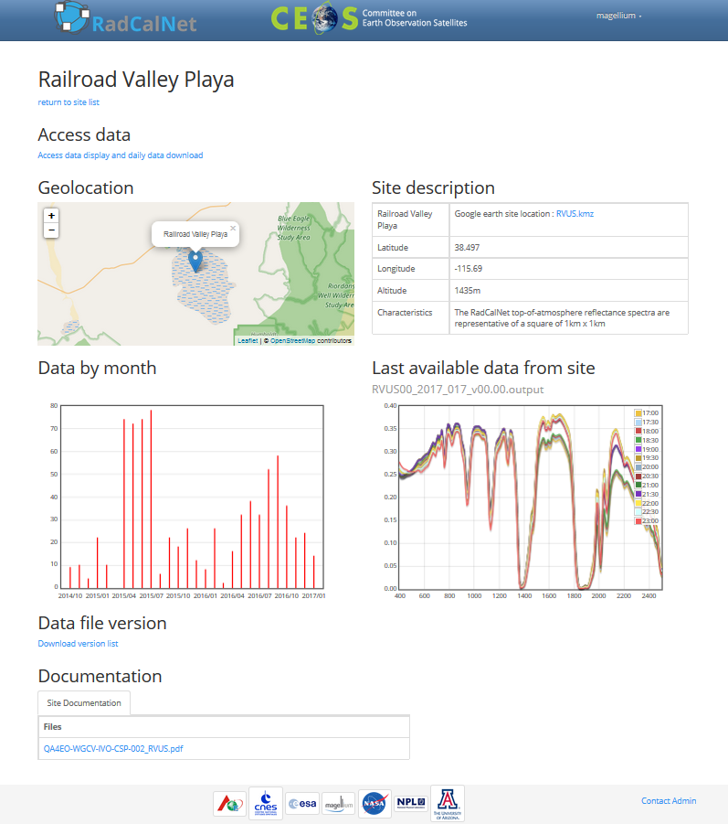
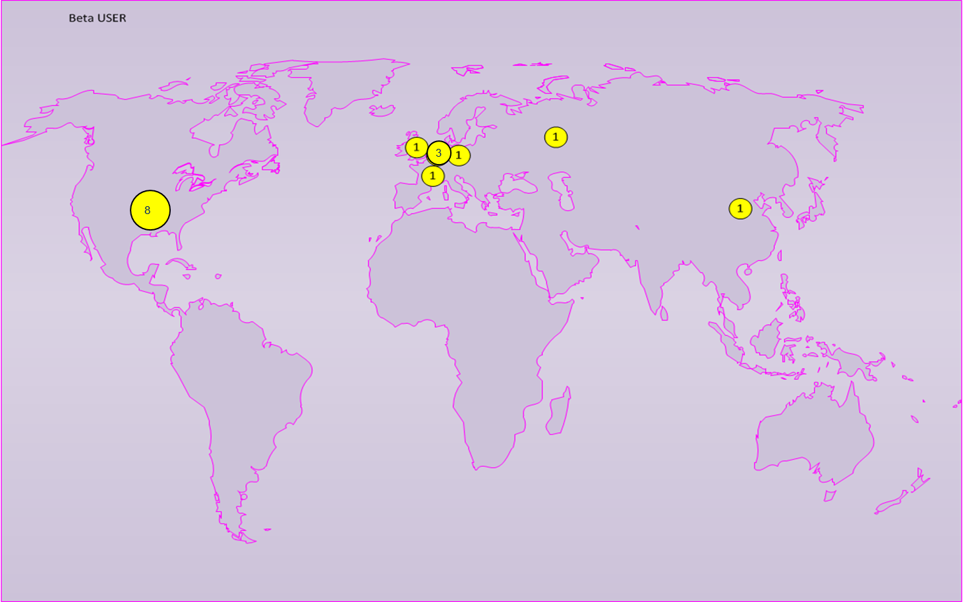
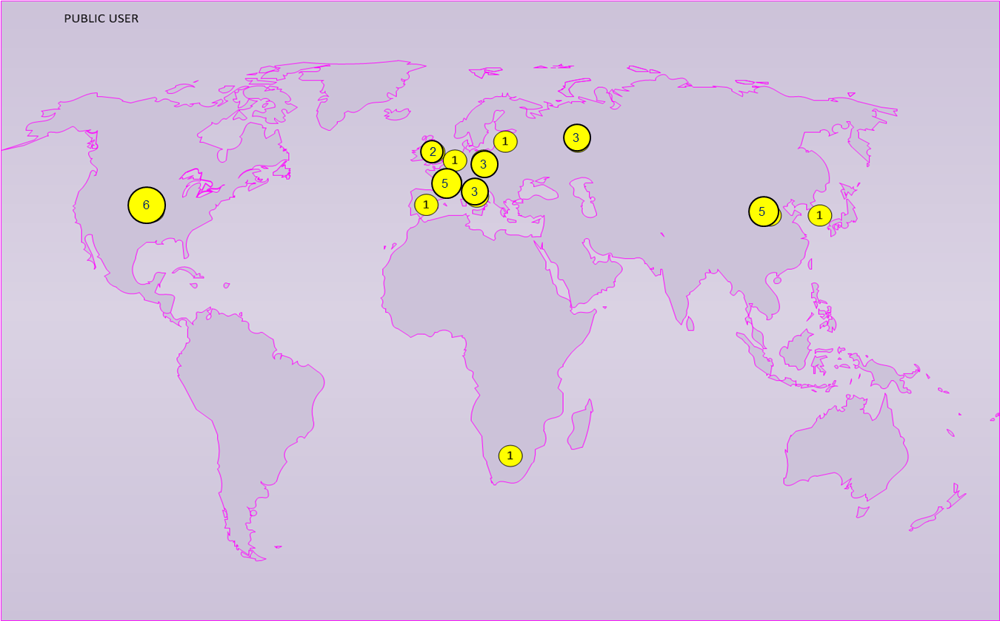
RadCalNet - Radiometric Calibration Network
RadCalNet is in Beta Testing and scheduled for opening of its website to the public in early 2018
WGCV in process of developing process to accept test sites into RadCalNet
The portal
16 Beta Users
32 Registered Users

Slide 12
Crosscutting WGCV activities related to MRI, CARD4L, etc.
WGCV activities cover a range of topics all related to understanding sensor-to-sensor differences
  Fiducial Reference Measurements (FRMs)
  Collaborations with other organizations such as GSICS
  Impacts of cloud masks and DEMs on Level 2 data production
  Solar irradiance spectrum
These activities also relate directly to CEOS Work Plan
  Completion of CV-12 - Evaluation of validation supersites and new validation approaches
  CV-15: L1 top-of-atmosphere interoperability
  VC-30: Interoperability case study for Landsat and Sentinel-2
  VC-29: Framework for moderate resolution land sensor interoperability
  VC-27: Develop a roadmap for the routine production of intercomparable CARD4L

Slide 13
CEOS LPV Supersites
CV-12 WGCV - Evaluation of validation supersites and new validation approaches
Well-characterized supersites with data continuity prospects for validation purposes that allow for testing of products, algorithms, and validation strategies through radiative transfer modeling
A Supersite should be fully characterized (3D canopy structure, plus key land variables) to allow a RT model parameterization, whereas a core site refers typically to the same variable
A Supersite should be useful for the validation of several land products ( > 3 )
Availability of data
Spatial representativeness
Overall, 61 Supersites selected out of:
TERN : 18 nodes in 10 Supersites
ICOS: 71 sites
NEON: 47 sites
LPV : 13 sites

Slide 14
Level 1 Interoperatibility
CV-15 to help define Level 1 top-of-atmosphere interoperability
Develop an initial recommendation of a community reference in collaboration with GSICS
  Introduced at WGCV-42 as a means to provide input to the MRI team
  Develop an initial recommendation of a community reference in collaboration with GSICS
Makes use of ongoing and newly instituted activities
  RadCalNet
  Solar irradiance spectrum
  Fiducial reference measurements
  SI-traceability and good pratices

Slide 15
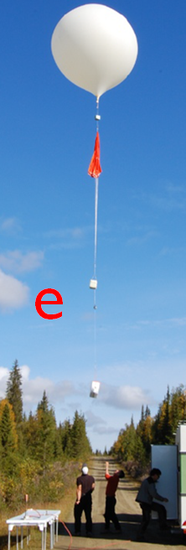
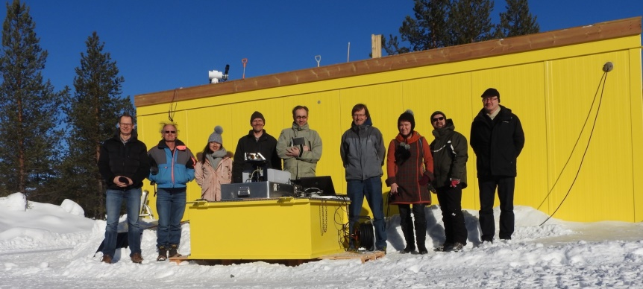
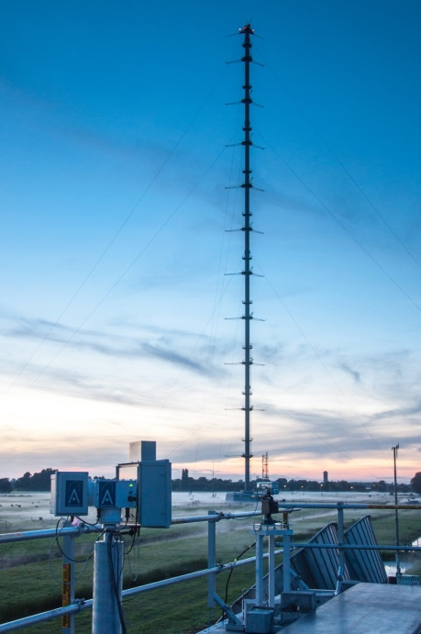
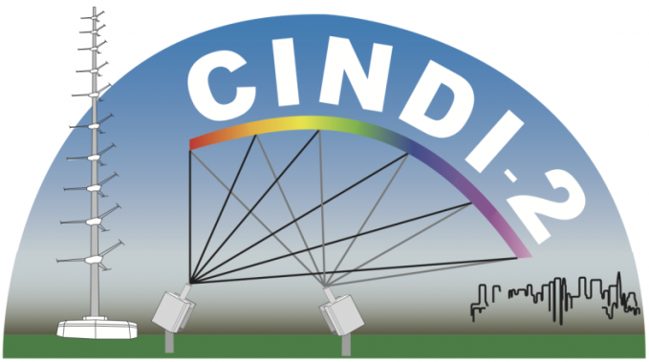
FRMs for atmospheric composition
FRM4GHG Campaign
  CO2, CH4, CO + other GHGs
  S-5p, GOSAT, OCO-2
  Test of new low cost instruments
  ESA, national agencies
CINDI-II Campaign
  OMI, GOME-2A/B
  Validation of NO2, HCHO, SO2…
  NSO, ESA FRM4DOAS, EU QA4ECV

Slide 16
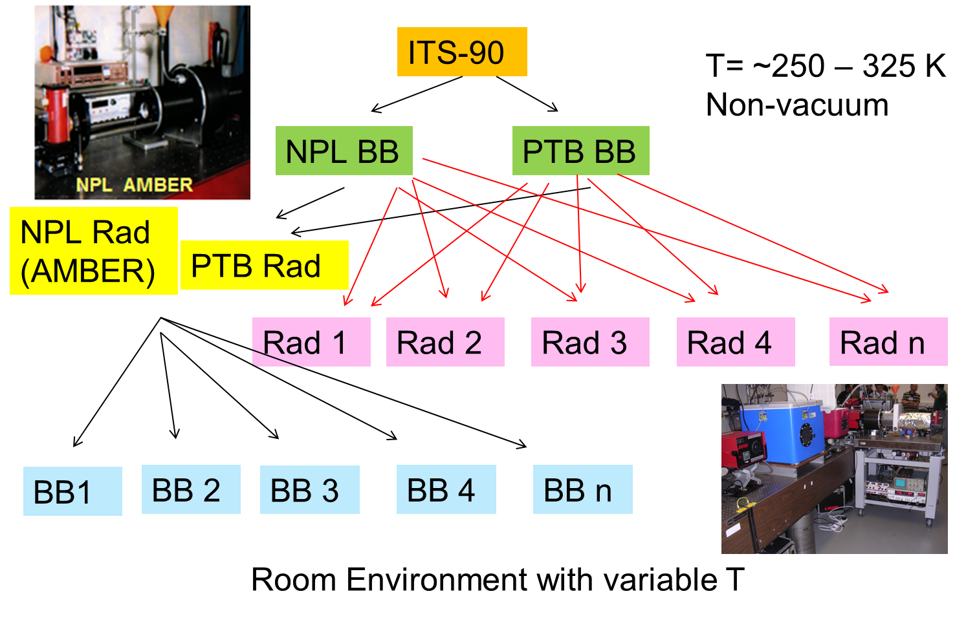
Importance of SI-traceability
Work within all subgroups (AC, IVOS, LPV, Microwave, and SAR) developing good practice approaches to ensure laboratory and field measurements are interoperable
Lead towards Level 1 and higher product agreement

Slide 17
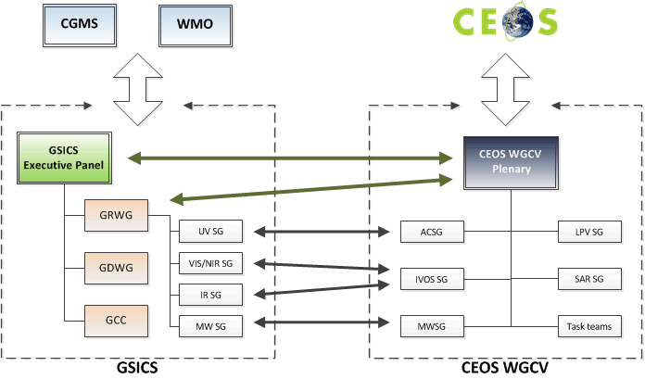
Interaction with other entities
Cooperation with GSICS
Identification of cooperation
priorities and concluded
(cf CV-03 and CV-15)
Cooperation on subgroup level &
working group level which includes
joint meetings of sub-groups
WGCV chair observer @ GSICS-EP
GRWG chair observer @ WGCV
Others
Interaction with IOCCG wrt Cal/Val ocean color
Participation on LSI VC telecons
Combined meeting with WGISS

Slide 18
Solar Irradiance Spectrum
Description of proposed GSICS/WGCV IVOS solar irradiance spectrum is being evaluated by WGCV membership for approval
  Solar spectrum choice can lead to differences in comparisons between sensors
  WGCV accepted solar irradiance spectrum will be distributed on the CEOS Cal/Val Portal
CV-16 - Report on outcomes from GSICS/CEOS reference Solar Spectrum evaluation

Slide 19
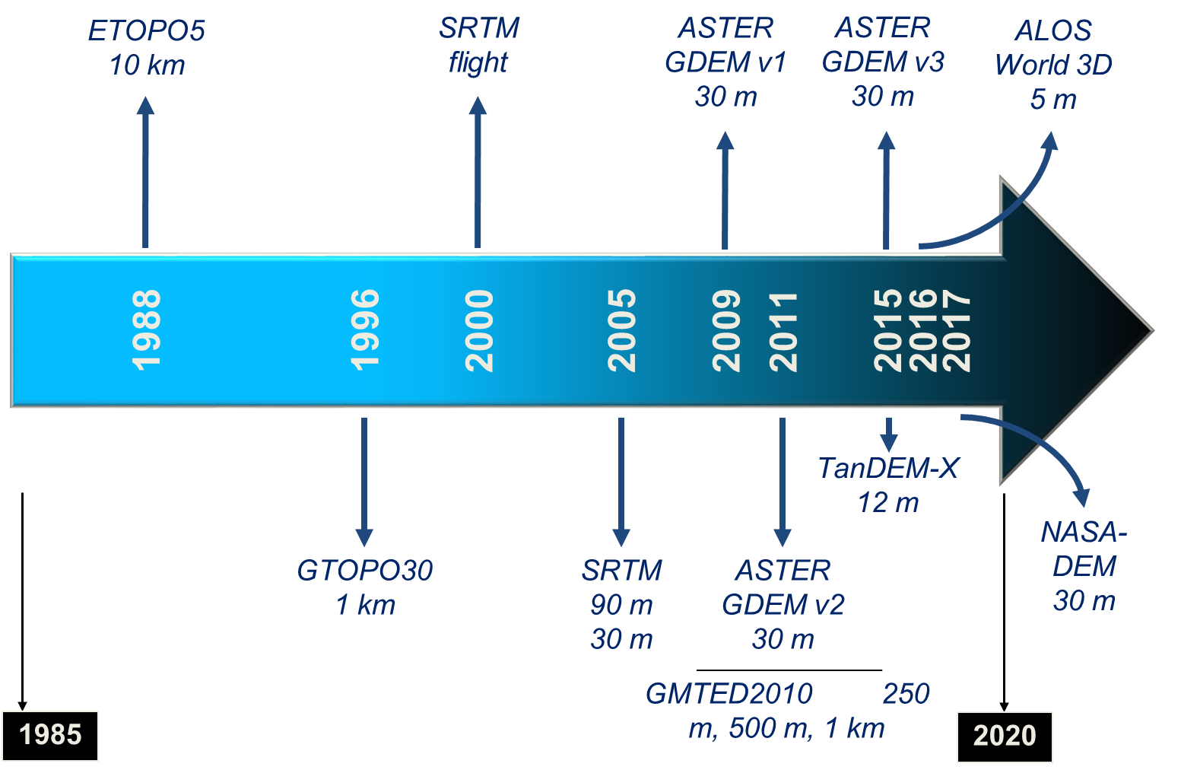
Moving forward on DEM Task Group
WGCV / Terrain Mapping Subgroup
GEO Global DEM Task
ISPRS WG IV/3 – Global DEM Interoperability
Activities:
SRTM workshop / PE&RS special issue
ASTER GDEM evaluation / IGARSS session
ISPRS sessions (2008, 2010, 2012, 2014, 2016)
DEM | Grid spacing (m) | Absolute vertical accuracy specification (m)
 |  | RMSE | LE90 | LE95
SRTM | 30 | 9.7 | 16 | 19.07
ASTER GDEM | 30 | 10.2 | 16.78 | 20
TanDEM-X (WorldDEM) | 12 | 6.08 | 10 | 11.92
PRISM (AW3D) | 5 | 5 | 8.22 | 9.8

Slide 20
Conclusion
WGCV subgroups are still the best opportunity for those not part of a CEOS Space Agency to impact CEOS
LPV is playing a key role in advancing WGCV’s progress on CEOS Work Plan activities
CARD4L, Interoperability, and Carbon Actions are near-term activities requiring help from LPV members
Subgroups are an excellent means to improve international collaborations on an array of topics
  Some of these topics can have relevance only to the subgroup
  Some must still have relevance to WGCV and at some point an impact on CEOS itself
Continue to do the work that is of interest to LPV while periodically considering how the activity can help the broader CEOS community

