Slide 1
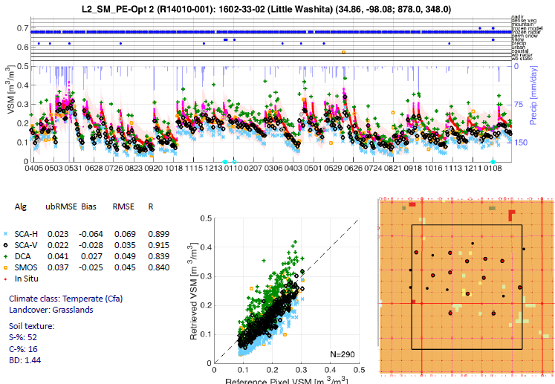
Soil moisture validation stage
Little Washita; Colliander et al., 2017

Slide 2
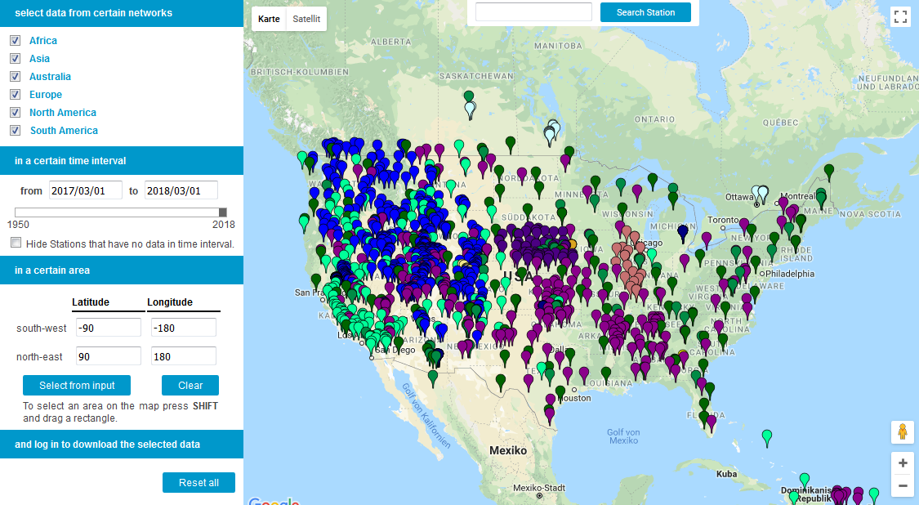
International Soil Moisture Network - ISMN
ESA prolonged funding for ISMN ensuring continuation until mid 2019.

Slide 3
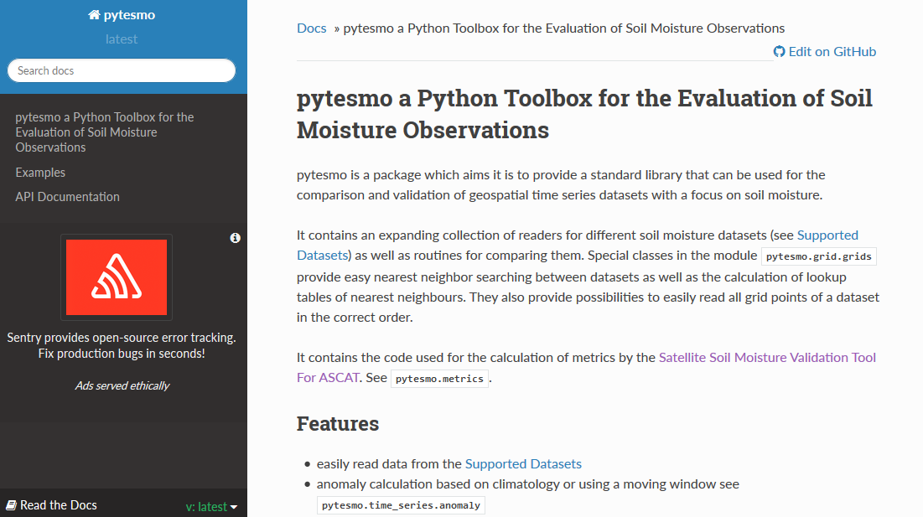
Validation tool by TU Vienna
Direct validation of ASCAT, H-SAF, SMAP, GLDAS Noah, ERA Interim, ERS with ISMN data

Slide 4
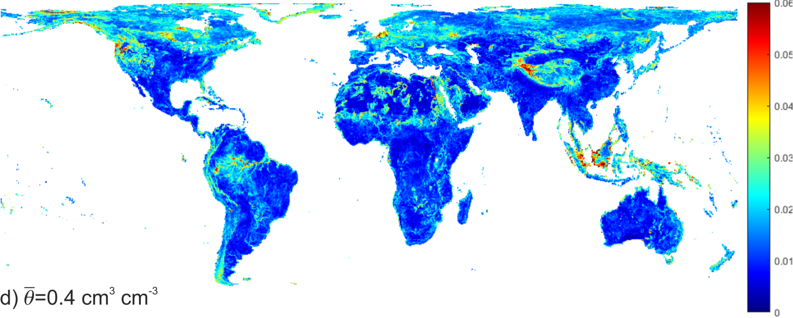
Sub-grid soil moisture variability estimate important for validation
SMAP sub-grid variability estimate at soil moisture mean of 0.4m³m⁻³
Available for SMAP, SMOS and ASCAT at: https://doi.org/10.1594/PANGAEA.878889

Slide 5
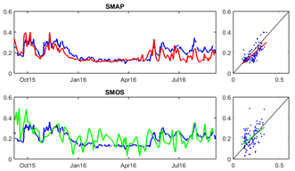
Temporal vs. Spatial Validation
Temporal validation:
Singanallur, India
Spatial validation:
REMEDHUS, Spain

Slide 6
Soil Moisture
SMOS L2 V650 available: Substitution of ECOCLIMAP by IGBP to align with SMAP, Improved mixed forest representation by CDF-matching, in many areas this data set is wetter than the previous versions.
SMAP/Sentinel-1 3km soil moisture Beta product available via NSIDC.
ESA CCI Soil Moisture product V4.2 available from 1978 through the end of 2016
L-band continuation workshop in Toulouse (France) in November, documents /white paper currently prepared. We will report on this as soon as it is published.
JAXA is initiating a follow-on to GCOM-W that would launch in 2023 with GOSAT and extended the soil moisture records beyond 20 years.
NISAR is requesting expanded coverage to produce SM over U.S. in addition to India.

Slide 7
Soil Moisture Workshops/Meetings
Remote Sensing and Hydrology Symposium, Cordoba Spain, May 2018.
Soil Moisture in Forests Workshop, Ann Arbor, MI, USA May 2018.
National Soil Moisture Workshop, Lincoln, NE, USA, June 2018.
IGARSS, Valencia, Spain, July 2018.
SMAP Cal/Val Workshop Fairfax, VA, USA October 2018.
5th Satellite Soil Moisture Validation and Application Workshop Fairfax, VA, USA, October 2018.

Slide 8
Validation Workshop in Bonn, Germany

Slide 9
Timeline for Soil Moisture Protocol Development
Spring 2018 – Review analog protocols and design SM outline
Summer 2018 – assign sections to community members
Fall/winter 2018 – assemble sections from community members
Spring/summer 2019 – community review and additional input
Fall 2019 – complete final draft

