Slide 1
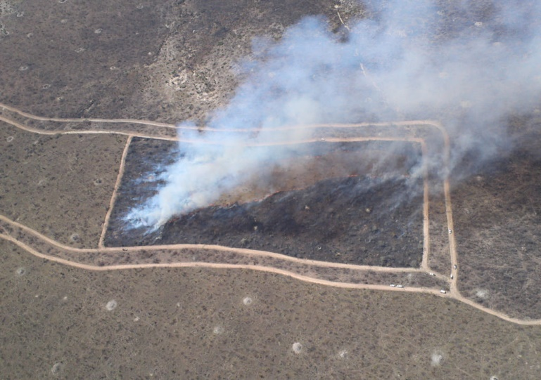
CEOS LPV : ‘Fire Disturbance’
Luigi Boschetti, Andrew Edwards & Gareth Roberts

Slide 2
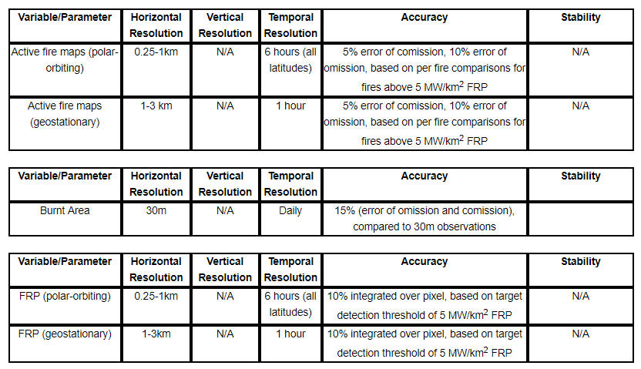
CEOS LPV Fire Disturbance: Current Status
Current ECV product requirements (GCOS-200)
Beyond ECVs: fire products have multiple user communities that need validation information (e.g. GEO GWIS, UN REDD+)

Slide 3
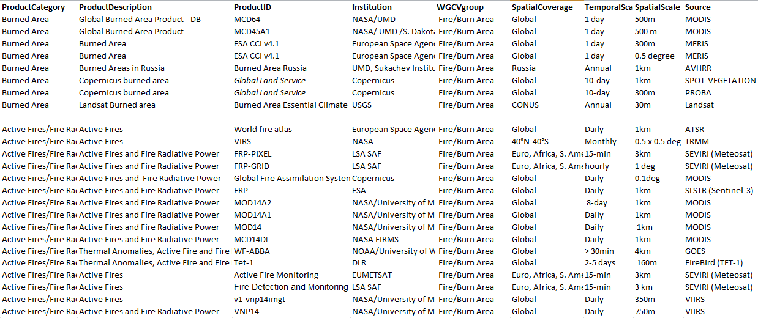
CEOS LPV : Fire Disturbance Products
Website Updates : Active Fire\FRP & Burned Area datasets (not all global)
Updated the publication list

Slide 4
CEOS LPV Fire Disturbance Products : Current Status
Burned Area has well established validation protocol for reference data generation.
Level 2 – Level 3 ongoing
Active Fire
Level 3 and 4 (MODIS/ASTER only)
FRP
Level 1
Currently active fire & FRP validated via :
Product inter-comparison
Comparison to ground datasets

Slide 5
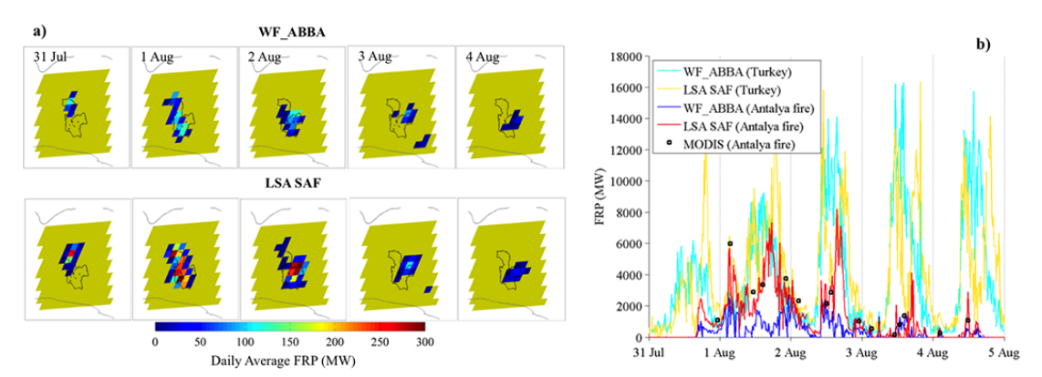
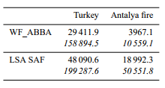
CEOS LPV : AF inter-comparison
SEVIRI Active fire products inter-comparison
Spatial & temporal comparison of fire pixel detections (e.g. same sensor, diff alg.)
Baldassarre et al., 2015; Atm. Chem. Phys
Total particulate matter estimates [tons] est. from WF_ABBA and FRP-PIXEL

Slide 6
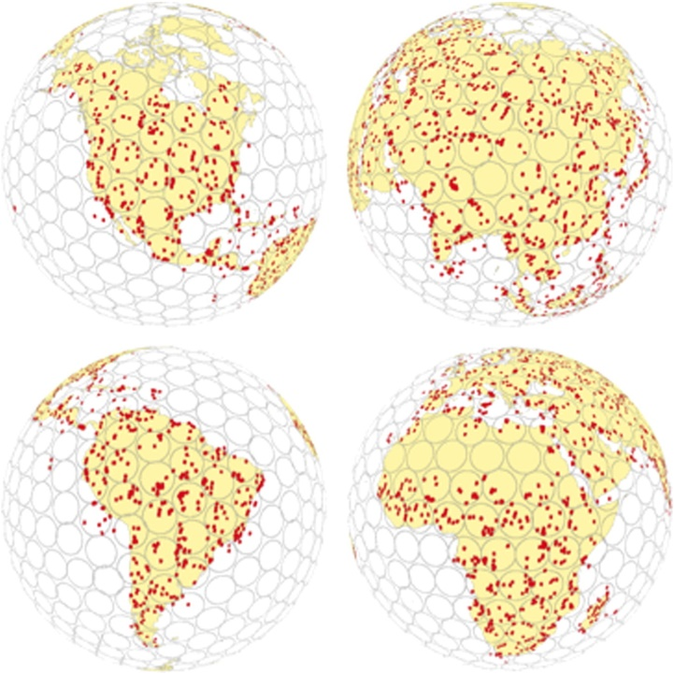
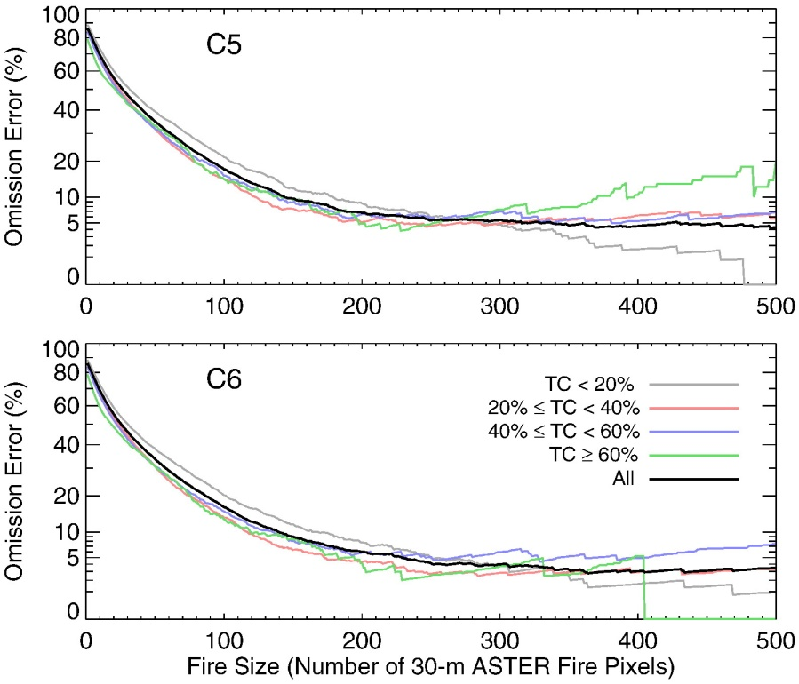
CEOS LPV : Active Fire product inter-comparison
MODIS (1km) against ASTER (60m)
Giglio et al., 2016; RSE
MODIS validation using ASTER
Most comprehensive AF validation to date
Global, temporally and spatially coincident

Slide 7
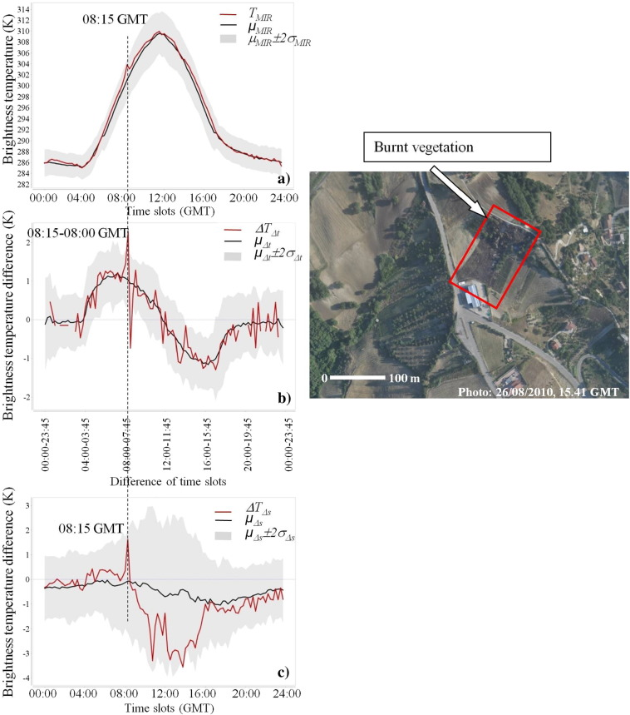
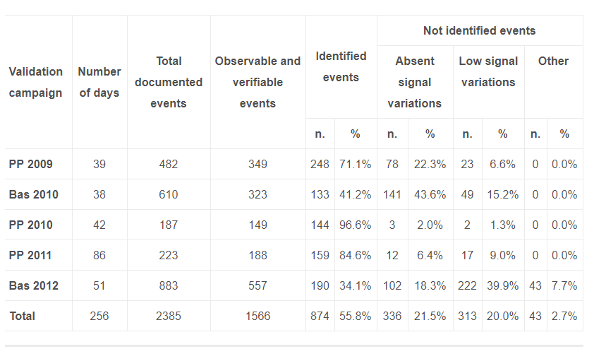
CEOS LPV : Active Fire product inter-comparison
Active products compared against ground obs.
Comparison of SEVIRI active fire detects against fire reports
Fire agency \ local gov.
Fillizzola et al., 2017; RSE

Slide 8
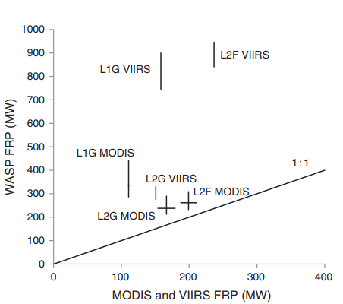
CEOS LPV : FRP validation
Validation of FRP constrained by:
Limited availability of reference data
ASTER saturates
Other high resolution sensors not temporally coincident
Validation typically carried out by
Field campaigns (prescribed fires;
surface & airborne imagery)
Costly
logistically challenging
limited number of samples
Dickinson et al., (2016)

Slide 9
CEOS LPV Fire Disturbance: Future Needs
Finalize the burned area protocol:
Literature now mature to address sampling protocols and accuracy metrics
Linkages to other products (e.g. Land cover change, Albedo) to ensure consistency
How to develop validation protocol of AF / FRP?
Introduce SI traceable units for active fire and FRP products
Define a protocol for product intercomparison
Reference datasets for AF & FRP validation into the future ?
Coordinated field campaigns
Reliable but limited spatially\temporally, logistically difficult
Inter-comparison of different sensors
ASTER approach not applicable
Geostationary sensors important for FRP
Not global

