Slide 1
CarboEurope, IMECC and GHG-Europe
Mike Jones
School of Natural Sciences
Trinity College Dublin

Slide 2
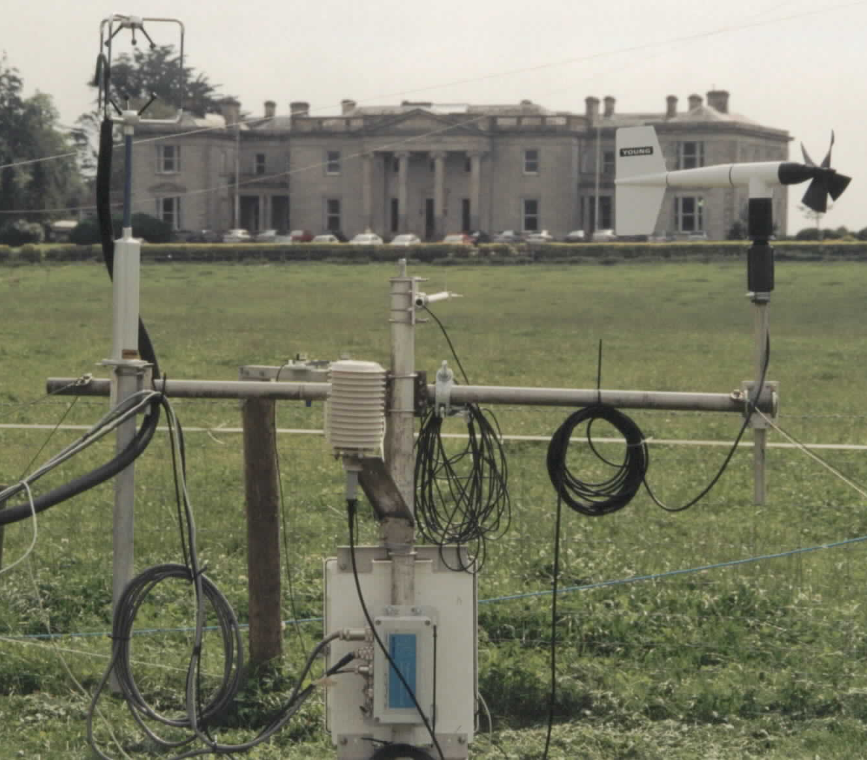
NEE – CO₂
Vertical C Flux by
Eddy covariance
Mean over 30 mins
[CO₂] / [H₂O]
Fc = ωρ_{c}
Vertical wind speed
CO₂ fluxes are monitored using eddy covariance, including the use of 3D sonic anemometers and fast infrared gas analysers.
Flux
μmol CO₂ / H₂O m⁻² s⁻¹

Slide 3
Ecosystem sites in CarboEurope IP

Slide 4
Land cover of functional types in Ireland
Woodward et al. (2010)

Slide 5
GHG sources and sinks in grasslands
CH₄
CO₂
OM fluxes
Herbivore
Atmosphere
CO₂
Vegetation
Manure / Slurry
(CH₄)
CO₂
NO₂
Soluble organic C
GHG fluxes currently included
or not directly included
in the national inventories under
Art. 5.1. of the Kyoto protocol
Soil

Slide 6
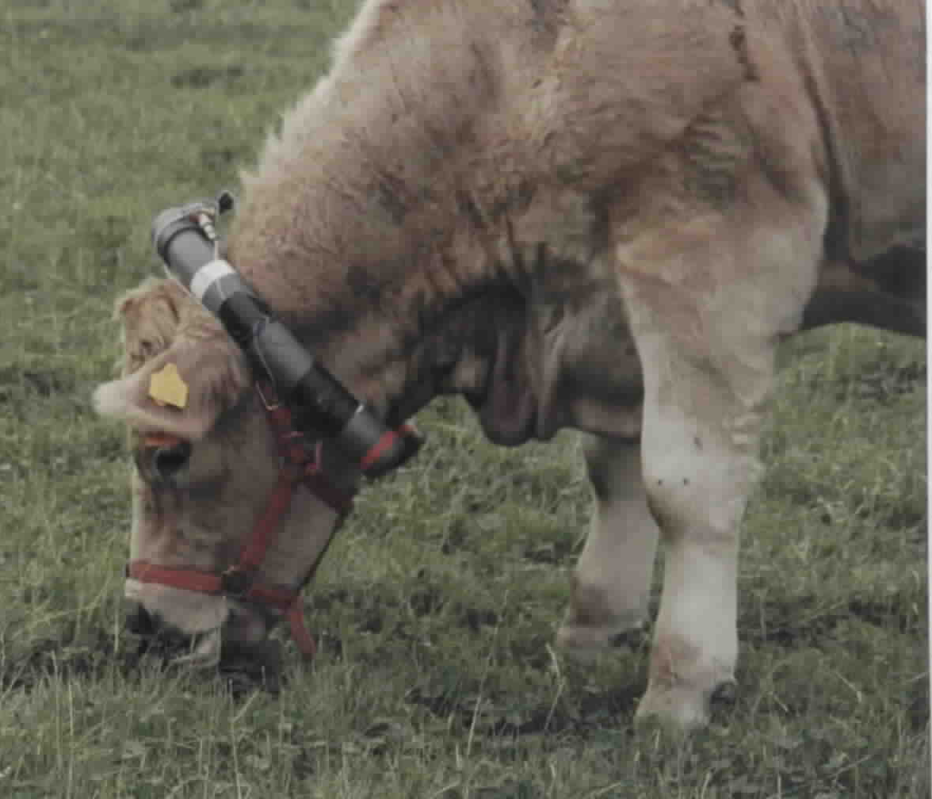

Slide 7
EU-25 croplands carbon cycle
Ciais et al. (2009)

Slide 8
EU-25 forest carbon cycle
Luyssaert et al. (2009)

Slide 9
IMECC – Infrastructure for Measuring the European Carbon Cycle
http://imecc.ipsl.jussieu.fr/ - Coordinator: CEA, France
33 partners with the aim of building the infrastructure for a coordinated, calibrated, integrated and accessible dataset for characterising the function of the European terrestrial biosphere.
Improve access to data on ecosystem parameters and state-of-the-art facilities for ecosystem measurement and manipulation.
Tie European terrestrial data into emerging remotely-sensed datasets on atmospheric composition.

Slide 10
IMECC is based on 3 main activities:
Networking Activities (NA): Designed to improve cohesion, comparability and access to European Carbon Cycle Measurements
Transnational Access activities (TA): Designed to broaden and improve access to European Carbon Cycle measurement facilities
Joint Research Activities (JRA): Designed to support new technologies for European Carbon Cycle measurements

Slide 11
IMECC – Infrastructure for Measuring the European Carbon Cycle
The IMECC project is divided into thirteen separate activities, each of which targets one of the fundamental objectives. The activities complement each other although there are few critical dependencies among them. An important exception is NA6 which required for the full impact of most of the other activities. Thus, for much of the project, activity will proceed in parallel.

Slide 13
GHG-Europe
http://www.vti.bund.de/en/institutes/ak/projects/ghg-europe/ - coordinator: von Thunen-Institute
Aims to improve the quantification of the annual to decadal variability in the European terrestrial C and GHG budgets through:
Full exploitation of all available data streams.
Stronger data-model integration.
Consistent temporal and domain coverage.
Complete consideration of error propagation.

Slide 14
GHG-Europe – Scientific Objectives
Quantify annual and decadal variability of GHG budgets of terrestrial ecosystems in Europe.
Improve understanding of terrestrial C cycle and responses of GHG fluxes to variability in natural and anthropogenic drivers.
Identify most sensitive and vulnerable C pools and GHG processes.

Slide 15
GHG-Europe – Technical Objectives
Extend observations to under-sampled ecosystems.
Maintain a core network of long term GHG measuring stations.
Build a consistent multi-source database.
Ensure coherence in quantification of uncertainty.
Quantify at the European scale the annual to decadal variability of GHG budgets of terrestrial ecososystems.

Slide 16
GHG-Europe – Policy Relevant Objectives
Integrate research supported by national and European programmes via improved access.
Identify the critical vulnerabilities of the terrestrial C sink, C pools and GHG fluxes.
Develop tools to perform integrated assessments of feedbacks between climate and land use policies.
Give direct scientific and technical advice about potential role of terrestrial ecosystems post 2012.

